Slide 1
CSS
Pan OS

Slide 2
CSS layout
CSS float
Flexbox
CSS Grid

Slide 3
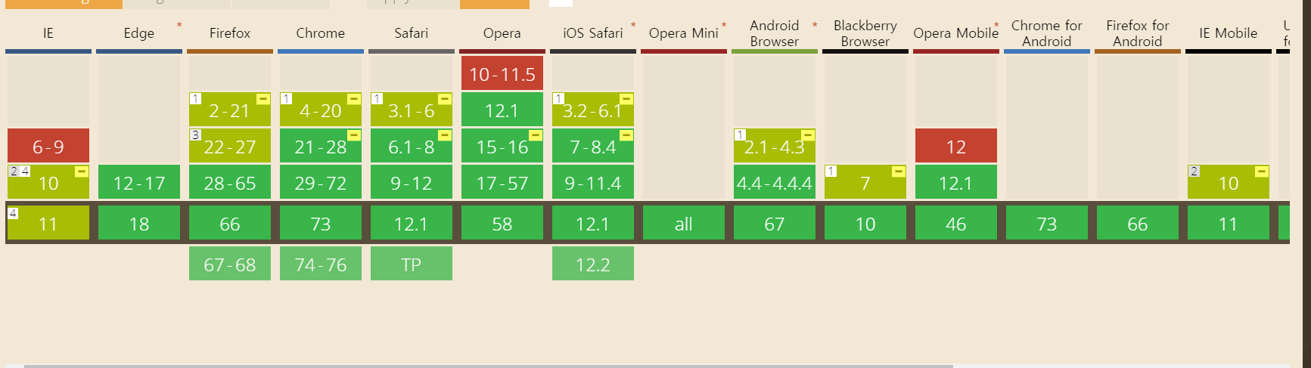
Flexbox

Slide 4
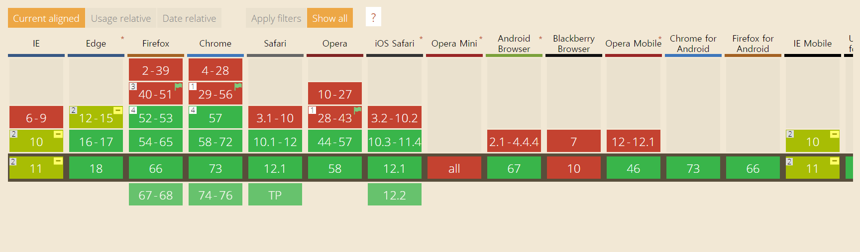
Grid

Slide 5
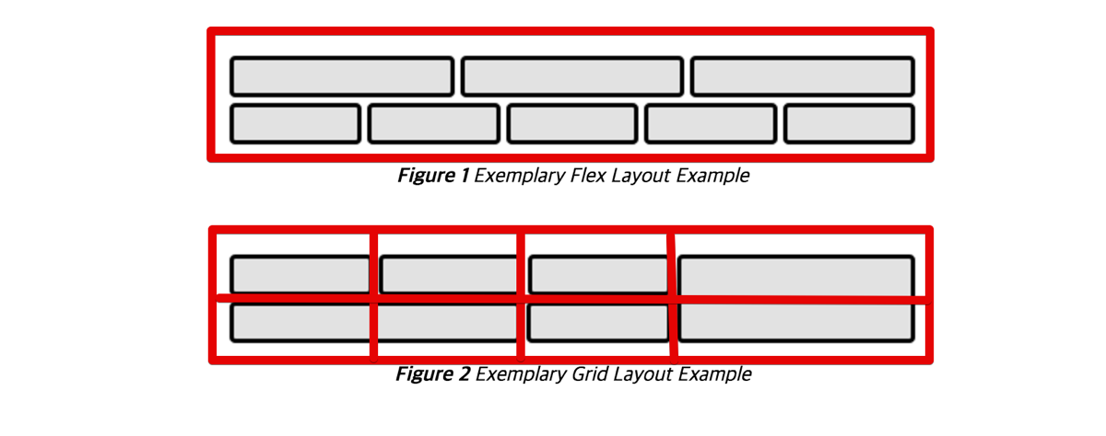
Flexbox VS Grid
http://www.usefulparadigm.com/2017/03/31/a-few-ways-to-make-a-grid-layout/
그림 출처: W3C CSS Grid Layout Module 명세

Slide 6



PAN Expedition - Log Ingester: UI - Dashboard
Click title to go to page
Simple match (contains)
Firewalls
Search
Logs
10.1.1.1
Rate Limited to 1 per second, Max 100
PAN 1
PAN 2
Confirm
10.1.1.1
PAN-OS 8.1
2348972 received
Start 100 days ago
Last received 2 sec
10.1.2.1
PAN-OS 8.1
123 received
Start 1 hour ago
Last received 2 sec
+
Syslog 10.1.1.1 2019/04/2 03:02:11 X, Y, Z
File 10.1.1.1 2019/04/2 03:02:11 X, Y, Z
Change color on detected firewalls that has not been confirmed by user yet
HA1 10.1.1.1 2019/04/2 03:02:11 X, Y, Z
Ingestion
Output
Change color on error condition such as connection error, or keep alive.
Syslog, Syslog-conn over UDP, TCP and Syslog-tls. A single syslog server is configured by default
Syslog
File
Port 514 No TLS
2348972 received Start 100 days ago Last received 2 sec
/User/log/ TLS
2348972 saved Start 100 days ago Last saved 2 sec
Splunk
HA1
Change color on error condition such as Splunk API error, connection error, or no activity for more than 1 day
10.3.1.2 Port 8089
2348972 received Start 100 days ago Last received 2 sec
10.5.1.2 Load Balanced
2348972 sent Start 100 days ago Last sent 2 sec
+
HA2
10.5.1.3 Connection Error
2348972 sent Start 100 days ago Last sent 2 sec
Splunk need query during setup. May use default query that is provided
Best Customer Experience

Slide 7
Container > window > bucket > item
CSS Frame(Flexbox version)
I spend lots time to find a frame.

Slide 8
CSS Frame(Flexbox version)
Firewalls
Search
PAN 1
10.1.1.1
PAN-OS 8.1
2348972 received
Start 100 days ago
Last received 2 sec
I spend lots time to find a frame.

Slide 9
Interactor에서 CSS 실행되게 하기

Slide 10
Change Frame…
Like this
But I think it is easier than original.
I use vue.js

Slide 11
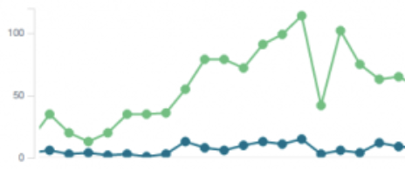
License: Trial, Expires 9/1/2019
Logged in as: admin
Hostname: Interactor
IP: 10.109.8.17
Netmask: 255.255.255.0
Gateway: 10.109.8.1
Version: 3.1.5r2
Updated: Apr 10, 2019 4:52:10
License: Trial, Expires 9/1/2019
Uptime: 105 days
Since: Mar 31, 2019
Serial: Tr23450693
System
Nodes: 1
CPU: 1
RAM: 16 GB
Storage: 5 TB
Disks: 5
Alarms: None
Resources
Disk Capacity Status
Disk 1 1 TB Ok
Disk 2 1 TB Ok
Disk 3 1 TB Ok
Disk 4 1 TB Ok
Disk 5 1 TB Ok
Storage
Dashboard
Devices
Interactions
Administration
Performance Overview
Unique
devices: 5
Data
Sources: 3
Logs processed: Hourly
Logs processed: last 24 hours
System Events
Time: Event: Severity:
2019/21/04:14:55:12 Lost connection with Splunk source High
2019/19/18:22:01:54 Transform failed Medium
Logout

Slide 12
License: Trial, Expires 9/1/2019
Logged in as: admin
Unique devices: 5
Data sources: 5
Dashboard
Devices
Data Source | Type | Connector | Status
Syslog-1 | Direct | none | active
Splunk-1 | API | splk-conn | active
Panorama-1 | API | Panorama-conn | active
Splunk-2 | API | splk-conn | active
Interactions
Administration
Device | Hostname | Source | Last transaction | future
10.3.4.5 | FW01DC019 | Splunk-2 | 2019/21/04:14:55:12
10.189.4.5 | fw-jnpr-ofc-10 | Syslog-1 | 2019/21/04:14:55:12
Logout

Slide 13
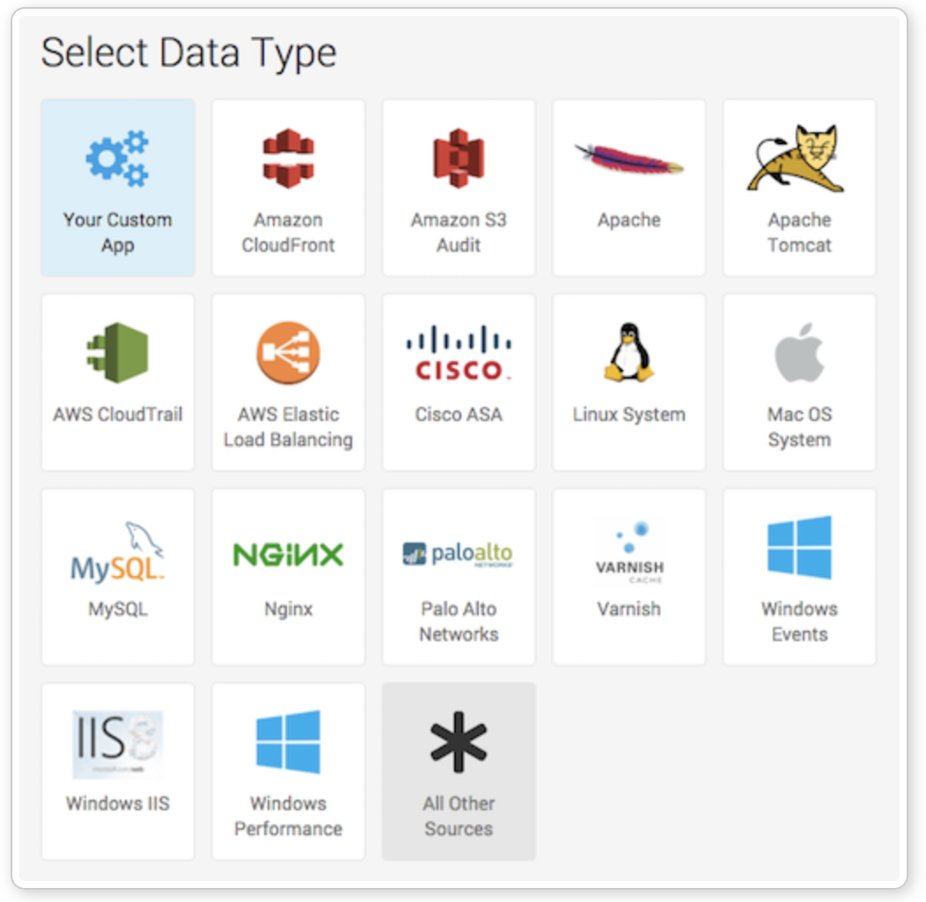
License: Trial, Expires 9/1/2019
Logged in as: admin
Dashboard
Display the interactor services configuration page
List predefined services (example below - does not have to be graphical):
Start with: Splunk, Palo Alto, Fortigate, Juniper SRX, Cisco ASA
Devices
Interactions
Administration
Logout

Slide 14
License: Trial, Expires 9/1/2019
Logged in as: admin
Hostname: Interactor
IP: 10.109.8.17
Netmask: 255.255.255.0
Gateway: 10.109.8.1
DNS: 8.8.8.8 4.2.2.2
NTP: time.us.gov univ.ntp.pool
Dashboard
Devices
Interactions
Administration
Save
Add Admin
Admin | Type | Auth type | Account Status
peter | superuser | local | active
david | superuser | local | active
jason | superuser | local | active
BK | superuser | local | active
Logout

Slide 15
First Page
Component1
:System
Component2
:Resources
Component3
:Storage
Component4
:Performance Overview
Component5
:System Events

Slide 16
Second Page
Component1
:System
Component1
:System
Component1
:System
Component1
:System

Slide 17
Third Page

Slide 18
Fourth Page

Slide 19
I need to use CSS more effective
I mess my CSS code
So I decided my rule. How?
First, Deciding Frame

