Slide 1
Infrastructure Communication Manager Introduction
Qinghua Jin

Slide 2
Topic
Feature
Architecture
Usage

Slide 3
Feature
High performance, low latency, real-time
Distributed object computing platform
Pattern oriented/Object oriented software architecture
Client side sync/async method invocation
Server side sync/async method dispatch
DDS style, topic based publish/subsriber message broker
Efficient protocol marshal/demarshal
Pluggable transport protocol
Pluggable message protocol
Proxy/Server side idl code generation

Slide 4
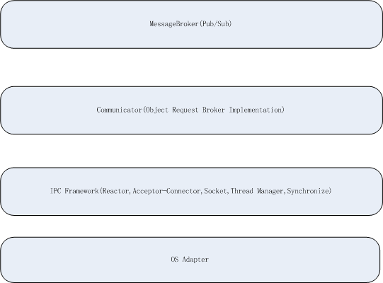
ICM Compoment

Slide 5
Internet Controller(ICC)
Support different OS(Linux,Windows)
Reactor framework(select/epoll based)
Connection manage framework
Thread manage and synchronize

Slide 6
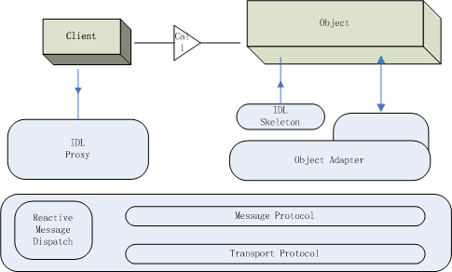
Internet Communicator Architecture

Slide 7
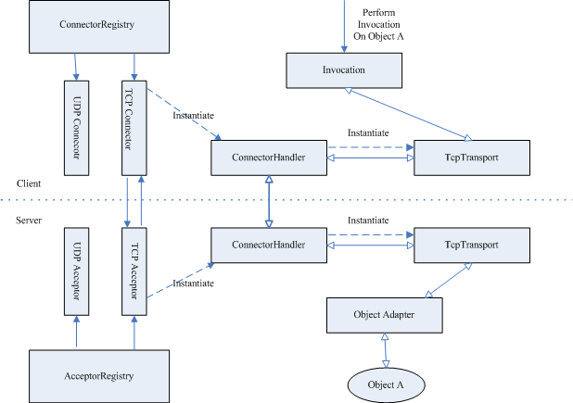
Pluggable Transport Layer

Slide 8
Message Protocol
Request message
Response message

Slide 9
Concurrent Strategy
Single thread reactor
Mutiple thread reactor
Half sync/half async

Slide 10
SMI & AMI

Slide 11
Asynch Method Invocation(AMI)

Slide 12
Usage
IDL definition and compile
Server side impl
Compile and link
Execution

Slide 13
IDL
Support type:
Integer(short,int,long)
String
Struct
Sequence(list)
Dictionary(map) (not tested)
Compile
#s2cpp my.idl => generate: my.h my.cpp

Slide 14
my.idl
module demo
{
class MyHello
{
string sayHello(string msg, short u, out long v);
};
};

Slide 15
my.h
namespace demo
{
class MyHello : virtual public Object
{
public:
MyHello() {}
virtual ::std::string sayHello(const ::std::string&, Short, Long&) = 0;
DispatchStatus ___sayHello(ServerRequest&);
virtual DispatchStatus __dispatch(ServerRequest& in);
};
}
namespace IcmProxy
{
namespace demo
{
class MyHello : virtual public IcmProxy::Object
{
public:
::std::string sayHello(const ::std::string& msg, Short u, Long& v);
};
}
}

Slide 16
my.cpp
::std::string
IcmProxy::demo::MyHello::sayHello(const ::std::string& msg, Short u, Long& v)
{
static const char* __operation("sayHello");
Reference* ref = this->getReference ();
TwowayInvocation _invocation (ref, __operation, ref->communicator ());
int ok = _invocation.start (this->transport ());
if (ok != 0)
return "";
ok = _invocation.prepareHeader (1);
if (ok != 0)
return "";
OutputStream* __os = _invocation.outStream();
__os->write_string(msg);
__os->write_short(u);
ok = _invocation.invoke();
if (ok != 0)
return "";
InputStream* __is = _invocation.inpStream();
::std::string __ret;
__is->read_long(v);
__is->read_string(__ret);
return __ret;
}

Slide 17
Client side
int
main (int argc, char* argv[])
{
Communicator* comm = Communicator::instance();
if (comm->init (true) == -1)
return -1;
Reference ref (comm, Identity("MyHello"), Endpoint("TCP", "127.0.0.1", 3000));
IcmProxy::demo::MyHello myHello;
myHello.setReference (&ref);
for (int i = 0; i < 10; i++) {
Short u = 10 + i;
Long v = 1000 + i;
std::ostringstream ss;
ss << "hello, world from " << i;
string ret = myHello.sayHello (ss.str(), u, v);
if (ret != "") {
std::cout << "ret:" << ret << std::endl;
} else {
//err process
}
}
return 0;
}

Slide 18
Server impl
namespace demo
{
class MyHelloI : public demo::MyHello
{
public:
virtual std::string sayHello(const ::std::string&, Short, Long&);
};
}
std::string demo::MyHelloI::sayHello(const ::std::string& msg, Short u, Long& v)
{
ostringstream oss;
oss << "receive:" << " msg:" << msg << " u:" << u << " v:" << v ;
std::string tmp = oss.str();
cout << tmp;
v = 0x1234 + v;
return tmp;
}

Slide 19
Server side
int
main (int argc, char* argv[])
{
Communicator* comm = Communicator::instance();
if (comm->init () == -1)
return -1;
Endpoint endpoint ("TCP", "", 3000);
ObjectAdapter* oa = comm->createObjectAdapterWithEndpoint ("MyHello", &endpoint);
Object* object = new demo::MyHelloI;
oa->add (object, "MyHello");
comm->run ();
return 0;
}

Slide 20
Message Broker
module demo
{
struct NetEvent
{
string ip;
short port;
string event;
};
class Network
{
void reportEvent(NetEvent event);
};
};

Slide 21
IDL Impl
class NetworkI : public demo::Network {
public:
virtual void reportEvent(const ::demo::NetEvent&);
};
void
NetworkI::reportEvent(const ::demo::NetEvent& netEvent)
{
cout << "receive network event:" << endl;
cout << "ip:" << netEvent.ip << " port:" << netEvent.port << " event:" << netEvent.event << endl;
}

Slide 22
Subscriber
int
Subscriber::run(int argc, char* argv[]) {
Communicator* comm = Communicator::instance();
if (comm->init (true) == -1)
return -1;
Reference ref (comm, Identity("TopicManager"), Endpoint("TCP", "127.0.0.1", 5555));
IcmProxy::IcmMsg::TopicManager topicManager;
topicManager.setReference (&ref);
ObjectAdapter* adapter = comm->createObjectAdapterWithEndpoint("Subscriber", "127.0.0.1 8888");
IcmProxy::Object* networkProxy = adapter->add(new NetworkI(), "NetworkTopic");
::IcmProxy::IcmMsg::Topic* topic = topicManager.retrieve("NetworkTopic");
if(topic == 0)
topic = topicManager.create("NetworkTopic");
if (topic == 0)
return -1;
topic->subscribe(networkProxy);
comm->run();
return 0;
}

Slide 23
Publisher
int Publisher::run(int argc, char* argv[]) {
Communicator* comm = Communicator::instance();
if (comm->init (true) == -1)
return -1;
Reference ref (comm, Identity("TopicManager"), Endpoint("TCP", "127.0.0.1", 5555));
IcmProxy::IcmMsg::TopicManager topicManager;
topicManager.setReference (&ref);
::IcmProxy::IcmMsg::Topic* topic = topicManager.retrieve("NetworkTopic");
if(topic == 0)
topic = topicManager.create("NetworkTopic");
if(topic == 0) {
cout << "err create topic " << endl;
return -1;
}
::IcmProxy::Object* pubObj = topic->getPublisher();
if(pubObj == 0) {
cout << "err get publisher " << endl;
return -1;
}
IcmProxy::demo::Network network;
network.setReference(pubObj->getReference());
cout << "publishing network events:" << endl;
demo::NetEvent event;
event.ip = "172.16.10.190";
event.port = 6789;
for(int i=0; i< 10; i++) {
ostringstream oss;
oss << "evt:" << i;
event.event = oss.str();
network.reportEvent(event);
}
return 0;
}

