Slide 1
Socket网络编程

Slide 2
asdf
sdf | xc | 反倒是
zxcv
电饭锅撒旦法 |  | 撒旦法
 |  | sdf

Slide 3
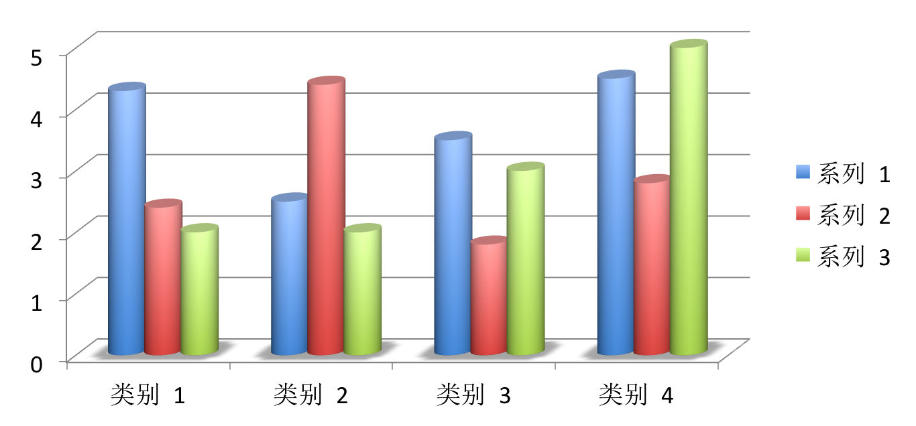
ssdf

Slide 4
大纲
TCP/UDP
Socket
HTTP
Unix IO 模型

Slide 5
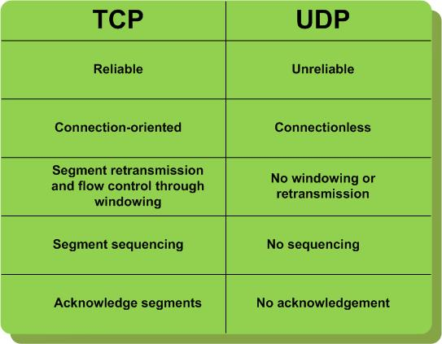
TCP-UDP 对比

Slide 6
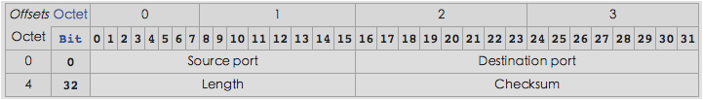
UDP
User Datagram Protocol

Slide 7
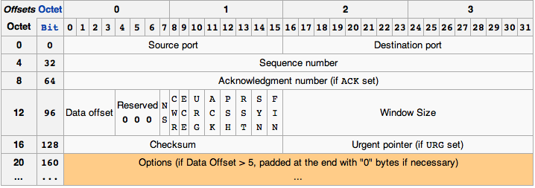
TCP
Transmission Control Protocol

Slide 8
TCP——连接建立
Before a client attempts to connect with a server, the server must first bind to and listen at a port to open it up for connections: this is called a passive open. Once the passive open is established, a client may initiate an active open.
  SYN: The active open is performed by the client sending a SYN to the server. The client sets the segment's sequence number to a random value A.
  SYN-ACK: In response, the server replies with a SYN-ACK. The acknowledgment number is set to one more than the received sequence number (A + 1), and the sequence number that the server chooses for the packet is another random number, B.
  ACK: Finally, the client sends an ACK back to the server. The sequence number is set to the received acknowledgement value i.e. A + 1, and the acknowledgement number is set to one more than the received sequence number i.e. B + 1.

Slide 9
TCP——连接关闭
The connection termination phase uses a four-way handshake, with each side of the connection terminating independently.
When an endpoint wishes to stop its half of the connection, it transmits a FIN packet, which the other end acknowledges with an ACK.
Therefore, a typical tear-down requires a pair of FIN and ACK segments from each TCP endpoint.
After both FIN/ACK exchanges are concluded, the side which sent the first FIN before receiving one waits for a timeout before finally closing the connection, during which time the local port is unavailable for new connections; this prevents confusion due to delayed packets being delivered during subsequent connections.

Slide 10
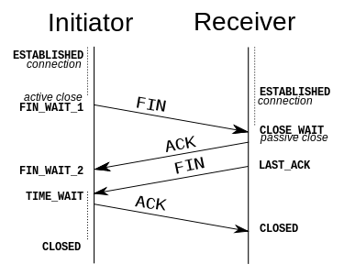
TCP——连接关闭

Slide 11
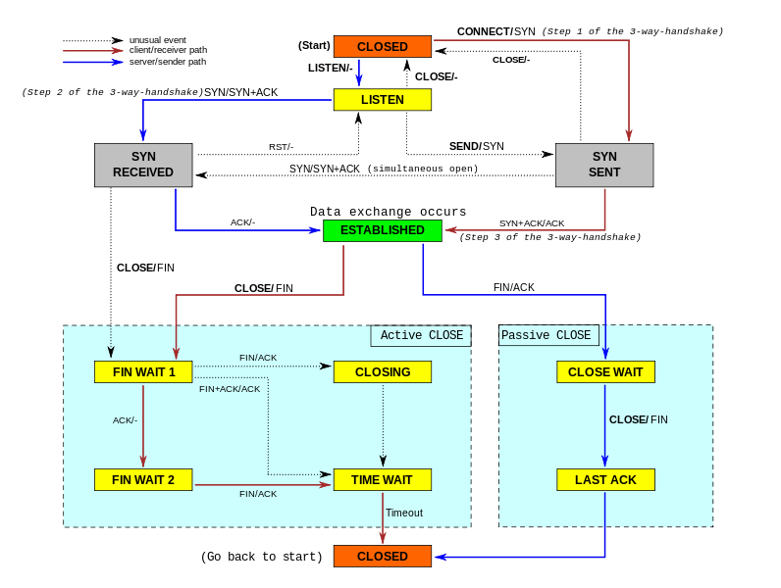
TCP——整个过程

Slide 12
TCP——netstat
LISTEN
(server) represents waiting for a connection request from any remote TCP and port.
SYN-SENT
(client) represents waiting for a matching connection request after having sent a connection request.
SYN-RECEIVED
(server) represents waiting for a confirming connection request acknowledgment after having both received and sent a connection request.
ESTABLISHED
(both server and client) represents an open connection, data received can be delivered to the user. The normal state for the data transfer phase of the connection.
Notes:
http://www.cnblogs.com/eoiioe/archive/2009/06/17/1504757.html

Slide 13
TCP——netstat
FIN-WAIT-1
(both server and client) represents waiting for a connection termination request from the remote TCP, or an acknowledgment of the connection termination request previously sent.
FIN-WAIT-2
(both server and client) represents waiting for a connection termination request from the remote TCP.
CLOSE-WAIT
(both server and client) represents waiting for a connection termination request from the local user.
CLOSING
(both server and client) represents waiting for a connection termination request acknowledgment from the remote TCP.
LAST-ACK
(both server and client) represents waiting for an acknowledgment of the connection termination request previously sent to the remote TCP (which includes an acknowledgment of its connection termination request).
TIME-WAIT
(either server or client) represents waiting for enough time to pass to be sure the remote TCP received the acknowledgment of its connection termination request.
CLOSED
(both server and client) represents no connection state at all.

Slide 14
Socket
A network socket is an endpoint of an inter-process communication flow across a computer network. Today, most communication between computers is based on the Internet Protocol; therefore most network sockets are Internet sockets.
A socket API is an application programming interface (API), usually provided by the operating system, that allows application programs to control and use network sockets. Internet socket APIs are usually based on the Berkeley sockets standard.
A socket address is the combination of an IP address and a port number, much like one end of a telephone connection is the combination of a phone number and a particular extension. Based on this address, internet sockets deliver incoming data packets to the appropriate application process or thread.

Slide 15
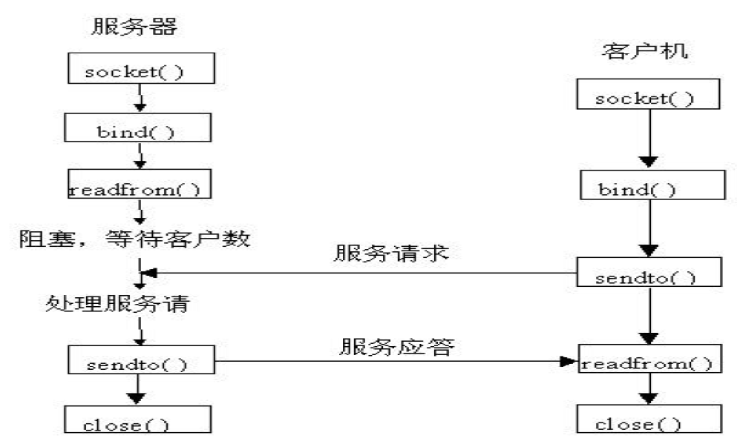
Socket——基于UDP编程流程

Slide 16
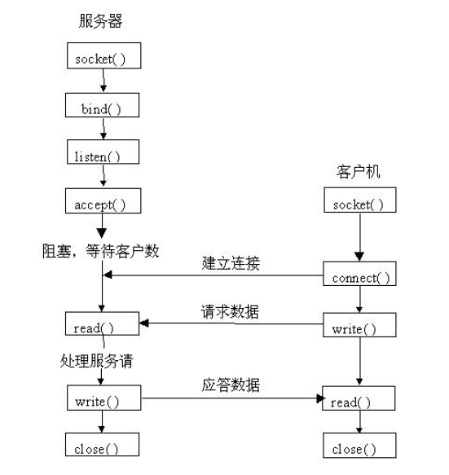
Socket——基于TCP编程流程

Slide 17
Socket——选项
SO_DEBUG
SO_DONTROUTE
SO_KEEPALIVE
SO_DONTLINER
SO_LINGER
SO_RCVBUF
SO_SNDBUF
SO_REUSERADDR
SO_RCVTIMEO
SO_SNDTIMEO
TCP_NODELAY(Nagle)

Slide 18
HTTP
Hypertext Transfer Protocol
HTTP functions as a request-response protocol in the client-server computing model.

Slide 19

HTTP——Request
Request methods
  HEAD/GET/POST/PUT/DELETE/TRACE/OPTIONS/CONNECT/PATCH

Slide 20
HTTP——GET POST
GET 参数
POST 参数
  application/x-www-form-urlencoded
  multipart/form-data(non-ASCII data, and binary data)

Slide 21
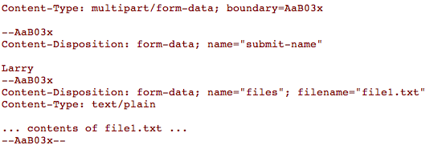
HTTP——POST multipart/form-data

Slide 22
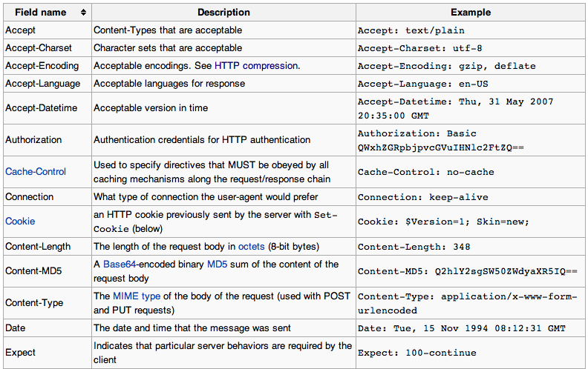
HTTP——Request Header

Slide 23
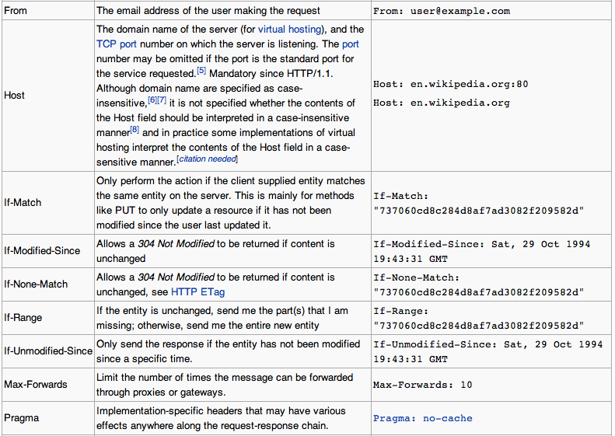
HTTP——Request Header

Slide 24
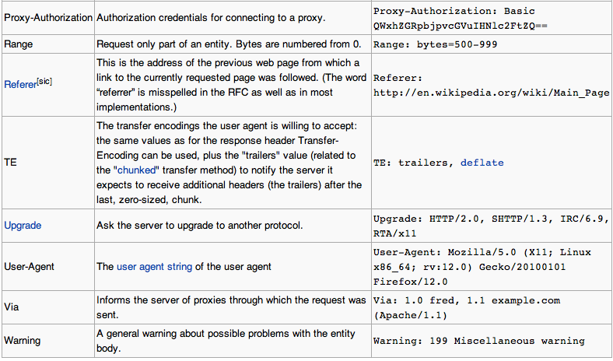
HTTP——Request Header

Slide 25
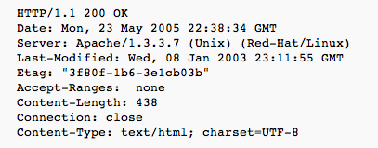
HTTP——Response
Status codes
  1xx Informational/2xx Success/3xx Redirection/4xx Client Error/5xx Server Error

Slide 26
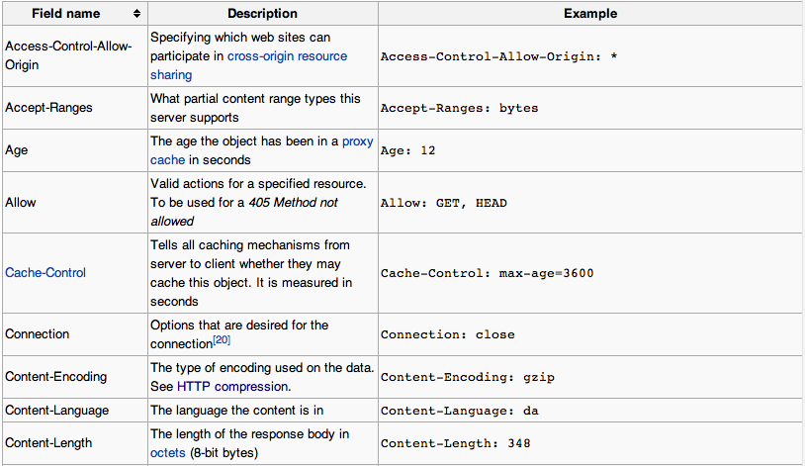
HTTP——Response Header

Slide 27
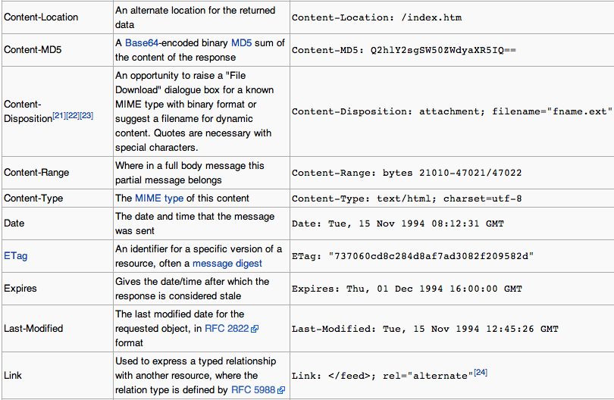
HTTP——Response Header

Slide 28
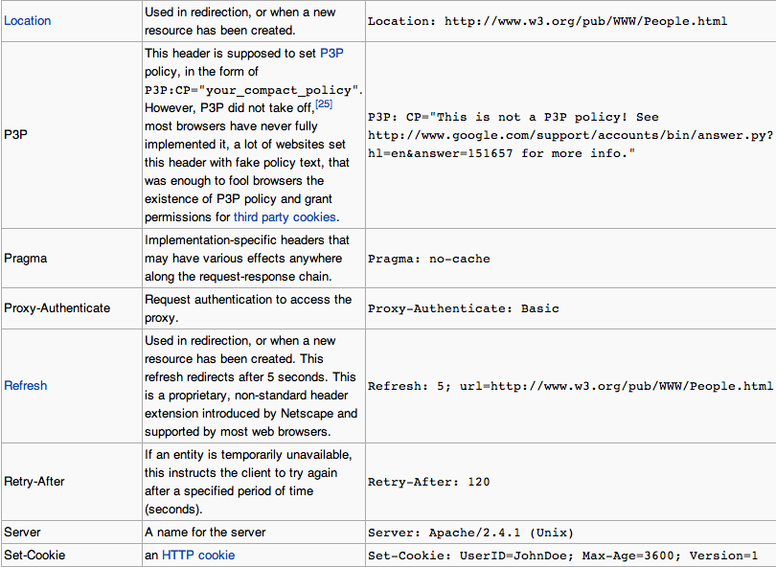
HTTP——Response Header

Slide 29
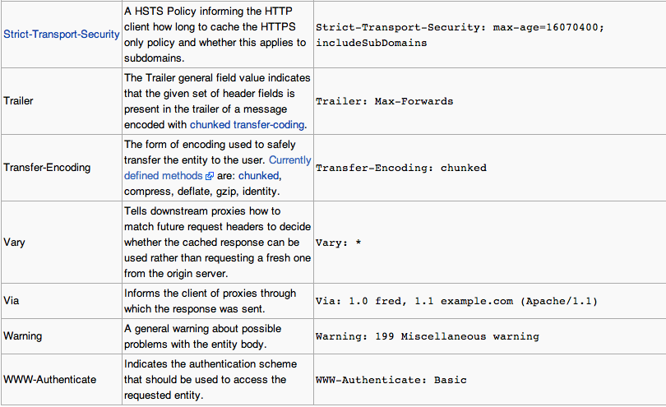
HTTP——Response Header

Slide 30
HTTP——Persistent connections
Persistent connections
  In HTTP/0.9 and 1.0, the connection is closed after a single request/response pair. In HTTP/1.1 a keep-alive-mechanism was introduced, where a connection could be reused for more than one request.

Slide 31
Unix IO 模型
Unix下共有五种I/O模型
  阻塞I/O
  非阻塞I/O
  I/O复用（select和poll）
  信号驱动I/O（SIGIO）
  异步I/O（Posix.1的aio_系列函数）

Slide 32
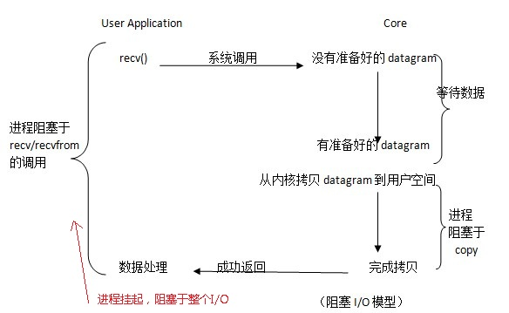
Unix IO 模型——阻塞IO

Slide 33
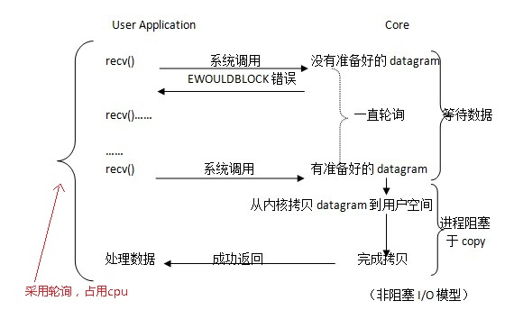
Unix IO 模型——非阻塞IO

Slide 34
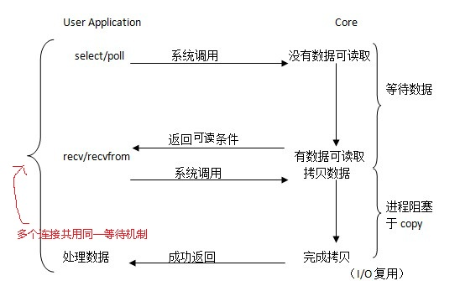
Unix IO 模型——IO复用

Slide 35
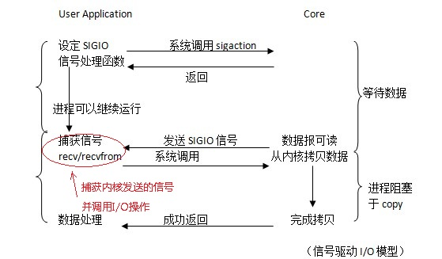
Unix IO 模型——信号驱动IO

Slide 36
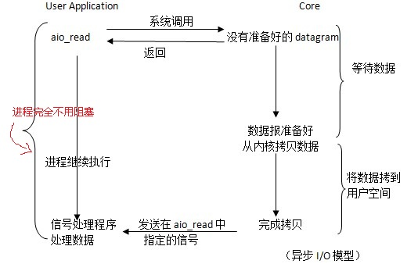
Unix IO 模型——异步IO

Slide 37
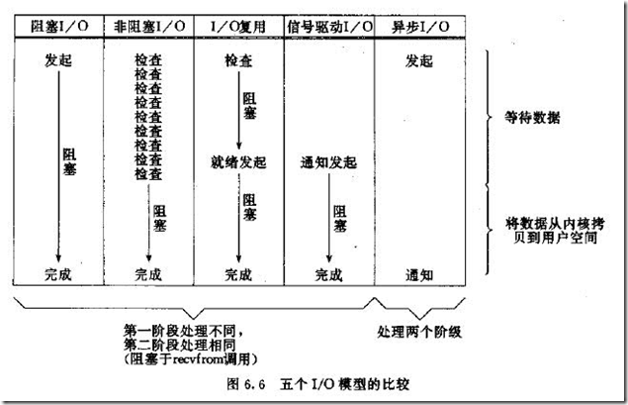
Unix IO 模型——对比
Notes:
异步I/O模型与信号驱动模型的主要区别是：前者是由内核通知用户进程I/O操作何时完成，而后者是内核通知用户进程何时去启动I/O操作（即是进程所等待的数据是停留在内核还是在进程缓冲区时变发送信号的区别）。

Slide 38
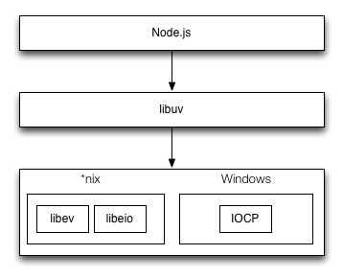
Unix IO 模型——异步IO
Notes:
http://www.infoq.com/cn/articles/nodejs-asynchronous-io

Slide 39
END

