Slide 1
Extending Security to your Containers with Prisma Cloud
January 2022

Slide 2


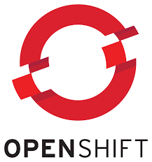
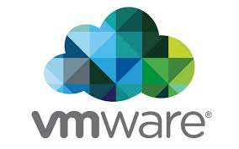
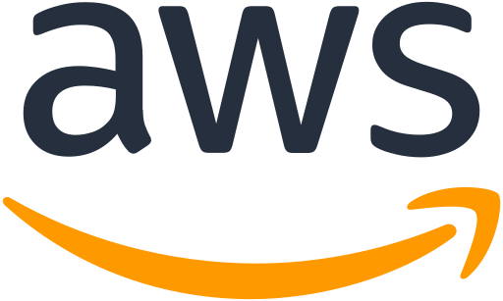
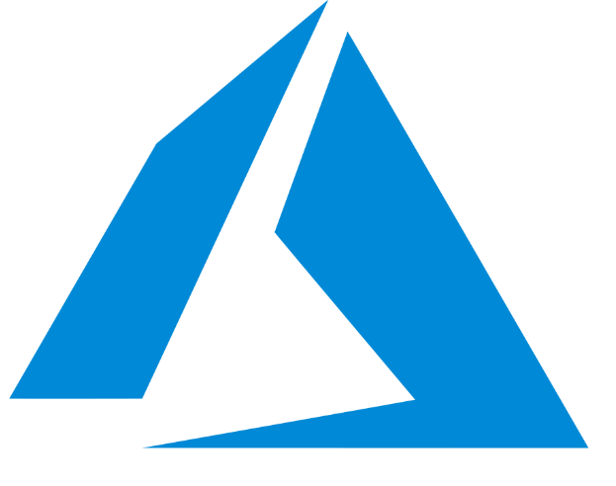
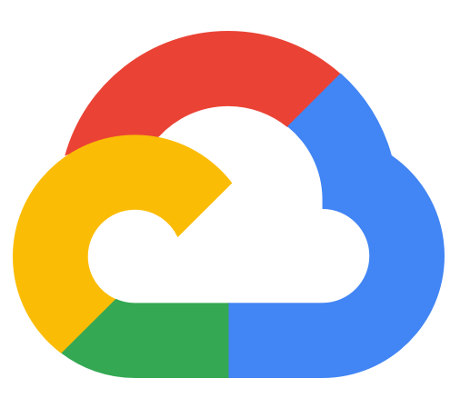

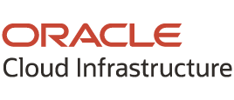

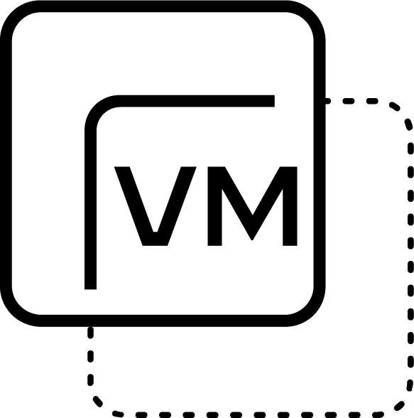


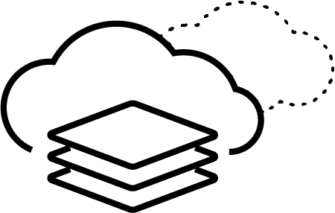
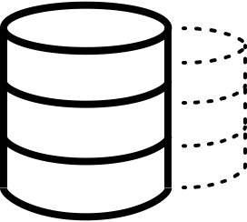




Applications are being deployed across multi-cloud and hybrid-cloud environments
Public cloud
Public cloud
Private cloud
Lift-and-shift applications
Cloud-Native applications
Lift-and-shift applications
Cloud-Native applications
VMs
Containers
Serverless
PaaS
Data Stores
VMs
Containers
Serverless
PaaS
Data Stores
VMs / Data Stores
Build
Deploy
Run
Build
Deploy
Run
81% of organizations are working with two or more public cloud providers.
Notes:
In order to understand the value and opportunity in the cloud, we need to focus on how organizations have gravitated toward multi-cloud and hybrid-cloud environments. Whether it’s by design or through mergers and acquisitions, multi-cloud is the new normal. According to Gartner, 81% of organizations said they are working with two or more public cloud providers.
The first way organizations have moved to the cloud is via lift-and-shift architectures. Here, organizations focus on leveraging virtualization running in the public cloud to reduce their on-premises data center footprint. This improves operability in order to begin benefitting from cloud services. While this has been a major effort of the last several years, we now see cloud native application architectures as the new focus for our customers.
Here organizations are leveraging new cloud native technologies, where microservices architectures like containers, Kubernetes, Platform-as-a-Service (PaaS), and serverless, allow applications to be spun up and down on demand. These architectures also allow for modern GitOps and DevOps driven workflows where applications are deployed using automation at weekly or daily releases. Importantly, cloud native applications can run in public or private clouds, to take advantage of modern technology stacks offered by the Cloud Service Providers, or leading ecosystem players such as Red Hat OpenShift or VMware Tanzu.
Source: Gartner: Why Organizations Choose a Multi-Cloud Strategy

Slide 3
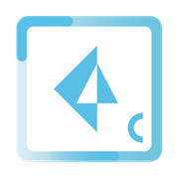
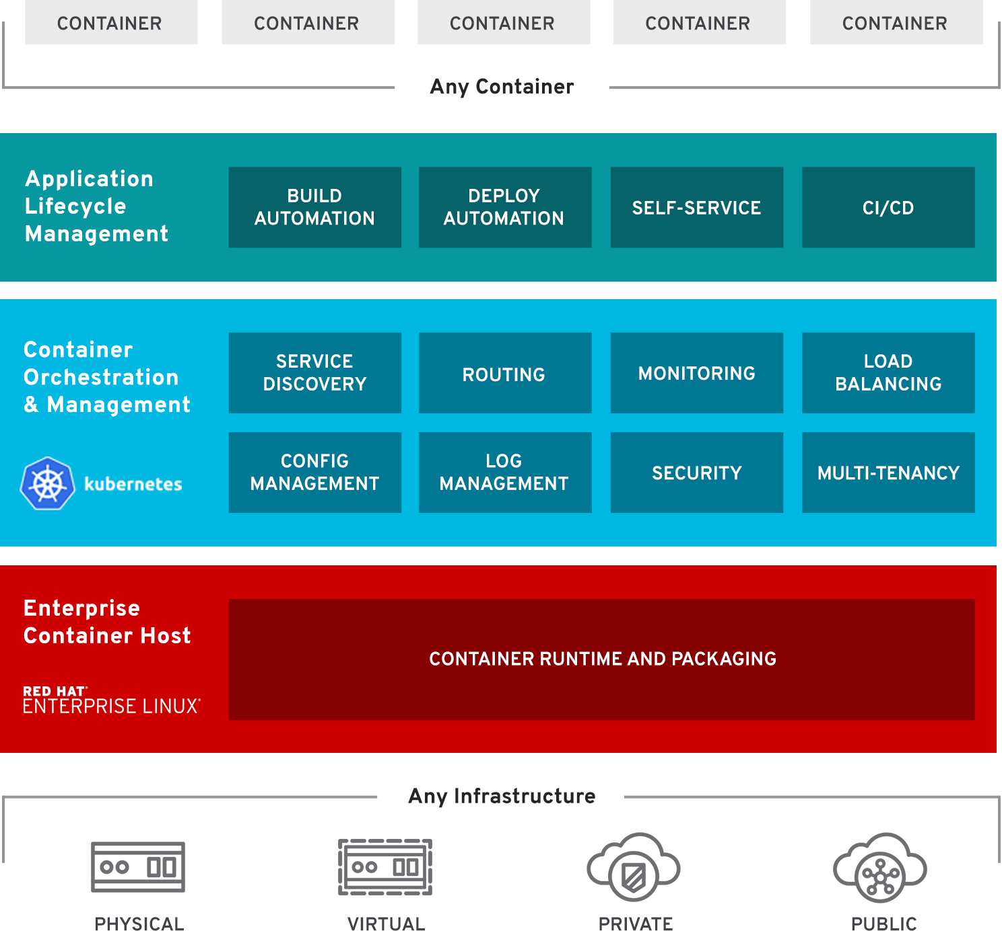
Key Use Cases
“Shift Left” Security Capabilities
Access Control
Prisma Cloud
Redhat Certified Vulnerability Scanner Compliance Mgt
Web App and API Sec Microsegmentation
Runtime Defense
Malware Detection

Slide 4
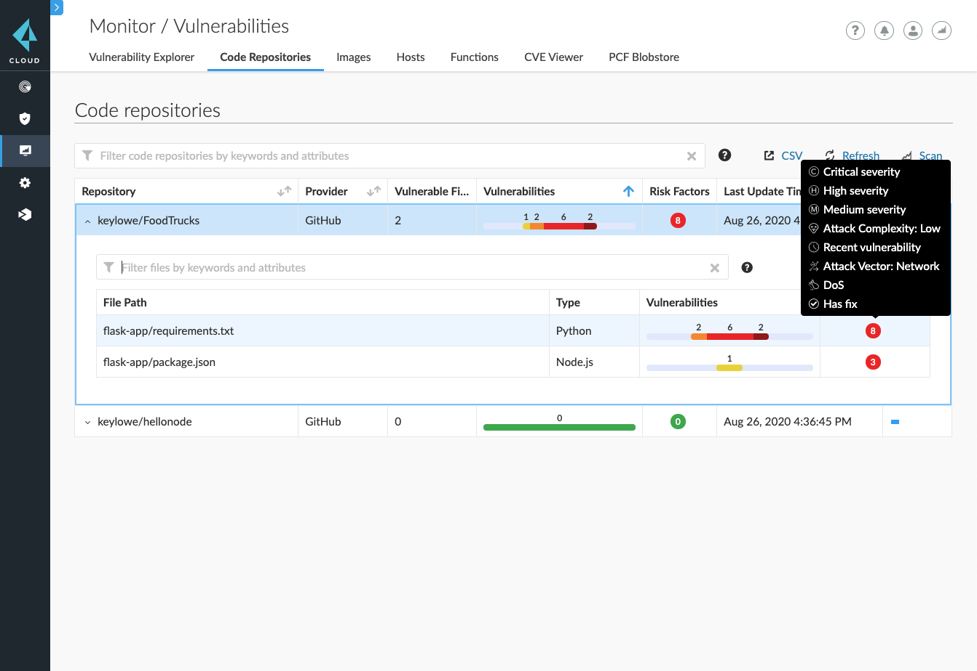
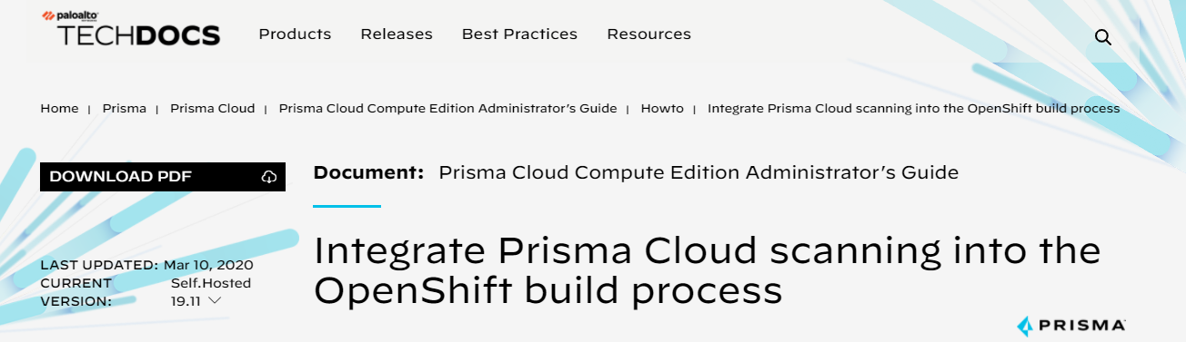
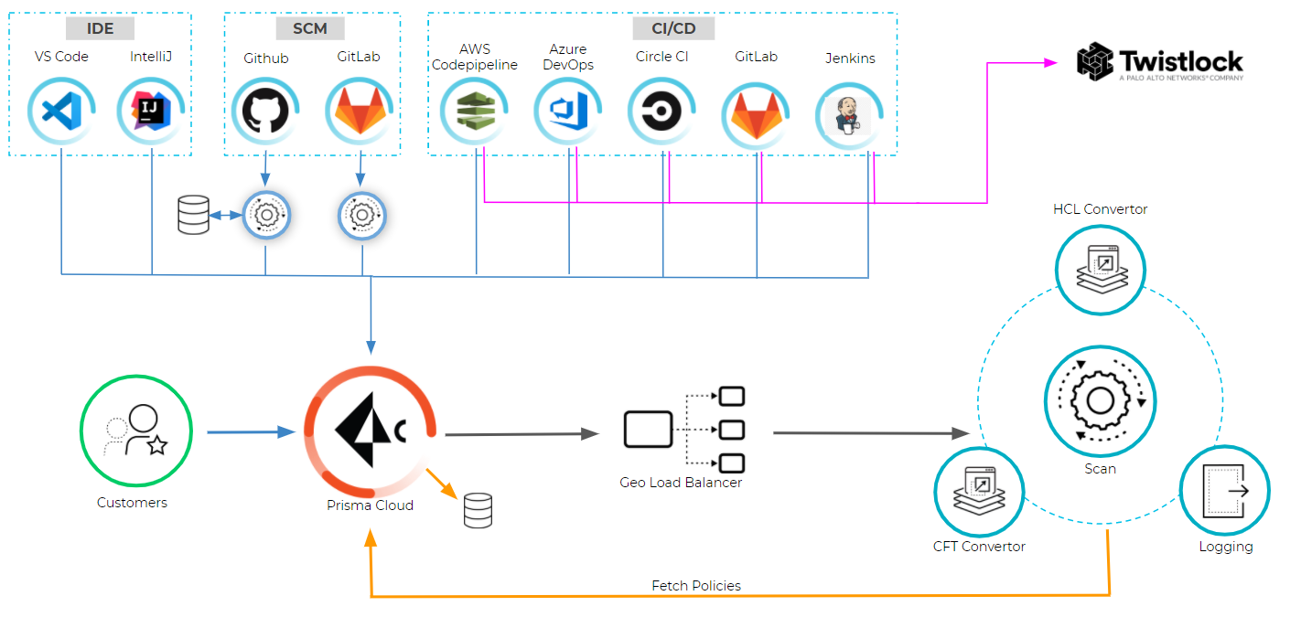
Key Use Cases
“Shift Left” Security Capabilities
Secure Pipeline: Vuln and Compliance Scanning and Control
Registry Scanning
Developer Tooling Integration (SCM, CI, ALM, Messaging)
Redhat Certified Vulnerability Scanner
Compliance Mgt
Runtime Defense

Slide 5
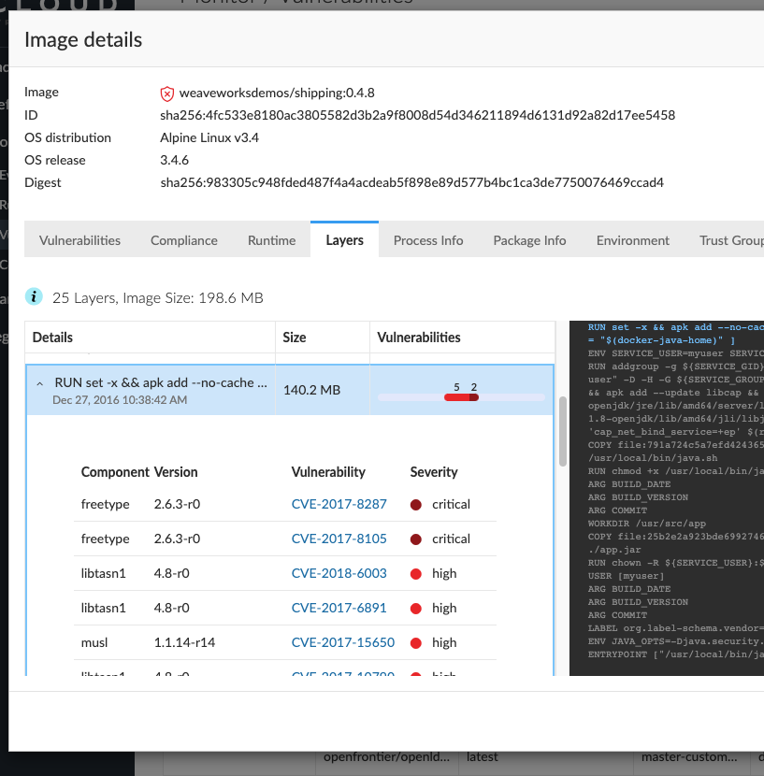
Key Use Cases
Redhat Certified Scanning
Automated prioritization of vulnerabilities based on your unique env
Prevent running vulnerable software across your environment
CRI-O Based Compliance Checks
“Shift Left” Security Capabilities
Redhat Certified Vulnerability Scanner
Compliance Mgt
Runtime Defense

Slide 6
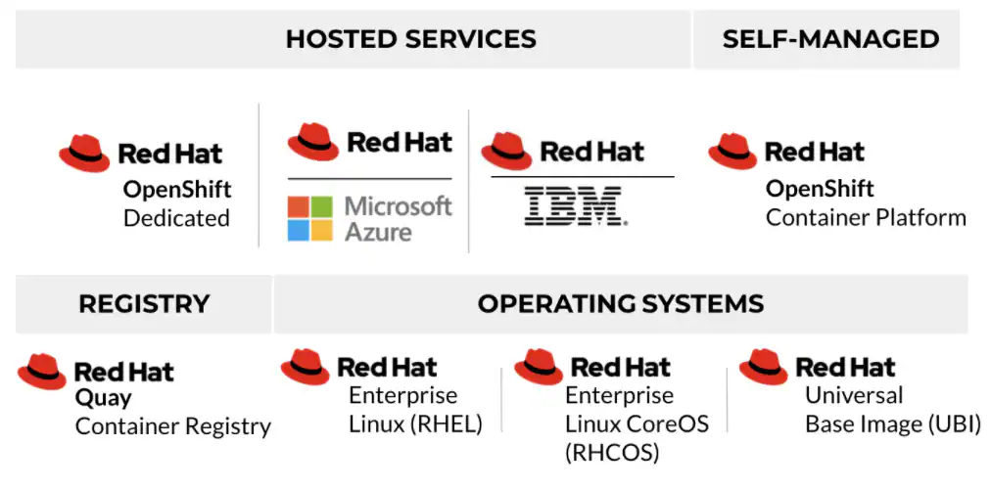

Slide 7
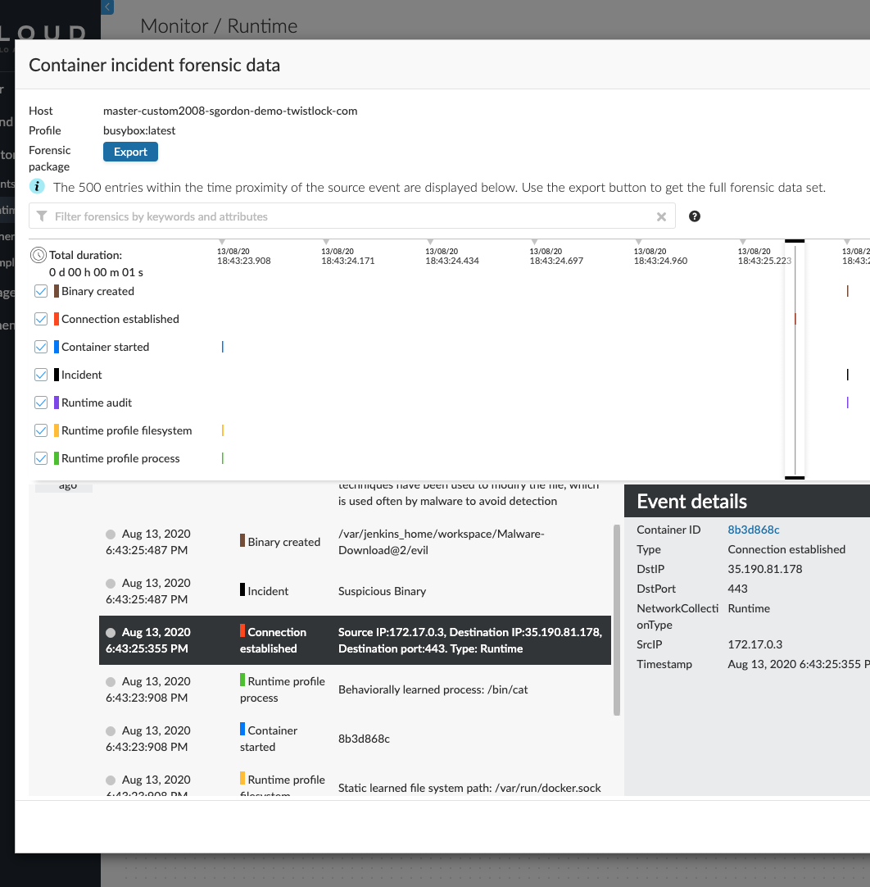
Key Use Cases
Automatic modeling of explicit ‘allow lists’ every app
Automated incident detection and prevention based on model and threats
Continuous forensics for every container and host in your environment
“Shift Left” Security Capabilities
Redhat Certified Vulnerability Scanner
Compliance Mgt
Runtime Defense

Slide 8
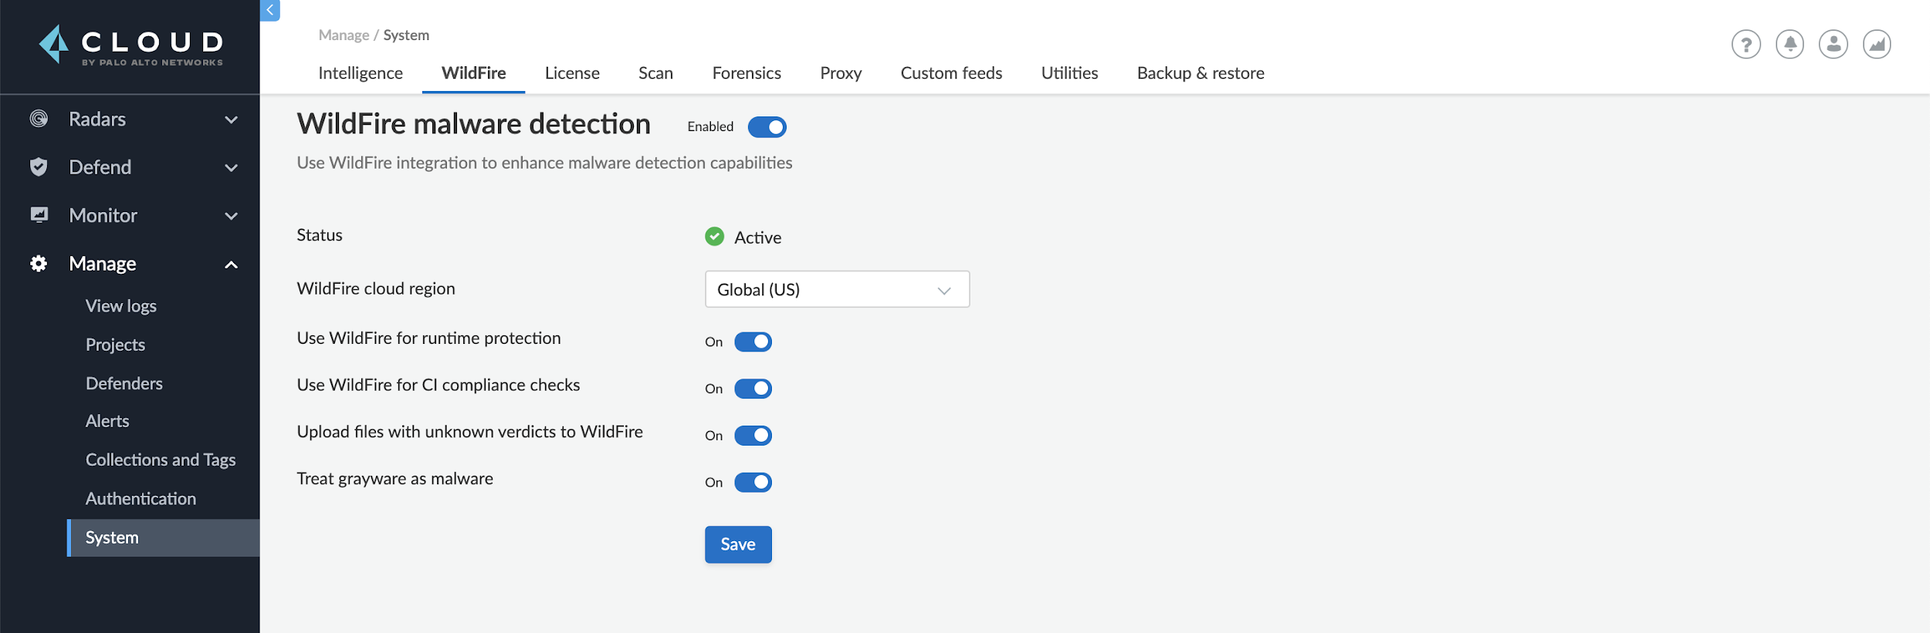
Key Use Cases
Integration with Wildfie
Protection for containers and hosts
Access Control
Web App and API Sec Microsegmentation
Malware Detection

Slide 9









Better Together; Securing Openshift with Prisma Cloud
Host Orchestration Container
CI Tools
Registry
Build
Integrate scanning into your CI pipeline to ensure vulnerability and compliance issues do not emerge in your container images.
Ship
Continuously monitor your registry to ensure you are always shipping secure code into production.
Run
Protect your running applications with least privilege access, access control, and audits — providing defense in depth to prevent next generation attacks.
Notes:
Now back our Coming together;-> lets start with the journey
When you are journeying into container, how confident are you in your security posture taking into consideration security practices you have in place
Continuously monitor your pipeline and provide DevOps team with security compliance and vulnerability risk
Prisma™ Cloud offers built-in coverage of Red Hat CVEs directly from the Red Hat OVAL feed
Ensure quality of images at rest ->Quay registry
and supports open container standards like CRI-O that power the OpenShift Container Platform.
Protect running containers against their required behaviours
Compliment RH orchestration with further granular controls
Secure running Host from behavioural drifts

Slide 10





Prisma Cloud: Cloud Native Application Protection Platform
Cloud Code Security
Secure app artifacts, analyze code, and fix issues
Cloud Security Posture Management
Monitor cloud security posture, detect and respond to threats, maintain compliance
Cloud Workload Protection
Secure hosts, containers, and serverless across the application cycle
Cloud Network Security
Monitor and secure cloud networks, enforce microsegmentation
Cloud Identity Security Enforce permissions and secure identities across workloads and clouds
Infrastructure as Code (IaC) Security
Visibility, Compliance & Governance
Host Security
Identity-Based Microsegmentation
Cloud Infrastructure Entitlement Management
Threat Detection
Container Security
Data Security
Serverless Security
Web App & API Security

Slide 11
Thank you
paloaltonetworks.com

