Slide 1


Project on Software Engineering
Decentralized NFT Marketplace Website
Lecturer: Dr. Nguyễn Thiên Bảo Members 1. Nguyễn Hồ Quốc Bảo - 19110070 2. Nguyễn Quốc Hoàng - 19110128

Slide 2
BH Trading PROJECT

Slide 3
01
What is Blockchain ?
02
What is NFT ?
03
What is our purpose ?
04
Our difficulty
05
Our future goals

Slide 4
1. What is

Slide 5
A blockchain is a distributed database or ledger that is shared among the nodes of a computer network. As a database, a blockchain stores information electronically in digital format. Blockchains are best known for their crucial role in cryptocurrency systems, such as Bitcoin, for maintaining a secure and decentralized record of transactions. The innovation with a blockchain is that it guarantees the fidelity and security of a record of data and generates trust without the need for a trusted third party.

Slide 6
One key difference between a typical database and a blockchain is how the data is structured. A blockchain collects information together in groups, known as blocks, that hold sets of information. Blocks have certain storage capacities and, when filled, are closed and linked to the previously filled block, forming a chain of data known as the blockchain. All new information that follows that freshly added block is compiled into a newly formed block that will then also be added to the chain once filled.

Slide 7
A database usually structures its data into tables, whereas a blockchain, as its name implies, structures its data into chunks (blocks) that are strung together. This data structure inherently makes an irreversible timeline of data when implemented in a decentralized nature. When a block is filled, it is set in stone and becomes a part of this timeline. Each block in the chain is given an exact timestamp when it is added to the chain.

Slide 8
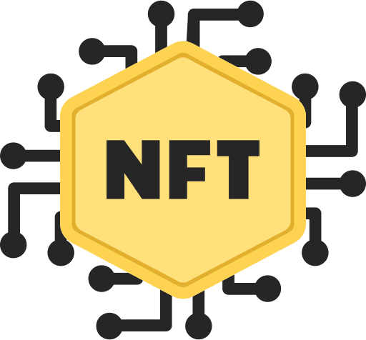
2. What is

Slide 9
What is NFT ?
NFTs are tokens that we can use to represent ownership of unique items. They let us tokenize things like art, collectibles, even real estate. Ownership of an asset is secured by the Ethereum blockchain – no one can modify the record of ownership or copy/paste a new NFT into existence.

Slide 10
What is NFT ?
NFT stands for non-fungible token. Non-fungible is an economic term that you could use to describe things like your furniture, a song file, or your computer. These things are not interchangeable for other items because they have unique properties.

Slide 11
WHY IS NFT IMPORTANT
NFTs solve some of the problems that exist in the internet today. As everything becomes more digital, there's a need to replicate the properties of physical items like scarcity, uniqueness, and proof of ownership. Not to mention that digital items often only work in the context of their product. For example you can't re-sell an iTunes mp3 you've purchased, or you can't exchange one company's loyalty points for another platform's credit even if there's a market for it.

Slide 12
WHY IS NFT IMPORTANT
NFT also solves the copyright issue, which is also controversial in many countries. The things you create will be owned by you, only you have the right to provide the right to use them to whom you want.

Slide 13
What is our purpose ?
1
First purpose
Create a decentralized NFT marketplace website where all users can freely create their own NFTs
2
Second purpose
Users can sell their own NFTs to others so they can make a profit for themselves

Slide 14
What is our purpose ?
3
Third purpose
Users can use the anonymous system extremely safe and do not worry about stealing personal information
4
Forth purpose
can control their own assets, not subject to the management of any third party.

Slide 15
What is our purpose ?
5
Fifth purpose
The system is extremely secure, can prevent attacks
6
Sixth purpose
Transactions on the system are transparent, all users can see the transaction history of all NFTs created and sold on the system.

Slide 16
Our difficulty
Because blockchain technology is relatively new, this system requires us to spend a lot of time and effort on self-research and self-study on the internet to be able to build and develop the system in the best way
Not only that, our system is a very new topic for all users so our system will remain inaccessible to users who are inexperienced with blockchain applications.

Slide 17
Our future goal
First
Second
Create a page with content about blockchain so that new users can rely on it to better understand this technology
We will create an auction function so that users can bid together to buy valuable NFTs
Sixth
Third
We will improve our programming skills, our ability to complete projects better
We will create a function to create collections by different themes to make the system more diverse
Fifth
Fourth
Improve and make the user interface more beautiful
We will create stats so that users can see the statistics on the system

Slide 18
DEMO

