Slide 1


Project on Software Engineering
Decentralized NFT Marketplace Website
Lecturer: Dr. Nguyễn Thiên Bảo Members 1. Nguyễn Hồ Quốc Bảo - 19110070 2. Nguyễn Quốc Hoàng - 19110128

Slide 2
BH Trading PROJECT

Slide 3
01
What is Blockchain ?
02
What is NFT ?
03
What is our purpose ?
04
Our difficulty
05
Our future goals

Slide 4
1. What is

Slide 5
The fidelity and security
Database or ledger
Storing information in digital format
Secure and decentralized record of transactions

Slide 6
A blockchain collects information together in groups, known as blocks, that hold sets of information.
Blocks have certain storage capacities and, when filled, are closed and linked to the previously filled block.

Slide 7
A database usually structures its data into tables, whereas a blockchain, as its name implies, structures its data into chunks (blocks) that are strung together.
When a block is filled, it is set in stone and becomes a part of this timeline.
Each block in the chain is given an exact timestamp when it is added to the chain.

Slide 8
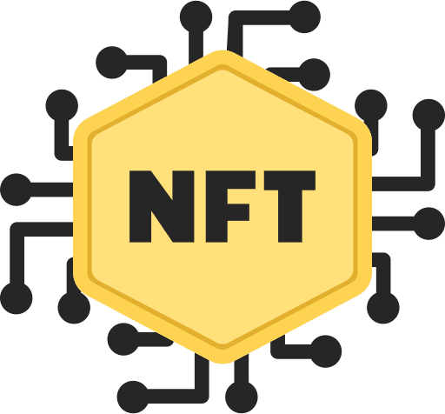
2. What is

Slide 9
What is NFT ?
There are 2 easy understanding about NFT:
NFTs are tokens that we can use to represent ownership of unique items.
Ownership of an asset is secured by the Ethereum blockchain

Slide 10
What is NFT ?
NFT stands for non-fungible
These things are not interchangeable for other items because they have unique properties.

Slide 11
WHY IS NFT IMPORTANT
NFTs solve some of the problems that exist in the internet today.
NFT also solves the copyright issue, which is also controversial in many countries.
"Tokenizing" these real-world tangible assets makes buying, selling, and trading them more efficient while reducing the probability of fraud.

Slide 12
What is our purpose ?
1
First purpose
Create a decentralized NFT marketplace website where all users can freely create their own NFTs
2
Second purpose
Users can sell their own NFTs to others so they can make a profit for themselves

Slide 13
What is our purpose ?
3
Third purpose
Users can use the anonymous system extremely safe and do not worry about stealing personal information
4
Forth purpose
can control their own assets, not subject to the management of any third party.

Slide 14
What is our purpose ?
5
Fifth purpose
The system is extremely secure, can prevent attacks
6
Sixth purpose
Transactions on the system are transparent, all users can see the transaction history of all NFTs created and sold on the system.

Slide 15
Our difficulty
Because blockchain technology is relatively new, this system requires us to spend a lot of time and effort on self-research and self-study on the internet to be able to build and develop the system in the best way
Not only that, our system is a very new topic for all users so our system will remain inaccessible to users who are inexperienced with blockchain applications.

Slide 16
Our future goal
First
Second
Create a page with content about blockchain so that new users can rely on it to better understand this technology
We will create an auction function so that users can bid together to buy valuable NFTs
Sixth
Third
We will improve our programming skills, our ability to complete projects better
We will create a function to create collections by different themes to make the system more diverse
Fifth
Fourth
Improve and make the user interface more beautiful
We will create stats so that users can see the statistics on the system

Slide 17
DEMO

