Slide 1


Capstone Presentation Creating an online movie streaming web application
Instructor: PhD. Mai Anh Tho
Reviewer: MSc. Nguyen Duc Khoan
Nguyen Quoc Hoang 19110128
Chu Nguyen Hoang Son 19119128

Slide 2
Table Contents of Moviersals
1. Project Introduction | The reason, purpose, scope, and results.
2. System Architectural Overview | Front-end, Back-end, Database, 3rd libraries.
3. Actors and Features | Roles, functions,…
4. Business flow | Some main flows of Moviersals.
5. Outcomes | Lessons reached, achievements, limitations
6. Demonstration | Production Demonstration

Slide 3
01
Project Introduction

Slide 4
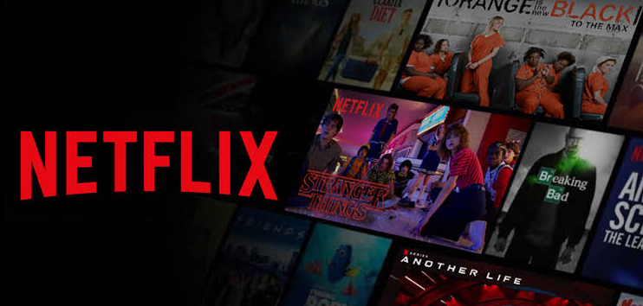
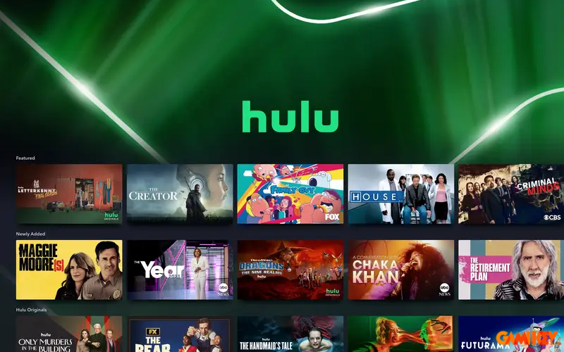
Context
Entertainment and simplicity are trends among young people
Convenient, economical, every time
Problem
Paid to use

Slide 5
Scope
Product goal
Core Functions
Target Users
Providing an optimal user experience with rich content and ease of use.
Focus on streaming videos, account management, payment, comment & rating,…
For Moviegoers with internet access

Slide 6



Video streaming
Transcode
Contain
…
Original
Playlist
Segments

Slide 7
02
System Architectural Overview

Slide 8
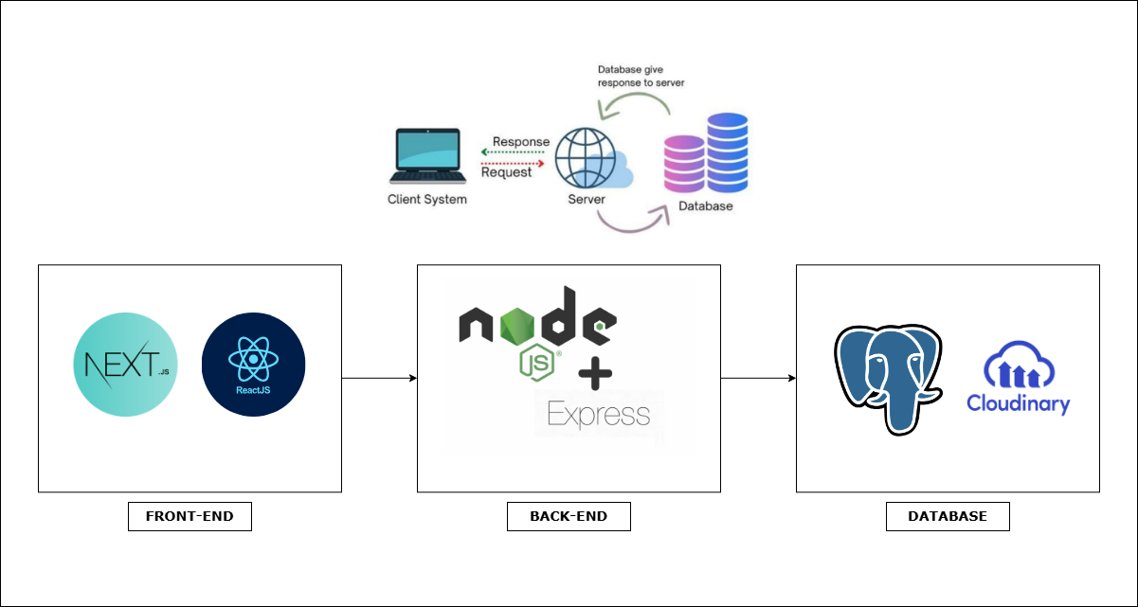
Architecture
ReactJS
NextJS
NodeJS
Express
Postgres
Cloudinary

Slide 9
03 Actors and Features
Guest
Customer
Admin
Login
Register
View detail movies
Filter categories
Watching movies
Using movie functions
Adding favorites
Checkout
Profile management
Comment
...
Managing accounts
Movies and episodes management
Categories management
Tickets/Subscriptions
Statistics

Slide 10
04
Business flow

Slide 11

1. Authentication
2. Content Browsing
3. Video Streaming
4. Subscription

Slide 12
05
Outcomes
Lessons Learned
Application Achievement
Limitations

Slide 13
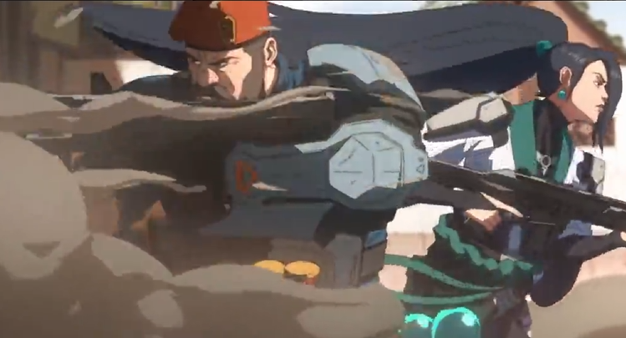

Demonstation

Slide 14
Thanks!
Do you have any questions?

