Slide 1
Algorithmic Mechanism Design
Qianhui Wang
Oct 2022
COMP4600 Advanced Algorithms
Convenor: Dr. Sid Chau

Slide 2
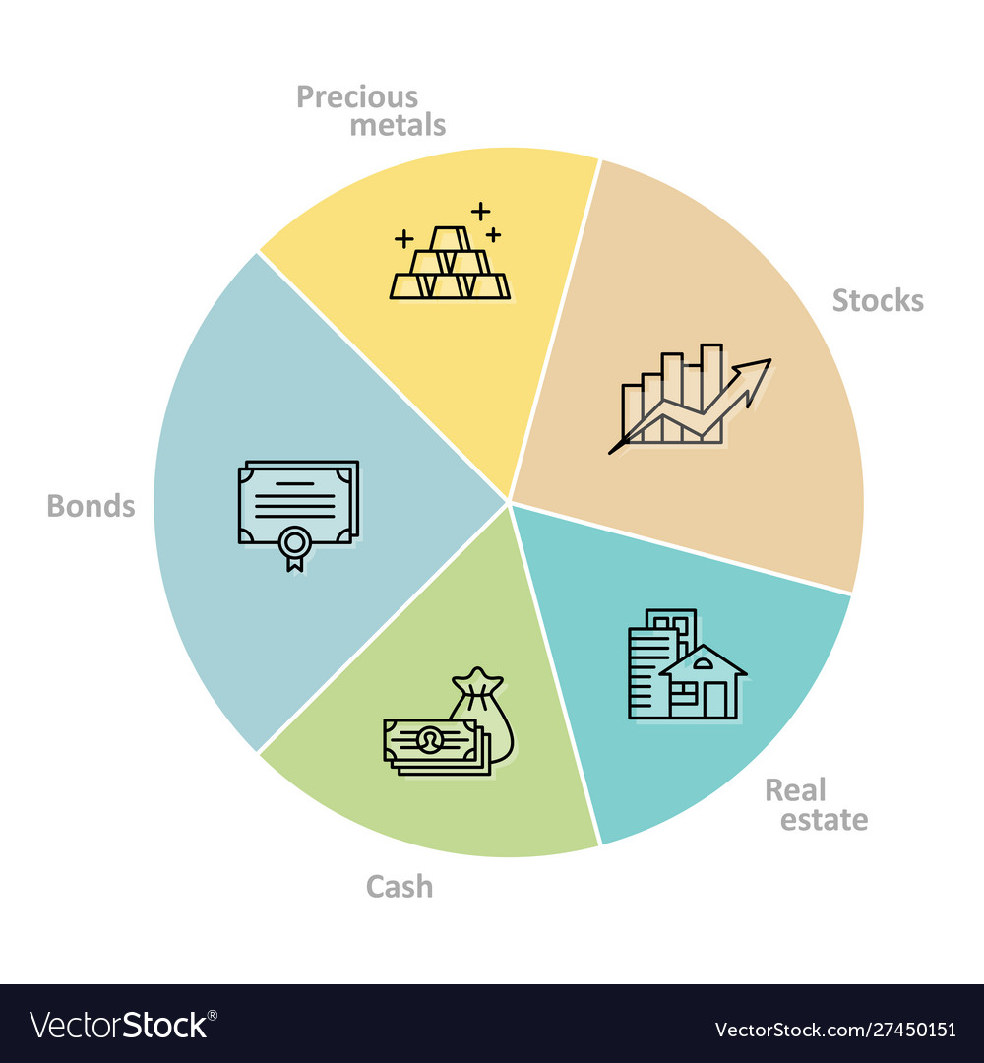
Mechanism Design
“a field in economics and game theory that explores how businesses and institutions can achieve desirable social or economic outcomes given the constraints of individuals' self-interest and incomplete information.”
Notes:
design of some mechanism to achieve certain desired soical outcomes/properties
increase overall social welfare/ decrease social cost

Slide 3

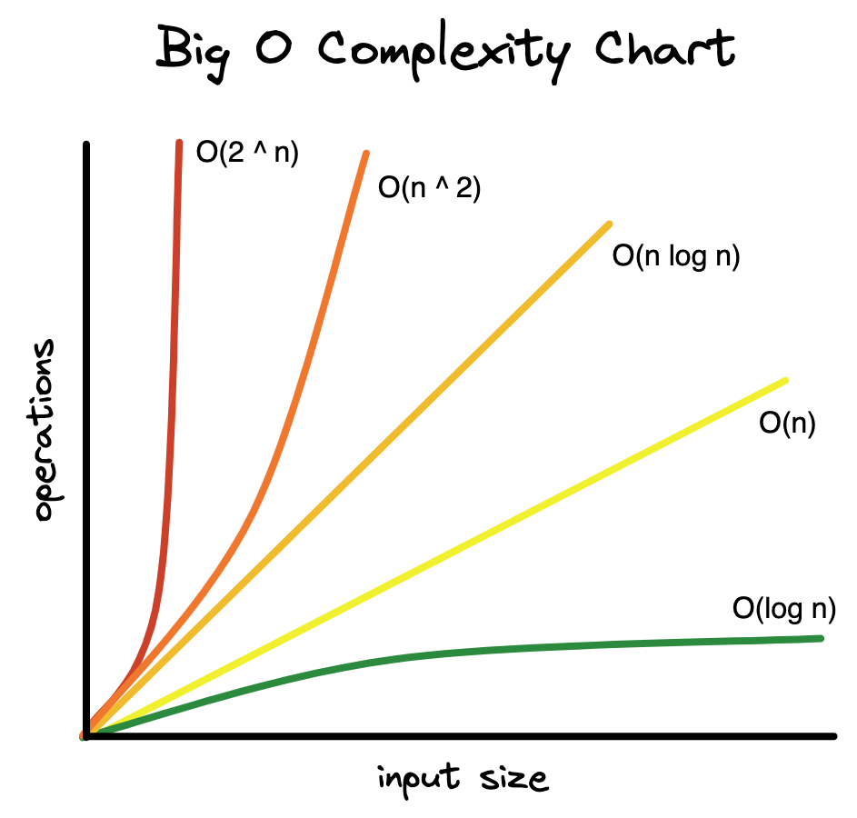
Where Algorithm Comes In
Economics | Computer Science
real-world Bayesian distributions - Average Case Analysis | abstraction - Worst Case Analysis
Solution exactness | Approximations
Nil | Efficiency - computation time - memory - communication
Notes:
http://timroughgarden.org/talks/focs10.pdf
abstract away from low-level real-world distribution details
more robust & technical simpler -- worst case
-> focus on algorithmic designs

Slide 4
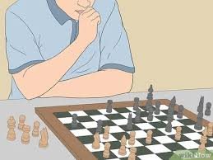


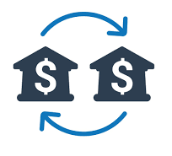
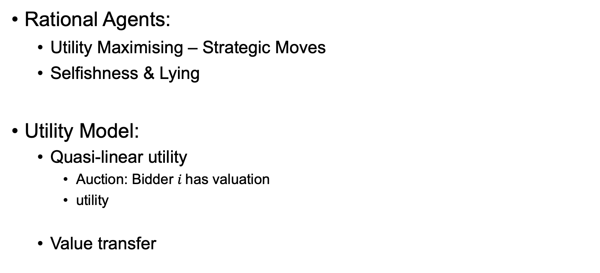
Strategic Models
Rational Agents:
Utility Maximising – Strategic Moves
Selfishness & Lying
Utility Model:
Quasi-linear utility
Auction: Bidder $i$has valuation
utility
Value transfer
Notes:
strategic incentive is to maximise his own gains, measured by the common economic notion of utility
In this game, the players are acting strategically to optimise their resulting utility
Doing so, we expect players co

Slide 5
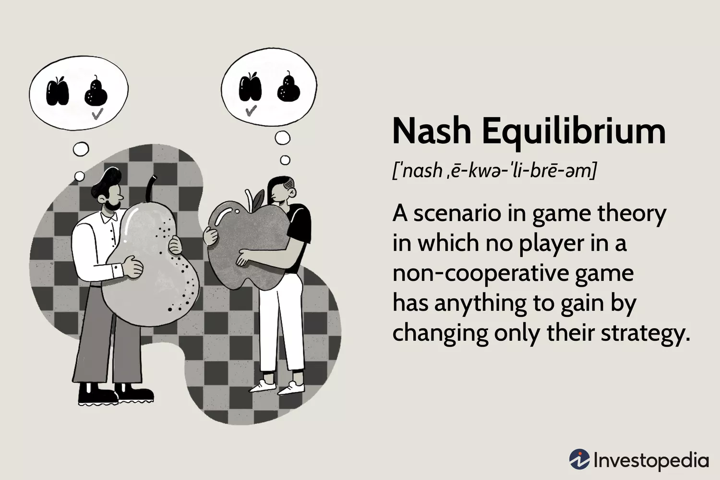
Combining Strategy and Computation
Goal
Design truthful mechanisms
Run in polynomial time
Determine “optimal” social outcome
Truthfulness:
aka Incentive compatibility
Reporting false value is no better than true value
Internalise “Dominant strategy” into the mechanism
Direct Revelation principle in Mechanism Design
Notes:
adopt the rational modelling of participants, taking into account the possibility of falsification of valuations, and abuse of mechanism
“the rational modeling of participants was adopted into computational settings and Mechanism Design was embraced as a paradigm for the design of distributed computational protocols over the Internet.”
-> still design a robust mechanism that can withstand false reportings of valuations, and deliver desired social outcomes that are aligned with the planner’s objectives
-> as well as that can detemine this prefered social outcome in polynomial running time.
definition of nash equilibrium
no single player would change its strategy unilaterally : meaning the current state is better -> hence state equilibrium / equilibrium outcome
the incorporation of strategic dominance into mechanism design -> “truthful mechanism”
player has no incentive to report false values; i.e. in the context of auction, false bid never outperforms true bid
“revelation principle”

Slide 6


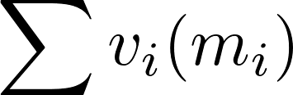
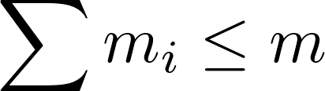


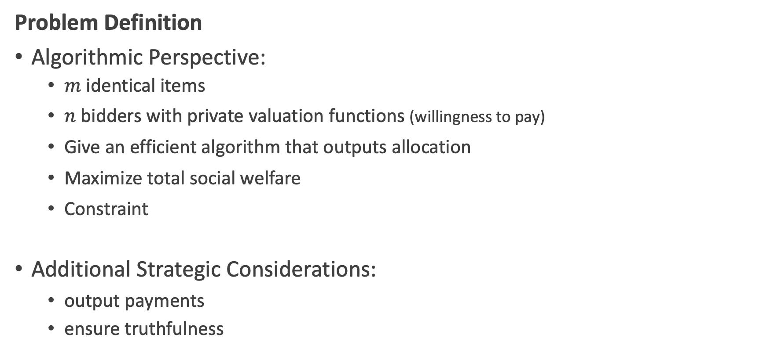
Multi-unit Auction
Problem Definition
Algorithmic Perspective:
$m$ identical items
$n$ bidders with private valuation functions (willingness to pay)
Give an efficient algorithm that outputs allocation
Maximize total social welfare
Constraint
Additional Strategic Considerations:
output payments
ensure truthfulness
Notes:
ensure truthful mechanism
payments;
where players can measure their own utility by the simple difference of

Slide 7

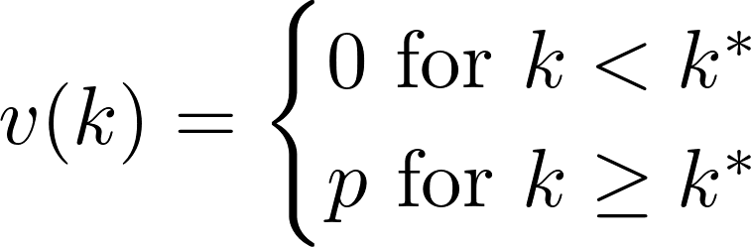
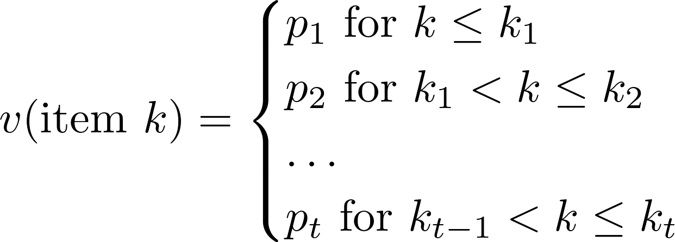

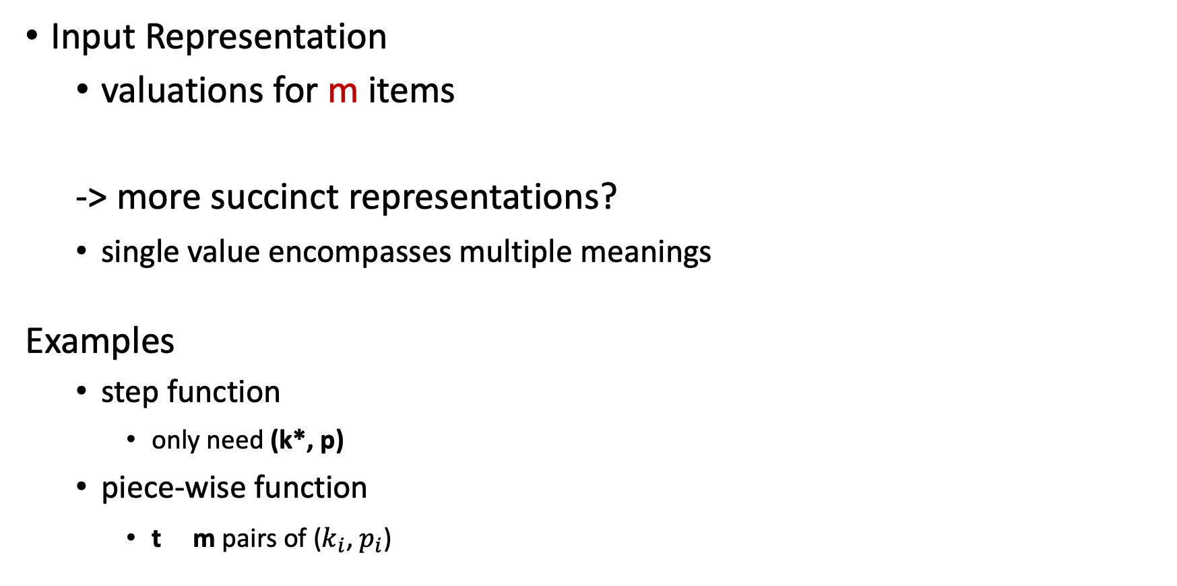
Memory Considerations
m could be very large!
Input Representation
valuations for m items
-> more succinct representations?
single value encompasses multiple meanings
Examples
step function
only need (k*, p)
piece-wise function
t m pairs of ($k_{i}$, $p_{i}$)
Notes:
from the perspective of computer program

Slide 8


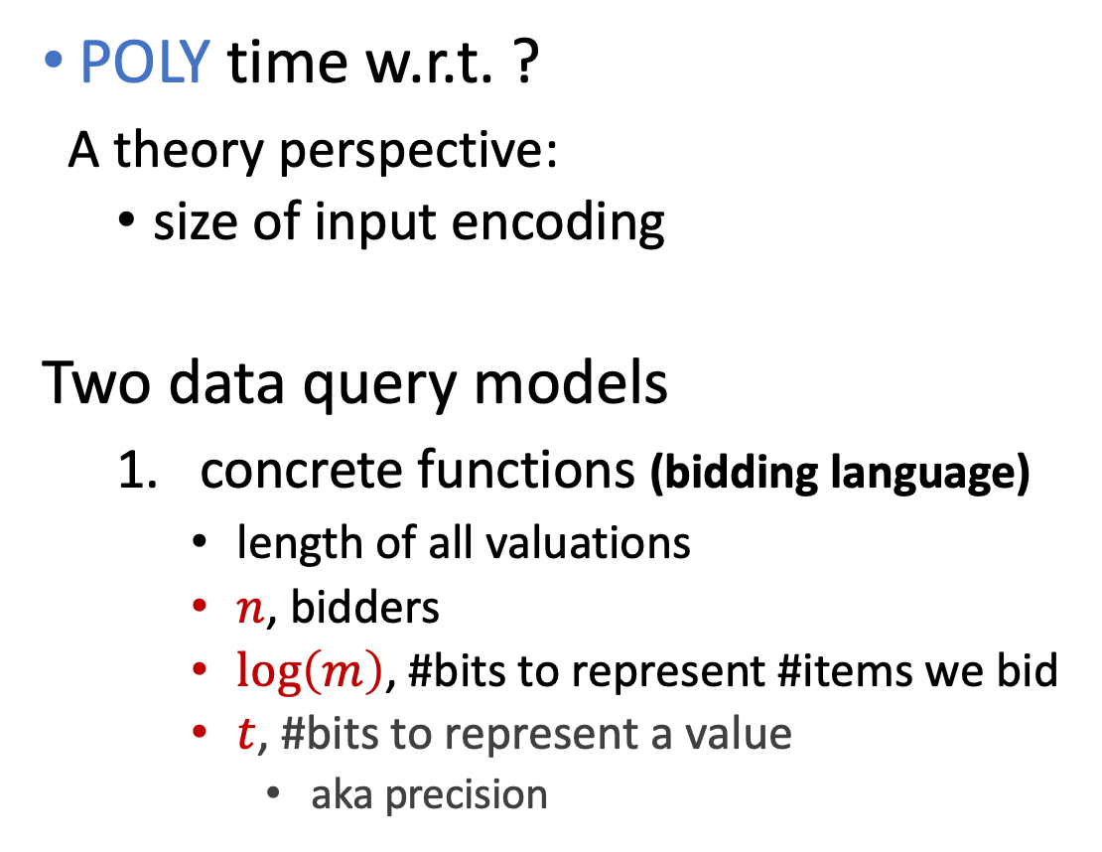
Efficiency Requirements
POLY time w.r.t. ?
A theory perspective:
size of input encoding
Two data query models
concrete functions (bidding language)
length of all valuations
$n$, bidders
$\log\left(m\right)$, #bits to represent #items we bid
$t$, #bits to represent a value
aka precision
2. black-box communication
no precise input representation
- number of “value-queries”
- length of answer bits
still require sublinear in m!
e.g.,
Notes:
Thinking from computation perspective:
Our basic requirement from the algorithm is that it be “computationally-efficient”
for every input, want algorihtm to provide output quickly
Any process that solves a problem, must certainly get access to the data specifying the problem requirements. In our case this is to the valuation functions of the n players.

Slide 9

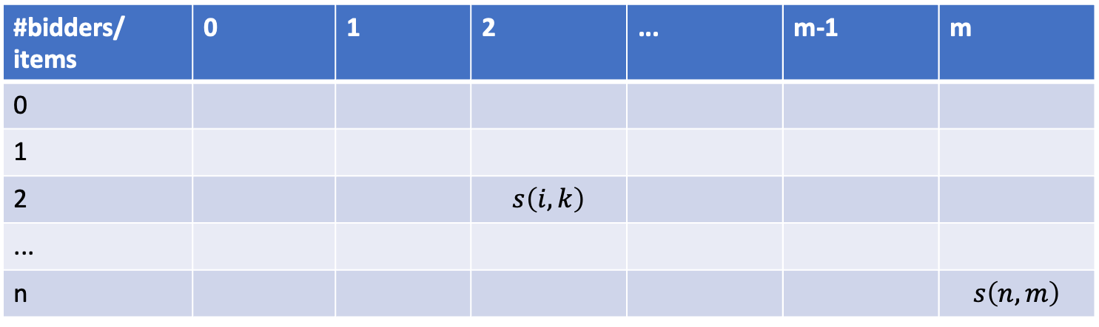

General Allocation Algorithm
NOT computationally efficient!
Dynamic Programming (DP)
Divide-and-Conquer & Optimal Substructure
Subproblem:
Optimal allocation of first k items among the first $i$ bidders
#bidders/ items | 0 | 1 | 2 | ... | m-1 | m
0
1
2 |  |  | $$s\left(i, k\right)$$
...
n |  |  |  |  |  | $$s\left(n,m\right)$$
Notes:
Dynamic Programming (DP) is an optimisation technique applicable to the class of problems with optimal substructure, i.e. a problem can be solved optimally by breaking it into simpler subproblems, and recursively finding the optimal solutions to the subproblems.

Slide 10
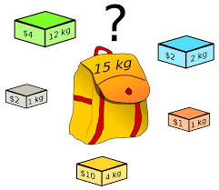
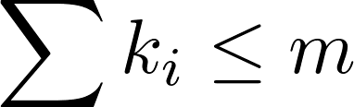
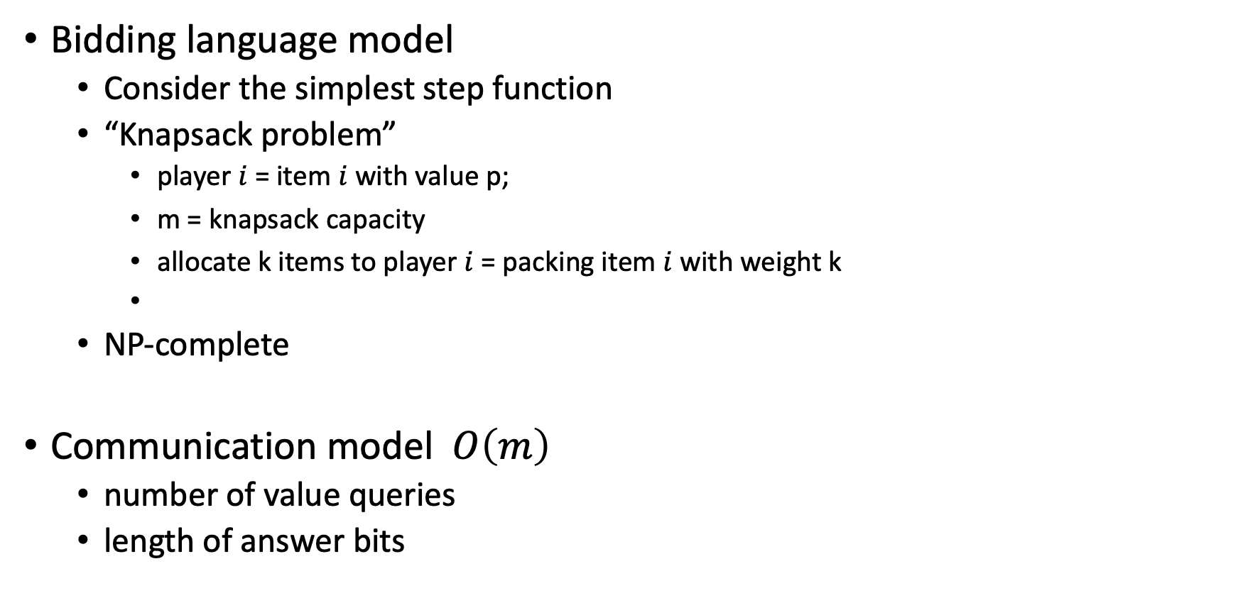
Intractability
Bidding language model
Consider the simplest step function
“Knapsack problem”
player $i$ = item $i$ with value p;
m = knapsack capacity
allocate k items to player $i$ = packing item $i$ with weight k
NP-complete
Communication model $O\left(m\right)$
number of value queries
length of answer bits

Slide 11

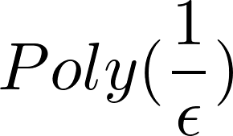

Approximate Optimality
Fully polynomial-time approximation scheme (FPTAS)
additional parameter
specifies how close our approximation should be
additional polynomial time requirement
for maximisation problem:
- approximation
for maximisation problem:
1/2 * f(Opt)
f(Approx)
f(Opt)
Notes:
an approximation scheme for an optimization problem is an algorithm that receives, in addition to the input of the optimization problem, a parameter ✏ which specifies how close to optimal do we want to solution to be. For a maximization optimization problem (like our allocation problem) this would mean a solution whose value is at least (1 - epsilon) the value of optimal solution

Slide 12




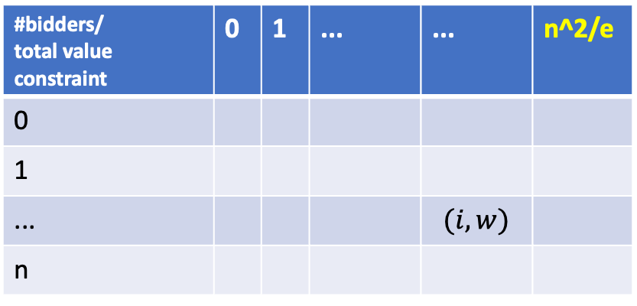
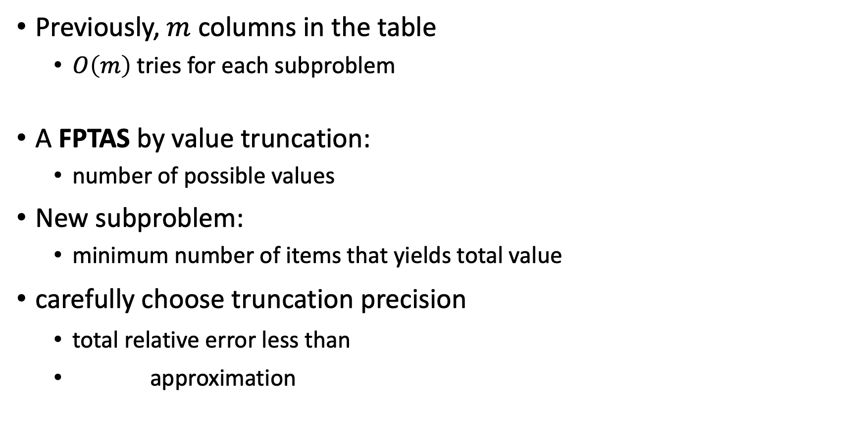
Truncation
#bidders/ total value constraint | 0 | 1 | ... | ... | n^2/e
0
1
... |  |  |  | $$(i, w)$$
n
Previously, $m$ columns in the table
$O\left(m\right)$ tries for each subproblem
A FPTAS by value truncation:
number of possible values
New subproblem:
minimum number of items that yields total value
carefully choose truncation precision
total relative error less than
approximation
look at previous n/e cells in the row above

Slide 13
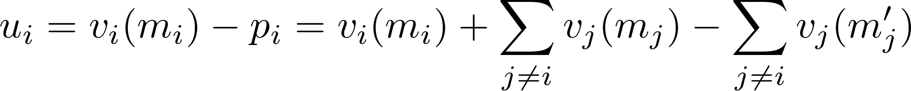
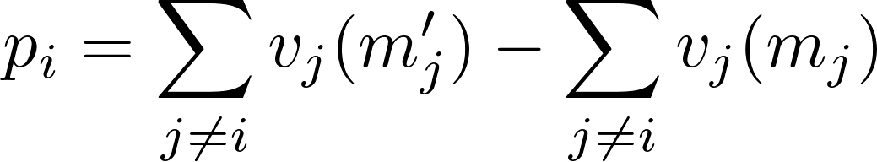
Truthful Auctions - VCG Mechanism
Choice of payment function
Align players’ max utility with total social welfare
Sadly,
General Allocation Algorithm
1. no positive transfer
2. individual rationality
optimal allocation that maximises other players’ welfare

Slide 14
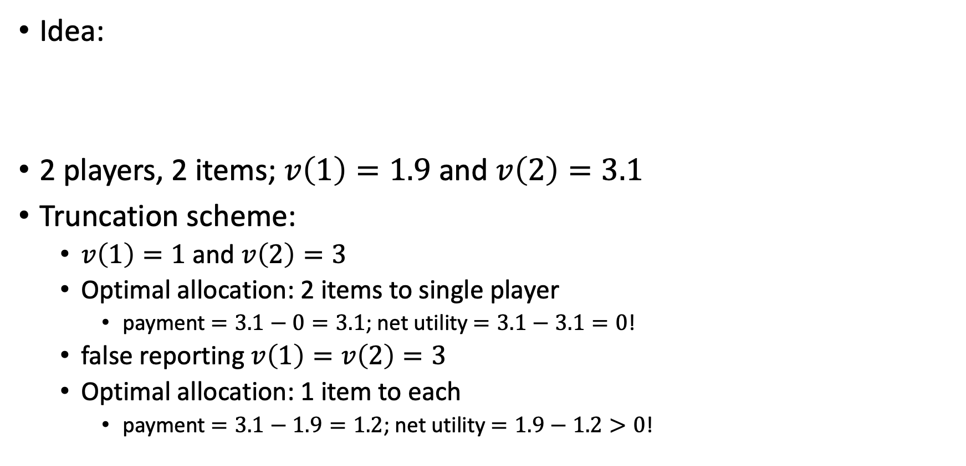
Truthful Approximation? - Counter Example
allocation that “approximately” maximises total welfare
Idea:
2 players, 2 items; $v\left(1\right)=1.9$ and $v\left(2\right)=3.1$
Truncation scheme:
$v\left(1\right)=1$ and $v\left(2\right)=3$
Optimal allocation: 2 items to single player
payment $=3.1−0=3.1$; net utility $=3.1−3.1=0$!
false reporting $v\left(1\right)=v\left(2\right)=3$
Optimal allocation: 1 item to each
payment $=3.1−1.9=1.2$; net utility $=1.9−1.2>0$!
Not incentive compatible!
Notes:
we see a clash between truthfulness and efficiency

Slide 15
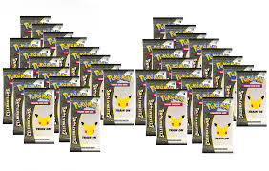

Restricted VCG - Maximum in Range
2-approximation scheme
Idea:
maximise over a restricted range of possible allocations
use General Allocation Algorithm
bundles of items
manipulate m into some form in n
e.g., items in a bundle -> items in total
the only approximation mechanisms that become truthful under the VCG payment rule.
Notes:
The optimal VCG mechanism requires maximization of Pi vi(mi) over all possible al- locations (m1,...,mn). One can think about a “restricted” version of VCG which does not aim to maximize over all possible allocations but rather only over some pre-specified range of possible allocations.
The smaller the range, the easier, potentially, it will be to optimize over it, but the less good will the best allocation in this limited range be.

Slide 16

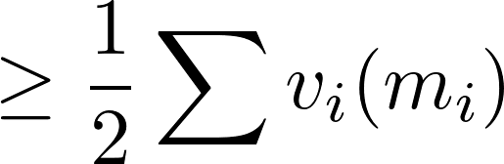

Proof
cannot be better than 2!
bidder who gets the greatest number of items
Case 1: at least half total value from him
-> give everything to him
Case 2: less than half from him
-> take everything from him; distribute to all others
our allocation always ≥ half total optimal
Notes:
quality of the allocation always at least half the total value of the optimal one

Slide 17

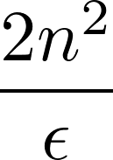
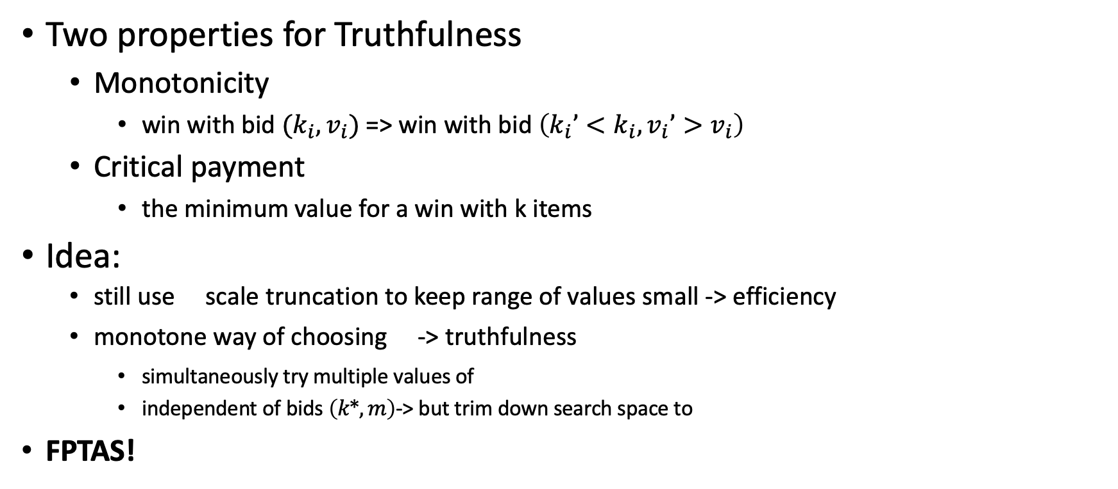
Truthful Auctions - non- VCG Mechanism (Single Parameter)
Two properties for Truthfulness
Monotonicity
win with bid $(k_{i},v_{i})$ => win with bid $\left(k_{i}’<k_{i},v_{i}’>v_{i}\right)$
Critical payment
the minimum value for a win with k items
Idea:
still use scale truncation to keep range of values small -> efficiency
monotone way of choosing -> truthfulness
simultaneously try multiple values of
independent of bids $\left(k*,m\right)$-> but trim down search space to
FPTAS!

Slide 18
Beyond
Randomisation
maximise expected social welfare
maximum-in-distributional-range
FPTAS
reduce the number of values to consider for each player
Combinatorial Auctions
m heterogenous items
allocation of a subset of items
valuation of all subsets

Slide 19
References
Nisan, Noam. (2015). Algorithmic Mechanism Design: Through the lens of Multiunit auctions. Handbook of Game Theory with Economic Applications. 4. 477-515. 10.1016/B978-0-444-53766-9.00009-4.

Slide 20
Central Issue with Algorithmic Mechanism Design
CLASH
Algorithm Efficiency
Truthfulness
Notes:
the required outcome is the socially-ecient allocation of resources.
Even for the simplest types of valuations, it turns outs that just computing the optimal allocation is computationally intractable. This will lead us to considering also relaxations of our economic e
The basic difficulty in AMD is to simultaneously achieve computational efficiency and incentive compatibility

Slide 21
Beyond Multi-unit Auctions

