Slide 1
Hardware-software interface: How it contributes to better computer security
Qianhui
1st year PhD in Computer Science
Hardware-assisted memory safety
Notes:
anyone knows how machine understands the source code we wrote? like systems dev languages C/C++? i.e. compilation of the program
I do research on using hardware resources and mechanisms to provide memory safety for software systems
Starting from a broader idea on computer security and vulnerabilities, and on the other hand, what the hardware-software interface is,
and slowly uncover the idea of hardware-assisted memory safety.
With a special focus on software memory safety
what is memory safety? Pointer-related, mainly C/C++ languages
two main classes of vulnerability : out-of-bounds access (spatial) and UAF (temporal)
Why is it important? Causes great loss of money, HeartBleed,

Slide 2
Starter Question
Can you think of any real-life cyberattacks?
Notes:
To get you start thinking,

Slide 3
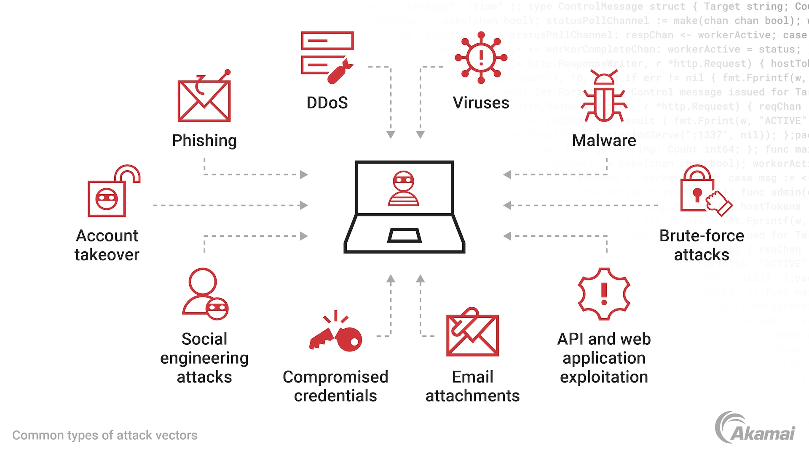
Notes:
Zero-day attacks can take advantage of many types of vulnerabilities — including buffer overflows, broken algorithms, URL redirects, SQL injection, and password security issues. With a zero-day exploit, threat actors may access a machine to steal money or sensitive data, disrupt operations, or hijack the machine as part of a botnet designed to launch distributed denial-of-service (DDoS) attacks.
Because a DDoS attack based on zero-day vulnerabilities exploits weaknesses that are unknown to a software manufacturer and its customers, it is very difficult to defend against. The best strategy is to adopt a multilayered defense that protects against the various methods malicious actors may use to exploit a zero-day vulnerability in cybercrime. These include defenses against ransomware, malware, viruses, botnets, API-based attacks, SQL injection, and other common yet dangerous attack vectors.
hundreds of millions of requests from anonymous IPs, to a service, blocking real requests from legitimate users. Cloudflare several times a week
Malware: malicious software (malware) that encrypts a victim’s files or locks them out of their device, demanding payment (ransom) in exchange for restoring access. Some requires user clicking and downloading malicious files, some need no user interaction and traveled automatically between computers (WannaCry worm).
Virus: A computer virus is a type of malicious software (malware) that attaches itself to legitimate programs, files, or documents to infect a computer. Once active, it can copy itself, spread to other computers via networks or shared drives, and alter or damage data and system operations.
API attack: usually the cloud microservices, each expose their own APIs. defects in access control, authentication, etc. mistakenly give escalated privilege for unintended users or attackers
Well, so there are many forms of attacks, and you might think of cyberattacks very dynamic, and new ways of exploitation emerging everyday.
hard to expect or defend against
take many different forms

Slide 4
Attack Vectors and Vulnerabilities
Attack vectors: specific method, path, or pathway used by a cybercriminal to gain unauthorized access to a computer, network, or application to exploit vulnerabilities.
Vulnerabilities: flaws, weaknesses, or errors in a system's design, implementation, or operation that can be exploited by attackers to compromise security, steal data, or disrupt services.
Attacks are often categorised based on the underlying vulnerability they exploit.
Notes:
But, one highlight is, these different forms of attacks all fall under the term “attack vectors”.
And in formal definitions, these vectors refer to methods that attackers use to undermine a system.
BUT, the fact that attacks can succeed is due to vulnerabilities existing in the system.
In formal terms, vulnerabilities refer to “flaws in the software systems existing from its conception of system design, or implementation, or during maintenance”. They are much easier to categorise and study for.
These flaws expose the opportunity for attackers to take advantage of, to launch different forms of attacks
e.g., phishing emails, weak credentials, software vulnerabilities, and social engineering

Slide 5
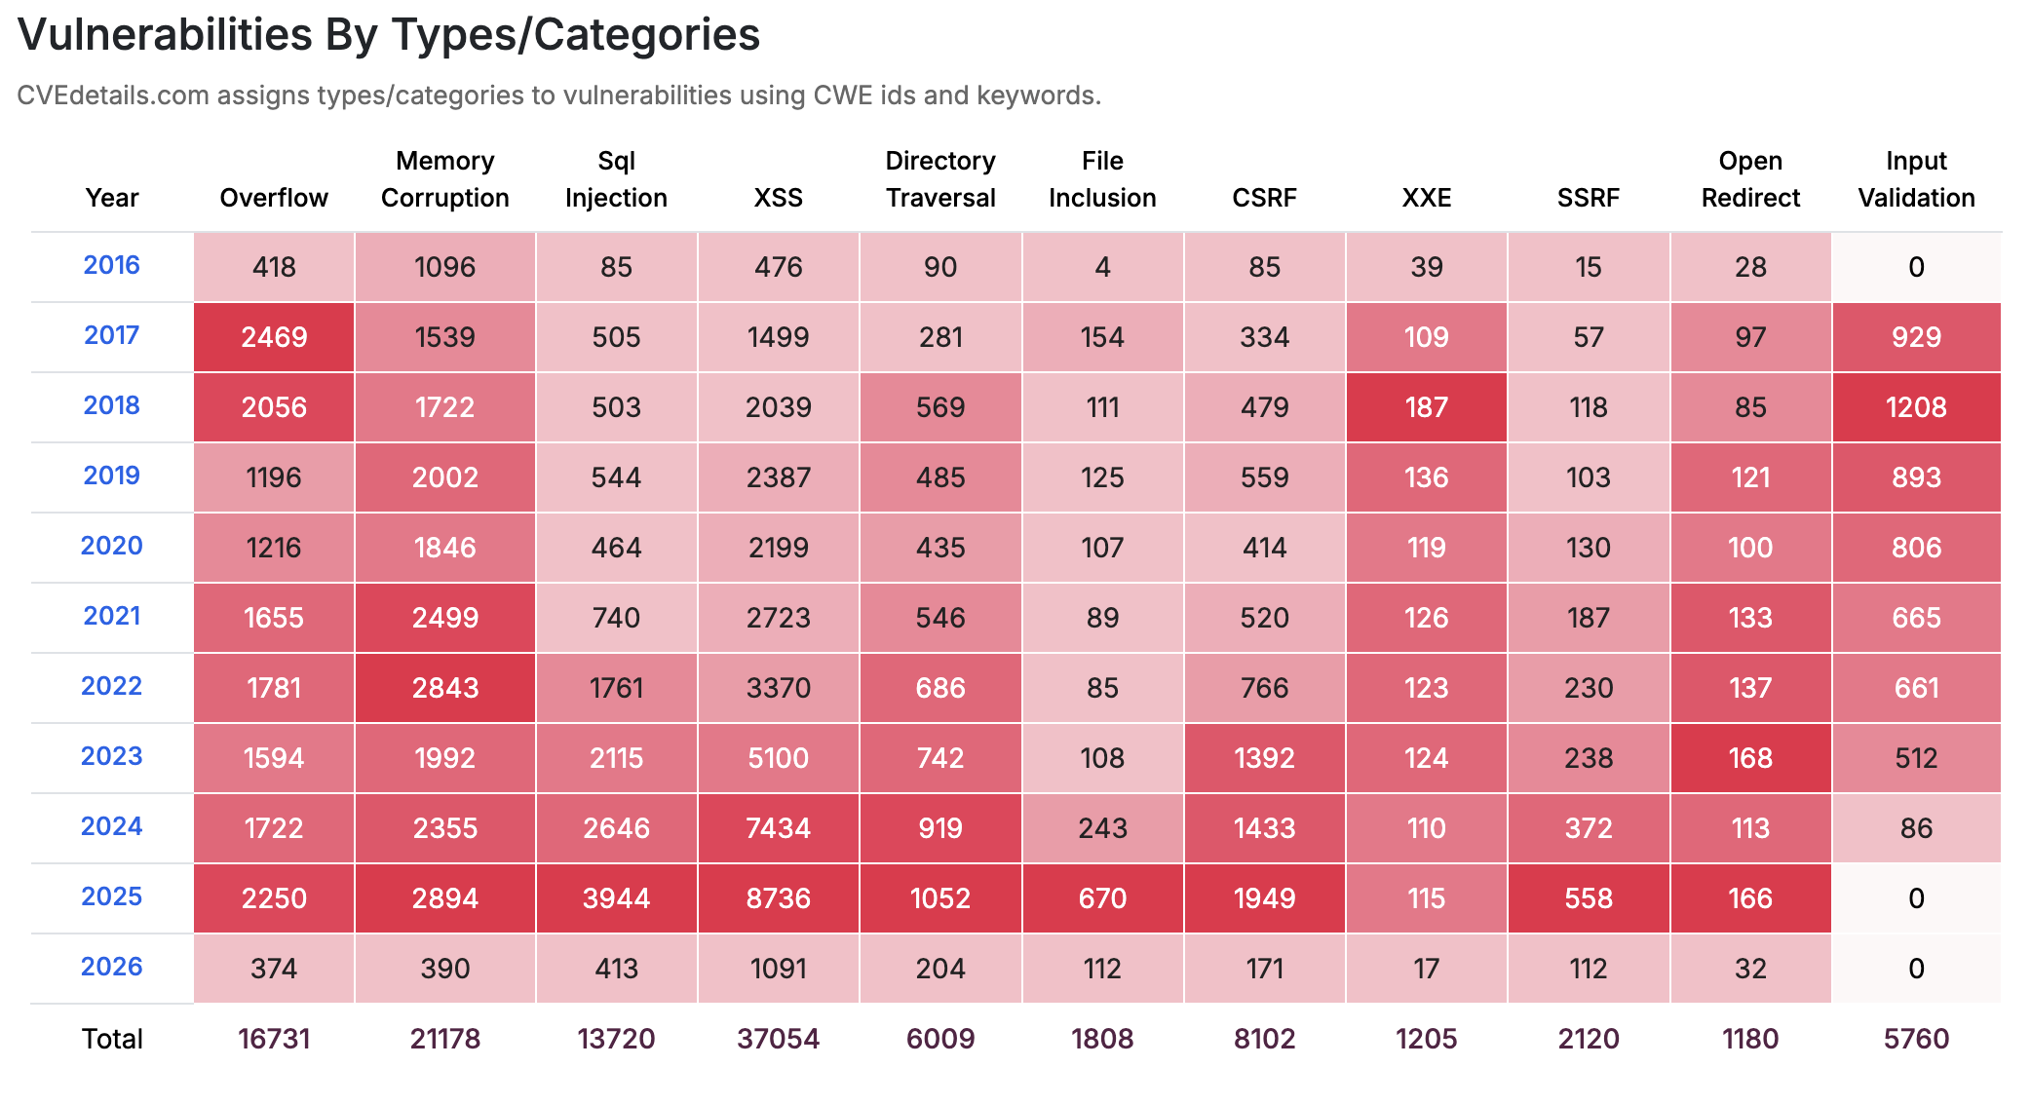
Common Vulnerabilities and Exposures (CVEs) Databases
“a standardized, publicly available list of known information security vulnerabilities and exposures in software and hardware.”
-- maintained by MITRE, a not-for-profit organisation sponsored by the US government.
https://www.cvedetails.com/
Notes:
a number of databases that document vulnerabilities and their patches, in all kinds of software ecosystem you can think of. It could be your python ecosystem, javascript/the web, etc.
CVE stands for Common Vulnerabilities and Exposures, which is a standardized, publicly available list of known information security vulnerabilities and exposures in software and hardware. Maintained by the MITRE Corporation and sponsored by the U.S. Department of Homeland Security, this system provides a consistent naming convention to help cybersecurity professionals identify, prioritize, and remediate risks.
operate FFRDCs—federally funded research and development centers

Slide 6
Main classes of vulnerabilities
Memory safety
Input injection/broken access control
due to lack of input sanitization
application-level logic bugs
low-level memory management issues
due to improper direct manipulation of machine memory, often in C/C++
e.g., buffer overflow, memory corruption
https://www.cvedetails.com/
Notes:
account for roughly 70% of all security vulnerabilities in major products like Windows and Android
Input injection:
XSS: Cross-Site Scripting
XXE: XML External Entities
SSRF: Server-Side Request Forgery
Broken access control: Logic errors (e.g., bypassing a login screen)
Directory/Path traversal,
CSRF: cross-site request forgery
open redirect
missing input validation and sanitisation there.
you might think based on the numbers, the input injection based vulnerabilities are a big issue, but for vulnerability we are also concerned with their CVSS scores, the severity index. Memory safety ones are usually much more severe, less easier to find and patch.
Open source vulnerabilities from OSV.dev
https://osv.dev a project by Google, collects vulnerabilities in open source projects from various sources and publish them in Open Source Vulnerability format. We regularly pull and process data published by OSV.dev and add it to our database, correlating OSV data with CVEs. This allows users to access additional information about CVEs, for example debian or github advisories, malware data and much more.
OSV data also includes items without CVEs, such as malware, issues discovered by fuzzing etc.
Additionally OSV data is grouped by ecosystem (e.g Maven, npm etc) and package names, unlike CVEs OSV does not use CPEs to provide affected product and version information. Using package names allows OSV data to be used for scanning SBOM or Lockfiles.

Slide 7

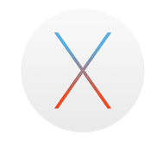

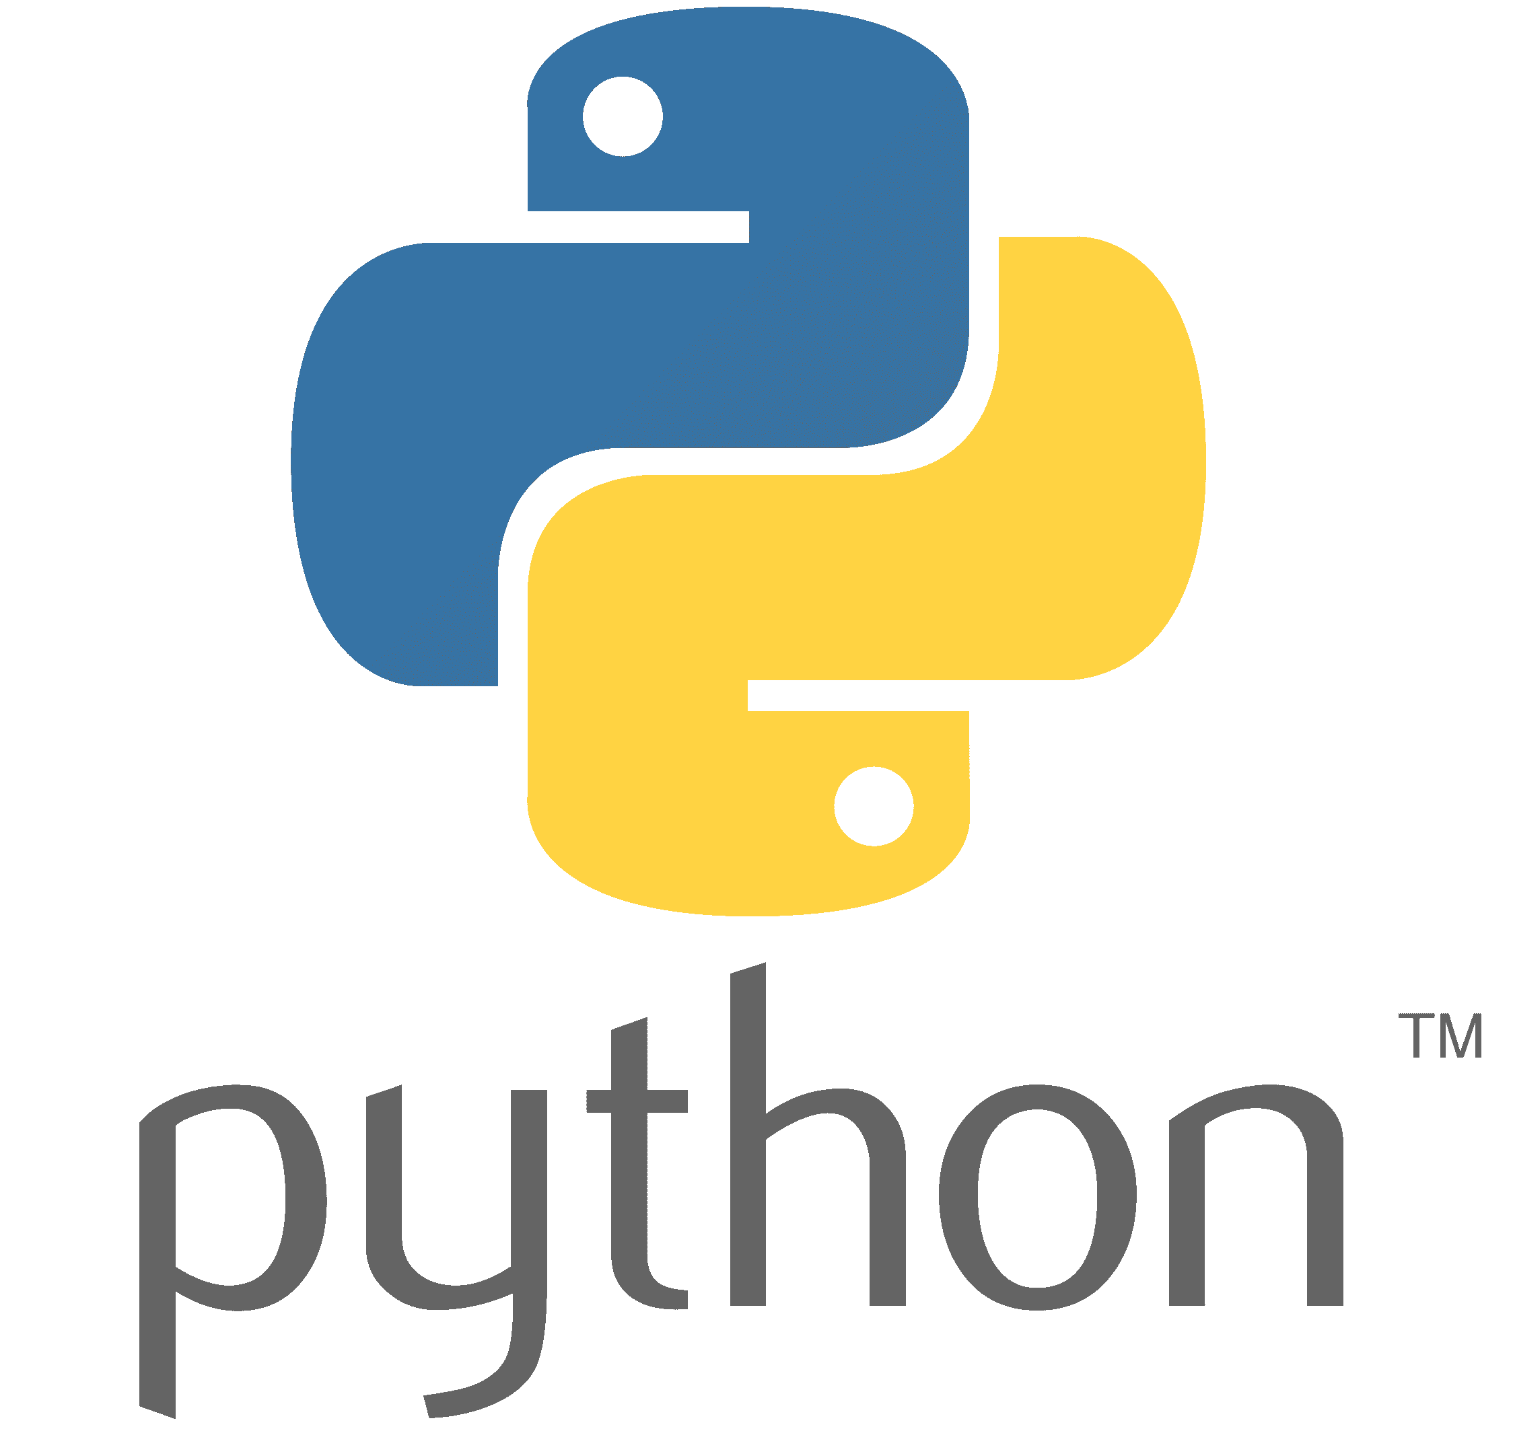


Importance of memory safety
Critical infrastructures written in memory-unsafe C/C++
e.g. mainstream OS, language runtimes, embedded system devices
~70% critical security bugs reported by Microsoft, Chromium, Ubuntu, Android are memory-safety related
The multi-billion-dollar problem
Zero-day vulnerabilities cause governments and institutions a great loss of money
Notes:
More specifically, why do we want to talk about memory safety vulnerabilities?
the most straightforward evidence is that
and as a matter of fact, the systems that we interact with daily, they are all written in memory-unsafe languages, specifically C/C++.
javascript engine running your browser,
embedded system devices powered by RunTime OS.
hundreds of millions of dollars
For decades industry has created billions of lines of C & C++ code but addressing the resulting memory safety risks has been a tough challenge. This blog series will explore memory vulnerabilities, the causes of memory unsafety and potential preventative measures.
Trusted means they are assumed to be protected and free from exploitable vulnerabilities, regardless of actual effective mechanisms to make them safe

Slide 8
Why C/C++, not any other languages?
 | C/C++ | Memory-safe Languages (Java, Python, Go, etc.)
Memory management | Manual allocate, free, manipulate via pointers | Automate via runtime garbage collection or compile-time checks
Language specification | Built-in undefined behaviours (UB) | Strict formal semantics with few restricted escapes
Notes:
Let’s answer the question: why memory-safety vulnerabilities mostly occur in C/C++, but not other languages?
The key distinction between C/C++ and other memory-safer languages such as Java, Python is that it does not have a runtime to auto manage memory allocations, frees. But developers in C/C++ rely on pointers to do so. And pointers are dangerous and specifically designed to give programmers max flexibility to manipulate system and hardware resources. This is purposefully designed for speed in processing. But comes with a cost in security.
The other key distinction is that the spec for C family langs purposefully leaves blank for certain behaviours, allowing the compilers themselves to innovate their own response. For example, the standard C compiler gcc compiles undefined behaviours without giving warnings or stops the program. So it could lead to haphazard runtime crashes, not easily traceable back to the source code. on the other hand, runtime managed languages follow stricter semantics, allowing very few escape hacks that are left to developers’ own discern.
Architectural deficiency : not distinguishing pointers from data or addresses – i.e. designed with no protection against pointer misuse despite it being much more omnipotent than other systems primitives
C & C++ specifically allows arbitrary behaviours from its golden standard for practice, i.e. ISO specification
i.e. their compilers do not trap weird instruction sequences even at the static analysis step, and allow software to behave haphazardly
In languages like C and C++, the language specification leaves certain situations as "undefined".
Memory Unsafety: Allowing arbitrary pointer arithmetic or accessing out-of-bounds memory can lead to the runtime performing unpredictable, "arbitrary" actions.
Compiler/Platform Dependency: The compiler, ABI, or operating system may define what happens in these scenarios, which can vary wildly between environments.
While high-level languages (Java, Python, Rust) generally restrict arbitrary behaviours to ensure safety, they still offer escape hatches (e.g., unsafe in Rust, reflection in Java) that can lead to unexpected behaviours. Lower-level languages (C, C++) have "undefined behaviour" explicitly built into their specifications, allowing them to exhibit a wide range of, or "arbitrary," behaviours at runtime.

Slide 9
Issues with using pointers
A pointer in C/C++ is a variable that stores the addresses of other variables, i.e. it points to the memory of language constructs
Pointer is architecturally indistinguishable from memory addresses as they are all represented as integers
Mistreatment of pointers could corrupt or leak memory
out-of-bound access
/buffer overflow
use-after-free
Notes:
We mentioned about pointers, if you are unfamiliar with pointers, they store memory addresses of other language members.
Pointers are dangerous to use because architecturally there are no rules built in to distinguish it from addresses, yet they are dynamic and powerful. They represent software’s ability to access hardware and system resources, by reading and writing to memory.
Two main sources of memory safety vulnerabilities are spatial misuse, out-of-bound access or buffer overflow, and temporal misuse, use-after-free.
Pointers are associated with dedicated memory regions, or buffers. Since they are treated as integers architecturally, they move by conventional arithmetic. If they move outside their allocated region, it could potentially cause spatial memory safety error when we try to access mismatched region. When we write to it, it is buffer overflow.
Temporally, when we free a region of memory and later access that region with the old pointer, it would also be a problem because now that pointer points to memory that does not belong to it. It could cause memory leaks or corrupt that region of memory.

Slide 10

Let’s have some fun playing with real C/C++ vulnerability
Notes:
Now understanding why memory-safety vulnerabilities occur in C/C++, lets have some fun playing with real ones.

Slide 11
Return-Oriented Programming (ROP)
“a software attack where the attacker corrupts the function return addresses, to take over the control flow of the application by chaining useful instructions (gadgets) already present in the program’s memory.”
Notes:
The key attack method/vector we are using is ROP – it corrupts the function return address, to try to change the original program control flow, diverting into attacker controlled code.
It succeeds by exploiting existing sequences of instructions present in the program memory, either in the source code or shared libraries such as libc.
Return Oriented Programming (ROP) is a software attack where the attacker corrupts the function return addresses stored in the stack to point it to somewhere in the application with a useful sequence of instructions, ending in an indirect branch. These sequences are known as gadgets, and are prevalent in most code. By chaining multiple gadgets, the attacker can mislead the program to perform actions that end up in a security compromise. An example of such a security compromise is spawning an interactive shell.
A gadget is:
A short instruction sequence ending in ret that you can chain together by controlling the stack.
Executing Arbitrary Commands: The goal of the ROP chain is often to call dangerous functions, such as system() in libc, with attacker-controlled arguments (e.g., "/bin/sh"), allowing them to execute arbitrary OS commands.

Slide 12
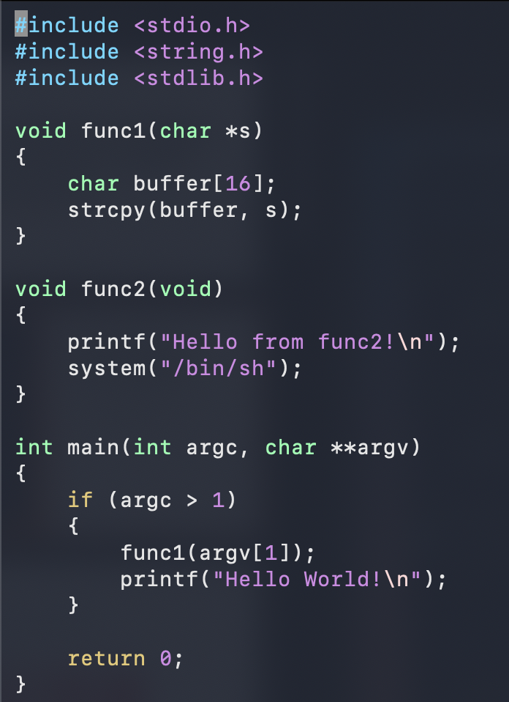
What could go wrong with the program?
strcpy in func1 is memory-unsafe, allowing compiler unchecked buffer overflow
system(”/bin/sh”) in func2 spawns a new shell process that could execute arbitrary OS commands, which could be a useful gadget for ROP
Notes:
Here is a vulnerable program.
With a main entry point, if it takes more than one arguments, calls func1 with the second argument as its input, and returns, and prints hello world to the screen.
func1 allocates a buffer of 16 bytes on the stack, and copies the input string to the buffer and returns.
func2 is unused, but inside it it prints hello from func2 and spawns a new shell process.
Do you see any exploitable gadgets there to achieve ROP?

Slide 13
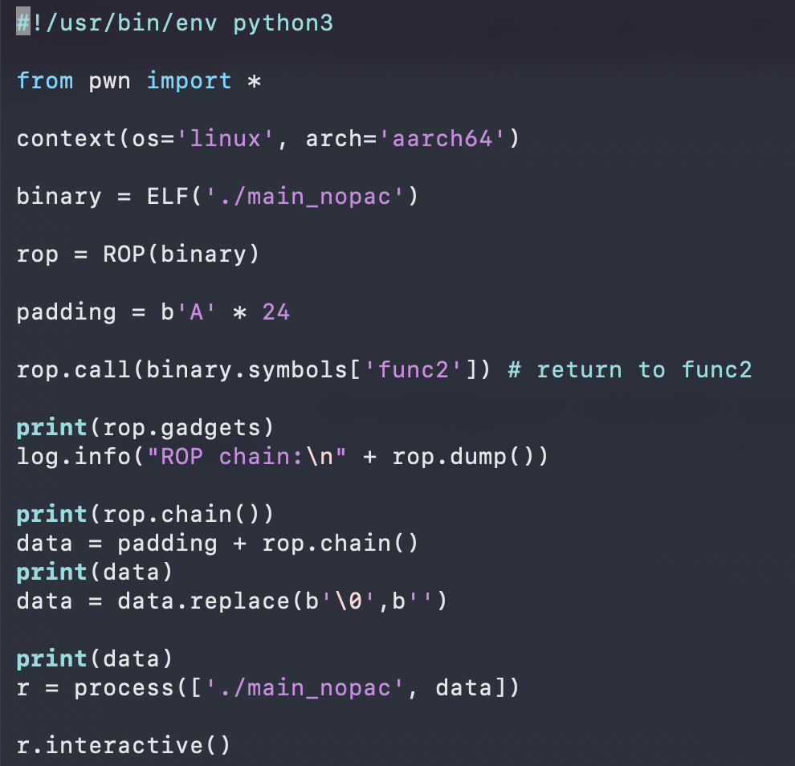
Python Exploit Script using pwntools
automate low-level exploitation
finds ROP gadgets automatically
craft overflow payload
start the vulnerable program and inject exploit payload
attach an interactive terminal to the process
buffer overflow
payload
Notes:
Here is a sample exploit script written with Python pwntools. We use this library to demo what an attack can do to the vulnerable program.
This is a library that automates low-level exploitation, finds ROP gadgets, craft overflow payload,
We start the vulnerable program and inject the exploit payload.
We also attach an interactive terminal to the process to see how far our attack can go (if we can seize control of the program).
pwntools is a high-level Python framework that turns low-level exploitation into programmable automation.
Pwntools is a CTF framework and exploit development library. Written in Python, it is designed for rapid prototyping and development, and intended to make exploit writing as simple as possible.
In the digital world, a CTF is a competitive exercise where participants use technical skills to find hidden text strings, known as "flags," in purposefully vulnerable programs, websites, or networks.
Wikipedia +1
Purpose: These events are used to train and test skills in areas like cryptography, web exploitation, reverse engineering, and digital forensics.
CTF most commonly refers to Capture The Flag, a cybersecurity competition where participants find hidden "flags" in vulnerable systems to learn hacking skills.
from pwn import *
context(arch = 'i386', os = 'linux')
r = remote('exploitme.example.com', 31337)
# EXPLOIT CODE GOES HERE
r.send(asm(shellcraft.sh()))
r.interactive()
pwntools is especially useful for:
Studying control-flow integrity bypasses
Testing return address protection
Crafting ROP chains to probe hardware security behaviour
Pwntools is scanning the ELF binary (main_nopac) and extracting ROP gadgets.
A gadget is:
A short instruction sequence ending in ret that you can chain together by controlling the stack.

Slide 14
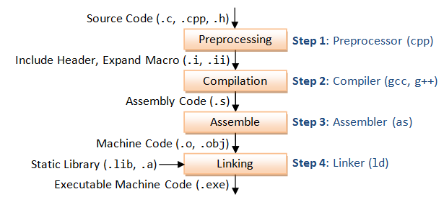
Disassembly: Reverse Engineering to understand program vulnerabilities inherent in the architecture
inspect program memory layout
and detailed machine instructions
C/C++ compilation pipeline
Notes:
C was effectively designed as a higher-level abstraction directly on top of Assembler targeting multiple architectures for portability. C is a high-level low-level language and a low-level high-level language.
The process of disassembly refers to translating machine code back into assembly language, essentially reversing the last step of the compilation process.
disassembly to inspect program binary memory layout
the detailed machine instructions used
to understand the program vulnerabilities better and how architecture could play a role in terms of security
to analyze, debug, or understand a program's functionality without its original source code.

Slide 15
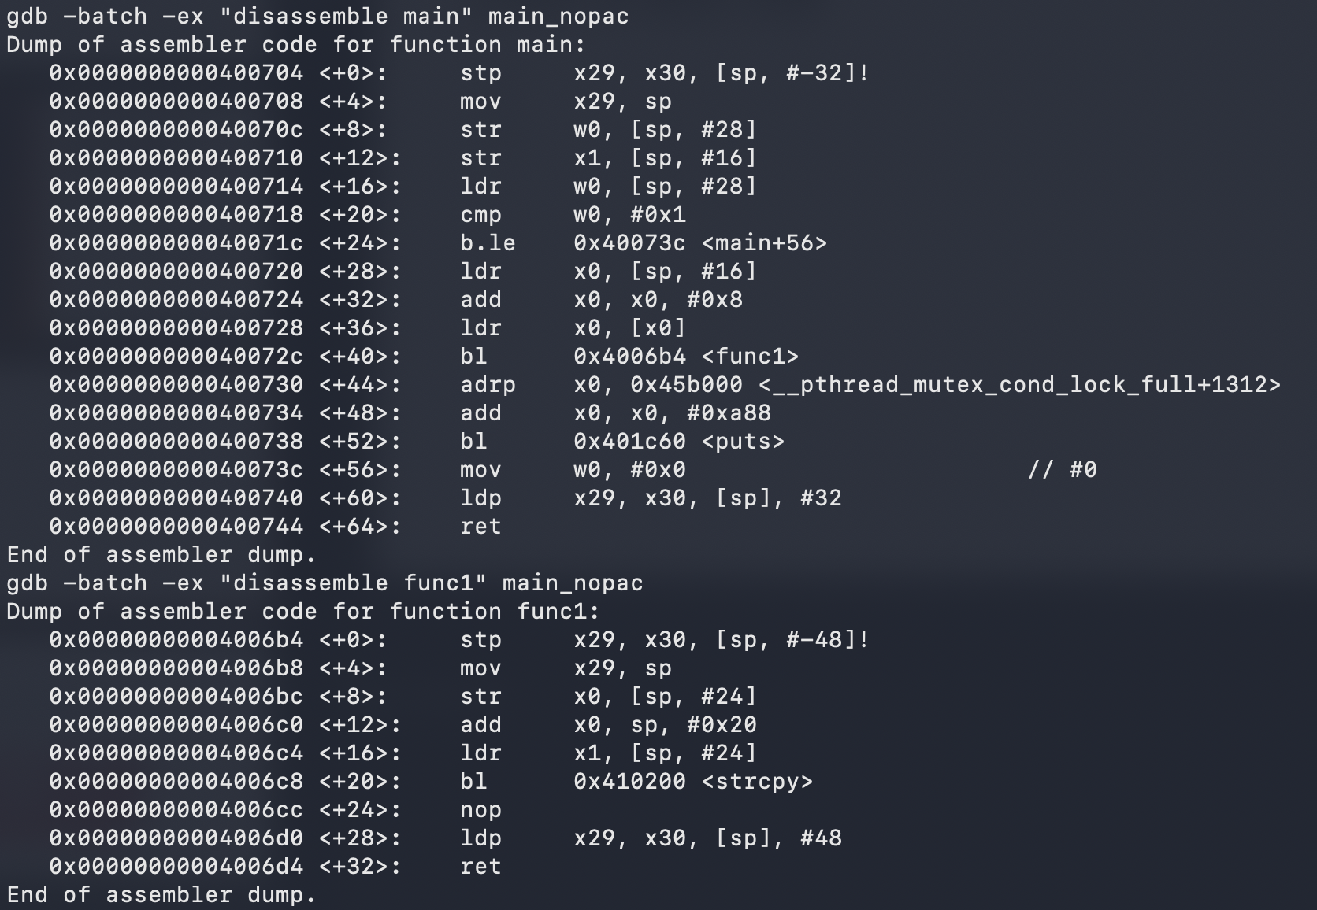
Caveats
Each function has a prologue and epilogue
push FP (x29) and LR (x30) onto stack at offsets 32 and 24
load back and jump to address stored in LR on func exit
LR could potentially be overwritten for ROP attack
Notes:
qemu vs cloud img:
qemu system mode virtual emulation of hardware arch, useful when no direct hardware access
cloud pay-as-you-go service : under the hood prioritize using physical machines of the same CPU architecture
high level explanations, no need details
each line is memory location, instruction mnemonic, register operands, in different addressing modes
function start address
An instruction opcode (short for operation code) is the specific portion of a machine language instruction that tells the CPU which operation to perform, such as ADD, SUB, LOAD, or JUMP. It represents the command itself in binary or hexadecimal, acting as the instruction's "verb" that initiates the CPU's fetch-decode-execute cycle
By pure inspection, we can see that the sequence of instructions that will be interpreted by the hardware are without security protections. They are standard ones, and the hardware will not be aware of any unintentional branches, for example, to func2 if the LR in func1 is being overwritten.

Slide 16
Consequence: remote code execution (RCE)
“An attacker’s ability to run malicious code on a target system or in a target process from a remote location, such as over a network. The worst case could lead to complete system takeover and arbitrary code execution.”
Notes:
lead to complete system takeover, unauthorized access to sensitive information, and installation of ransomware or spyware.
a critical cybersecurity vulnerability that enables
maximal privilege it can have,
complete system takeover

Slide 17
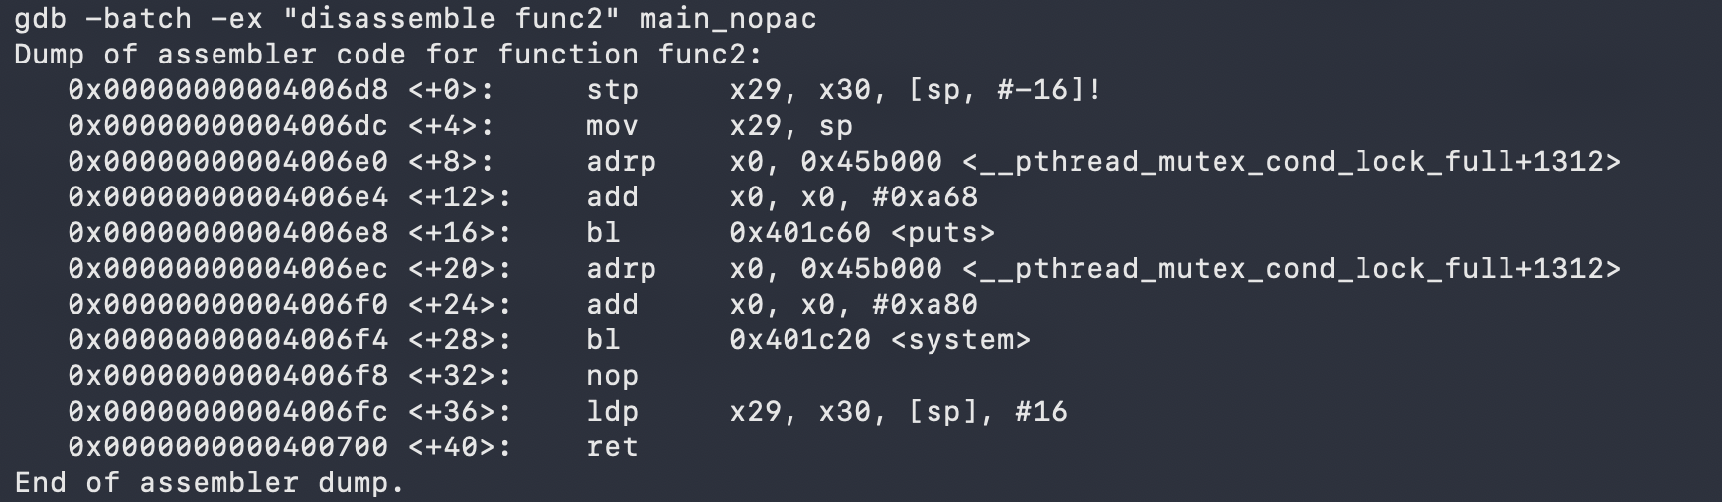
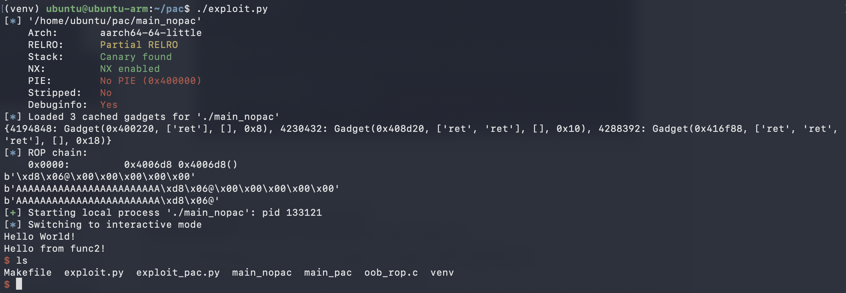
Altered Control flow to func2
ROP exploit chain: to invoke func2()
successful hijacked control flow:
enter func2 + remained in the interactive terminal
Notes:
In your current setup:
The 24 'A's get you to the "door" (the saved Link Register).
The address 0x4006d8 is the person you are jumping to.
The other gadgets are just other tools in the toolbox that you haven't picked up yet.
You have successfully altered execution flow of the program and jumped to address 0x4006f8 (func2).
You will be in an interactive shell prompt whilst still inside the application:
Active Chain
mimicking RCE with local processes rather than process over the network.

Slide 18
Now let’s shift our attention, and questions!
What do you think the hardware-software interface is?
In what ways do you think it could make the software systems more secure?
Notes:
What is the HW&SW Interface? How is it related to software security?

Slide 19
An overview into the computer stack
Application
The software-hardware interface:
Defines how software communicates to the hardware, including the CPU, memory and peripherals
Programming language
Software
Compiler/Runtime
Operating System
Instruction Set Architecture (ISA)
Microarchitecture
Register-transfer level
Hardware
Gates, Circuits, Physics
Notes:
The software-hardware interface is the boundary and communication layer enabling software to control physical computer components.
It consists of device drivers, machine code instructions, and memory-mapped registers, allowing operating systems and applications to send commands to hardware. It acts as a contract defining how software interacts with CPU, memory, and peripherals.
A series of questions :
What do you think is the interface between hardware and software? Or how many of you came across terms such as x86, MIPS, RISC-V? or coming with big company names such as Intel/AMD x86-64, ARMv9 etc.
and more general terms CISC, RISC? What do they mean?

Slide 20
Instruction-set architecture(ISA)
“the abstract, conceptual interface between a computer's software and its hardware, defining the set of instructions (machine code), data types, registers, and memory management methods a processor understands.”
Notes:
in formal terms
formal definitions
It acts as the "language" of the CPU, ensuring that software written for a particular architecture can run on different hardware implementations of that same ISA.
Key components of an ISA include:
Instruction Set: The specific, fundamental operations a processor can perform (e.g., arithmetic, data movement).
Registers: The number, size, and purpose of processor registers available to programmers.
Memory Model: How the CPU accesses and manages memory, including addressing modes.
Data Types: The supported types of data the processor can process directly.

Slide 21
Why do we revisit the ISA for software security?
Currently, software-based mitigations incomplete coverage
compiler static inspection
runtime sanitizers + fuzzing
patches vs exploits in an arms race
Ideally, we desire
Deterministic protection for known classes of vulnerabilities
Mitigation of unknown classes by confining impacts
Notes:
confining impacts within exploited regions
undermined

Slide 22

The big idea
Building security primitives into the architecture, providing software guarantees from the bottom of the computer stack
Notes:
the big idea fore including ISA in security design
machine understandable instructions, registers, data types, memory models,

Slide 23
Two mainstream ISA design philosophy
Philosophy | Complex Instruction Set Computer. one instruction can do many things (Load + Add + Store). e.g. Intel/AMD x86-64 | Reduced Instruction Set Computer. instructions are simple and uniform. e.g. ARMv9, RISC-V, MIPS
Instruction Length | Variable (1 to 15 bytes). Harder to decode. | Fixed (usually 32-bit). Very easy to pipeline.
Memory Access | Memory-to-Register: Most instructions can talk to RAM directly. ADD DWORD PTR [ebx], 5; Add 5 to a number stored at a memory address [ebx] | Load/Store Architecture: Only specific instructions (LDR/STR) touch RAM. LDR w0, [x1] ; Load: Pull value from memory [x1] into register w0 ADD w0, w0, #5 ; Compute: Add 5 to the register STR w0, [x1] ; Store: Put the result back into memory [x1]
Notes:
To understand how to build security into the interface, we need to understand what are the mainstream ISA design philosophies.
In x86, you can perform math directly on a value sitting in your RAM.
simple decoder logic

Slide 24
RISC ISA-based security protections
Notes:
here I want to show you how we can build security into RISC ISAs

Slide 25
Example: ARM Pointer Authentication (PAuth)
PAC* and AUT* instructions at function prologue and epilogue
requires compiler support
Two steps working in synergy:
On saving pointers (e.g., return address) on the stack : CPU signs with a cryptographic hash using a secret key and the current context (like the stack pointer)
On function return: CPU verifies signature
If authentication fails, CPU generates a hardware exception to the OS and OS traps the application
Notes:
The pointer authentication instructions in the Armv8.3-A architecture were introduced as a software security countermeasure for Return-Oriented Programming (ROP) attacks.
a mathematical algorithm that transforms any amount of input data (a message) into a fixed-size, unique, and irreversible string of characters, acting as a "digital fingerprint"
PAC's Solution: Before saving a pointer (like a return address) to memory, the CPU signs it with a cryptographic hash (a PAC) using a secret key and the current context (like the stack pointer). When the function returns, the CPU verifies the signature.
If attackers attempt to modify such a pointer in memory they will also need to compute the right PAC signature for it. Using the ROP example, if the return address stored in the stack is signed and verified before returning to it, the attacker will not be able to control the program flow and an exception is raised.
One of the key uses of the PAC feature is to detect corruption of return addresses in function calls. Because the return address is often stored on the stack, there is a risk that stack corruption can change the return address, allowing an attack to be carried out.
The PAC is computed using a cryptographically strong algorithm. The cryptography key is protected and is unknown to the attacker. Also, the nature of the cryptographic algorithm makes it difficult for an attacker to decode the key by reading authenticated pointers and PACs from memory. Because the keys cannot be determined, the attacker cannot create new PAC codes to validate corrupted return addresses. As a result, PAC significantly reduces the likelihood of undetected return address corruption.

Slide 26
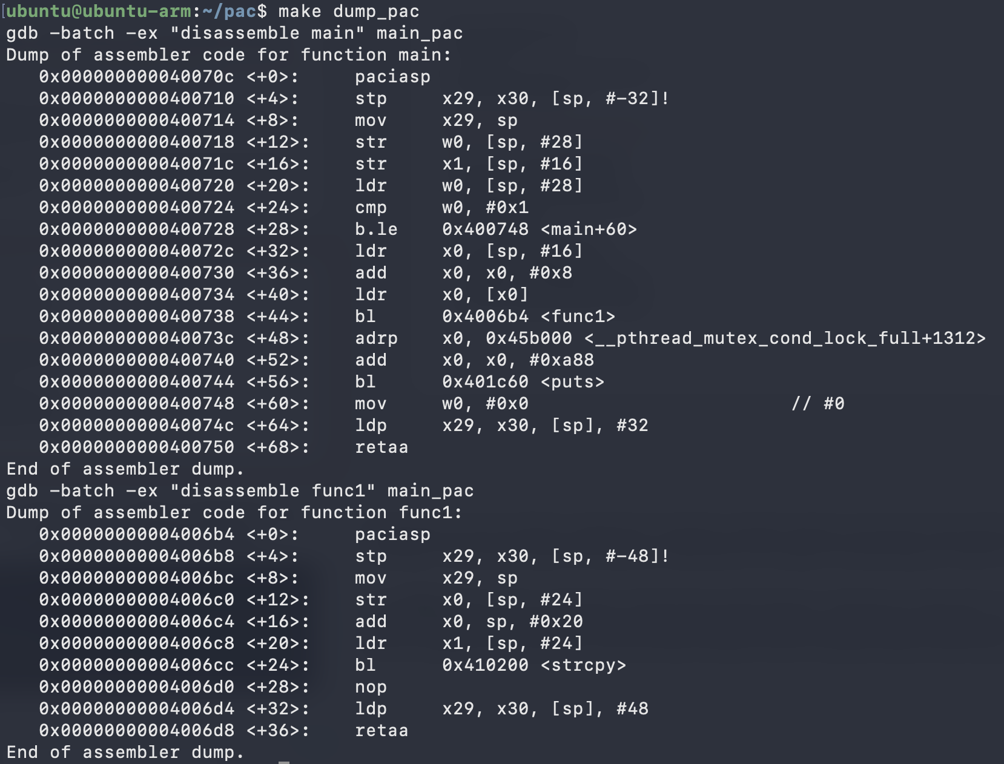
Recompiled with -mbranch-protection=standard compiler support
paciasp instruction signs return address using key A and current SP register
retaa instruction authenticates return address using key A and the SP before branching
Notes:
Generation and use of PAC in applications requires compiler support, as function calls and returns will need to be modified. This Learning Path will help you understand the impact of protecting your code in this way..
The paciasp instruction (Pointer Authentication Code for Instruction address, using key A, with SP modifier)
The RETAA (Return from subroutine, with pointer authentication, using key A) instruction in AArch64 (ARMv8.3-A and later) is used to return from a function while verifying the integrity of the return address. It authenticates the address in the Link Register (LR) using Key A and the Stack Pointer (SP) as a modifier before branching.

Slide 27
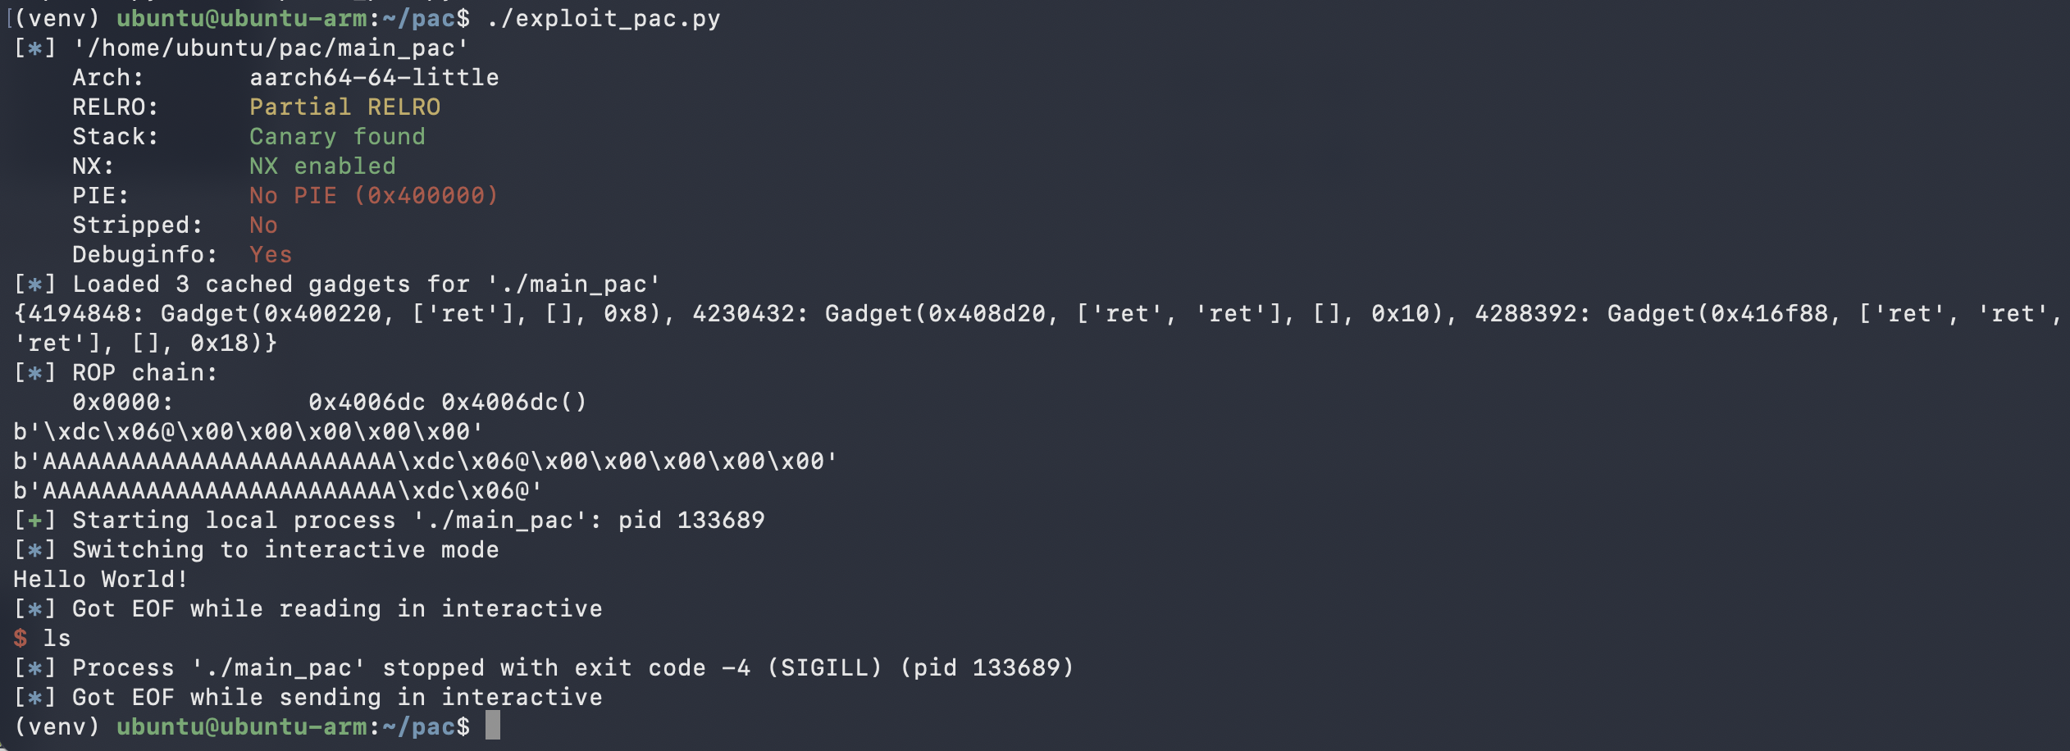
PAuth catches return address integrity fault and traps the same vulnerable program
Notes:
Run exploit on the newly compiled program,
In x86, you can perform math directly on a value sitting in your RAM.
simple decoder logic
thrown out from the attached terminal
direct proof that built in security in the ISA is working for software applications

Slide 28
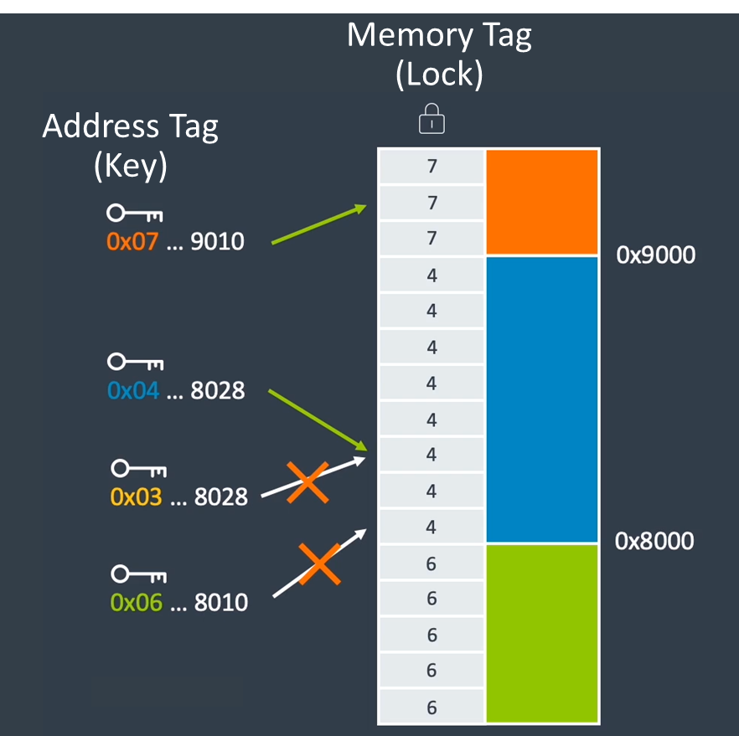
There are many other hardware security extensions, each with different design approach
ARM Memory Tagging Extension (MTE)
Capabilities Hardware-Enforced RISC Instructions (CHERI)
tag
64bit metadata
64bit pointer
Capability
Hardware Enhanced RISC Instructions
Notes:
Apart from the pointer authentication scheme, we have many other hardware security extension that have different design approach.
For example, MTE adds new instructions for runtime memory access.
CHERI capability works by directly adding a new pointer type in the architecture and changing its layout in memory by adding security metadata alongside it.
The point here is the design space for adding security into the architecture and the ISA is quite large. Each microarchitecture can have the choice to implement any security extension as needed.
The pointer authentication instructions in the Armv8.3-A architecture were introduced as a software security countermeasure for Return-Oriented Programming (ROP) attacks.
PAC's Solution: Before saving a pointer (like a return address) to memory, the CPU signs it with a cryptographic hash (a PAC) using a secret key and the current context (like the stack pointer). When the function returns, the CPU verifies the signature.
If attackers attempt to modify such a pointer in memory they will also need to compute the right PAC signature for it. Using the ROP example, if the return address stored in the stack is signed and verified before returning to it, the attacker will not be able to control the program flow and an exception is raised.
One of the key uses of the PAC feature is to detect corruption of return addresses in function calls. Because the return address is often stored on the stack, there is a risk that stack corruption can change the return address, allowing an attack to be carried out.
The PAC is computed using a cryptographically strong algorithm. The cryptography key is protected and is unknown to the attacker. Also, the nature of the cryptographic algorithm makes it difficult for an attacker to decode the key by reading authenticated pointers and PACs from memory. Because the keys cannot be determined, the attacker cannot create new PAC codes to validate corrupted return addresses. As a result, PAC significantly reduces the likelihood of undetected return address corruption.

Slide 29
Question
What commonalities do you think there are for these hardware security extensions?
Notes:
What is the HW&SW Interface? How is it related to software security?
What commonalities can you see for these hardware security extensions?
let people think
“Are there any commonalities among these security mechanisms, even though each are designed to work very differently?" Then we will talk about the similar design approach of "hardware-software-semantics codesign", "levels of software protections", and "trade-offs".

Slide 30
Hardware-Software-Semantics Codesign
New instructions to the Instructions Set Architecture
e.g. MIPS, RISC-V, Arm64, x86-64
New decoding logic, data-path to the microarchitecture
Formal verification of the new instructions to prove correctness
Port software stacks to the secure architecture
e.g. OS, compiler, language runtimes, assembler, linker, loader, debugger, etc.
tape-out new chips with experimental security extensions
Benchmarking and analysis
Notes:
One common aspect is their design approach
nevertheless how each extension works, they all follow this development cycle
- start from designing new instructions, ensuring no overlaps in encodings
- then design new decoding logic, data path, registers to the microarch
- verify the new instructions do not break the existing functionalities of the chip
- tape out
- adapt our software stack to make use of the hardware provided protection features
- then we benchmark software systems
- loop back to optimise the design

Slide 31
Levels of software protection
operating system
bootloader file
system-wide userspace
environment variables, shell configuration files
single application at runtime
allocator tunable, compiler flags
Notes:
Another common thing they share is that we have to enable these security features on the software side
have a number of scope we can add the protection for
- for the kernel space, enable from the bootloader
- systemwide userspace, protect from the start of the device, by using shell config files and env vars
- or if perceived runtime overhead too large to enable protection for the whole system, could optionally enable at runtime for a single application

Slide 32
Design Tradeoffs
Software Performance
Execution time, memory footprint
Ecosystem
% Lines of Code Change
Security
Coverage, deterministic or probabilistic
Functionality
Backwards Compatibility
Power, Performance, Area
Microarchitecture, chip design
Notes:
And of course, we will meet a number of trade-offs in design.
From the software perspective,
- how much overhead are there for execution time, memory footprint
- how much change is needed to use that hardware provided feature in the ecosystem, i.e. libraries, toolchains
- does it break the existing functionality of the software?
- how much security improvement does this feature actually give? is it deterministic guarantee for some classes of vulnerabilities? or is it probablistic?
In terms of hardware,
- how much more area and power is needed? does it slow down the number of operations the cpu can process per second?

Slide 33
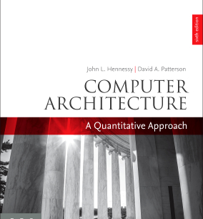
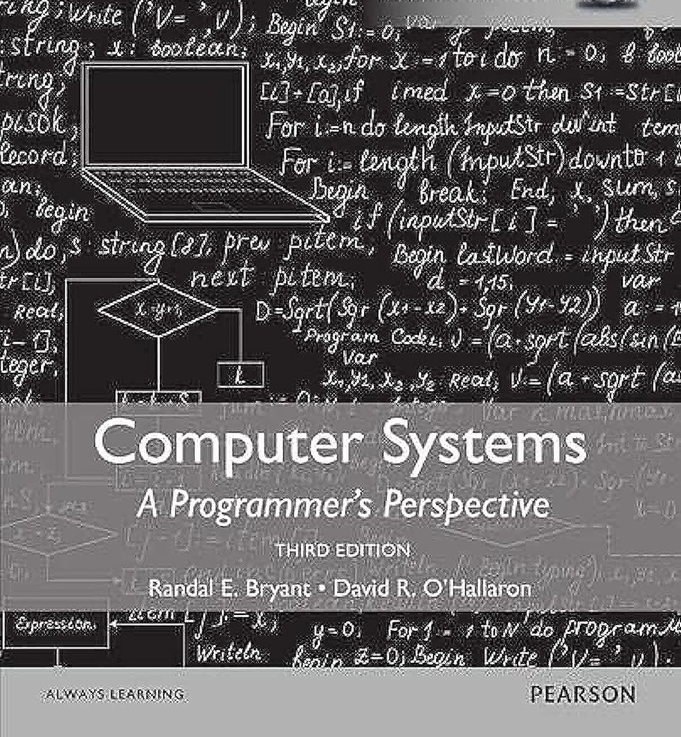
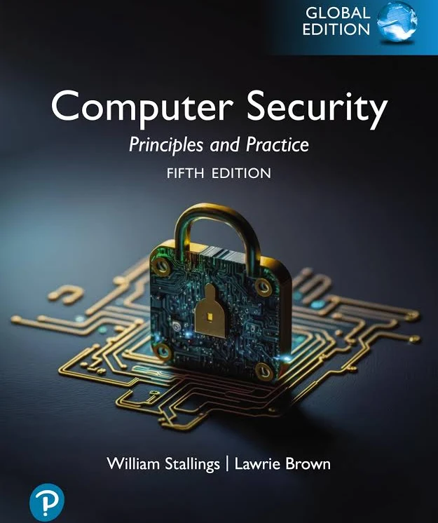
More Readings
Undergraduate-level introduction to computer architecture, systems and security
Notes:
The text now features examples from the RISC-V (RISC Five) instruction set architecture, a modern RISC instruction set developed and designed to be a free and openly adoptable standard. It also includes a new chapter on domain-specific architectures and an updated chapter on warehouse-scale computing that features the first public information on Google's newest WSC.
Since this is a multi-disciplinary research, so if you are interested, here is a list of undergrad-level introduction to the areas that could be relevant

Slide 34
Questions?
Notes:
Thanks for your time and any questions?

Slide 35
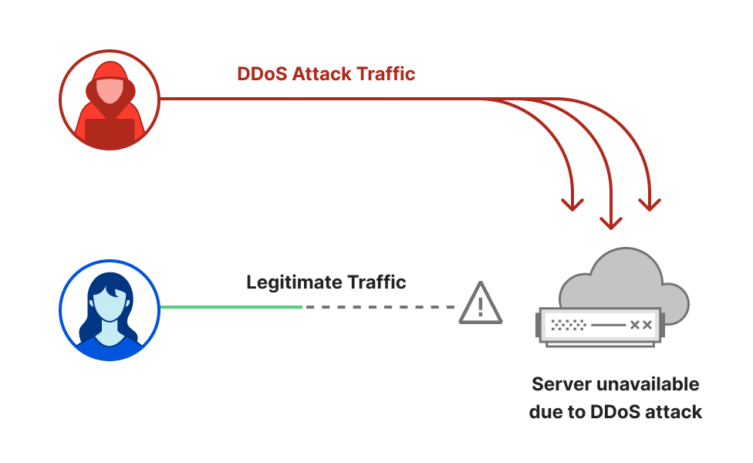
Example1: DDoS Attack
Notes:
HTTP/2 Rapid Reset campaign of hyper-volumetric DDoS attacks
Cloudflare’s systems automatically detected and mitigated the vast majority of attacks. We deployed emergency countermeasures and improved our mitigation systems’ efficacy and efficiency to ensure the availability of our network and of our customers’.
affect Google, Cloudflare, etc

Slide 36
Levels of software protection
operating system
bootloader file
system-wide userspace
environment variables, shell configuration files
single application at runtime
allocator tunable, compiler flags

Slide 37
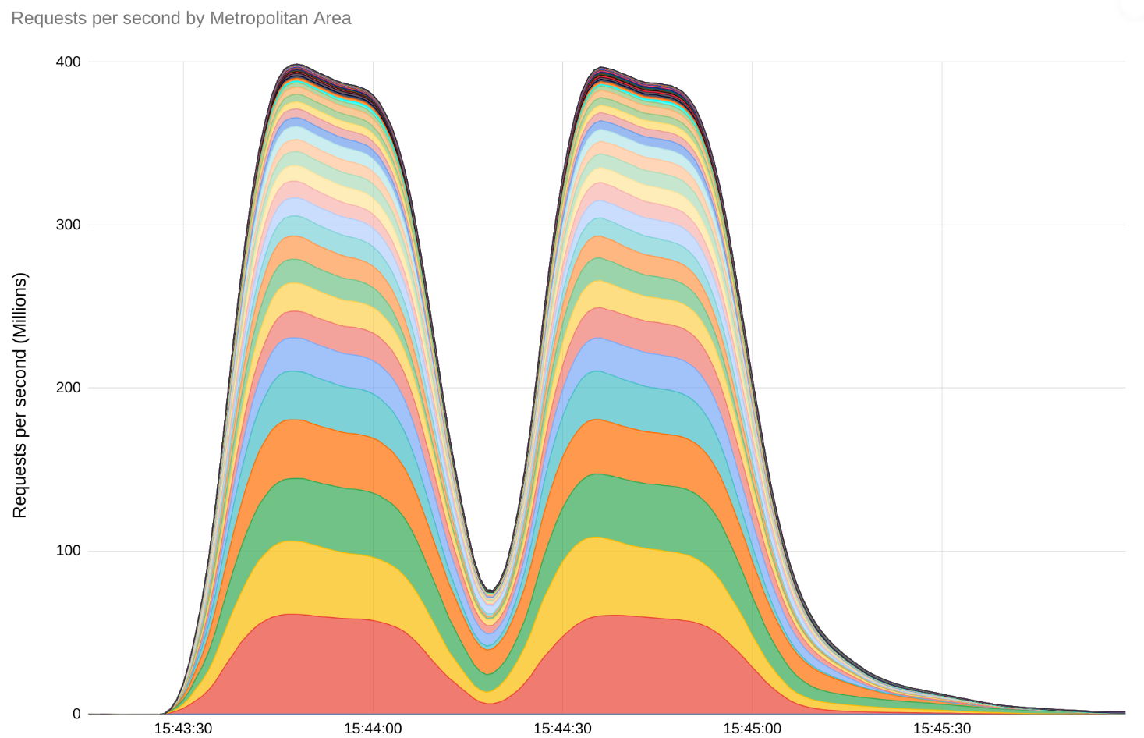
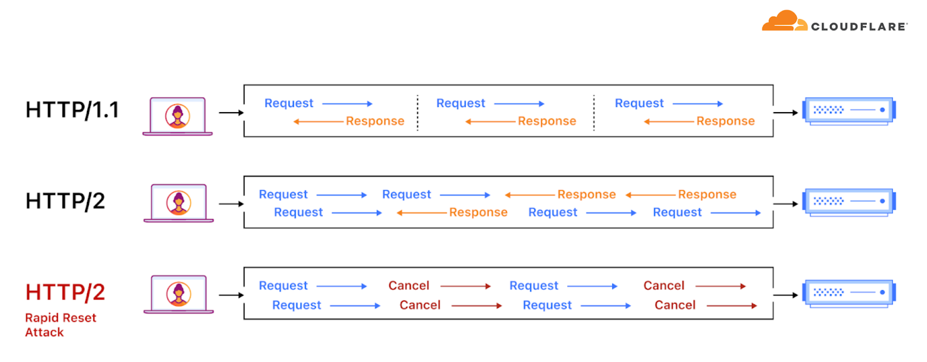

Slide 38
CVE databases
Two broad categories of attacks
memory safety
buffer overflow/use after free
direct manipulation of machine memory
input injection
lack of input sanitization
logic bugs

Slide 39
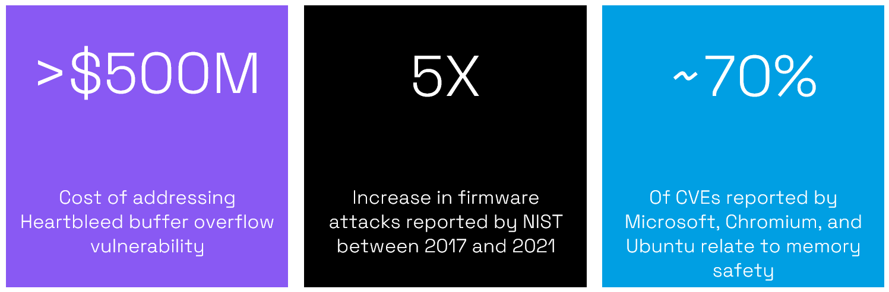

Slide 40
Attacks are often categorised based on the underlying vulnerability they exploit

Slide 41
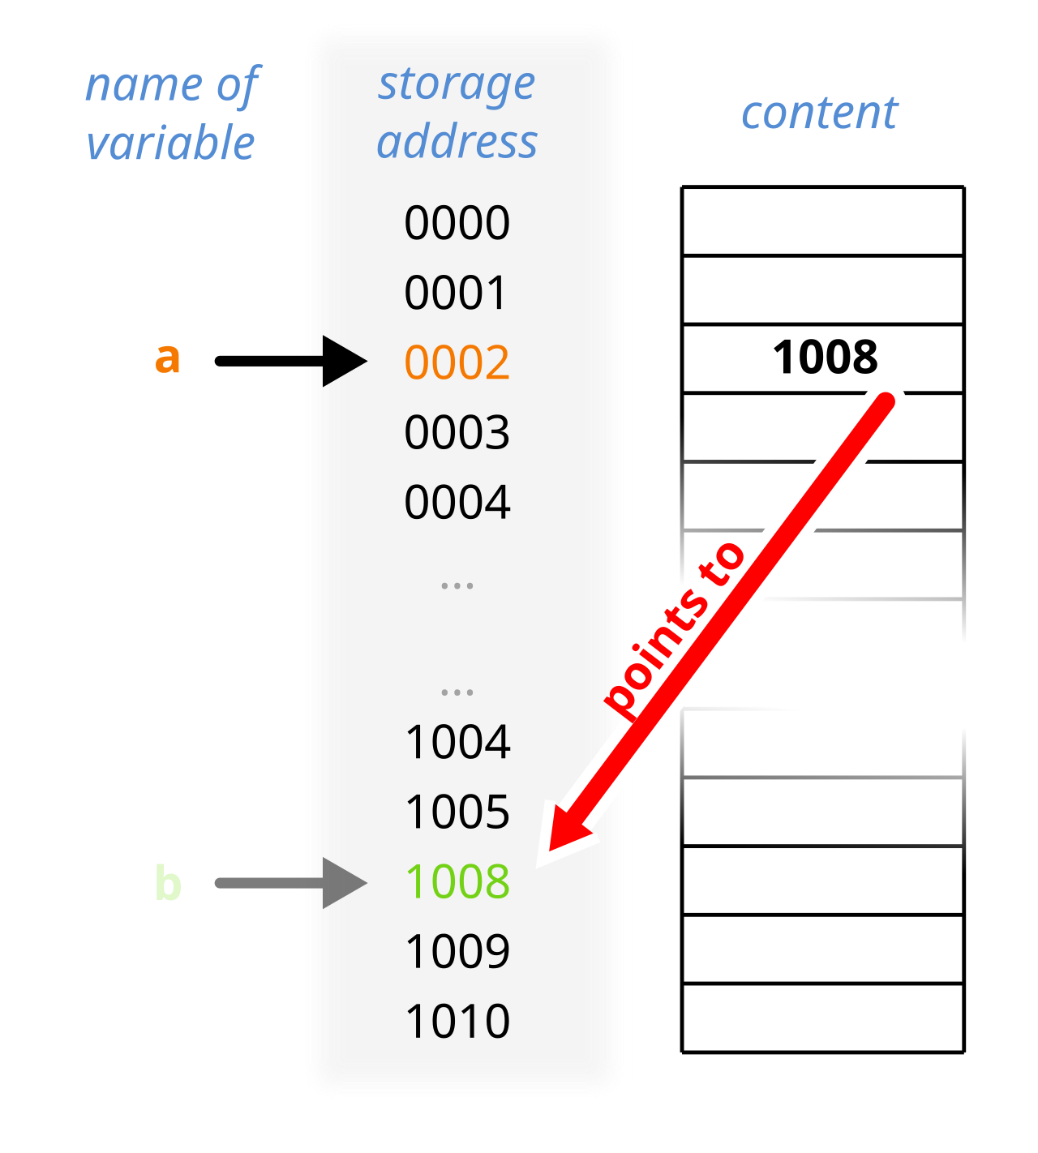
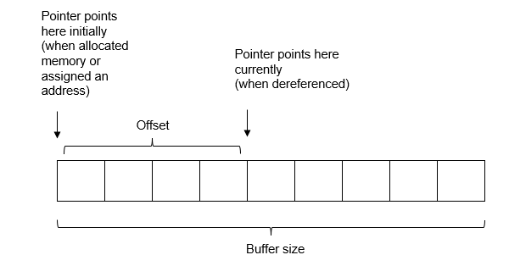
Notes:
https://www.mathworks.com/help/codeprover/ref/illegallydereferencedpointer.html
https://en.wikipedia.org/wiki/Pointer_%28computer_programming%29

Slide 42
Case study: Cpython language runtime
Notes:
What is lang runtime? Software layer or VM that executes code and manages resources while a program is running
runtimes handle memory allocation, security checks, and interaction with the operating system.

Slide 43
Example2: Malware
Notes:
These remain the #1 type of exploited, critical, and zero-day vulnerabilities, as highlighted by CISA and NSA.

Slide 44
Types of attacks
memory safety-based
Notes:
Memory Safety Attacks (e.g., Buffer Overflow): These exploit bugs in low-level languages (like C/C++) to overwrite memory, execute arbitrary code, or crash systems. They deal with direct manipulation of machine memory.
Injection Attacks (e.g., XSS, SQLi): These exploit a failure to properly sanitize input. The application mistakenly treats user-supplied data as executable code or commands.

Slide 45
Classes of Vulnerabilities
Memory safety
Others

Slide 46
Mitigations?
Patches
e.g., HTTP/2 Rapid Reset vulnerability (CVE-2023-44487).

Slide 47
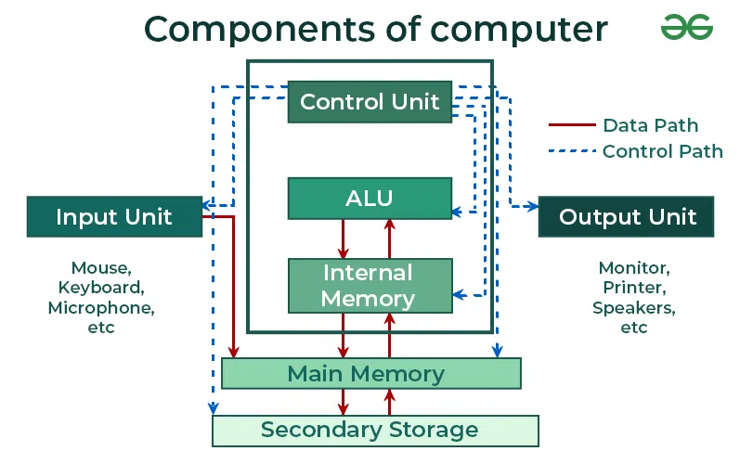


Slide 48
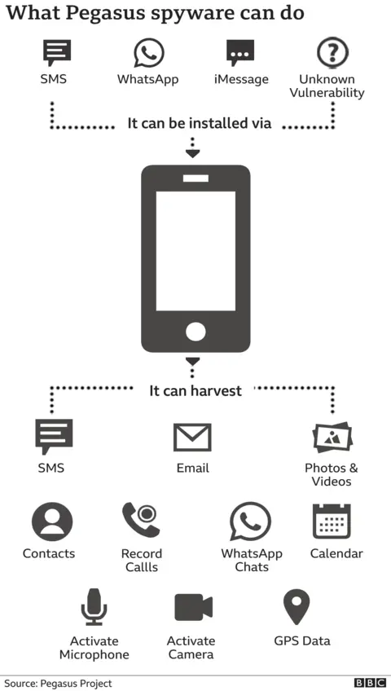

Vulnerabilities and Cyberattacks in real life
Zero-click attacks
Malware/Ransomware
WannaCry
(CVE-2017-0147)
Pegasus spyware
(CVE-2024-4863 BLASTPASS)
Notes:
Computer security (also cyber security, digital security, or information technology (IT) security) is a subdiscipline within the field of information security. It focuses on protecting computer software, systems, and networks from threats that can lead to unauthorized information disclosure, theft or damage to hardware, software, or data, as well as to the disruption or misdirection of the services they provide.^{[1][2]}
This year we are celebrating the 30th anniversary of the Morris
Worm, one of the first known exploitations of a memory safety bug, and the problem is still not
^{solved.}
Anonymous is an international collective, organized as a decentralized group of activist and hacktivist individuals, best known for orchestrating cyberattacks against governments, government institutions, agencies, corporations, and the Church of Scientology.
The WannaCry ransomware attack was a worldwide cyberattack in May 2017 by the WannaCry ransomware cryptoworm, which targeted computers running the Microsoft Windows operating system by encrypting data and demanding ransom payments in the form of bitcoin cryptocurrency.[
https://en.wikipedia.org/wiki/WannaCry_ransomware_attack
WannaCry ransomware attack on 12 May 2017 affected hundreds of thousands of computers in more than 150 countries.^{[2]}
Common Attack Methods:
Malware: Malicious software including viruses, spyware, and ransomware.
Phishing: Fraudulent emails or messages aiming to steal sensitive data.
DDoS Attacks: Overwhelming systems to take them offline.
SQL Injection: Inserting malicious code into server queries.
Zero-day Exploits: Targeting unknown software vulnerabilities.

Slide 49
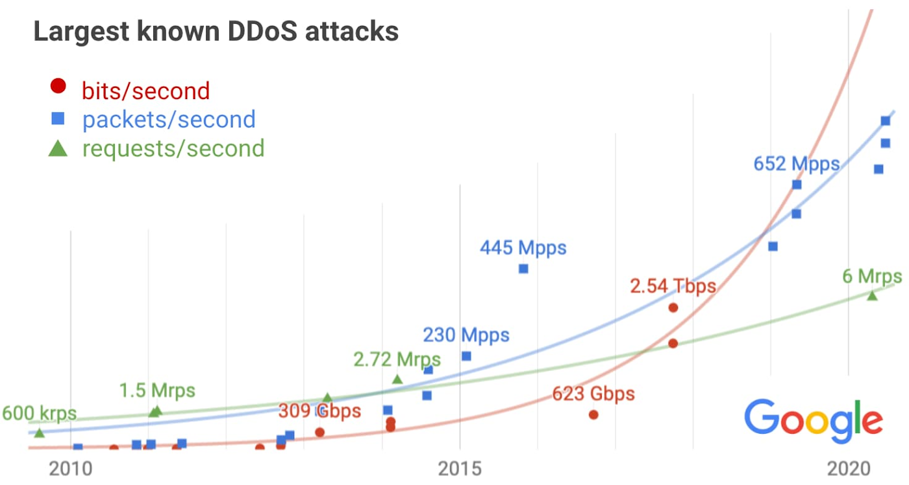

Slide 50
Example 2: Memory Tagging Extension (MTE)
Runtime Memory Access
Top Byte Ignore
lock-and-key mechanism

Slide 51
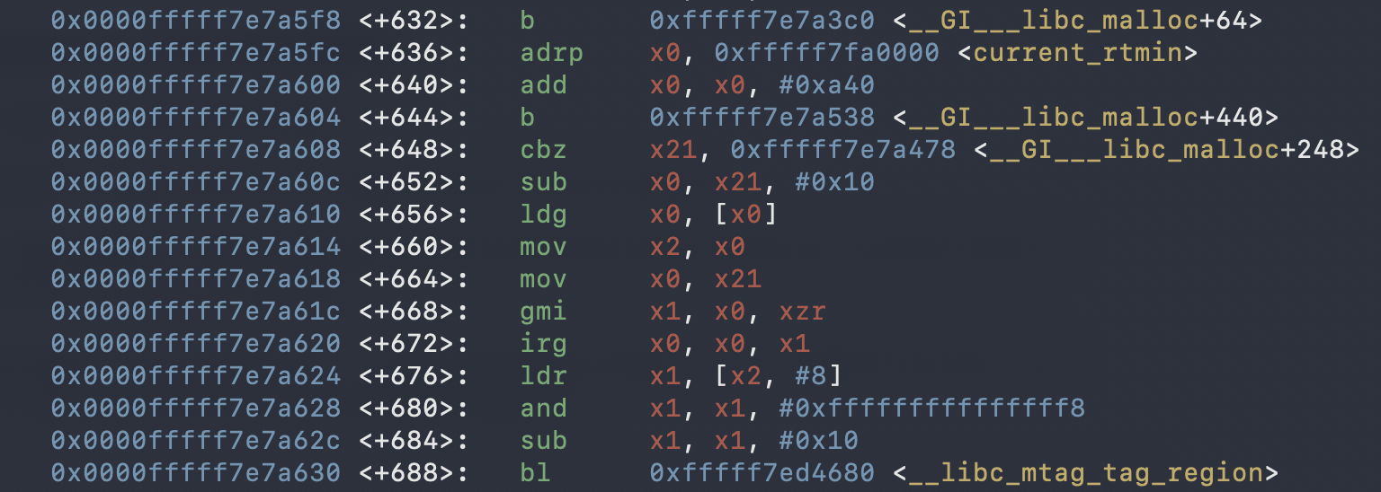
Tag manipulation instructions
libc malloc

Slide 52
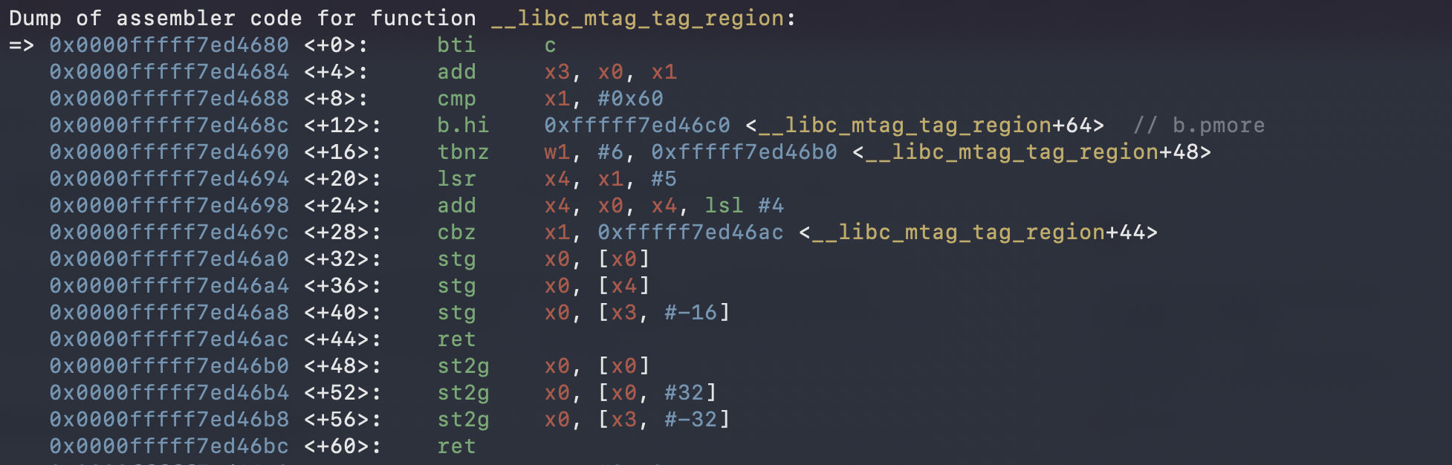

Slide 53
Example 3: Access Control vs Capabilities
Access Control Lists | Capability Lists
It is defined object-wise (resources). | It is defined subject-wise (users, processes, and procedures).
It lists the various subjects along with the rights of an object. | It lists the various objects along with the rights permitted on them for a subject.
Each object (resource) has a list of pairs of the form <subject, access rights> | Each subject (user, process procedure) has a list of pairs of the form <object, access rights>

Slide 54
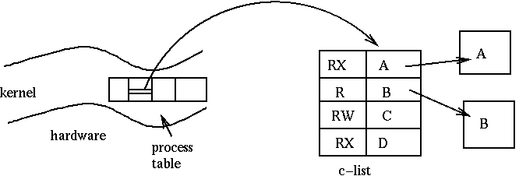
Key Security Principles
Principles of Least Privilege
Principles of Intentional Use

Slide 55
CHERI: hardware-assisted memory safety
tag
64bit metadata
64bit pointer
Capability Hardware-Enforced RISC Instructions (CHERI)
An architecture-agnostic memory protection model that leverages hardware deterministic actions against illegal memory access
A hardware-software-semantics codesign project now into its 15th year
Capability
Hardware Enhanced RISC Instructions
Notes:
Policy-based/defined
CHERI 15th year anniversary exhibition at William Gates Building during March
CHERI Blossom conference 25-27th March
our exploit model/attack model is on software
Methodology : what does this mean?

Slide 56
Levels of protection
bootloader file
system-wide user-space
environment variables, shell config files
single executable at runtime
libc tunable, compiler flags
kernel-space

