Slide 1
Enhancing temporal safety of CHERI-enabled language runtimes with ARM Memory Tagging Extension
Qianhui Wang
Supervisor: Robert N.M. Watson
10 Mar 2026

Slide 2

Background: CHERI C/C++ memory safety
CHERI mitigates memory safety vulnerabilities in C/C++ through capabilities
Architecturally, capabilities distinguish pointers from memory addresses
Spatial safety through hardware enforcement
Temporal safety through software-assisted memory quarantines and capability revocation
1-bit
tag
v
Upper bound
Use-after-reallocation
perms
otype
relative bounds
128-bit
capability
Pointer address
Memory allocation
64-bit virtual address
freed
Quarantine
buffer
Lower bound
fast & efficient ✅
Virtual address space
Overhead❓
Allocator
freelist
Notes:
CHERI is a capability-based protection model that targets software C/C++ memory safety.
Architecturally, capability is a distinct data type from integer memory addresses.
It extends the conventional 64-bit pointer with security metadata such as bounds, permissions and object types and restricts privileges granted to pointers from escalating or being forged.
These protections are enforced strictly through hardware checking on each memory access.
This means CHERI’s spatial safety is fast and efficient.
On the other hand, CHERI achieves a relaxed notion of C/C++ temporal safety “use-after-reallocation”, through software-assisted memory quarantines and capability revocation mechanism. This means whenever we have a freed allocation, we want to push it into a quarantine buffer, wait until the buffer reaches a certain threshold and do batch revocation of the capabilities pointing to those freed regions. This ensures that the stale capabilities pointing to those memory regions are fully revoked before the same memory can be reused. However, we will see later that this becomes the performance bottleneck in language runtimes which we would like to overcome and is the core of this research problem.
(1) on free, paint kernel bitmap + push to quarantine buffer
(2) revocation finishes, batch clean bitmap + release memory to allocator

Slide 3



CHERI C/C++ is also useful for managed languages
Managed languages rely on ~M lines of memory-unsafe C/C++ that are prone to bugs, e.g., 0.7M in CPython, 1.2M in JDK, 2M in V8
1 critical memory-safety vulnerability every 2 days in V8
Dynamically
Linked C/C++
Need to protect the language’s smaller memory allocations
and memory that flows across language borders at runtime
FFI escape
Runtime GC & Bounds Check
512B
Internal allocated
small objects
32B
16B
OS memory
mappings
4KB/1MB CHERI-protected page
Notes:
While CHERI primarily targets software vulnerabilities in C/C++, as these languages have no guarantees that pointers are used correctly. CHERI is also useful for higher-level languages such as Python, Java, JavaScript which have a runtime that manage the pointers and do the GC and bounds checking on behalf of developers.
This is because underneath those languages, there are millions of lines of vulnerable C/C++. One critical vulnerability in those runtimes could impact the whole ecosystem reliant on that interpreter.
This highlights the place where CHERI could give better protection for.
Furthermore, those languages themselves have a number of internal allocators that are often in charge of small object allocations. These are not protected by CHERI kernel or libc allocators. But there is a need to protect those memory as they could easily be passed to vulnerable code via foreign function interface at run time.

Slide 4
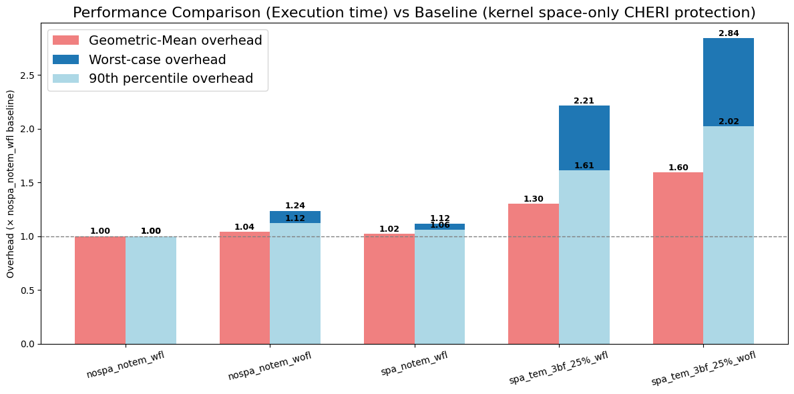
Limitation: CHERI temporal safety incurs high overhead for language runtimes [a study on CHERI-CPython]
High churn rate of small object allocations and frees in runtimes
90% increase in memory traffic due to the need for quarantine
30% execution time overhead + another 30% due to unfriendly interaction with the language’s type-based freelist mechanism
Notes:
What we did last year was we added CHERI support to the CPython’s internal allocators.
We chose Cpython as a case study because it has much simpler runtime. It does not have JIT compilers, so we can much quickly obtain a prototype than directly jump to work with V8.
We did a performance study on both spatial and temporal safety cost.
As with expected, temporal safety overhead is main cause of concern.
Quarantined memory causes 90% geometric mean increase in memory traffic, and in terms of exec time, it is 30% overhead plus another 30 due to unfriendly interaction with the language’s type-based freelist mechanism.
Spatial-safety :
40% base overhead due to pointer width and alignment expansion; 2% overhead due to allocator adaptation
Temporal-safety :
30% execution-time overhead & 90% max RSS overhead due to quarantining
Additional 30% and 12% overhead due to disabling freelists

Slide 5
Key observations: prototyping [temporary] vs essential overheads[research-worthy]
Prototype software:
Preliminary CHERI support in language allocators
Yet to explore integration of language-level GC with capability revocation mechanism
Prototype hardware:
ARM Morello board has known microarchitectural limitations
There are intrinsic limitations to the CHERI temporal safety mechanism on language runtime allocators:
Could we reduce the amount of memory quarantined and thus the total amount of memory traffic?
Could we reduce the number of revocation sweeps required and thus improve the execution time?
Notes:
The key message here is that there are two classes of overheads: prototyping costs which are specific to the implementation, and essential overheads to the temporal safety mechanism which are more interesting research-worthy problem.
For that study on CPython, we recognise our prototypes are not optimized and not profiled thoroughly. For example, we only achieves a functional software model for the language allocators and not yet optimise the design.
We have not seriously investigated the possibility of integrating language-level GC with cap revoker. That could reduce time taken for the sweep as GC can inform the revoker where stale caps are, speed up revocation by having that in young generation/compaction phase, pace sweeps at program “safe points”(io or thread barrier) to hide heavy-lifting from time-critical tasks.
Our results are also collected on an experimental platform, ARM Morello prototype that has known performance limitations.
What we want to really know is if we could improve the temporal safety mechanism on language runtimes:
Specifically:
if we can reduce the amount of memory quarantined and thus the total amount of memory traffic?
if we could reduce the # of revocation sweeps needed and thus the execution time?

Slide 6
ARM Memory Tagging Extension (MTE)
MTE provides hardware protection against memory safety errors at run-time; software decides faulting modes for speed/security
Pointer address
MTE tag
56-bit virtual address
64-bit
pointer
64-bit
pointer
MTE tag
56-bit virtual address
Pointer address
Memory allocation
Virtual address space
Notes:
What we turn to is ARM memory tagging extension:
this is a hardware feature that provides protection against runtime memory safety errors, by using the idea of pointer colouring.
Each pointer now has 4-bit colour tag, and its associated memory region will be assigned the same colour.
The colours of the memory and the pointer will be checked for mismatch on each memory access, such as read/write.
If colours do not match, hardware forbids that access and raises exception to the kernel.
Software has the flexibility to choose a relaxed/strict faulting mode in respect to higher performance or security needs.
The best part of this approach, if you note, is that on each memory free, we have another 14[if you reserve tag 0 for the untagged memory]/15 colours to play with for immediate reallocation. And we think this could reduce the quarantine needs for each memory free in the current CHERI temporal safety mechanism and also closing the gap in the threat model from UAR to UAF.
Under the hoods, the MTE extension introduces two types of tags:
- Address Tags, and,
- Allocation Tags (a.k.a., Memory Tags)
Address Tag: which acts as the key. This adds four bits to the top of a virtual address. It is built on AArch64 'top-byte-ignore'(TBI) feature.
Allocation Tag: which acts as the lock. Allocation tags also consist of four bits, linked with every aligned 16-byte region in the physical memory space. Arm refers to these 16-byte regions as tag granules. The way Allocation tags are stored is a hardware implementation detail.

Slide 7
How could CHERI work with MTE in synergy?
What are our goals?
retain CHERI deterministic security guarantees vs MTE probabilistic nature
achieve MTE performance [best ~2-17% overhead*] & close the gap from UAR to UAF
Our initial use-case study:
explore using the MTE colours for immediate reallocation
this could lead to an ideal 15x reduction in #revocation sweeps
Architecturally, add MTE pointer tags into capability metadata and retain MTE physical memory tags
*Noh, Taehyun, et al. "ARM MTE Performance in Practice (Extended Version)."
arXiv preprint arXiv:2601.11786 (2026).
Notes:
So, how could CHERI work with MTE?
Our primary goals would be to retain the security guarantees of CHERI, its deterministic mitigation against multiple categories of attacks/vulnerabilities.
On the other hand, we want to achieve that ideally with only the performance overheads of MTE.
best geomean 2-17% overheads depending on the microarchitecture and software faulting mode chosen. [very recent performance study done by Google and US academics]
Our initial focus would be exploring using colours for immediate reallocation – since we already have results on the unoptimised allocators. There are many other use cases such as colouring memory passed across compartments.
Ideally, this would result in a 15 times reduction in exec time. There will be a practical limit to it, and that will be the focus of later stage PhD study.
Architecturally, we would investigate where to add the MTE pointer tags and how to fit the MTE physical memory tags into the CHERI cache hierarchy.

Slide 8
Progress update: CHERI/MTE threat model study
Difficulties:
support for MTE in mainstream OSes, compilers, hypervisors is mostly under development
devices and emulators implement different versions of FEAT_MTE
 | CHERI (morello) | Apple EMTE (m5 chip) | QEMU-MTE3 Linux | QEMU-MTE3 FreeBSD[buggy]
UAF | UAR | ✔️ 🎲 | ✔️ 🎲 | ✔️ 🎲
OOB | ✔️ | Heap: ✔️ 🎲 Stack: pthread no support Global: ？ | Heap: ✔️ 🎲 Stack: Global: ⨯ | Heap: ✔️ 🎲 Stack: ⨯ Global: ⨯
read-only PTR | ✔️ | ⨯
IPC | ✔️ | ⨯
monotonicity | ✔️ | ⨯
pointer type confusion | ✔️ | ⨯
Work in Progress
Notes:
threat model study of CHERI against various practical MTE implementations, e.g., Apple’s EMTE on m5, Linux and FreeBSD with MTE support on QEMU’s MTEv3
There are some slowdowns due to having to patch very immature software stack supports.
A first glance of this table reveals the mutual compatibility in terms of the classes of vulnerabilities they protect against.
This is a convincing first result that motivates our attempt to combine the two security technologies together.

Slide 9
Looking ahead: design an architectural model that combines CHERI & MTE and build a software prototype for evaluation
An architectural model such as QEMU is a fastest way to validate our hypothesis on whether CHERI+MTE could reduce memory traffic on language runtimes
Later accurate microarchitectural performance studies could be done by feeding QEMU-generated traces into Gem5 cache model
MTE-related instructions targeting morello ISA
implement a QEMU target emulating both CHERI and MTE features
port CheriBSD or FreeBSD+MTE
Performance studies on CHERI+MTE-enabled runtimes
optimise
iteratively
Notes:
For the bigger picture, our methodology is hardware-software codesign.
But we will be using models initially to rapidly validate our hypothesis – we are interested in knowing whether CHERI+MTE could reduce memory traffic on language runtimes -- QEMU could report accurate results on that.
So for the initial stage of the research, we will produce a QEMU target that emulates both CHERI and MTE features, port OS, compiler toolchains, language runtimes and do more perf studies.
For later-stage interest in accurate microarchitectural memory footprints, we could feed QEMU-generated traces into Gem5 cache model.
but we haven’t thought about this in depth.

Slide 10

Qianhui Wang
qw304@cam.ac.uk

