Slide 1
Accessibility Service
Kyeong-Min Han

Slide 2
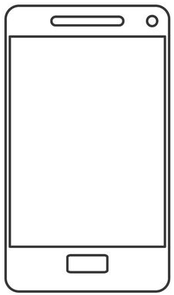
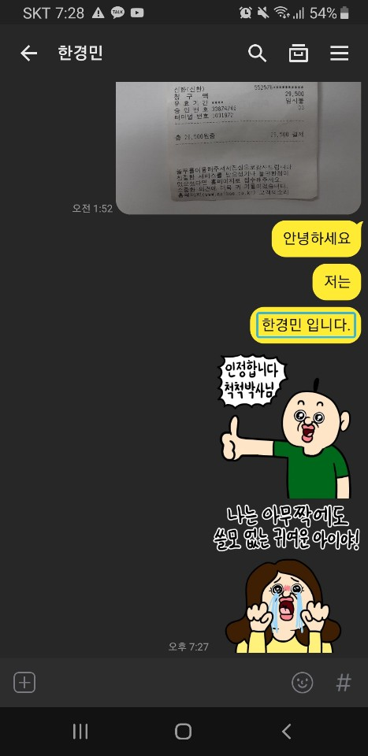



Introduction
Accessibility services assist user with disabilities in using Android devices and apps
한경민 입니다.
Click()
Callback()
System
Accessibility App

Slide 3

Background
Lifecycle
Turn on
<Accessibility Service>
onServiceConnected()
Create:
Service
Setting
Accessibility App
Turn off
<Accessibility Service>
disableSelf()
Accessibility Service
Destroy:
Setting
Accessibility App

Slide 4
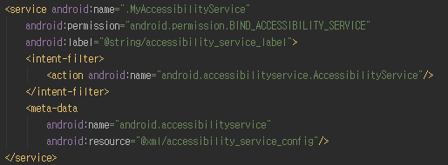
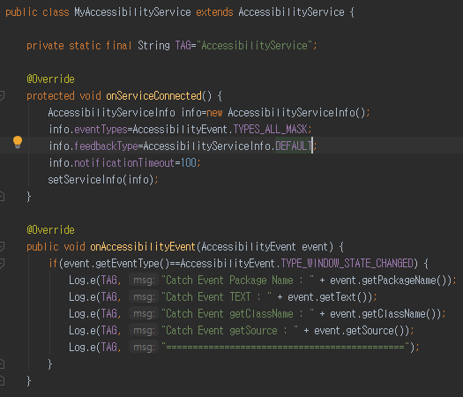
Implementation
Code
Setting
<AndroidManifest>
Event receive
<MyAccessibilityService.java>

Slide 5
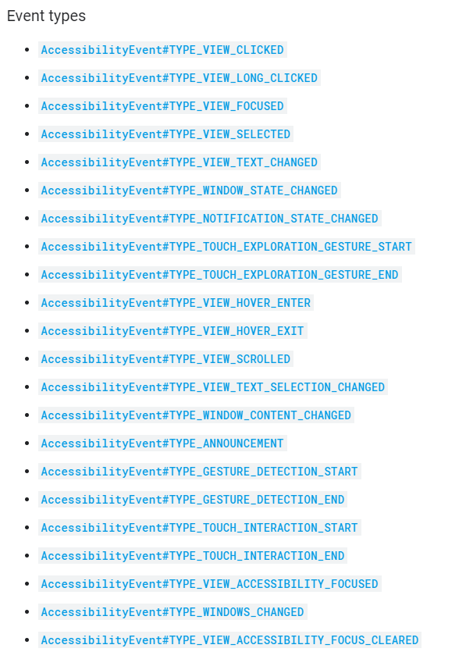
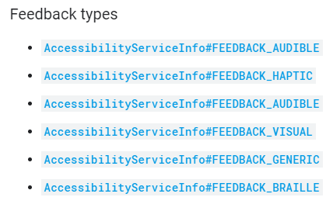
Implementation
Event type, feedback type

Slide 6
Implementation
getEventType()
getRecordCount()
getRecord()
getClassName()
getClass()
getSource()
getContentDescription()
getText()
getPackageName()
getAction()
getContentChangeTypes()
getEventTime()
getMovementGranularity()
getWindowChanges()
accessibilityEvent Methods
getAddedCount()
getBeforeText()
getCurrentItemIndex()
getFromIndex()
getItemCount()
getMaxScrollX()
getMaxScrollY()
getParcelableData()
getRemovedCount()
getScrollDeltaX()
getScrollDeltaY()
getScrollX()
getScrollY()
getToIndex()
getWindowId()
Event receive

Slide 7
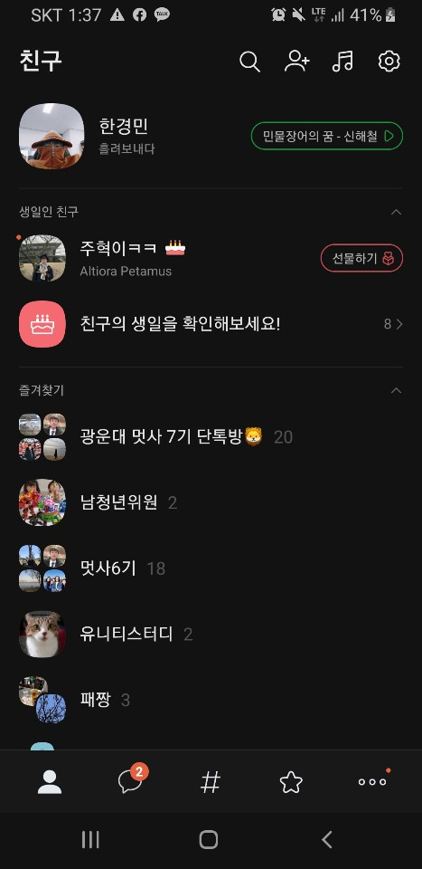
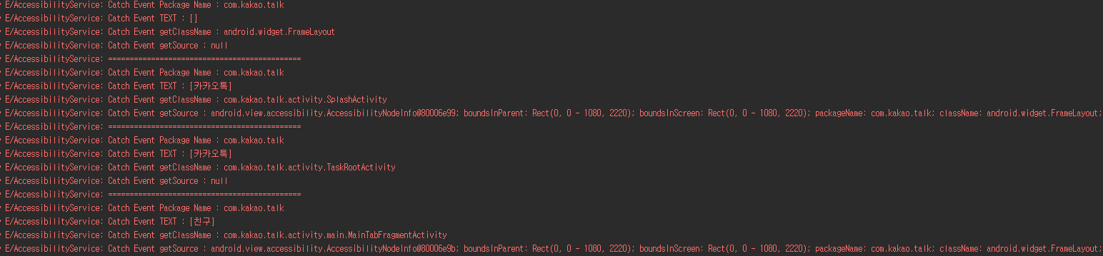
Experiment
kakaotalk

Slide 8
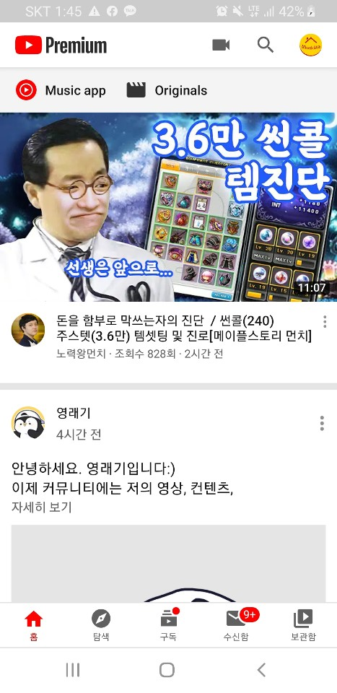
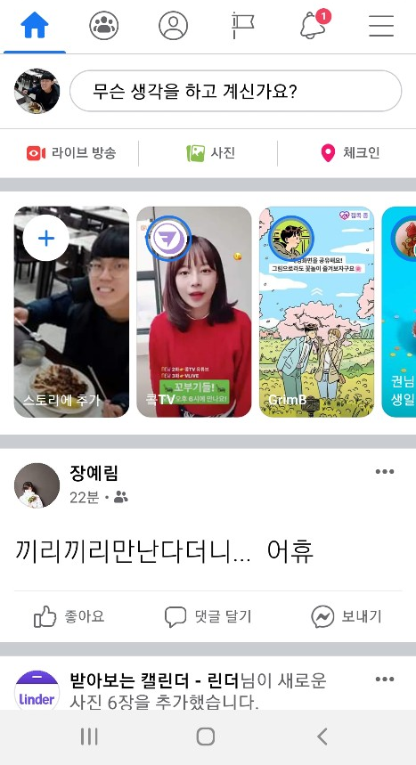
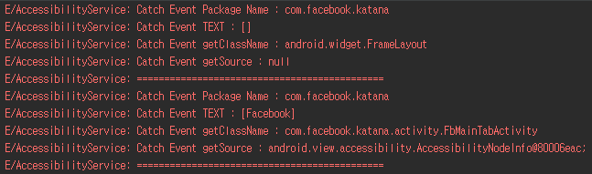
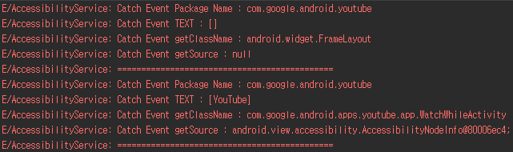
Experiment

Slide 9
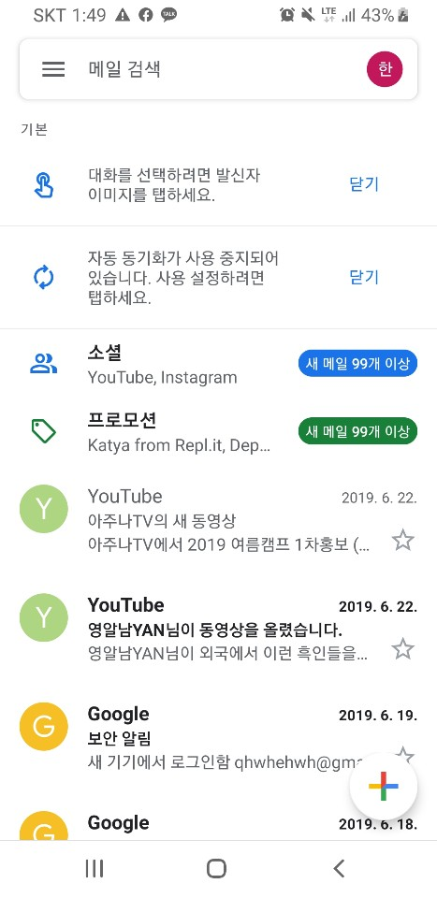
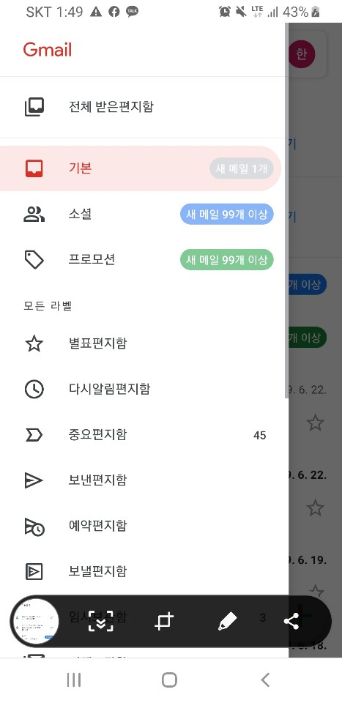
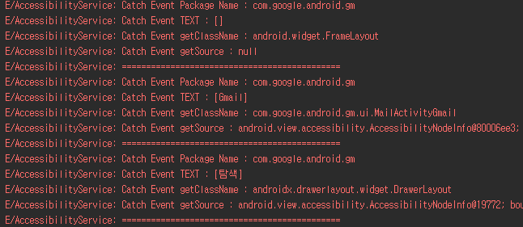
Experiment
Gmail

Slide 10
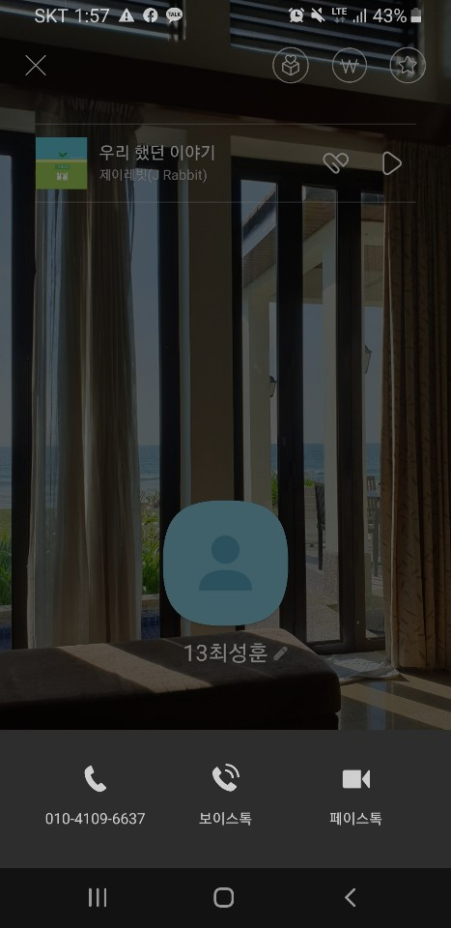


Experiment
Click event

Slide 11
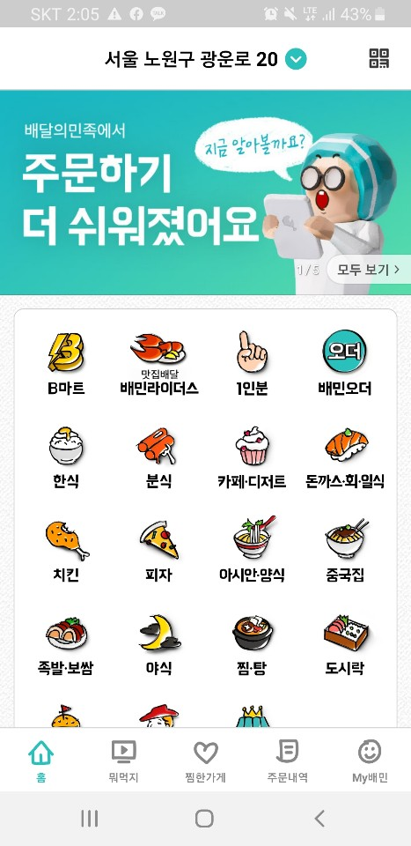
Experiment
Button position & size

