Slide 1

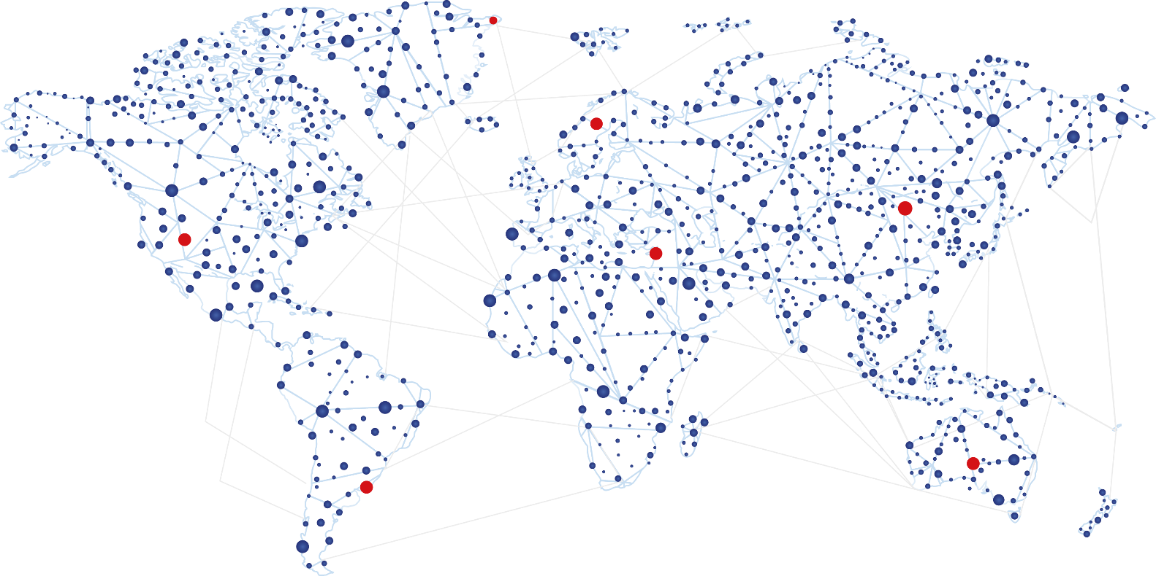
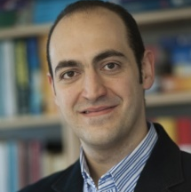
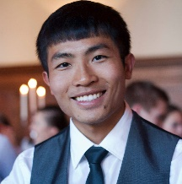
WebRTC
On Mobile Edge Cloud
BRIDGE
real-time communication between
browsers and telecoms world
PROVIDE
peer-to-peer optimization as a
service on mobile edge cloud
IMPROVE
user experience for WebRTC
based mobile applications
REDUCE
bandwidth consumption for
mobile network operators
Dr. Ahmad Al-Shishtawy
Senior Research Engineer
ahmad@sics.se
Qi Qi
Research Engineer
qiq@sics.se

