Slide 1
Control Structures
PhD Seminar „Python for Linguists“ @ ZHAW, March 3-4, 2022
Qi Yu

Slide 2
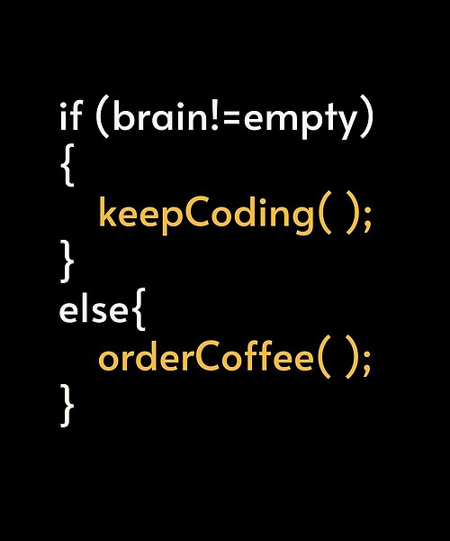
Control Structures
(Time for a small pause:
some pseudo-programming-language meme for fun.)
Source: https://www.pinterest.de/pin/705024516665158762/

Slide 3
Control Structures
What we have programmed in the intro-section: sequence of statements that are executed one after the other.
→ They are not that powerful: They will be executed once at each run of the script, and that’s all.
With control structures, you will be able to…
execute statements only under certain conditions;
execute statements for any number of times as defined by you.
Control sequences in Python:
Branching: if elif else
Loops: for while

Slide 4
Control Structures: Branching
Branching if elif else:
if clause:
my_statements_1
my_statements_2
if can be augmented with elif and else
Demo: control_structures.ipynb (Section 1)
check if the clause (condition) is true
if the clause is true, execute the block of statements

Slide 5
Control Structures: Loops
Loops iterates over a sequence. (Iteration: Repeated execution of a block of statements)
Iteration using for:
for element in my_sequence:
my_statements_1
my_statements_2
…
Iteration using while:
while my_condition:
my_statements_1
my_statements_2
…
Technically, anything you can do with for, you can do with while.
Demo: control_structures.ipynb (Section 2-3)

Slide 6
Control Structures: Loops
break and continue: Statements used for finer control of loops.
break: Exits from the smallest enclosing loop
continue: Exits from the current iteration of the smallest enclosing loop and moves to the next iteration
Demo: control_structures.ipynb (Section 2-3)

Slide 7
Control Structures: Loops
Hands-On: exercise_control_structures.ipynb

Slide 8
Reference
Dawson, Michael. 2003. Python Programming for the Absolute Beginner. 3rd Edition. Thomson Course Technology.
Hammond, Michael. 2020. Python for Linguists. Cambridge University Press.

