Slide 1
Linguistic Gaming with Python:
Introduction to Python Programming
Qi Yu, 28.10.2022

Slide 2
Some Logistic Issues
Before Diving into Programming…

Slide 3
For Whom is This Seminar?
This seminar is intended for beginners, i.e., we will start from the very basics.
That means: Please DO reconsider whether you really need this course if:
... you already master one object-oriented language. In this case, there are abundant tutorials online and you can catch up the knowledge taught here in a much quicker way!
… you have already visited other Python courses, e.g., ”Corpus Linguistics with Python”
Not because we want as less people as possible because we are lazy (otherwise I wouldn’t have re-arranged this larger classroom).
IT IS ALL ABOUT ALLOCATING YOUR OWN TIME IN AN EFFICIENT WAY! It is not productive for learning programming by only sitting in courses and doing the toy-assignments there. It is about using it actively on real-life cases.

Slide 4
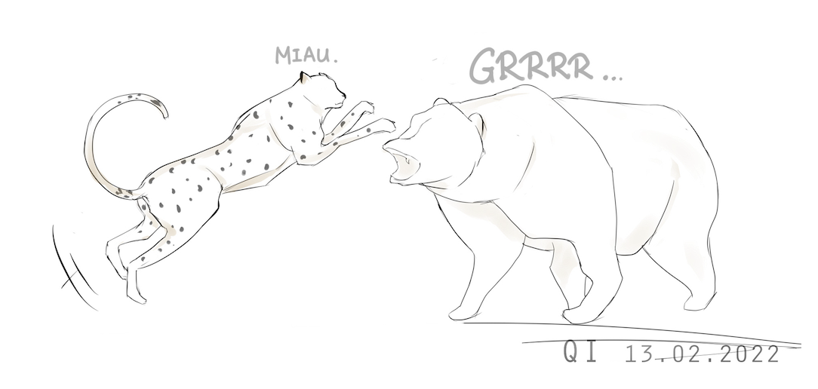

About Us…
Course instructor: Qi Yu
Qi is the first name
Pronunciation: like the “chee” in “cheetah”
Research fellow of:
My broad interests: NLP; XAI; Everything about applying machine learning and statistical approaches to explore text data
I speak: English, German
Whereas the course is taught in English, you are free to choose the one you prefer when talking with me privately
(A cheetah-sketch of mine. ☺ )

Slide 5
About Us…
Teaching assistant: Clara Giralt Mirón
clara.giralt-miron@uni-konstanz.de
Clara’s duties:
Helping you with questions/problems about programming
Evaluating your weekly assignments

Slide 6

About You: Some Surveys
Your study program?
Experiences with programming?
Operating system(s) you use?
(Windows, Mac OS, Linux, etc.)

Slide 7
Organizational Issues
All course materials will be made available on ILIAS
Main textbook: Dawson (2003)
For questions about Python programming, package installation etc.:
First googling the error message: Google solves 99% of the questions (!) ☺
If Google does not help: Clara or me
Courtesy when asking programming questions: always attach your code and the output
(No solely text description! We cannot infer or reproduce your error with bare text descriptions.)
For questions regarding credits/Prüfungsordnung: Carmen Kelling (referat.linguistik@uni-konstanz.de).

Slide 8
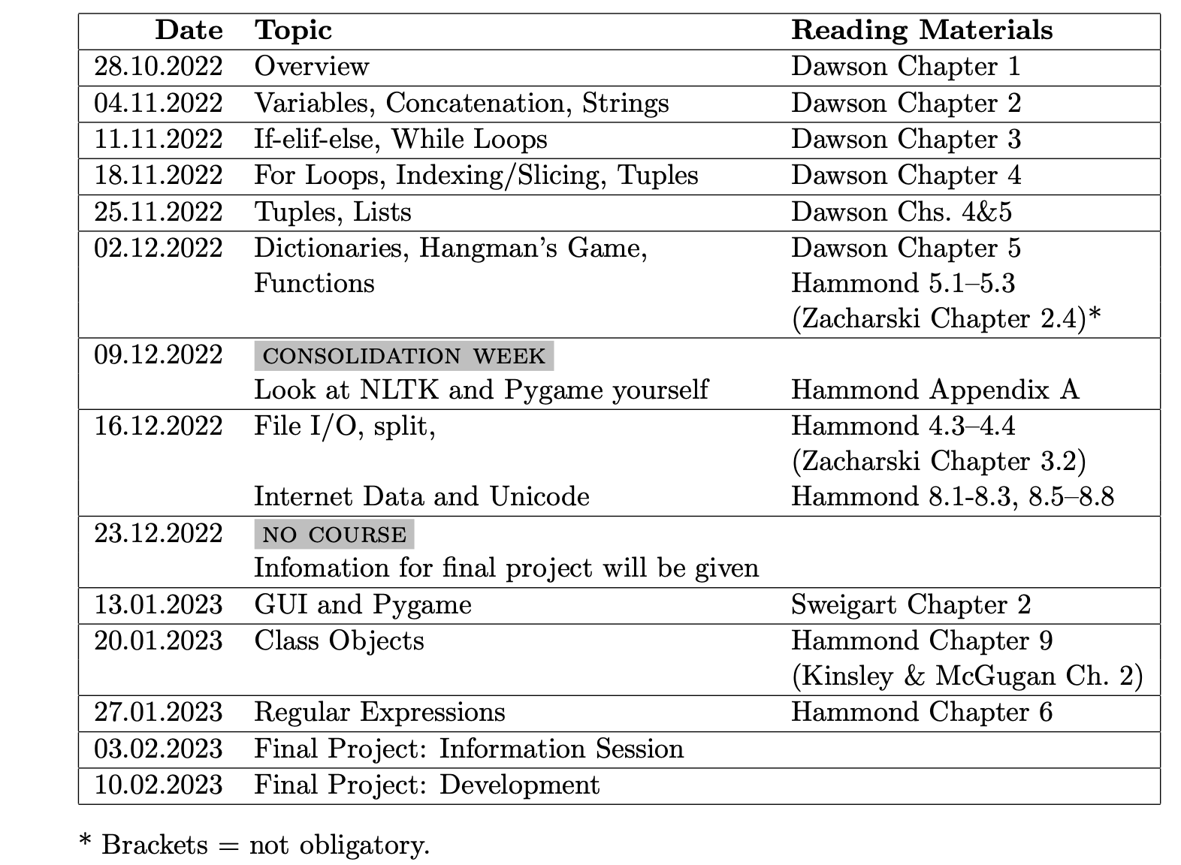
Organizational Issues
Syllabus:
full version on ILIAS

Slide 9
Credits
Credits consists of:
Weekly assignment: 50%
Final project: 50%
In order to receive credit for the course, each part must receive a pass grade (≤ 4.0).
Make sure that your code runs before submission: Codes that cannot be compiled (even only one task in the assignment!) will be directly given a fail (5.0) without any further consideration.

Slide 10
Credits
Weekly Assignments:
Due: always 11:00 AM on the Friday one week after. Late submission is NOT accepted.
Each assignment should have a pass-grade (≤ 4.0). The first assignment is NOT graded.
Weekly assignments are done in groups of 2 persons (see next slides)
Submission:
Via ILIAS. E-mail submission is NOT accepted (except for technical issues, e.g., ILIAS is broken)
One and only one submission per group
Format: .py (or .ipynb if you prefer to use Jupyter). One and only one file per assignment.
Fri. Sat. Sun. Mon. Tue. Wed. Thu. Fri.
e.g., 2nd lecture & Assignment 2 on Nov. 4, 2022
e.g., Assignment 2 due on Nov. 11, 2022, 11:00 AM

Slide 11
Credits
Weekly Assignments - Groups:
Groups should consist of 2 person
NO 3- or more-person groups
1-person group is only allowed in case the participant number is odd
As long as a group has been built, the constellation cannot be changed.
NO change of group partner allowed.
What should you do in case your group partner drops the course?
Inform Clara by E-mail (clara.giralt-miron@uni-konstanz.de) immediately
You will finish the assignments by yourself
NO Plagiarism: In case it is found that two groups have exactly the same solution, both group will be given a fail (5.0).

Slide 12
Credits
Weekly Assignments - Groups:
Task for you in the coming week:
Form teams of two. You can make use of the time after this session, or use the forum on ILIAS.
Each group sends one (and only one!) e-mail to clara.giralt-miron@uni-konstanz.de with the following format:
From: your university e-mail address (…@uni-konstanz.de)
Cc: the university e-mail address of your group partner
To: clara.giralt-miron@uni-konstanz.de
Subject: Python assignment group
Content: Full names of both members of your team
Deadline: Thursday, November 03, 2022 at 11:00 AM

Slide 13
Credits
Final project:
Information will be given during the semester
Due: March 10, 2023

Slide 14
Questions about organizational issues?

Slide 15
Introduction to Python

Slide 16

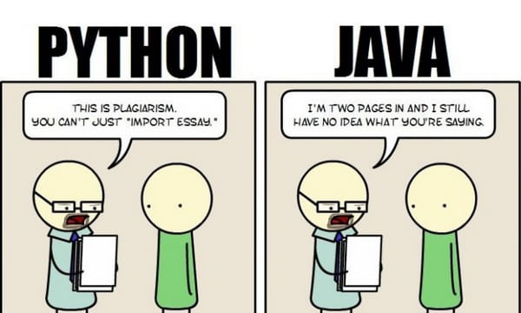
Why Python?
For linguistic research: a large collection of libraries for NLP
Portability: Python runs on almost every major operating system
Readability; Relatively easy to learn
A large community for support
Source: https://9gag.com/gag/aWZXKyx

Slide 17

Let’s Start: Ways to Interaction with Python
1. Interactive mood: directly in command line
Open Command Prompt in Windows: [LINK]
Open Terminal in Mac OS: [LINK]
Start Python: type python
End Python: type exit()
DEMO: Print “hello world” directly in Terminal
Some useful commands:
cd Change directory
ls (Unix), or dir (Windows) : List all files and folders in the current directory
clear Clear all inputs and outputs in the window

Slide 18
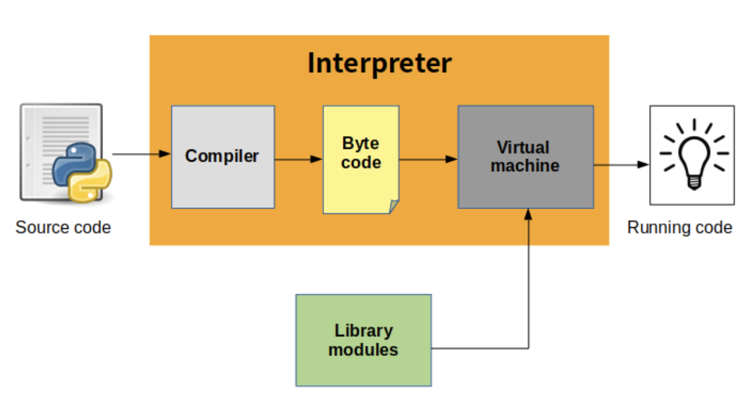
Excursion: …But How Does Python Run?
Explaination - Byte code: a lower-level, platform independent representation of the source code
Source: https://indianpythonista.wordpress.com/2018/01/04/how-python-runs/

Slide 19
Let’s Start: Ways to Interaction with Python (cont’d)
2. Script Mode
Step 1: Get an editor (e.g., Notepad++, Sublime Text), write your code there and save the file with the suffix .py
Step 2: Run the script in Terminal / Command Prompt:
Using cd directory/of/your/file to redirect to the directory where the .py-file is stored
Call python name_of_your_file.py to run your code
DEMO: create a file “hello_world.py” and run it

Slide 20


Let’s Start: Ways to Interaction with Python (cont’d)
3. Using IDE
IDE = Integrated development environment
E.g., PyCharm [LINK], Jupyter [LINK]
DEMO 1: Pycharm
DEMO 2: Jupyter
Install Jupyter [LINK]
Launch JupyterLab using the command jupyter-lab
Shut down the Jupyter server: Type ctrl+c
open an existing Jupyter Notebook file (.ipynb):
cd path/of/your/file
Then type in terminal/command prompt : jupyter-lab name_of_your_file.ipynb
In most of the time of this course, we will use PyCharm or Jupyter. Please install them.
In this session, we will use the interactive mode with command line, for pedagogical purpose.

Slide 21
Excursion: More about Jupyter
Jupyter:
A web-based application for creating and sharing computational documents
Supports over 40 programming languages
The power of Jupyter:
It allows interactive coding
It integrates many things into a single script:
Code
Output of the code
Visualizations
Your notes
…
A USEFUL DEMO on coding and mark-down in Jupyter: python_jupyter_basics.ipynb

Slide 22
Input, Output, and Comments
DEMO:
Output: print()
Input: input()
Write comments in Python: #
It's a good practice to comment your code sufficiently.
But please do not overdo this: You don't need to comment every single line

Slide 23

A Last-Minute Help Desk:
Installation, finding groups etc.

