Slide 1
Linguistic Gaming with Python:
Control Structures
Qi Yu, 04.11.2022

Slide 2
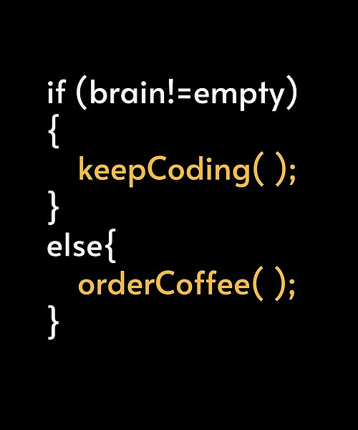
Time for some fun…
(Probably the most clichéd scene that strikes you when you think about programming. ☺)
Source: https://www.pinterest.de/pin/705024516665158762/

Slide 3
Content for Today
Generating random numbers and using modules
Control structure 1: Branching
Control structure 2: While-loop

Slide 4
Generating Random Numbers
&
Using Modules

Slide 5

Generating Random Numbers: Using Modules
Recap: Last session we have learned the data type numbers.
You can also use Python to generate random numbers:
For doing this, we need the random module.
But what is a module?
A collection of Python-scripts for a certain functionality - You can imagine them as toolkits.
They can be used inside other programs.
Keyword for “grabbing a certain toolkit”, i.e., using a module: import
E.g., using the random module: import random
DEMO: random_module.py

Slide 6
Generating Random Numbers
Functions of the random module:
Function 1: randint(start, stop)
generate a random integer i within the range of start ≤ i ≤ stop
start : required argument, i.e., a value must be passed.
stop : required argument
DEMO: random_module.py (Part 1)

Slide 7
Generating Random Numbers
Functions of the random module:
Function 2: randrange(start, stop, step)
start : optional argument, i.e., a value is not necessary.
stop : required argument, i.e., a value must be passed.
step : optional argument. step defines the incrementation.
generate a random integer i within the range of start ≤ i < stop
→ Caveat: The value of stop is not included in the range!
DEMO: random_module.py (Part 2)

Slide 8
Excursion: Two Different Way of Importing Modules
Recap – What we have learned just now: import
E.g.: import random
x = random.randint(0, 3)
You can also using the keyword from to directly import a function
E.g.: from random import randint
x = randint(0, 3)
Note that in this case you don’t need to write the function as “random.randint()” anymore.
Difference between the two ways:
import m : imports the whole module m
from m import f : imports only the function f of module m
DEMO: import_modules.py

Slide 9
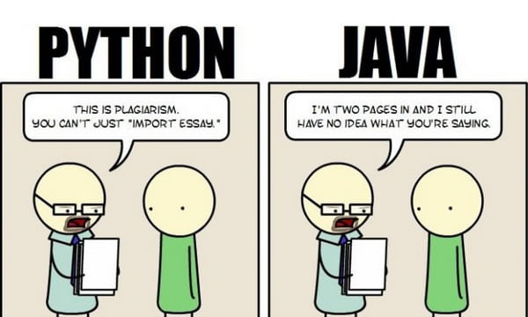
Excursion: Two Different Way of Importing Modules
(Time for some fun – Now you should have a better understanding of this meme from our very first lecture! ☺)
Source: https://9gag.com/gag/aWZXKyx

Slide 10
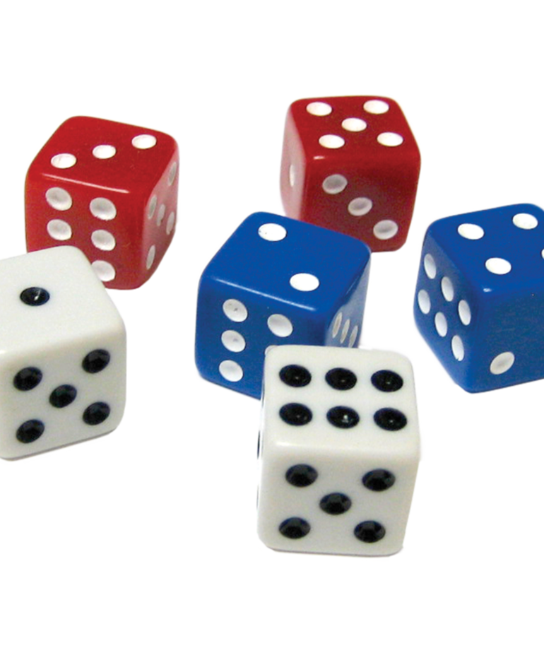
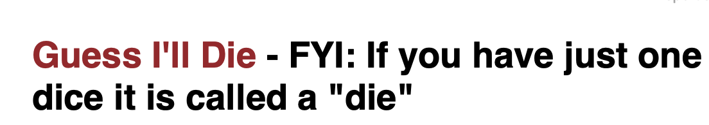
Generating Random Numbers
Hands-On 1:
Write a program that simulates the process of rolling a die, i.e., generates a random number i within the range of 1 ≤ i ≤ 6 .
At the end, you should print out the generated random number.
Please write your program in two different ways:
Using randint() ;
Using randrange().

Slide 11
Control Structure 1: Branching

Slide 12
Control Structures
What we have programmed in the last two intro-sections: sequence of statements that are executed one after the other.
→ They are not that functional: They will be executed once at each run of the script, and that’s all.
With control structures, you will be able to…
execute statements only under certain conditions;
execute statements for any number of times as defined by you.
Control sequences in Python:
Branching: if elif else
Loops: while for

Slide 13
Control Structure 1: Branching
Branching with if statement:
if clause:
my_statements_1
my_statements_2
if can be augmented with elif and else
Demo: if_elif_else.py
check if the clause (condition) is true
if the clause is true, execute the block of statements
Note the indentation here!

Slide 14
Control Structure 1: Branching
Comparison Operators:
What we have seen from last example: Operator ==
What does the statement x == y do?
Take two values x and y
…and compares if x and y are equal
…and returns an evaluation result at the end: either True, or False

Slide 15
Control Structure 1: Branching
Comparison Operators:
There are more comparison operators in Python.
Note that you can even use all of them to compare strings: With regard to string, the operators compare the alphabetical order of the strings
Operator | Meaning | Examples with Numbers | Examples with Strings
== | Equal to | 5 == 5 (Result: True) | “leopard” == “bear” (Result: False)
!= | Not equal to | 5 != 5 (Result: False) | “leopard” != “bear” (Result: True)
> | Greater than | 5 > 7 (Result: False) | “leopard” > “bear” (Result: True)
< | Smaller than | 5 < 7 (Result: True) | “leopard” < “bear” (Result: False)
>= | Greater than or equal to | 5 >= 3 (Result: True) | “leopard” >= “bear” (Result: True)
<= | Smaller than or equal to | 5 <= 4 (Result: True) | “leopard” <= “bear” (Result: False)

Slide 16
Control Structure 1: Branching
Hands-On 2:
Write a program which simulates two players throwing two dice each.
Inform the user which player won, i.e., the one who had the higher sum of dice roll.

Slide 17
Control Structure 1: Branching
A New Data Type: Booleans
The comparison operators returns an evaluation result at the end: either True, or False
Data type that only has two possible values True or False are called boolean
(“Boolean” is named after the English mathematician George Boole)
Any value can be interpreted as True or False in Python
The bool() function in Python allows you to evaluate any value
Rule of thumb: Any empty or zero value is evaluated as False, and everything else is True
Demo: booleans.py (Part 1)

Slide 18
Control Structure 1: Branching
Booleans and logical operators:
You can use logical operators to manipulate Booleans
Logical operators in Python:
and
or
not
Demo: logical_operators.py (Part 1)
Reference - Truth table: https://en.wikipedia.org/wiki/Truth_table

Slide 19
Control Structure 1: Branching
Booleans and logical operators:
Logical operators allows us to create compound conditions.
Recall what we have done in the former examples of if-elif-else branchings: We evaluate only one condition each time
if condition_1:
...
elif condition_2:
...
But we can use logical operators to concatenate multiple conditions
Demo: logical_operators.py (Part 2)

Slide 20
Control Structure 2: While-Loops

Slide 21
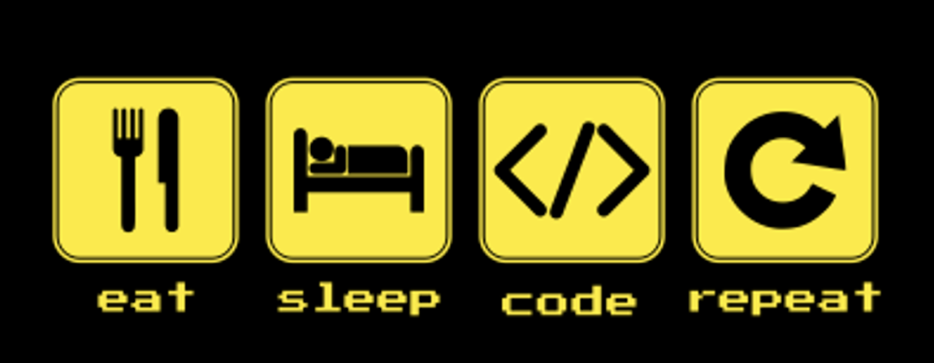
Control Structure 2: while-Loops
Loops:
Loops repeatedly execute a block of statements.
Loops using while:
while my_condition:
my_statements_1
my_statements_2
…
DEMO: while_loop.ipynb
As long as this condition is still fulfilled…
… this block of statements will be executed.
(Again, Note the indentation!)

Slide 22
Control Structure 2: while-Loops
Hands-On 3:
Write a program that:
1) asks the user to enter a number.
2) If the number entered by the user is not 0, it prints out “Enter 0 to quit” and asks for a new input.
3) If the number entered by the user is 0, the program ends.

Slide 23
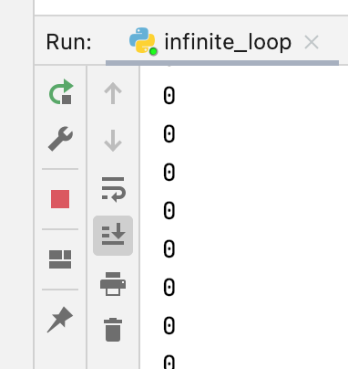
Control Structure 2: while-Loops
Avoid infinite loops! Your loop should have an termination condition.
DEMO: infinite_loop.ipynb
If you get stuck in an infinite loop by mistake:
In Terminal / Command Prompt: Hit ctrl + c
In PyCharm: Click the stop-button

Slide 24
Control Structure 2: while-Loops
Two statements for finer control of loops: break and continue
break: Exits from the smallest enclosing loop
continue: Jump back to the top of the loop
Demo: break_continue.py

Slide 25

Have a nice weekend!

