Slide 1
Linguistic Gaming with Python:
For-Loop, Indexing/Slicing, Tuples
Qi Yu, 18.11.2022

Slide 2

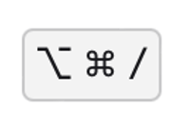
Updates from Last Session
Q: How do I comment out a block of code in PyCharm?
A: According to the official documentation of PyCharm -
Windows:
MacOS: (i.e., Option + Command + /)
If the keyboard shortcuts above doesn’t work for you, you can follow the instruction on this page to configure a customized shortcut by yourself:
https://www.jetbrains.com/help/pycharm/configuring-keyboard-and-mouse-shortcuts.html?keymap=secondary_macos

Slide 3
Updates from Last Session
Q: For random.randrange(start, stop, step), is there a way to only specify stop and step, but not start?
A: After having double-checked the documentation of the module random as well as experimented several ways, this is not working.
(Documentation of random: https://docs.python.org/3/library/random.html)

Slide 4
Content for Today
Control structure 3 (continued from last time): for-loop
Operations and functions for sequences
A first introduction to tuples (moved to next time)

Slide 5
Control Structure 3: for-loop

Slide 6
Control Structures – Overview & Recap
Types of control structures:
Branching
Loop
Last session:
1) Branching with if elif else
2) Loop with while
Statements for finer control of loops: break continue
Today:
Loop with for

Slide 7
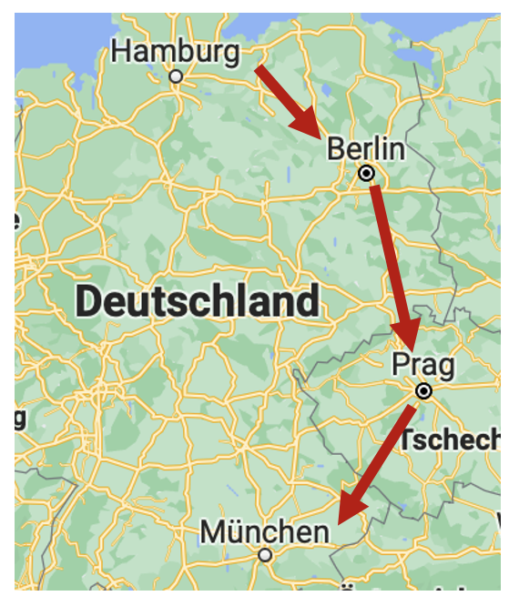
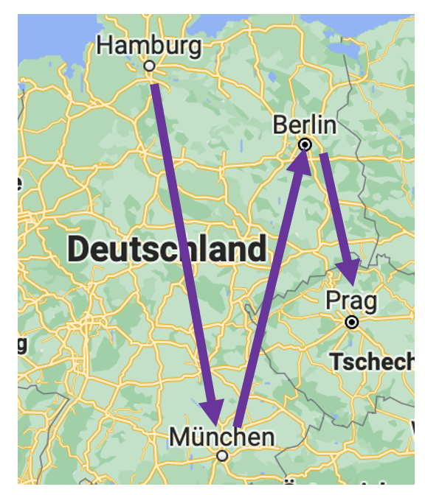
Sequences and for-loop
Before introducing for-loop, we should know about the concept sequence.
Sequence:
A list of ordered things
Examples:
Hamburg, Berlin, Prague, Munich
Hamburg, Munich, Berlin, Prague
Note that they are two different sequences! (“ordered”)

Slide 8
Sequences and for-loop
for-loop: goes through every element of a sequence (“iteration”)
Coming back to the basic data types we have learned until now (string, number, boolean):
Among them, there is an example of sequence: string
A string = a list of ordered characters
DEMO – Iterate over a string using for: for_loop.py

Slide 9
Sequences and for-loop
Using the function range() to generate a sequence of numbers:
range() : A built-in function of Python – You don’t need to import any module in order to use it
(cf. randrange()and randint() – You need to firstly import the random module.
range() takes three arguments: range(start, stop, step)
start : optional argument
stop : required argument
step : optional argument. step defines the incrementation.
range() generates a sequence of integers start ≤ i < stop
(Caveat: The value of stop is not included in the range!)
DEMO – Iterate over a sequence of numbers using range() and for-loop:
range_function.py (Part 1)

Slide 10
Sequences and for-loop
Hands-On 1:
Use for-loop and range() to generate the following number sequence:
5, 10, 15, 20, 25

Slide 11
Sequences and for-loop
Using the function range() to generate a sequence of numbers:
The examples before showed: range() “counts” through the range defined by the user.
You can do the “counting” in two different ways:
Counting forwards (This is what we have seen from the examples before)
Counting backwards
DEMO: range_function.py (Part 2)

Slide 12

Sequences and for-loop
Hands-On 2:
Use for-loop and range() to print out the following pattern.
(Tip: We have learned how to use the multiplication-operator (*) to repeat a string.)

Slide 13
Functions and Operators for Strings

Slide 14
Functions and Operators for Strings
An interim recap of what we have learned about strings…
From the second session of this course:
+ , *
upper() , lower() , title() , capitalize()
replace() , strip()
From Assignment 3:
len(), min(), max()
From today:
in : Check if an element is contained in a sequence
Today - More operations for strings:
Indexing
Slicing

Slide 15
Indexing
Indexing:
Grab a certain element of a sequence directly by using its index
DEMO: indexing.py (Part 1)

Slide 16
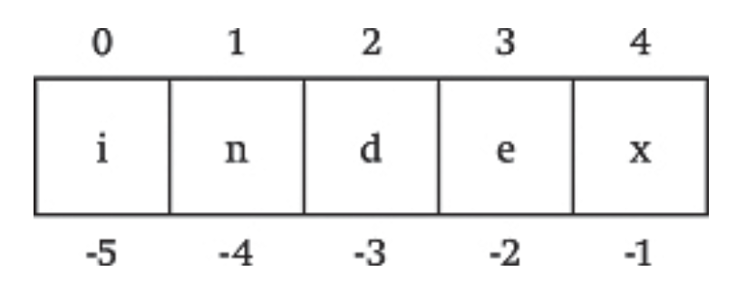
Indexing
IMPORTANT: Python starts counting from 0
→ The first element always has the index 0, not 1!
Two ways of indexing a sequence:
Positive position numbers
Negative position numbers
DEMO: indexing.py (Part 2)
Caveat: Be careful of IndexError
DEMO: indexing.py (Part 3)

Slide 17
Indexing
Comparing indexing with for:
Indexing: directly access an element at a certain position (random access)
for : goes through the sequence to access a certain element (sequential access)
E.g., to access the 3rd character of a string with more than 3 characters:
Indexing: directly grab the character at the 3rd position
for : needs to firstly go through the 1st and 2nd character, and then reach the 3rd character

Slide 18
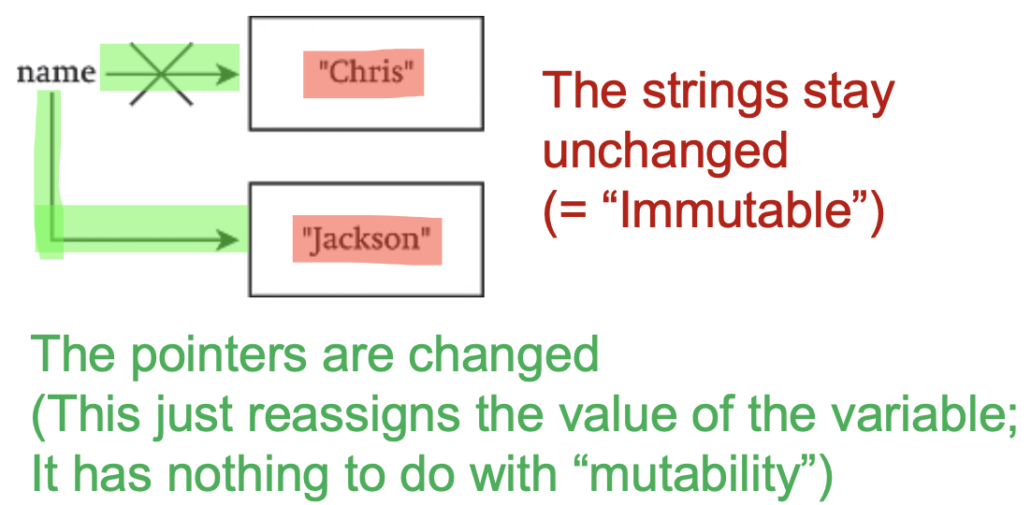
Indexing
Mutability of a sequence:
A sequence is mutable = can be changed; vice versa, immutable = cannot be changed
Strings are immutable
Caveat:
A variable of string type can be re-assigned new values ≠ A string is mutable!
DEMO: string_mutability.py

Slide 19
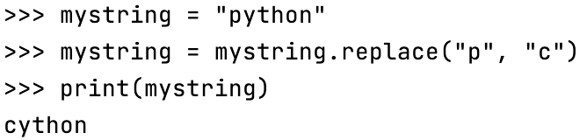
Indexing
Hands-On 3:
1) Create the following string:
mystring = “auto”
2) Iterate through all characters of the mystring. If the character is a vowel (a, e, i, o, u), replace it with a “x”, i.e., what you get at the end should be: “xxtx”.
Tip / Recap: We can use the replace() function here.
An example of using replace():

Slide 20

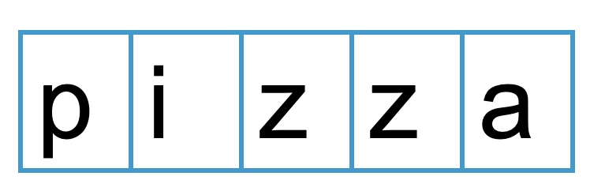
Slicing
One further operation for strings: Slicing
Slicing: “Cut” a piece of a string by specifying the starting position and ending position
DEMO: slicing.py (Part 1)

Slide 21
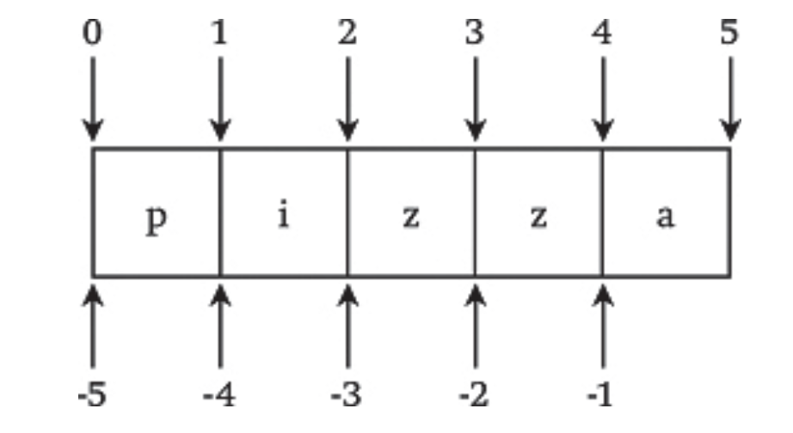
Slicing
Same as indexing, there are two ways of slicing a sequence:
Positive position numbers
Negative position numbers
Note the different numbering system between indexing (left) and slicing (right):
DEMO: slicing.py (Part 2)
For slicing, no IndexError is raised if the index is out of bound; Instead, Python just returns an empty slice in this case.
DEMO: slicing.py (Part 3)

Slide 22
Slicing
Shorthand for slicing:
In the last examples, we sliced a string by specifying two indices: The start point, and the cut-off point.
You can also leave the the start point and/or the cut-off point unspecified.
DEMO: slicing.py (Part 4)

Slide 23

Slicing
Hands-On 4 ( )
( = Exercises that are more difficult; It is okay if you fail to solve it, but please at least make sure that you understand the sample solution.)
Using for-loop and slicing to count how many times the pattern “er” appears in the following string:
“Jennifer and her daughter in Berlin”
Your answer should be 4.

Slide 24
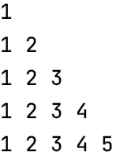
Challenge
Hands-On 5 ( )
Use for-loop and range() to print out the following pattern:

Slide 25

Have a nice weekend!

