Slide 1
Linguistic Gaming with Python:
Dictionaries & Functions
Qi Yu, 02.12.2022

Slide 2
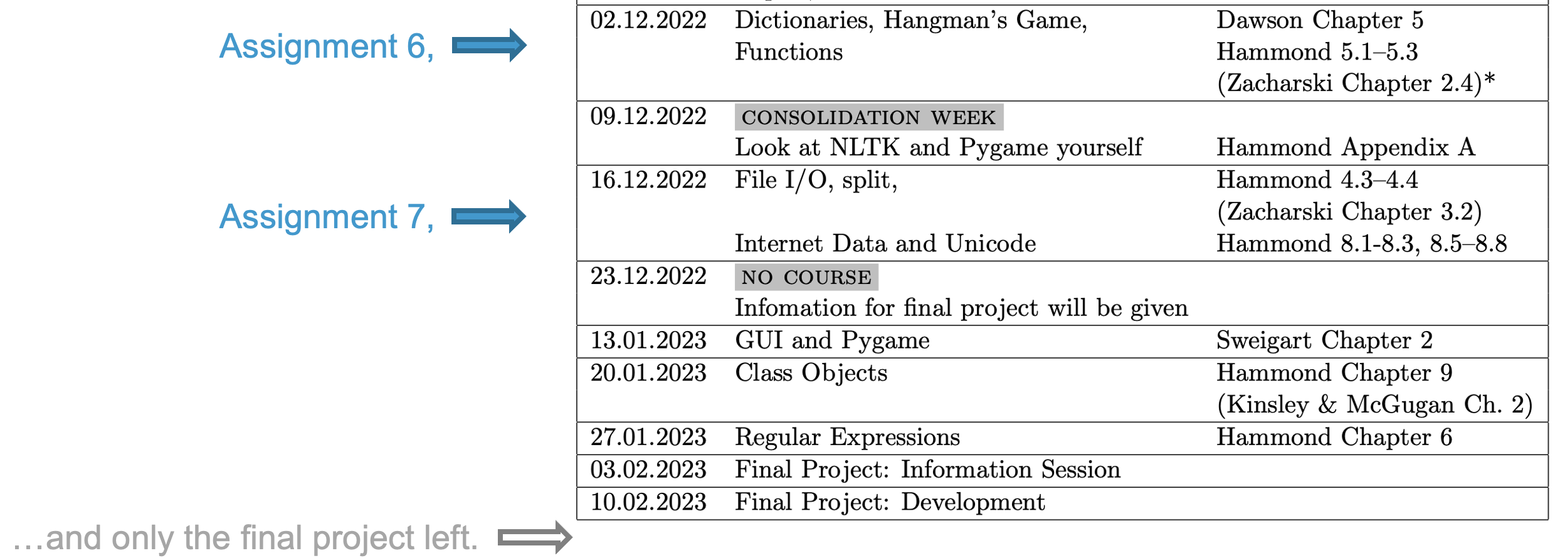
Content for Today
Dictionaries (one more new data type)
Functions
Today you’ll reach a milestone – We will have learned all the basic datatypes in Python
(string, number, boolean, tuple, list, dictionary)
The next milestone: Only 2 more obligatory assignments to go (!)

Slide 3
Organizational Issue
No lecture next week (Dec. 09, 2022)!
(Consolidation Week at the Department of Linguistics.)
Instead of the lecture, you will read about NLTK and Pygame by yourself (see the syllabus for the links and reading materials to them).

Slide 4
Dictionaries

Slide 5
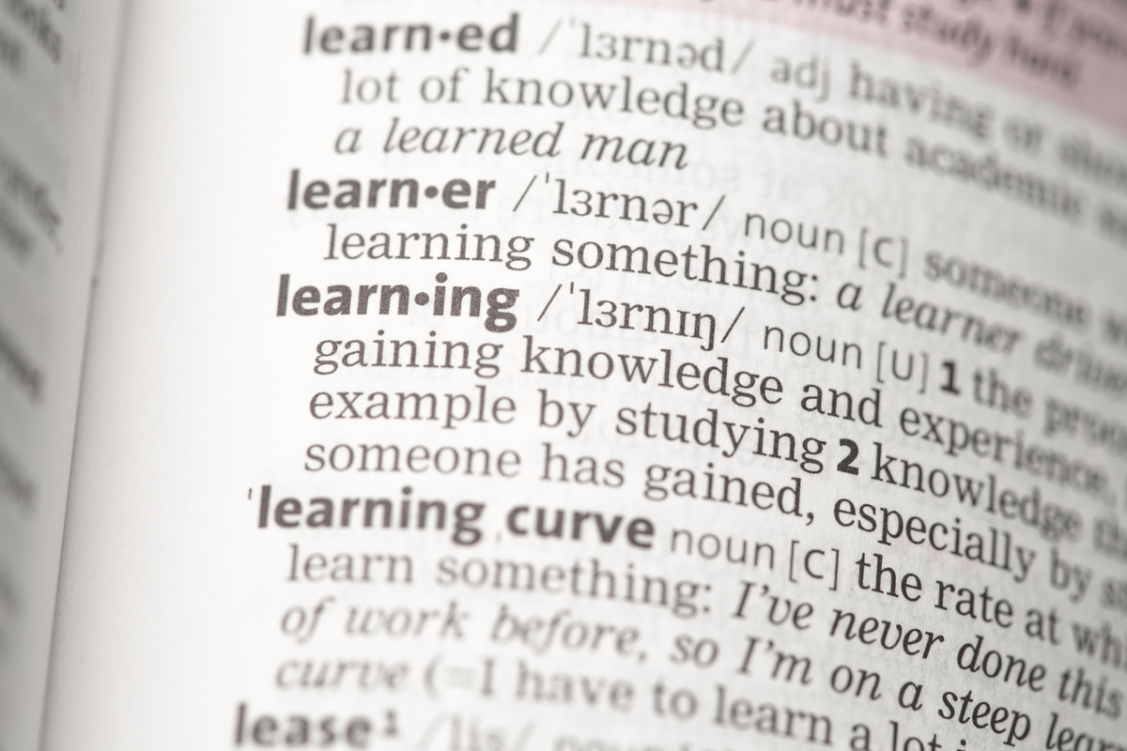
Basic Data Type: Dictionaries
Dictionaries in Python are sets of key-value pairs.
(Just like a real dictionary)
In Python, dictionaries are denoted by the following syntax:
{ key1: value1,
key2: value2,
key3: value3 }
Some terminologies:
Everything on the left side of the colon (:): keys
Everything on the right side of the colon (:): values
A key-value pair: an item
DEMO: dictionaries.py (Part 1)

Slide 6
Basic Data Type: Dictionaries
Operations and methods for dictionaries:
Looking up a key in the dictionary: dict[key], get()
Adding items: dict[key]= new_value
Deleting items: del dict[key]
Get all keys, all values, or all items: .keys(), .values(), .items()
DEMO: dicts_operations_functions.py (Part 2)

Slide 7
Basic Data Type: Dictionaries
IMPORTANT – A caveat :
All keys of a dictionary should be unique.
If one item is added to the dictionary with the key NOT being unique, i.e., there already exists an item with the same key, the value of the old item with the same key will be rewritten
DEMO: dicts_unique_keys.py

Slide 8

Basic Data Type: Dictionaries
Hands-On 1:
1) Create the following two dictionaries:
dict1 = {"x": 1, "y": 2, "z": 3}
dict2 = {"x": 4, "y": 5, "z": 6}
2) Add up the elements with the same name in dict1 and dict2, i.e., 1+4, 2+5, 3+6.
Print out the results at the end.
Your results should be:
5
7
9
3) BONUS TASK ( ) – If you have solved part 2) above: Think about if there are different ways to solve it!

Slide 9
Basic Data Type: Dictionaries
Dictionaries and Mutability:
Dictionaries is a mutable datatype – As you have seen, we can add, delete or edit the items of a dictionary.
A summarization of the mutability of the data types we have learned:
Dictionaries are mutable, but dictionaries require immutable types as its keys:
DEMO: dictionaries_mutability.py
Mutable | Immutable
list, dictionary | tuple, string, number, boolean

Slide 10
Functions

Slide 11
Functions
Function: We have heard the name “function” and “method” many time the last lectures, without knowing what they mean…
What we already heard about until now:
some_name() : This syntax denotes a function → We’ll learn about functions today
.some_name() : This syntax denotes a method. A method is associated an object – We will learn about object in one of the future sessions. Stay tuned!)
What is a function?
It’s more straightforward to illustrate function with a bad example, where no function is used:
DEMO: bad_example.py (Part 1)

Slide 12
Functions
Why is bad_example.py bad?
Too redundant: Many lines are just repeating
Not robust: We can copy and paste the repeating lines, but this very prone to error:
What if the programmer missed one line by mistake in the process of copy-and-paste?
Very inflexible: As long as you want to change one single thing in this repeating block, you need to do this change for every block.
→ Repeating blocks of code is ALWAYS very bad, no exception!
→ Functions are there exactly to solve such redundancy/robustness/flexibility problems:
DEMO: simple_functions.py

Slide 13
Functions
Take-home message from the example simple_functions.py:
It illustrated us the definition and aim of function:
A function is a group of related statements that performs a specific task.
Function breaks our program to more concise and modularized chunks.
The keyword for defining function in Python: def
It is a so-called simple function:
It does not take any argument
It does not return any value

Slide 14
Functions
Caveat: Take care of the difference between defining a function and calling a function.
Demo: define_vs_call.py
Having written a function by using def: You only defined a function. It’s not been put into use yet; You won’t automatically see any outcome from it.
(Analogy: You bought a scissor. The scissor won’t cut anything for you automatically by itself just because you’ve bought it.)
Calling a function: You put the function into use. Only when you call a function, you will see the outcome.
(Analogy: You pick up the scissor and cut through a piece of paper with it. You are now using the scissor. With this action, you get the effect you expect from a scissor: It “breaks” the paper into pieces.)

Slide 15
Functions that Return Values
The example in simple_functions.py is a simple function. But we can also build a function that return value(s) using the keyword return.
DEMO: functions_with_return.py (Part 1)
return exits a function → statements after return will not be executed
DEMO: functions_with_return.py (Part 2)
return can be used to return more than 1 values
Syntax: separated the values by comma (recall the syntax we used for importing multiple modules or unpacking sequences)
DEMO: functions_with_return.py (Part 3)

Slide 16
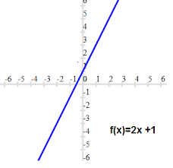
Functions that Take Arguments
Building a function that take arguments:
Arguments: imagine a real mathematical function such as f(x) = 2x+1:
It takes an x, returns a value,
and it can take a different x, and the returns a different value…
Syntax of defining a function that takes arguments:
def func(arg1, arg2, …)
DEMO: functions_with_arguments.py (Part 1)

Slide 17
Functions that Take Arguments
Different ways of invoking functions with arguments:
Specifying the names of the arguments:
Syntax: func(arg1=val1, arg2=val2, …)
This allows the arguments to be passed in any order
Not specifying the names of the arguments:
Syntax: func(val1, val2, …)
The arguments are interpreted in same order as defined in the function
DEMO: functions_with_arguments.py (Part 2)

Slide 18
Functions that Take Arguments
Using “=” in function definition:
Syntax: def func(arg1, arg2=val2, …)
This means: arg2 take the value val2 by default, but this default value can be overwritten if user passes a new value.
DEMO: functions_with_arguments.py (Part 3)

Slide 19
Functions that Take Arguments
Hands-On 2:
1) Create the dictionary below, where each key is a word, and its value is the type of the word:
word_dict = {"black": "adj", "computer": "noun", "sunny": "adj", "sleep": "verb"}
2) Write a function get_words(word_type):
The function takes an argument word_type, and prints out all words in word_dict which that belongs to the type defined by word_type.
E.g., if the user does get_words("adj") or get_words(type="adj"),
the words "black" and "sunny" should be printed out.

Slide 20
Functions that Take Arguments
Functions with unspecified number of arguments:
Syntax: def func(*args, **kwargs)
* : stands for unspecified number of unnamed arguments
** : stands for unspecified number of named arguments
kwargs : abbreviation of “keyword arguments”
The keyword arguments are stored as dictionaries, with the names as keys and values passed by users as values.
DEMO: functions_arg_num_unspecified.py
Note: The arguments can be given different names than than arg, kwargs, but calling them args, kwargs is the convention

Slide 21
Functions that Take Arguments
Hands-On 3:
Write a function named concatenate , which can take any amount of strings as arguments, and returns the concatenation of these strings.
E.g., concatenate("hello", "world") should return helloworld
concatenate("a", "b", "c", "d", "e") should return abcde

Slide 22
Functions
Write document for your functions:
It’s always a good habit to write sufficient comments to document your programs.
The same applies to functions – It’s a good habit to document your functions.
There is a specific way to document functions: Using docstrings
DEMO: functions_docstrings.py

Slide 23
Excursion: Hangman’s Game
in Dawson (2003)

Slide 24
A Good Program for Self-Learning
“Hangman’s game” in Dawson (2003), Chapter 5
A very good program for reviewing what you have learned until now:
Usage of tuples, lists and list methods
Usage of while-loops and if-branches
Functions print(), input(), len()…
Indexing a sequence
Conventions of naming variables
It is also a very good reference for your final project.
A homework:
1) Take a look at the “Hangman’s game”...
2) …And make sure that you understand everything. Bring your questions to the next class if you have any.

Slide 25

Have a nice weekend!

