Slide 1
Linguistic Gaming with Python:
Grafical User Interface & Pygame
Qi Yu, 13.01.2023

Slide 2
Organizational Issues
No weekly assignment anymore from this week on
Instead: Please take the time to think about potential ideas for your final project!
The information about final project is available on ILIAS.
Please read the guideline thoroughly!

Slide 3
Content for Today
Graphical User Interface (GUI)
Creating GUI using the module pygame

Slide 4
Graphical User Interfaces

Slide 5
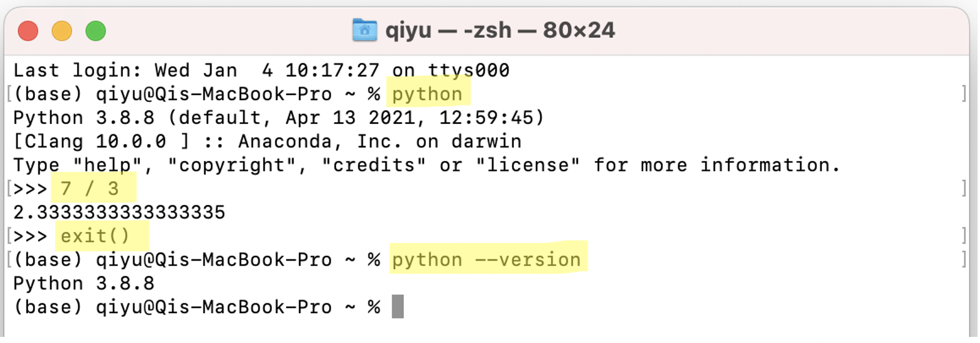
Two Types of User Interfaces
User Interface:
The operating system of any device is an interface between the user and the device itself:
It allows the user to interact with the device.
When you type in commands in your Commad Prompt (Windows) / Terminal (Unix):
You are interacting with your computer through the command line.
→ This is the so-called Command Line Interface (CLI)

Slide 6
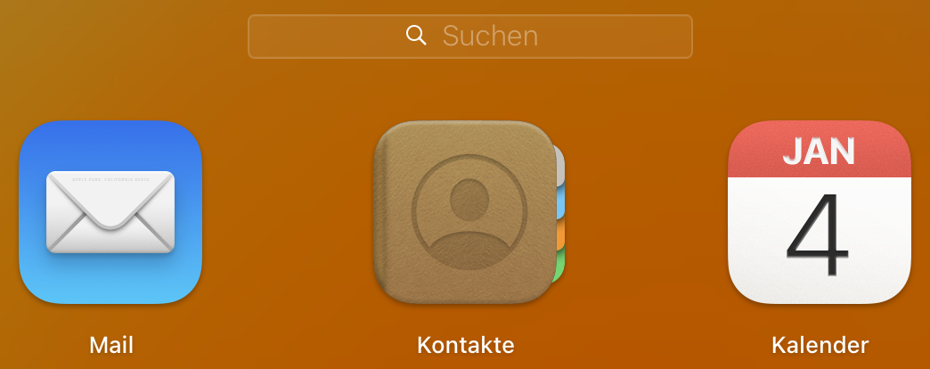
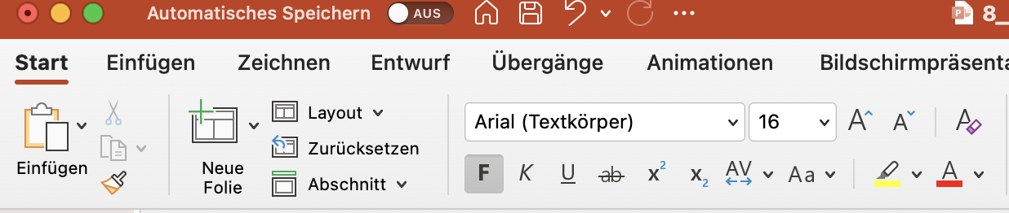
Two Types of User Interfaces
User Interface:
Beside the CLI, there is also a second type of user interface: the Graphical User Interface (GUI).
GUI enables users to interact with an operating system using graphical representations: icons, menus, cursors, etc.
When you click on an icon of an App on your cellphone / computer: You are interacting with your device through GUI.

Slide 7
Creating GUI Using the Pygame Module
DEMO:
(We will go through the examples in Swiegart (2012), chapter 2)

Slide 8
Reading: Swiegart (2012)
In Swiegart (2012) starting from Chapter 3, there are various examples of games you can create using the pygame module.
→ They might provide you some inspirations for your final project! ☺

