Slide 1
Linguistic Gaming with Python:
Object-Oriented Programming
Qi Yu, 20.01.2023

Slide 2
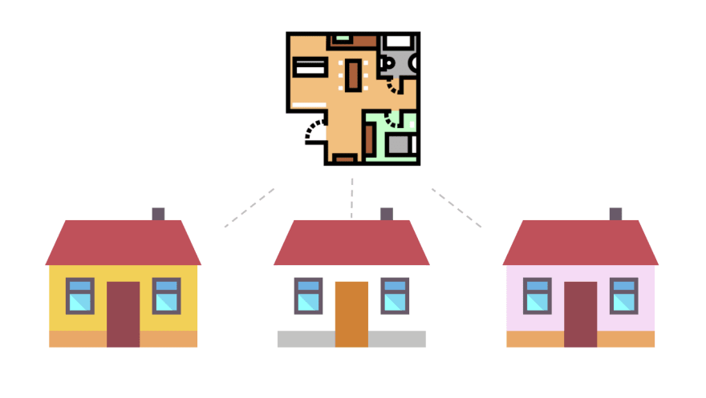
Basics of Object-Oriented Programming: Classes and Instances
Class: The “blueprint”/ “template”/ “general concept”
Object (or: Instance): The specific realization of the “blueprint”
House class:
House objects:
Source: https://dev.to/charanrajgolla/beginners-guide---object-oriented-programming

Slide 3
Basics of Object-Oriented Programming: Classes and Instances
Class can have properties (attributes) and behaviors (methods) that describe them:
House class:
wall_color
has_heating
start_heating()
get_age()
House objects:
wall_color=“yellow”
has_heating=True
start_heating()
get_age()=5
wall_color=“white”
has_heating=False
get_age()=4
wall_color=“pink”
has_heating=True
start_heating()
get_age()=2.5

Slide 4
Basics of Object-Oriented Programming: Classes and Instances
Many real-world systems can be modelled as classes and objects.
Class: Vehicle
Objects: cars, trains, trams, …
Attributes: numOfWheels, fuel,…
Methods: speedup(), brake(),…
Class: Sentence
Objects: each sentence in a text / corpus
Attributes: numOfWords, isQuestion,…
Methods: setSpeaker(), setTimeStample(),…

Slide 5
Construct Classes and Instances in Python
Classes are constructed using the keyword class
Class names are conventionally capitalized
DEMO: construct_classes.py

Slide 6
Attributes and Methods Explained in a More „Programming“ Way
Within the class definition, variables and functions can be defined.
They are the attributes and methods of this class.
Attributes and methods can be bound to different levels:
Bound to the class: They are called class attributes / class methods
Bound to specific instances of the class: They are called instance attributes / instance methods

Slide 7
Class Attributes and Class Methods
Class methods: methods that are relevant for an entire class
The class method is defined with a decorator @classmethod, and has cls as the first argument (cls bounds the method to the class)
Class attributes: variables that are relevant for an entire class
DEMO: class_attributes_methods.py

Slide 8
Instance Methods and Instance Attributes
Instance methods:
Instance methods has self as the first argument (self bounds the method to the specific instance)
Instance attributes: variables/property attached to a specific instance of a class
Instance attributes are always created and manipulated through instance methods.
Demo: instance_attributes_methods.py

Slide 9
Constructor
From the last example, we have seen that you can use instance methods to set/get the value for a certain instance attribute.
But: Suppose you constructed 4 instances from a certain class, and each instance has 3 different attributes. Then you need to do 4*3 = 12 times of attribute value setting.
A “shortcut” to avoid this nuisance in Python: Using the constructor __init()__
Using __init()__ , class can be defined so that when you instantiate it, it does some automatic setting up.
The __init__()will be run when the class is instantiated.
Doubled underscores at the begin and end indicates that it is a built-in "special methods" in Python.
Demo: using_init.ipynb (Section 4)

Slide 10
Inheritance
Sometimes you might want to construct classes that are related to each other. For instance, class A is a sub-class of class B.
E.g.,
class “furniture”:
Attributes that instances of “furniture” have: material, price,
Methods that instances of “furniture” have: get_material(), get_price()
class “desk”:
Attributes that instances of “desk” have: number_of_drawers, is_height_adjustable,
Methods that instances of “desk” have: get_number_of_drawers(), set_adjustability()
But: you also want “desk” to have all the attributes and methods that “furniture” has (e.g., you should also allow the user to get the price of a desk).
→ Inheritance helps in this case

Slide 11
Inheritance
Inheritance: Methods and variables of a parent-class are all available to its child-class.
(The “child” inherits properties from its parents)
Inheritance is a powerful feature of object-oriented programming. When building large programs with complex class relations, inheritance allows you construct these relations in simplified ways.
Inheritance is transitive: A child-class can inherit from a parent-class, and the parent-class can inherit from a grandparent-class. The methods and variables of the grandparent-class are in this case also available for the child-class.
Demo: inheritance.py

Slide 12
More About OOP…
Python also allows multiple inheritance, see Hammond (2020), Chapter 9.
To control the accessibility, you can also create private classes, private methods and private attributes. See Dawson (2003), Chapter 8.

Slide 13
Exercise
Hands-On 1:
Create a class “Hero” that allows user to create different hero characters. The class should fulfill the following requirements:
1) Each hero should have two attributes:
name: The hero’s name
health_value: an integer that stands for the hero’s health status
2) The class contains methods that allow the user to get the hero’s name and health status.
3) The class should also contain a method that allow the user to set new health_value.
4) Also allow the user to check how many heroes have bean created.

Slide 14

Have a nice weekend!

