Slide 1
PhD Seminar “Python for Linguists”
ZHAW, March 3-4, 2022
Qi Yu

Slide 2
For Whom is This Seminar?
This seminar is intended for beginners, i.e., we will start from the very basics.

Slide 3

About Me…
Qi Yu (pronunciation of Qi: like the part “chee” in “cheese”)
Doctoral researcher
@
Research Interest:
Broad: Natural language processing (NLP); Operationalizing well-studied semantic and pragmatic phenomena for NLP applications
Narrow – My work at the project “Framing Inequalities”: Automated detection of linguistic devices for framing in political discourses
Project “Framing Inequalities”
@

Slide 4
About You: Some Surveys
Experiences with programming languages other than Python? (E.g., R)
Which operating system do you use? (E.g., Windows, Mac OS, …)

Slide 5
Organizational Issues
Course materials: https://github.com/qi-yu/teaching-materials-python
Please download them. We will play with the codes there during the course.
For emergency (e.g., Zoom interruption): I will contact you via E-mail as soon as possible in emergency cases. So please keep an eye on your mailbox.
Credits:
Participants who take the course for credits should complete a final assignment
(more information at the end of the seminar)
Deadline on March 31, 2022 → Is the date feasible?

Slide 6
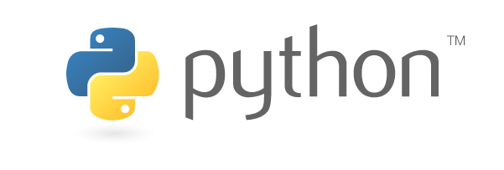
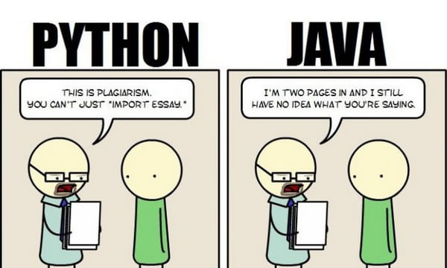
Why Python?
Source:https://www.python.org/community/logos/
For linguistic research: a large collection of libraries for computational linguistics / NLP
Portability: Python runs on almost every major operating system
Readability; Relatively easy to learn
A large community for support
Source: https://9gag.com/gag/aWZXKyx

Slide 7
Let‘s Start: Ways to Interaction with Python
Using command line
Open Command Prompt in Windows: https://www.howtogeek.com/235101/10-ways-to-open-the-command-prompt-in-windows-10/
Open Terminal in Mac OS: https://www.idownloadblog.com/2019/04/19/ways-open-terminal-mac/
(DEMO)
Using IDE (Integrated development environment), e.g., PyCharm
(DEMO)
Jupyter (Jupyter Lab, Jupyter Notebook, Jupyter Hub)
→ We will use JupyterLab for this course.

Slide 8
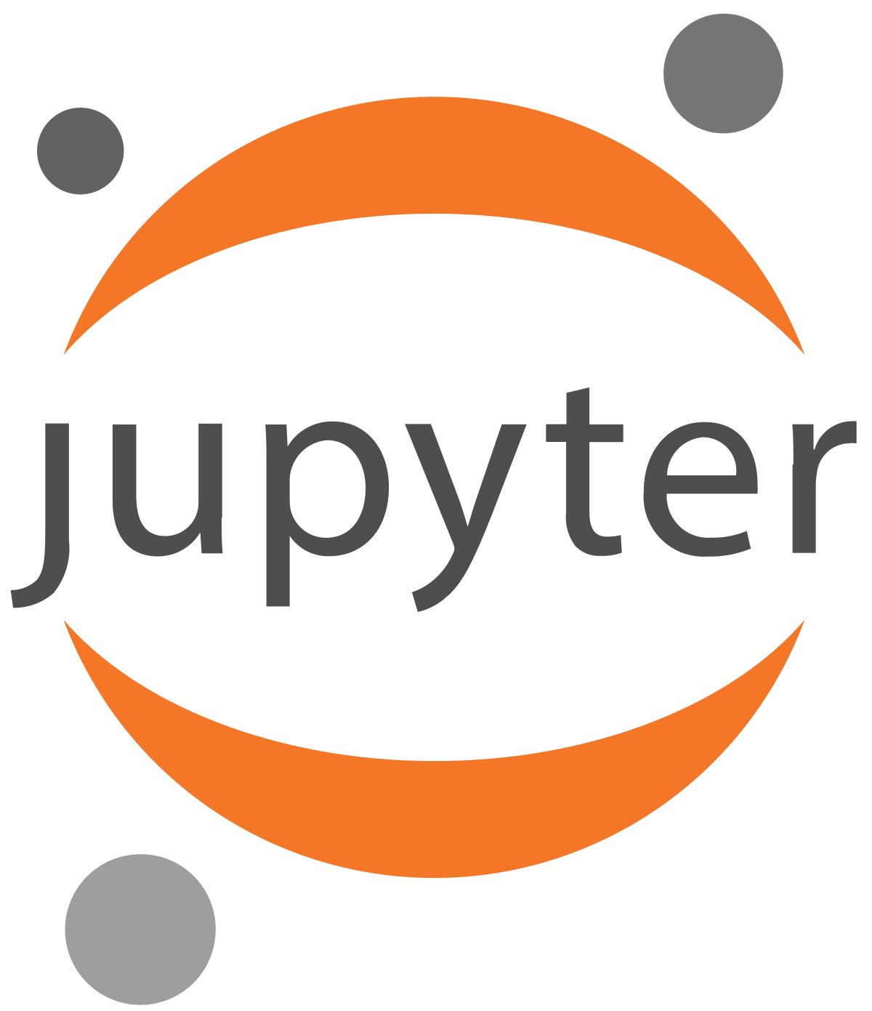
JupyterLab
JupyterLab:
A web-based application for creating and sharing computational documents
Supports over 40 programming languages
The power of JupyterLab:
It allows interactive coding
It integrates many things into a single script:
Code
Output of the code
Visualizations
Your notes
…
Source: https://commons.wikimedia.org/wiki/File:Jupyter_logo.svg

Slide 9
JupyterLab
Install Jupyter: https://jupyter.org/install
Launch JupyterLab:
Type in terminal (Linux/Unix, Mac OS) / command prompt (Windows): jupyter-lab
(DEMO)
Shut down the Jupyter server:
Type ctrl+c in terminal/command prompt : jupyter-lab
Use JupyterLab to open an existing .ipynb file:
Type in terminal/command prompt: cd directory_of_your_file
Then type in terminal/command prompt : jupyter-lab name_of_your_file.ipynb
(DEMO)

Slide 10
Basics of Python and JupyterLab
DEMO: python_jupyter_basics.ipynb

