Slide 1
Object-Oriented Programming (OOP)
PhD Seminar „Python for Linguists“ @ ZHAW, March 3-4, 2022
Qi Yu

Slide 2
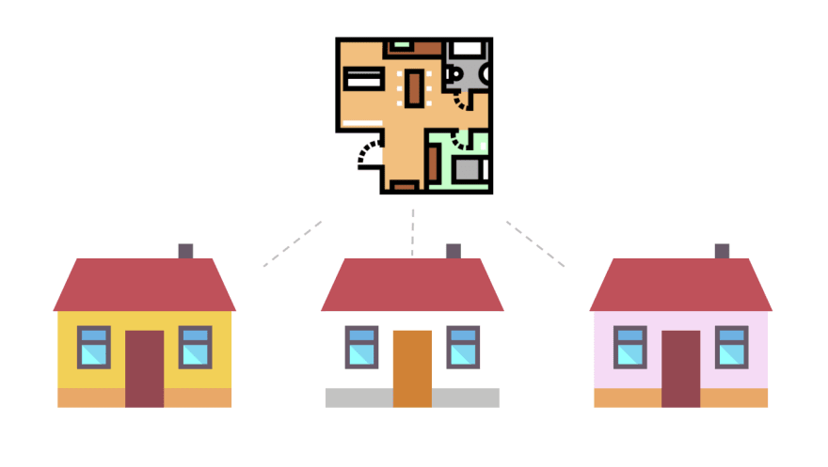
Object-Oriented Basics: Classes and Instances
Class: The “blueprint”/”template”
Object (or: Instance): The specific realization of the “blueprint”
House class:
House objects:
Source: https://dev.to/charanrajgolla/beginners-guide---object-oriented-programming

Slide 3
Object-Oriented Basics: Classes and Instances
Class can have attributes (i.e., properties) and methods (i.e., behaviors) that describe them:
House class:
wallColor
hasHeating
getAge()
startHeating()
House objects:
wallColor=“yellow”
hasHeating=True
getAge()=5
startHeating()
wallColor=“white”
hasHeating=False
getAge()=4
wallColor=“pink”
hasHeating=True
getAge()=2.5
startHeating()

Slide 4
Object-Oriented Basics: Classes and Instances
Many real-world systems can be modelled as classes and objects.
Class: Vehicle
Objects: cars, trains, trams, …
Attributes: numOfWheels, fuel,…
Methods: speedup(), brake(),…
Class: Sentence
Objects: each sentence in a text / corpus
Attributes: numOfWords, isQuestion,…
Methods: setSpeaker(), setTimeStample(),…

Slide 5
Construct Classes and Instances in Python
Demo: object_oriented_programming.ipynb (Section 1)

Slide 6
Class Attributes and Class Methods
Class attributes: attributes/information relevant for an entire class
Class methods: A method specific to a class, but not specific to any instance of the class
Demo: object_oriented_programming.ipynb (Section 2.1-2.2)

Slide 7
Instance Methods, Instance Attributes, Getters, Setters
Instance methods:
Methods specific to instances of a class
Always includes self as its first argument.
Instance attributes:
Attributes/information relevant for individual instances of a class
Always created and manipulated through instance methods (getter and setter)
Demo: object_oriented_programming.ipynb (Section 3.1-3.2)

Slide 8
Constructor:
Constructor:
Used for instantiating a class
Constructor function: __init()__
Demo: object_oriented_programming.ipynb (Section 4)

Slide 9
Inheritance
Inheritance is a powerful feature of OOP
If some class is specified to inherit from some other class, then the methods and variables of that latter class are available to the former.
Demo: object_oriented_programming.ipynb (Section 5)

Slide 10
More About OOP…
Python also allows multiple inheritance, see Hammond (2020), Chapter 9.
To control the accessibility, you can also create private classes, private methods and private attributes. See Dawson (2003), Chapter 8.

Slide 11
Reference
Dawson, Michael. 2003. Python Programming for the Absolute Beginner (3rd Edition). Thomson Course Technology.
Hammond, Michael. 2020. Python for Linguists. Cambridge University Press.

