Slide 1
Processing Text Data with Python
(Using NLTK as Example)
PhD Seminar „Python for Linguists“ @ ZHAW, March 3-4, 2022
Qi Yu

Slide 2
NLTK (Natural Language Toolkit)
We will use the Python module NLTK as an example, and build a text preprocessing pipeline step by step.
NLTK: A publicly available module with useful tools for processing text data
https://www.nltk.org
Demo: nltk.ipynb (Section 1-2)

Slide 3
Processing Text Data
For (almost) any computational tasks on text data, the texts need to be preprocessed.
In computational linguistics / natural language processing, text preprocessing includes normally the following tasks:
Tokenization
Part-of-speech tagging
Lemmatization / stemming
Removing stopwords / punctuations
Syntax parsing
Dependency parsing
Named entity recognition
Coreference resolution
…
Note:
Not all the tasks are always needed; The choice of the tasks depends on the use case.
Nor do the tasks need to be performed exactly in the order above.

Slide 4
Processing Text Data: Tokenization
Tokenization: The task of splitting a text chunk into smaller units
E.g.:
Splitting a text into sentences
Splitting a text/sentence/phrase into words
Demo: nltk.ipynb (Section 3.1)
“Winterthur is a city in Switzerland. It is the country's sixth-largest city by population. The official language of Winterthur is German.”
[ “Winterthur is a city in Switzerland.”,
“It is the country's sixth-largest city by population.”,
“The official language of Winterthur is German.” ]
“Winterthur is a city in Switzerland.”
[ “Winterthur”, “is”, “a”, “city”, “in”, “ Switzerland”, “.”]

Slide 5
Processing Text Data: Part-of-Speech Tagging
Part-of-speech (POS) ≈ word class
POS-tagging: The task of assigning a POS to each word in a text.
POS tagset: A set of all POS tags used in a corpus.
E.g., Penn Treebank English POS tagset:
https://www.ling.upenn.edu/courses/Fall_2003/ling001/penn_treebank_pos.html
“Winterthur is a city in Switzerland.”
[ ('Winterthur', 'NNP' ),
('is', 'VBZ' ),
('a', 'DT' ),
('city', 'NN' ),
('in', 'IN' ),
('Switzerland', 'NNP' ),
('. ', '. ' ) ]
POS-tags

Slide 6
Processing Text Data: Lemmatization
Lemma: The canonical form of a word, i.e., the form you will find in a dictionary.
Lemmatization: The task of mapping the inflected forms to their canonical forms (i.e., lemmas).
word | lemma
go, went, gone | go
apple, apples, apple’s | apple
“Winterthur is connected to Germany by direct trains”
“Winterthur be connect to Germany by direct train”

Slide 7
Processing Text Data: Stemming
Stemming: The task of reducing words to their stems by chopping off affixes (crudely).
Note the difference between lemmatization and stemming!
Examples of application: information retrieval
Reduces the variant word forms to the stem, and thus solve the problem of vocabulary mismatch (see Singh & Gupta 2016)
Demo of POS-tagging, lemmatization, stemming: nltk.ipynb (Section 3.2-3.3)
“Winterthur is connected to Germany by direct trains”
“winterthur is connect to germani by direct train”

Slide 8
Processing Text Data: Stop words, Punctuations
For certain cases, you may stumble upon the need of removing stop words and punctuations.
Stop words:
generally refers to a list of words that should be filtered out from text data;
usually the list of function words of a language, i.e., words which bear grammatical functions and have little lexical meaning
E.g., determiners the, a; prepositions in, to
There is no universal set of stop words. It highly depends on the task.
E.g., For some cases, you may want to remove the word not, whereas for some cases negation is highly crucial information and you would thus retain it.
Demo: nltk.ipynb (Section 3.4)
Demo: nltk.ipynb (Section 3.1-3.3)

Slide 9
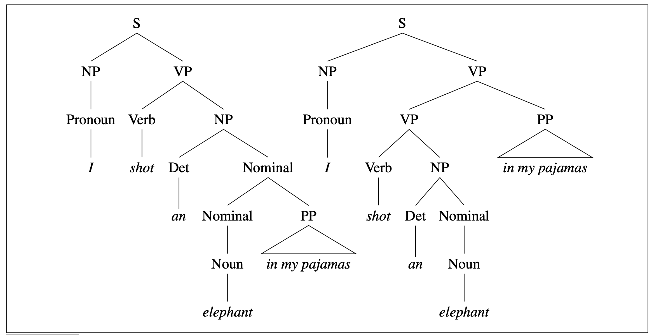
Processing Text Data: Constituency Parsing
Constituency parsing: The task of assigning phrasal structures to a sentence.
E.g.: I shot an elephant in my pajamas.
Resolving ambiguations is a huge challenge for constituency parsing.
Demo: nltk.ipynb (Section 4.1)
Further reading on constituency parsing: Jurafsky & Martin (2021), Chapter 13
(Source: Jurafsky & Martin 2021)

Slide 10
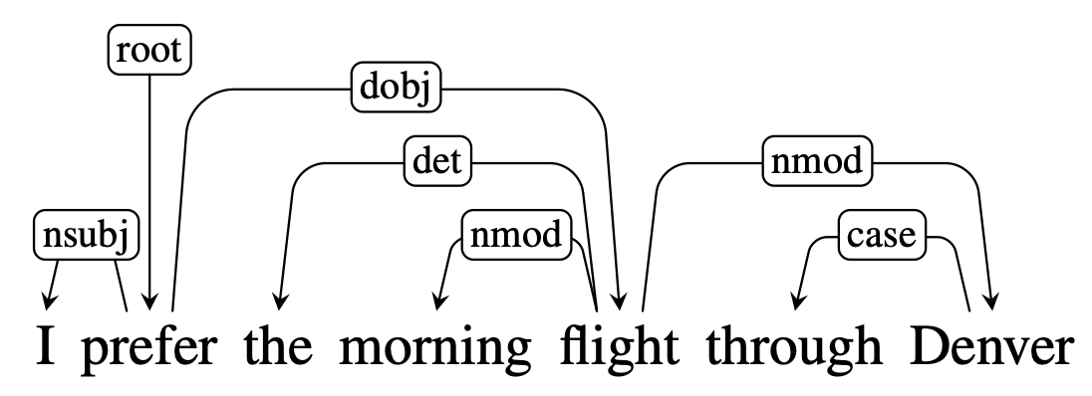
Processing Text Data: Dependency Parsing
To understand dependency parsing, the dependency grammar should be introduced first:
Dependency grammar: a class of grammatical theory in which the syntactic structure of a sentence is described solely in terms of directed binary grammatical relations between the words.
(Source: Jurafsky & Martin 2021)

Slide 11
Processing Text Data: Dependency Parsing
Notions in dependency grammar:
head: the word being modified (the “governor”)
dependent: the modifier of a head
E.g., in the figure above:
flight: a head
morning: a dependents of the head flight
nmod (‘nominal modifier’): the dependency relation between flight and morning
Universal Dependencies: https://universaldependencies.org/#language-u
(Source: Jurafsky & Martin 2021)

Slide 12
Processing Text Data: Dependency Parsing
Dependency parsing: the task of assigning the dependency grammar structure of a sentence.
Difference between dependency parsing and constituency parsing (Jurafsky & Martin 2021):
Phrasal constituents and phrase-structure rules do not play a direct role;
The syntactic structure of a sentence is described solely in terms of directed binary grammatical relations between the words.
Demo: nltk.ipynb (Section 4.2)
Further reading on Syntactic parsing: Jurafsky & Martin (2021), Chapter 14
(Source: Jurafsky & Martin 2021)

Slide 13
Concluding Remark
We have learned how to build a pipeline for text preprocessing using the Python module NLTK.
However, NLTK is not the only choice for text preprocessing. There are various state-of-the-art modules using different techniques (e.g., neural networks).
E.g.:
Stanza: https://stanfordnlp.github.io/stanza/
spaCy: https://spacy.io
Moreover, NLTK provides a whole range of different stemmers, parsers etc. which are realized using different algorithms, i.e., the ones shown in the demo file are not the only choices. See the NLTK book for details: https://www.nltk.org/book/

Slide 14
Excursion
There are several other Python modules that are often used in computational linguistic researches:
matplotlib: for data visualization (make plots etc.)
https://matplotlib.org
pandas: for manipulating data in table-form, such as .csv-files
https://pandas.pydata.org
SciPy: for statistical analysis, e.g., statistical tests
https://scipy.org
Demo: other_useful_libraries.ipynb

Slide 15
References
Jurafsky, Dan, and James H. Martin. 2021. Speech and language processing (3rd ed. draft). https://web.stanford.edu/~jurafsky/slp3/.
Singh, Jasmeet, and Vishal Gupta. 2016. Text stemming: Approaches, applications, and challenges. ACM Computing Surveys (CSUR) 49(3): 1-46.

