Slide 1
Data Types
PhD Seminar „Python for Linguists“ @ ZHAW, March 3-4, 2022
Qi Yu

Slide 2
Basic Data Types in Python
Numbers
Booleans
Strings
Lists
Tuples
Dictionaries

Slide 3
Data Type 1: Numbers
Three basic types of numbers:
Integers
E.g., 0, 2, 389, …
Floating point numbers
E.g., 3.23, 0.00001, 7.2 …
Complex numbers: Consist of a real part and an imaginary part
(They are not likely to be used in linguistic researches, so we won’t focus on them. See Python Documentation for more information: https://docs.python.org/3/library/stdtypes.html)
Demo: data_types.ipynb (Section 1)

Slide 4
Data Type 2: Booleans
The data type booleans has only two values:
True
False
Demo: data_types.ipynb (Section 2.1)

Slide 5
Data Type 2: Booleans
Doing comparisons with logical operators also results in booleans:
Demo: data_types.ipynb (Section 2.2)
Comparison | Denoted in Python as..
Equal to | ==
Not equal to | !=
Greater than / follows alphabetically | >
Greater than or equal / follows alphabetically or equal | >=
Smaller than / precedes alphabetically | <
Smaller than or equal / precedes alphabetically or equal | <=

Slide 6
Data Type 3: Strings
Strings are denoted by quotation marks - We have seen them in the intro-session.
Different quotation marks can be used for different cases – see the demo.
Demo: data_types.ipynb (Section 3.1)

Slide 7
Data Type 3: Strings – Functions and Operators
len() # A function for checking the length
in # An operator checking if an element is a member of a sequence
Demo: data_types.ipynb (Section 3.2.1)

Slide 8
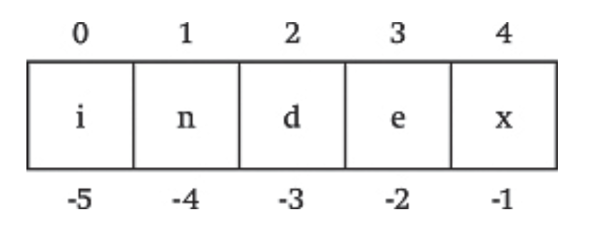
Data Type 3: Strings – Functions and Operators
Indexing: Grab certain element(s) of a sequence directly by using its index/their indices
Two possibilities of indexing:
Positive position numbers
Negative position numbers
Demo: data_types.ipynb (Section 3.2.2)
Source: Dawson (2003)

Slide 9
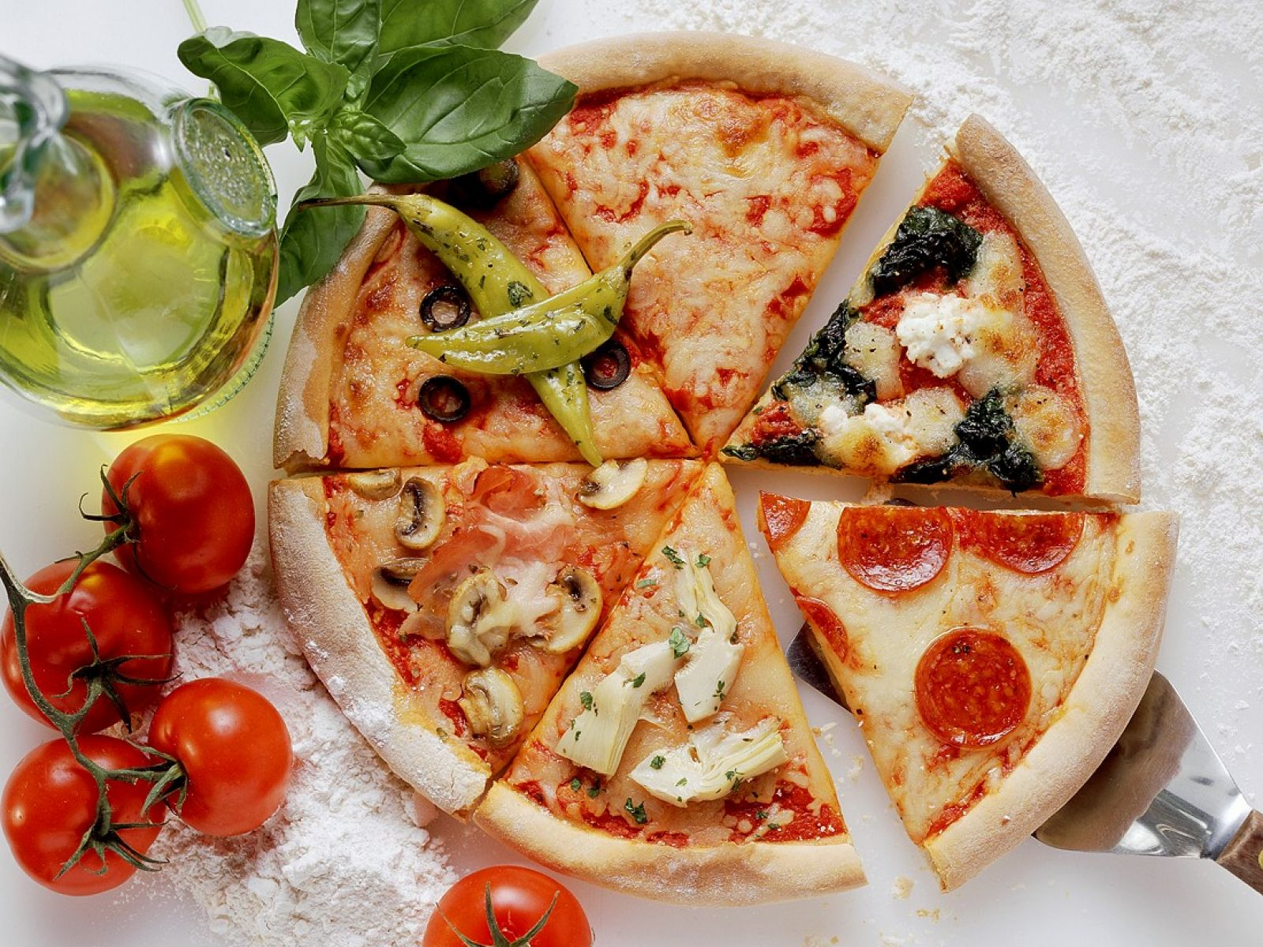
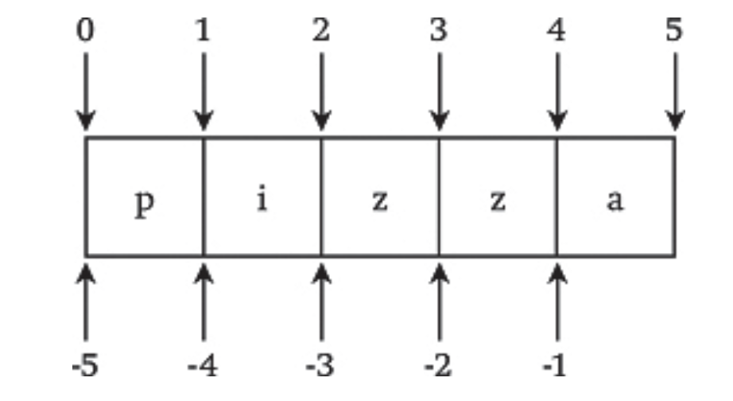
Data Type 3: Strings – Functions and Operators
Slicing: “Cut” a piece of a string by specifying the starting position and ending position
Note the different numbering system between indexing and slicing (see last slide)!
Demo: data_types.ipynb (Section 3.2.3)
Source: Dawson (2003)

Slide 10
Data Type 4: Lists
Lists are a structure for holding a sequence of elements. The elements can be of different data types.
In Python, lists are denoted by using square brackets []
Elements of a list can be changed.
(We will learn more about mutability in the coming part.)
Demo: data_types.ipynb (Section 4)

Slide 11
Data Type 5: Tuples
Tuples are also a structure for holding a sequence of elements. The elements can be of different data types.
In Python, tuples are denoted by using round brackets ()
Different from lists: Elements of a tuple can NOT be changed.
Demo: data_types.ipynb (Section 5)

Slide 12
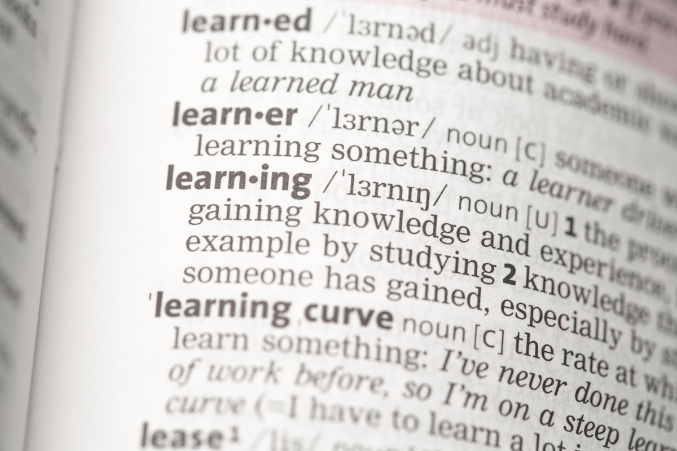
Data Type 6: Dictionaries
Dictionaries are sets of key-value pairs.
(Just like a real dictionary)
In Python, dictionaries are denoted by using curly brackets:
{ key1: value1,
key2: value2,
key3: value3 }
Items in a dictionary can be changed.
Demo: data_types.ipynb (Section 6)
Source: https://www.teachingenglish.org.uk/article/dictionary-skills-secondary-students

Slide 13
Important Notion: Mutability
Mutability: The property of being/not being able to changed
Mutable: can be changed
Immutable: cannot be changed
Mutable | Immutable
list, dictionary | string, tuple

Slide 14
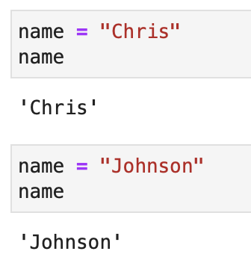
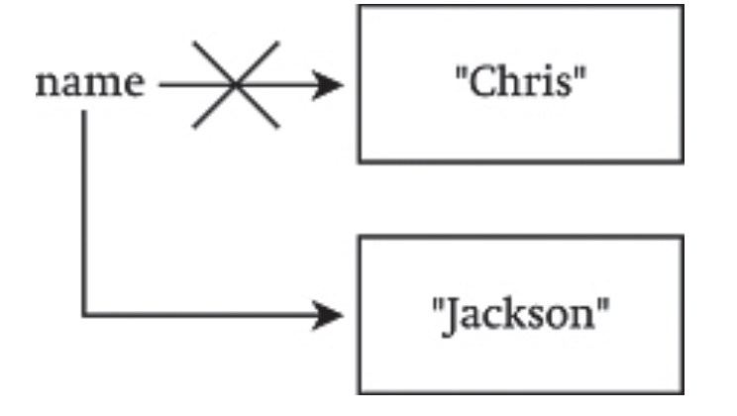
Important Notion: Mutability
Caveat of mutability:
A variable can be re-assigned new values ≠ The variable is mutable!
Demo: data_types.ipynb (Section 7)
THE STRINGS STAY UNCHANGED:
“Chris” stays “Chris”,
“Johnson” stays “Johnson”.
→ “IMMUTABLE”
THE POINTERS CHANGED:
“reassign”; has nothing to do with “mutability”

Slide 15
Basic Data Types
Hands-On: Write a program that asks the user…
1) for their given name;
2) for their family name;
3) print out the full name the user. E.g., if the user entered “Amy” as given name and “Smith” as family name, your program should print out “Amy Smith”.

Slide 16
Reference
Hammond, Michael. 2020. Python for Linguists. Cambridge University Press.

