Slide 1
PhD Seminar “Python for Linguists”
ZHAW, March 3-4, 2022
Qi Yu

Slide 2
For Whom is This Seminar?
This seminar is intended for beginners, i.e., we will start from the very basics.

Slide 3
About Me…
Qi Yu (pronunciation of Qi: like the part “chee” in “cheese”)
Doctoral researcher at the Cluster of Excellence “The Politics of Inequality”, University of Konstanz
Research interest:
Broad: Natural language processing (NLP)
Narrow: Automated detection of frames and linguistic devices for framing in political discourse; Operationalizing linguistic knowledge for NLP applications
Me and Python:
Python is one of my daily “working language” (besides English and German ☺)
Previous experiences in industry and study: Using Python for data extraction and analysis, and generally automatizing boring repeating procedures

Slide 4
About You: Some Surveys
Your background: Do you identify yourself as having a theoretical or an empirical background?
Programming experiences in languages other than Python?

Slide 5
Organizational Issues
Course materials: https://github.com/qi-yu/teaching-materials-python
Final assignment deadline: March 31, 2022 - feasible?

Slide 6
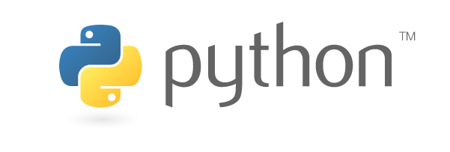
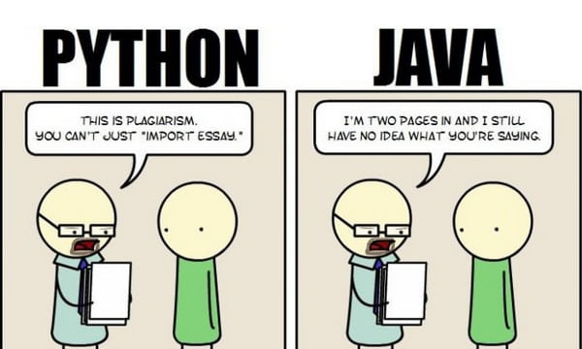
Why Python?
Source:https://www.python.org/community/logos/
For linguistic research: a large collection of libraries for computational linguistics / NLP
Portability: Python runs on almost every major operating system
Readability; Relatively easy to learn
A large community for support
Source: https://9gag.com/gag/aWZXKyx

Slide 7
Interaction with Python
Command line
(DEMO)
IDE
(DEMO)
Jupyter (Jupyter Lab, Jupyter Notebook, Jupyter Hub)
→ We will use Jupyter for this course.

Slide 8

JupyterLab
JupyterLab:
A web-based application for creating and sharing computational documents
Supports over 40 programming languages
The power of JupyterLab:
It allows interactive coding
It integrates many things into a single script:
Code
Output of the code
Visualizations
Your notes
…
Source: https://commons.wikimedia.org/wiki/File:Jupyter_logo.svg

Slide 9
JupyterLab
Install Jupyter: https://jupyter.org/install
Launch JupyterLab:
Type in terminal (Linux/Unix, Mac OS) / command prompt (Windows): jupyter-lab
Windows: https://www.howtogeek.com/235101/10-ways-to-open-the-command-prompt-in-windows-10/
(DEMO)
Shut down the Jupyter server:
Type ctrl+c in terminal/command prompt : jupyter-lab
Use JupyterLab to open an existing .ipynb file:
Type in terminal/command prompt : jupyter-lab name_of_your_file.ipynb
(DEMO)

Slide 10
Basics of Python and JupyterLab
DEMO: python_jupyter_basics.ipynb

