Slide 1
Five Fundamental Principles
of Ethics for Professional Accountants
Presenter: Shiqi Hu
Date: 28 May 2026
Notes:
Open by naming the topic and explaining why ethics matter in accounting. Emphasise that APES 110 is not only a compliance document; it is a public-interest framework for professional judgment.

Slide 2
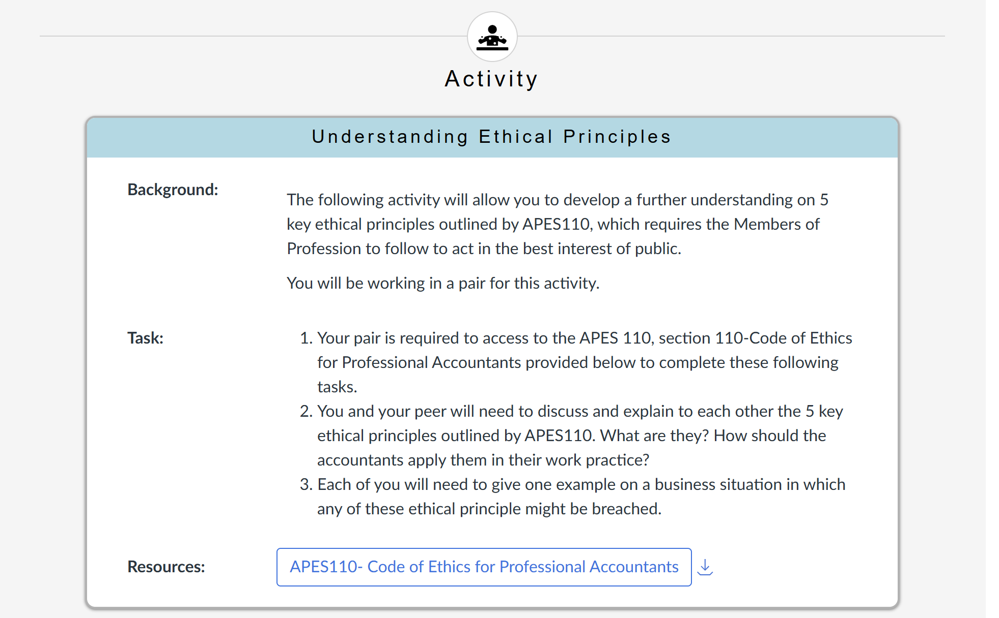

Slide 3
Principles 1-3: Fundamental Principles
APES 110 Section 110 sets out five core principles that guide professional accountants in serving the public interest.
01 Integrity
02 Objectivity
03 Professional Competence and Due Care
Be straightforward and honest in all professional and business relationships.
Avoid bias, conflicts of interest, and undue influence when exercising professional judgment.
Maintain professional knowledge and skill, and act diligently in accordance with applicable standards.
Notes:
Transition from the opening to the first three principles. Give the audience a simple listening task: notice how each principle protects the reliability of accounting work.

Slide 4
Principles 1-3: Applying the Concepts
01
02
03
Professional Competence
and Due Care
Integrity
Objectivity
Application
Do not be associated with false or misleading information; correct errors promptly.
Application
Do not allow personal relationships or financial interests to influence professional judgment.
Application
Keep knowledge current; accept only work you are competent to perform; supervise junior staff appropriately.
Notes:
Use quick examples rather than reading each box. For integrity, mention refusing misleading reports. For objectivity, mention conflicts of interest. For competence, mention knowing when to seek advice or decline work.

Slide 5
Principles 4-5: Fundamental Principles
04. Confidentiality
05. Professional Behaviour
Protect sensitive information obtained through professional work, unless disclosure is properly authorised or legally required.
Comply with laws and regulations, and avoid conduct that could discredit the profession.
Notes:
Introduce confidentiality and professional behaviour as outward-facing responsibilities. Stress that accountants often handle sensitive information and represent the credibility of the profession.

Slide 6
Principles 4-5: Applying the Concepts
04. Confidentiality
05. Professional Behaviour
Application: Do not disclose client or employer information without authority; never use confidential information for personal gain.
Exception: Disclosure may be required by law, such as reporting suspected fraud to authorities.
Application: Follow all relevant laws and standards; avoid misleading claims or conduct that harms the profession's reputation.
Notes:
Explain the difference between ordinary confidentiality and legal exceptions. Then connect professional behaviour to everyday conduct, such as honest communication and avoiding exaggerated claims.

Slide 7
Case Study: Breach of Multiple Principles
The Scenario
Principle Breaches
Outcomes
Sarah is asked to defer $2 million of expenses to smooth quarterly earnings. The CEO says jobs are at risk, but Sarah knows the adjustment would make the financial statements misleading.
ASIC investigation and financial restatement.
Loss of CPA membership and potential penalties.
Shareholder claims and reputational damage.
1. Integrity: Supports misleading reporting.
2. Objectivity: CEO pressure overrides professional judgment.
3. Professional Behaviour: Breaches accounting standards and corporate law.
Notes:
Set up the case briefly, then ask the class what Sarah should do before revealing the breaches. Highlight that pressure from senior management is a threat, but it does not remove professional responsibility.

Slide 8
Conclusion
Public Trust & Interest
They protect the public interest by sustaining trust in accountants and financial information.
Framework Application
Accountants should use the conceptual framework to identify, evaluate, and address threats to ethical conduct.
Foundation of Practice
The five fundamental principles provide the ethical foundation for professional accounting practice.
Ethical behaviour is not optional; it is a non-negotiable professional obligation.
Notes:
Close by linking the principles back to public trust. Remind the audience that the conceptual framework helps accountants move from recognising a risk to taking an appropriate action.
End with one clear takeaway: ethical accounting is a professional obligation, not a personal preference. Invite questions and discussion.

Slide 9
References
Accounting Professional & Ethical Standards Board. (2018). APES 110 Code of ethics for professional accountants (including independence standards). https://www.apesb.edu.au/standards/apes-110-code-of-ethics/
Auditing and Assurance Standards Board. (2019). ASA 102 Compliance with ethical requirements when performing audits, reviews and other assurance engagements. https://www.auasb.gov.au/standards/auditing-standards/asa-102/

Slide 10
Thank You
Questions?
Notes:
Thank the audience and invite questions. If time allows, ask which principle they think is hardest to apply in real workplaces and why.

