Slide 1
The 5 Fundamental Principles
of Ethics for Professional Accountants
Presenter: Shiqi Hu
Date: 2026.05.28
Notes:
Good morning/afternoon, everyone. Today, I will be presenting on the APES 110 Code of Ethics for Professional Accountants, focusing on its five fundamental principles. This code is crucial for ensuring that accountants act in the public interest, and I will break down what these principles are and how they apply in practice.

Slide 2
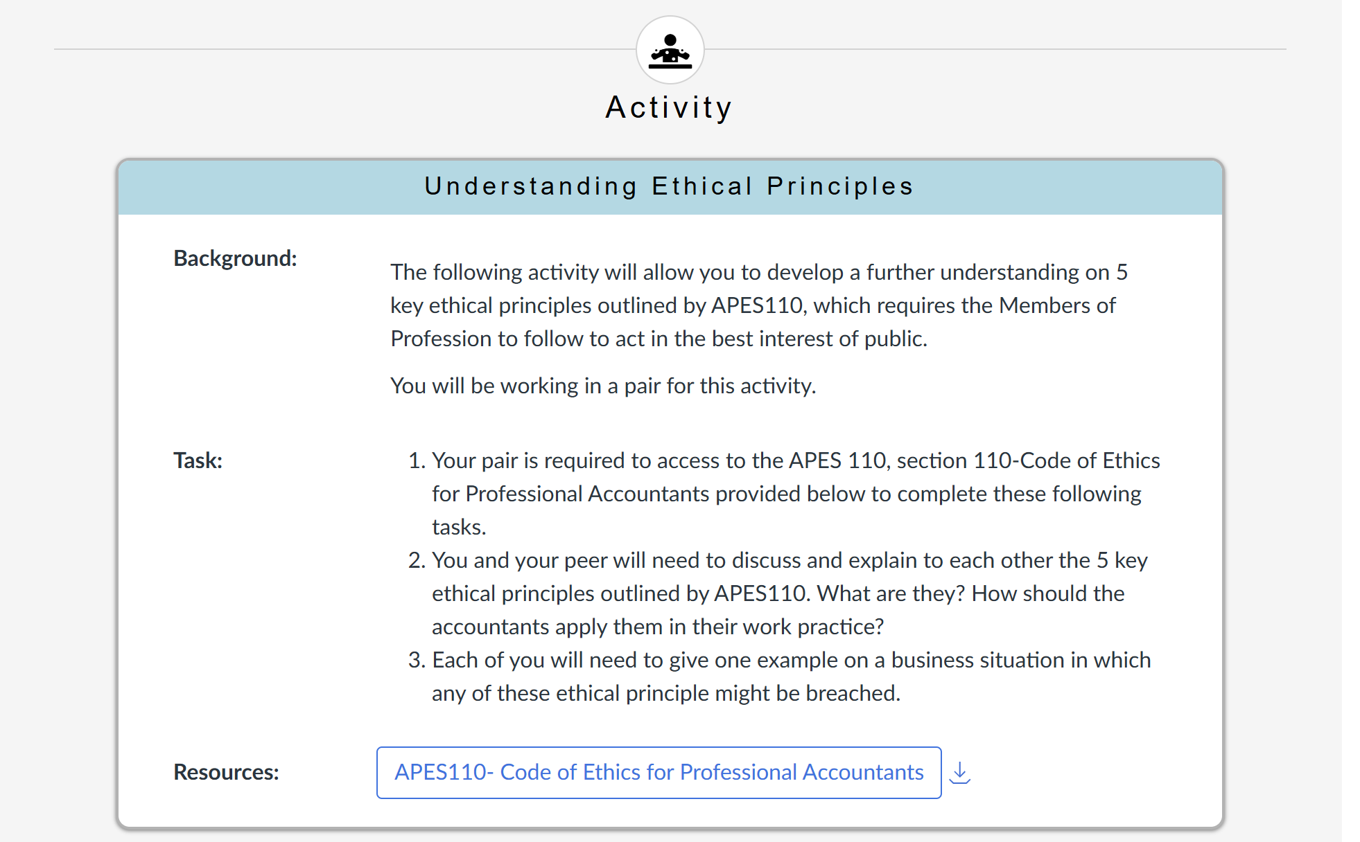

Slide 3
1 to 3 Fundamental Principles
APES 110 Section 110 defines 5 non-negotiable principles that form the foundation of ethical conduct for professional accountants:
01 Integrity
02 Objectivity
03 Professional Competence and Due Care
Be straightforward and honest in all professional and business relationships.
Avoid bias, conflict of interest and undue influence of others to compromise professional judgment.
Maintain professional knowledge and skill, act diligently in accordance with applicable standards.
Notes:
Now we dive into the heart of APES 110: the five fundamental principles. Today we will focus on the first three: Integrity, Objectivity, and Professional Competence and Due Care. These are the bedrock of ethical behavior for all professional accountants.

Slide 4
Principles 1-3 Application
01
02
03
Professional Competence
and Due Care
Integrity
Objectivity
Application
Do not associate with false/misleading information; correct errors immediately.
Application
Do not let personal relationships or financial interests influence professional judgment.
Application
Maintain up-to-date knowledge; only take on work you are qualified to perform; supervise junior staff.
Notes:
Let's look at the first three principles. Integrity means being honest and straightforward. For example, you must refuse to sign off on a report you know is misleading. Objectivity requires you to avoid conflicts of interest, like auditing a company where your family member is a senior executive. Finally, Professional Competence means staying skilled and only doing work you're qualified for, such as attending regular professional development training.

Slide 5
4 and 5 Fundamental Principles
04. Confidentiality
05. Professional Behaviour
Protect sensitive information acquired through professional activities, and do not disclose it without proper authority.
Comply with relevant laws and regulations, and avoid any conduct that discredits the profession.
Notes:
Continuing with the five fundamental principles, we have Confidentiality and Professional Behaviour. Confidentiality means protecting client information, while Professional Behaviour requires accountants to follow the law and uphold the reputation of their profession.

Slide 6
Principles 4-5 application
04. Confidentiality
05. Professional Behaviour
Application:Do not disclose client/employer information without proper authority; do not use confidential information for personal gain.
Exception:Required by law (e.g., reporting fraud to authorities).
Application:Comply with all laws and regulations; avoid any conduct that discredits the accounting profession or brings it into disrepute.
Notes:
Now for the last two principles. Confidentiality means protecting sensitive information. You shouldn't share a client's private business details, like an upcoming merger, with anyone outside the professional relationship. Finally, Professional Behaviour means following the law and acting in a way that brings credit to the profession, such as avoiding misleading advertising about your services.

Slide 7
Case Study: Breach of Multiple Principles
The Example
Principle Breaches
Outcomes
Sarah, a management accountant, is pressured by her CEO to “smooth” the company’s quarterly earnings by deferring $2 million in expenses. The CEO threatens that company jobs are at stake if she does not comply. Despite knowing the action will render the financial statements misleading, Sarah reluctantly agrees to follow the instructions.
ASIC launches a formal investigation into the company’s financial reporting.
Sarah is permanently stripped of her CPA membership and issued a huge amount fine.
This company is forced to restate financials and faces costly class-action lawsuits from shareholders.
1. Integrity:Associating oneself with materially false or misleading financial information.
2. Objectivity:Allowing undue influence and intimidation from the CEO to override professional judgment.
3. Professional Behaviour:Violating fundamental accounting standards and applicable corporate law.
Notes:
To see these principles in action, let's look at a case study. Imagine Sarah, an accountant, is pressured by her CEO to manipulate the company's earnings. By complying, Sarah breaches Integrity by being associated with false information, Objectivity by letting intimidation cloud her judgment, and Professional Behaviour by breaking the law. The consequences are severe: loss of her professional license, fines, and legal trouble for the company.

Slide 8
Conclusion
Public Trust & Interest
They protect the public interest by maintaining the integrity and reputation of the accounting profession.
Framework Application
Accountants must actively use the conceptual framework to identify, evaluate, and address threats to these core principles.
Foundation of Practice
The 5 fundamental principles are the bedrock of ethical accounting practice, guiding decision-making in every professional scenario.
Ethical behavior is not optional – it is an essential, non-negotiable obligation for every professional accountant.
Notes:
In conclusion, these five principles are the bedrock of ethical accounting. They ensure that accountants act in the public's best interest and uphold the trust placed in the profession. It's crucial for every accountant to understand and apply these principles daily.
Remember, ethical behavior isn't a choice; it's a professional obligation. Thank you for your time. I'm happy to answer any questions.

Slide 9
References：
Accounting Professional & Ethical Standards Board. (2018, November). APES 110 Code of ethics for professional accountants (including independence standards). Author. https://www.apesb.edu.au/standards/apes-110-code-of-ethics/
Auditing and Assurance Standards Board. (2019). ASA 102 Compliance with ethical requirements when performing audits, reviews and other assurance engagements. Author. https://www.auasb.gov.au/standards/auditing-standards/asa-102/

Slide 10
Thank you
for listening
Notes:
Good morning/afternoon, everyone. Today, I will be presenting on the APES 110 Code of Ethics for Professional Accountants, focusing on its five fundamental principles. This code is crucial for ensuring that accountants act in the public interest, and I will break down what these principles are and how they apply in practice.

