Slide 1
Benchmarking Spike-Based
Visual Recognition:
a Dataset, Evaluation and Algorithms
Qian Liu
Supervisor: Steve Furber
Co-Supervisor: David Lester
Adviser: Alvaro Fernandes
Notes:
讲解Spike-based 的特殊之处

Slide 2
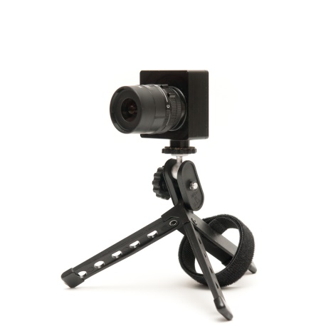
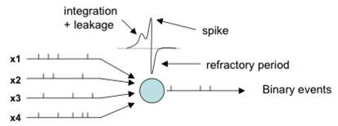
Background
Spikes
Spiking Neural Networks (SNNs)
Special visual input for SNNs
- e.g. DVS(Dynamic Vision Sensor)
DAVIS240: £3,346
Notes:
-expensive.
-separate research
Comparisons with spiking and non-spiking conventional methods
Special accessment particular for SNN

Slide 3
Aims and Motivations
Authors | Data | Accuracy
Matsugu et al. (2002) | Face plain images | 98.3%
Fu et al. (2012) | JAFFE plain images | 97.35%
O’Connor et al. (2013) | Poissonian Spiking MNIST | 95.0%
Bichler et al. (2012) | DVS recorded Car trajectories | 98%
Zhao et al. (2015) | DVS recorded Three postures | 99.48%
… | … | …
Unified spiking data
Meaningful comparisons
Promoting future research
Notes:
-expensive.
-separate research
Comparisons with spiking and non-spiking conventional methods
Special accessment particular for SNN

Slide 4


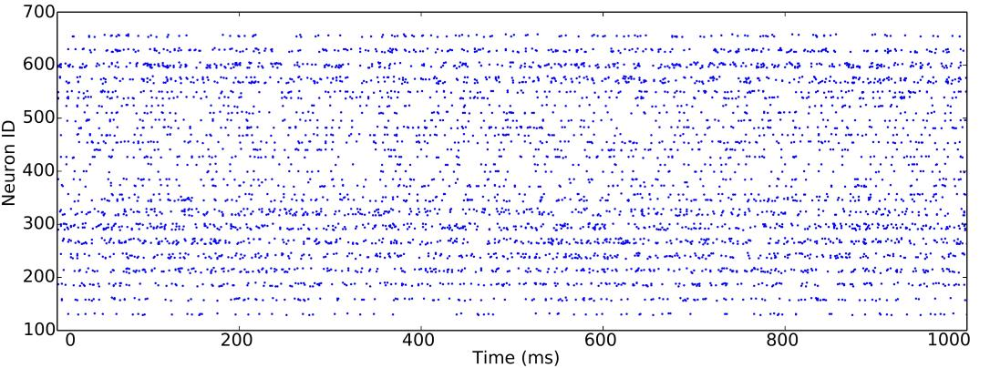
A Dataset: NE15-MNIST
Unified spiking data
- Poissonian generator
- Rank order coding generator
- DVS recorded flashing image
- DVS recorded moving image
Notes:
\item \textit{Poissonian}
to benchmarking existing methods of rate-based spiking models.
\item \textit{FoCal~(Filter overlap Correction)}
to promote the study of spatio-temporal algorithms applied to recognition tasks using few input spikes.
\item \textit{DVS recorded flashing input}
to encourage research on fast recognition methods which are found in the primate visual pathway.
\item \textit{DVS recorded moving input}
to trigger the study of algorithms targeting on continuous input from real-world sensors and to implement them on mobile neuromorphic robots.
Motivations!

Slide 5
A Dataset: NE15-MNIST
Meaningful comparisons
- On the same data
- Among SNNs
- vs. conventional algorithms
Notes:
Among SNNs
Special input for different algorithms
Same input different algorithms

Slide 6
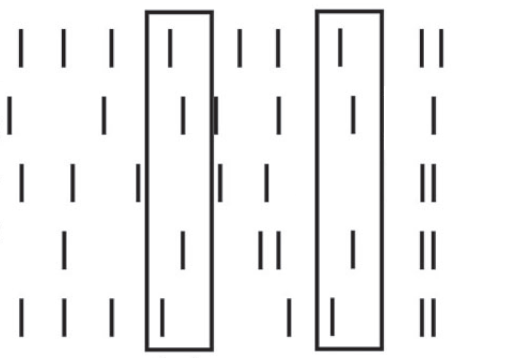
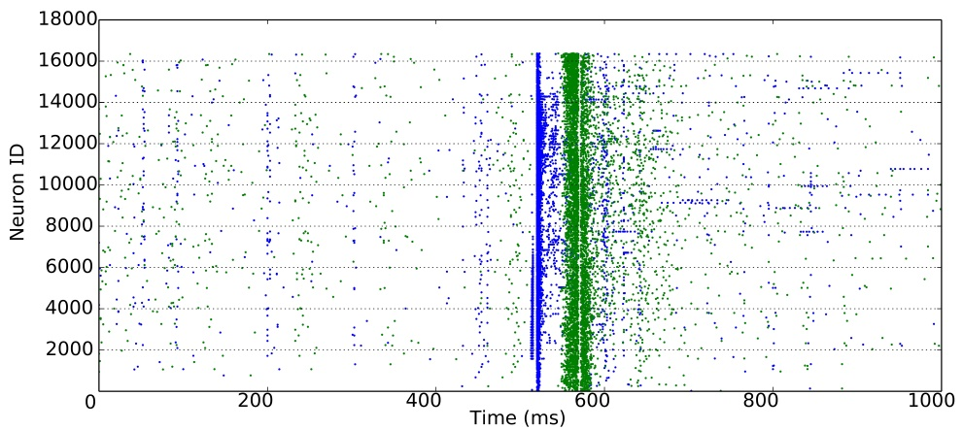
A Dataset: NE15-MNIST
Promoting future research
- Poissonian: easier accessible
- ROC: spatio-temporal pattern recognition
- Flashing image: fast recognition
- Moving image: invariant recognition
Notes:
\item \textit{Poissonian}
to benchmarking existing methods of rate-based spiking models.
\item \textit{FoCal~(Filter overlap Correction)}
to promote the study of spatio-temporal algorithms applied to recognition tasks using few input spikes.
\item \textit{DVS recorded flashing input}
to encourage research on fast recognition methods which are found in the primate visual pathway.
\item \textit{DVS recorded moving input}
to trigger the study of algorithms targeting on continuous input from real-world sensors and to implement them on mobile neuromorphic robots.
Motivations!

Slide 7
Evaluation on Spiking Vision Recognition
Metrics on SNN models
- Biological training time
- Biological testing time
- Response latency
Notes:
feasibility (classification accuracy)
Such as: network size, neural and synaptic type and learning algorithm and precision

Slide 8
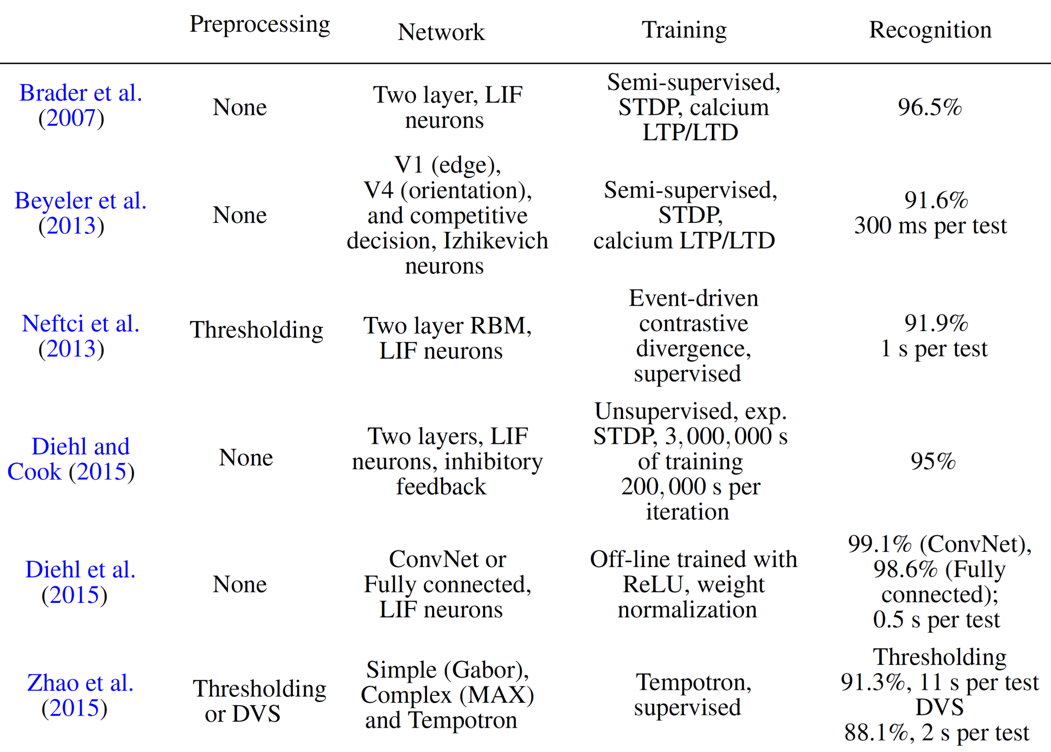

Slide 9
Evaluation on Spiking Vision Recognition
Metrics on H/W platforms
- Feasibility due to H/W limits
- Simulation time
- Energy use
Notes:
feasibility (classification accuracy)
Such as: network size, neural and synaptic type and learning algorithm and precision
Self injection spikes.
Best performance, but unpractical model.

Slide 10
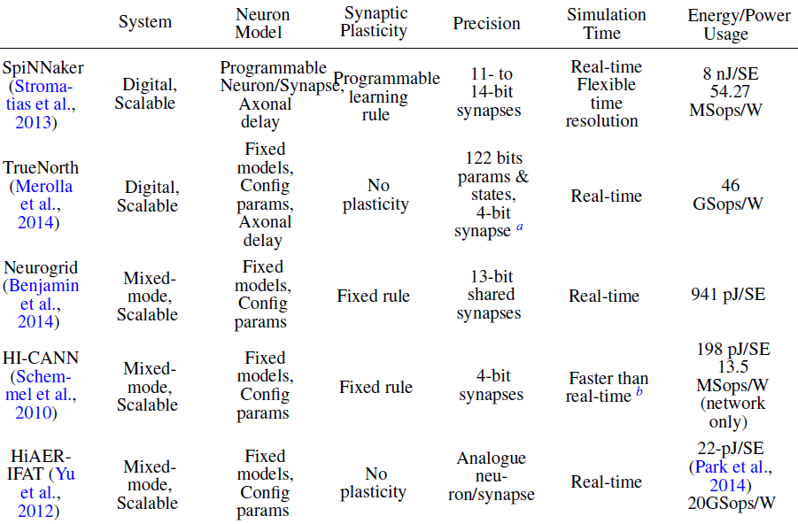
Notes:
General but not specific evaluation
Self injection spikes.
Best performance, but unpractical model.

Slide 11
Benchmarking SNNs Algorithms
state-of-the-art
- 2-Layer STDP (Synaptic-timing dependent plasticity)
- Spiking Deep Network (off-line training)
- Spiking Convolutional Network(ConvNet) (off-line training)
Case studies on H/W (SpiNNaker)
- STDP online training
- Spiking Deep Belief Network (SDBN) (Evangelos Stromatias)
- Spiking ConvNet (1st year, and future work)
Notes:
STDP biologically plausible

Slide 12
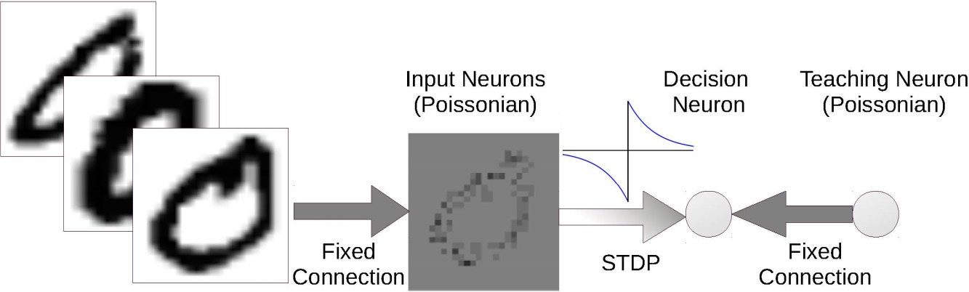
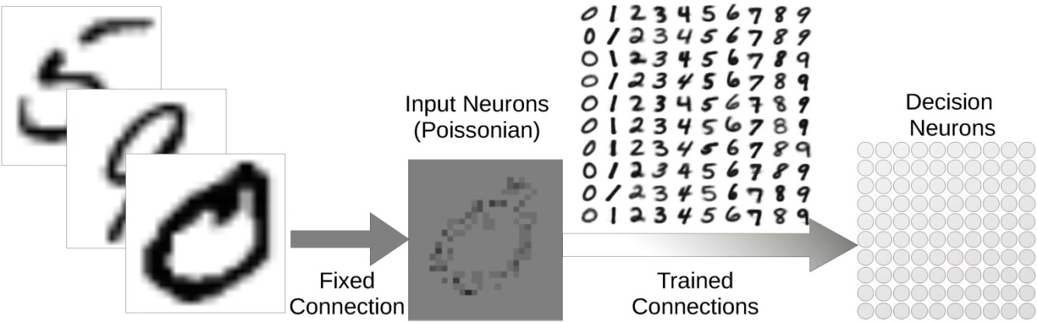
Case Study I: 2-layer STDP
Training
Testing
Notes:
feasibility (classification accuracy)
Such as: network size, neural and synaptic type and learning algorithm and precision

Slide 13
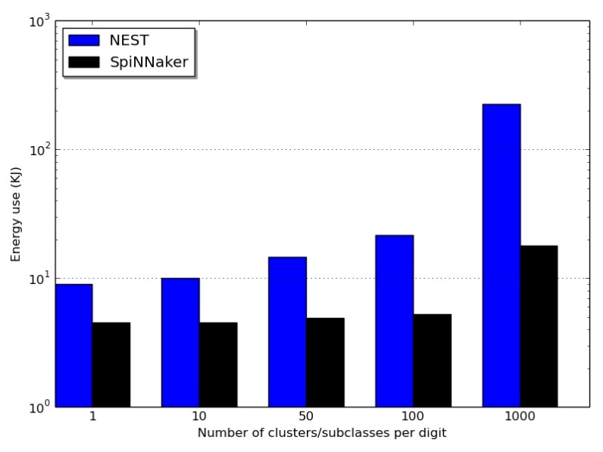
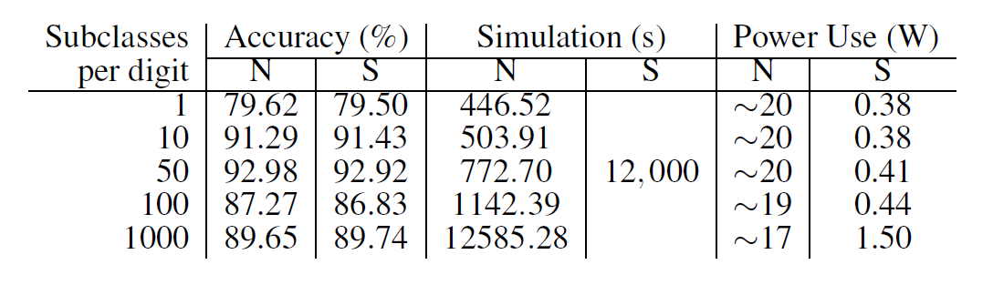
Case Study I: 2-layer STDP
Metrics on SNN models
- biological training time: 18,000s, 0.3s / image
- biological testing time: 1s / image
- response latency: 10.7ms
Metrics on H/W platforms
- feasibility due to H/W limits
- simulation time
- energy use
N: Nest
S: SpiNNaker
This work has been submitted to Frontiers in Neuromphic Engineering and is under interactive review.
Notes:
Thermal design power

Slide 14
Future Work:
Towards the Robust Object Recognition
state-of-the-art
2-Layer STDP learned – 1 case study
Spiking DBN (off-line training) – online formalised training
Spiking ConvNet (off-line training) – future case study
My exploration on Spiking DBN
Restricted Boltzmann Machine (RBM)
Deep Belief Net
Future work: spiking RBM & DBN
Current work has been written down in a study report.

Slide 15
Potential Research Tasks
Future Tasks
Contrastive Divergence
Mean-Field Theory
RBM Validation
SRBM Structure
Maths of DBN
STDP Learning for CD
Practical Training Methods
Layered STDP Learning
2015
Q4
Q1 2016
Q2
Q3
Q4
2016
Today
RBM
32 days
DBN
31 days
SRBM
92 days
SDBN
93 days
Benchmarks
92 days
Thesis Writing
184 days

Slide 16
Questions?

