Slide 1
Benchmarking Spike-Based
Visual Recognition:
a Dataset, Evaluation and Algorithms
Qian Liu
Supervisor: Steve Furber
Co-Supervisor: David Lester
Adviser: Alvaro Fernandes

Slide 2
Aims and Motivations
Unified spiking data
Comparisons
Evaluation methodology
Promote future research
Notes:
Have to record data individually
Comparisons with spiking and non-spiking conventional methods
Special accessment particular for SNN

Slide 3
A Dataset: NE15-MNIST
AER format
jAER support code
4 subsets
Poisson: unified data generation
FoCal: Rank-Order-Coding
Flash: fast recognition
Moving: invariant recognition
Notes:
\item \textit{Poissonian}
to benchmarking existing methods of rate-based spiking models.
\item \textit{FoCal~(Filter overlap Correction)}
to promote the study of spatio-temporal algorithms applied to recognition tasks using few input spikes.
\item \textit{DVS recorded flashing input}
to encourage research on fast recognition methods which are found in the primate visual pathway.
\item \textit{DVS recorded moving input}
to trigger the study of algorithms targeting on continuous input from real-world sensors and to implement them on mobile neuromorphic robots.
Motivations!

Slide 4
Evaluation
SNN models
biological training time
biological testing time
response latency
H/W platforms
feasibility due to H/W limits
simulation time
energy use
Notes:
feasibility (classification accuracy)
Such as: network size, neural and synaptic type and learning algorithm and precision

Slide 5
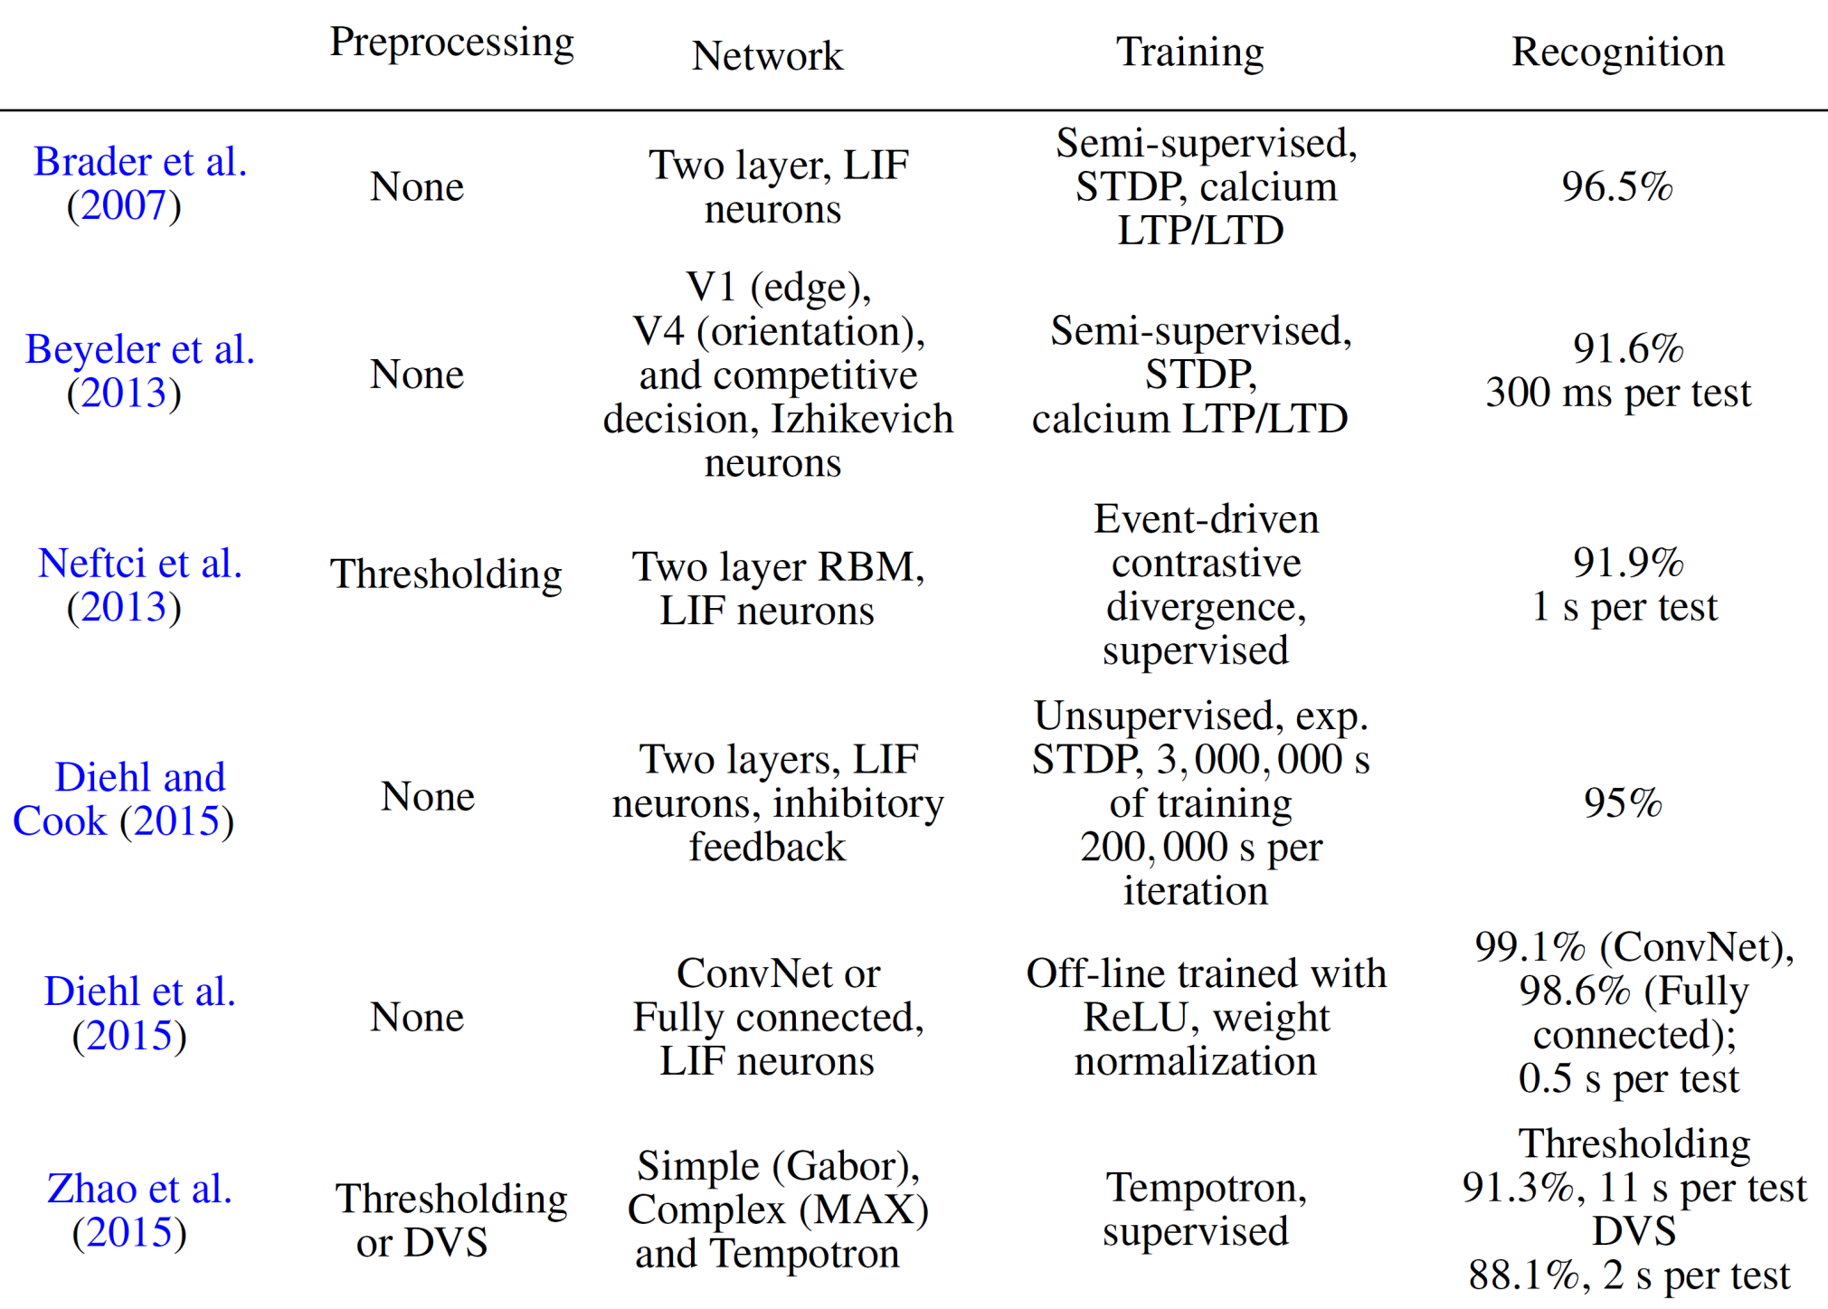

Slide 6
Evaluation
SNN models
biological training time
biological testing time
response latency
H/W platforms
feasibility due to H/W limits
simulation time
energy use
Notes:
feasibility (classification accuracy)
Such as: network size, neural and synaptic type and learning algorithm and precision

Slide 7
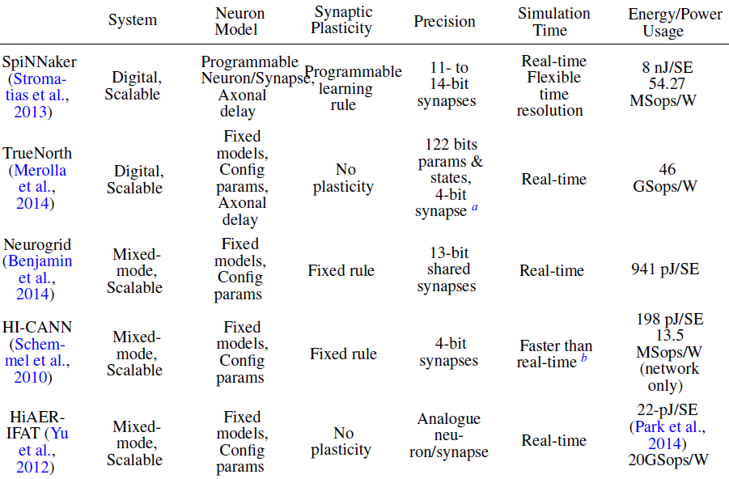
Notes:
General but not specific evaluation

Slide 8
Algorithms
state-of-the-art
2-Layer STDP learned
Spiking ConvNet (off-line training)
Spiking DBN (off-line training)
Case studies
STDP online training on SpiNNaker
Spiking DBN on SpiNNaker (Evangelos Stromatias)
Notes:
feasibility (classification accuracy)
Such as: network size, neural and synaptic type and learning algorithm and precision

Slide 9
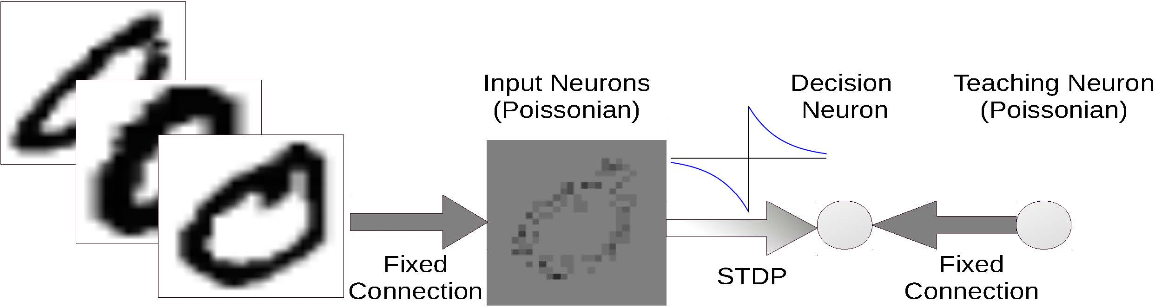
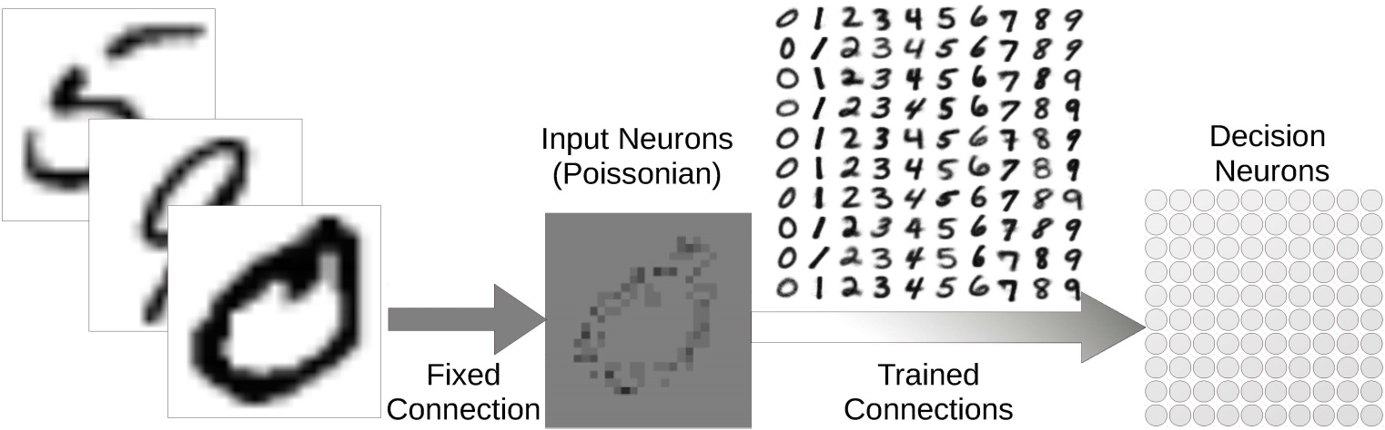
Case Study I: 2-layer STDP
a simple model
fast training
short latency
Notes:
feasibility (classification accuracy)
Such as: network size, neural and synaptic type and learning algorithm and precision

Slide 10
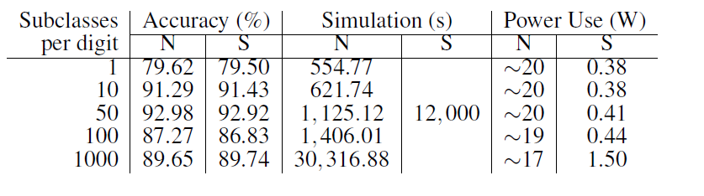
Case Study I: 2-layer STDP
The network with 500 decision neurons achieved a CA of 92.98% and average latency of 10.70 ms, and the simulation costs SpiNNaker 0.41 W on power use and 4,920J on energy use.
The work is submitted to the Frontiers in Neuromorphic Engineering under review process.

Slide 11
Future Work:
Towards the Robust Object Recognition
state-of-the-art
2-Layer STDP learned – 1 case study
Spiking ConvNet (off-line training) – future case study
Spiking DBN (off-line training) – online formalised training
My exploration on Spiking DBN
Restricted Boltzmann Machine (RBM)
Deep Belief Net
Future work: spiking RBM & DBN
Current work has been written down in a study report.

Slide 12
Potential Research Tasks
Future Tasks
Contrastive Divergence
Mean-Field Theory
RBM Validation
SRBM Structure
Maths of DBN
STDP Learning for CD
Practical Training Methods
Layered STDP Learning
2015
Q4
Q1 2016
Q2
Q3
Q4
2016
Today
RBM
32 days
DBN
31 days
SRBM
92 days
SDBN
93 days
Benchmarks
92 days
Thesis Writing
184 days

Slide 13
Questions?

