Slide 1
Towards the Invariant Object Recognition Using Spiking Neurons
Qian Liu
Supervisor: Steve Furber
Co-Supervisor: David Lester
Adviser: Alvaro Fernandes

Slide 2
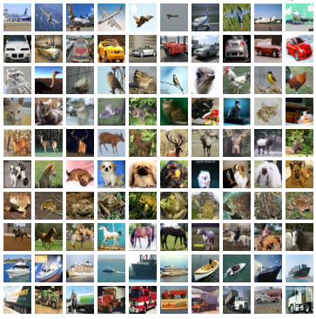

Goals and Motivation
What is the goal?
to build an object recognition system
with position, scale and view invariance
by modelling the brain
Why spiking neurons?
- biological
- energy efficient
Notes:
<number>
describing the goal by explaining the topic!
three highlighted words.
understand the brain = modelling the brain
mimicking the activity
buiding the same structure

Slide 3
Or images should
Be uniform in size
Compliment the content
Not impact on the copy area

Slide 4
Or images should
Be uniform in size
Compliment the content
Not impact on the copy area

