Slide 2
A | B | OUT
0 | 0 | 0
0 | 1 | 1
1 | 0 | 1
1 | 1 | 0

Slide 3
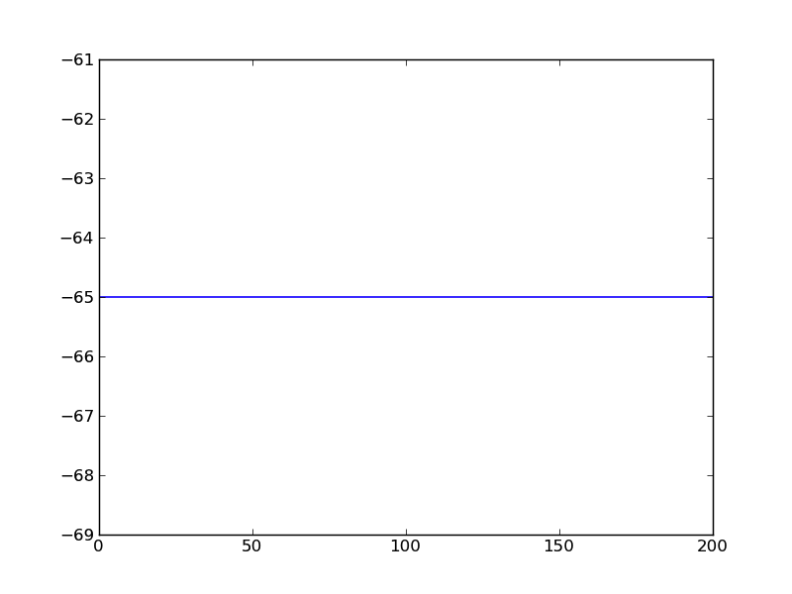
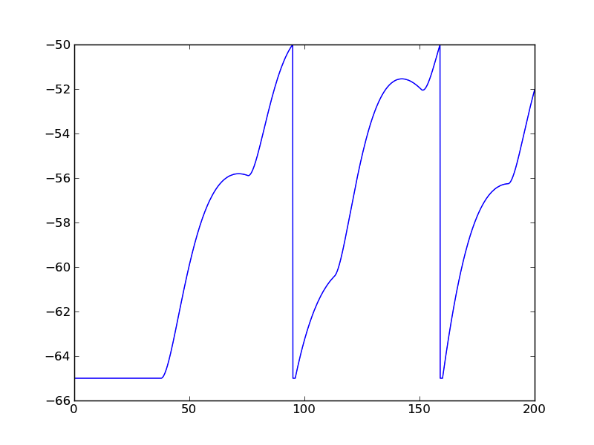
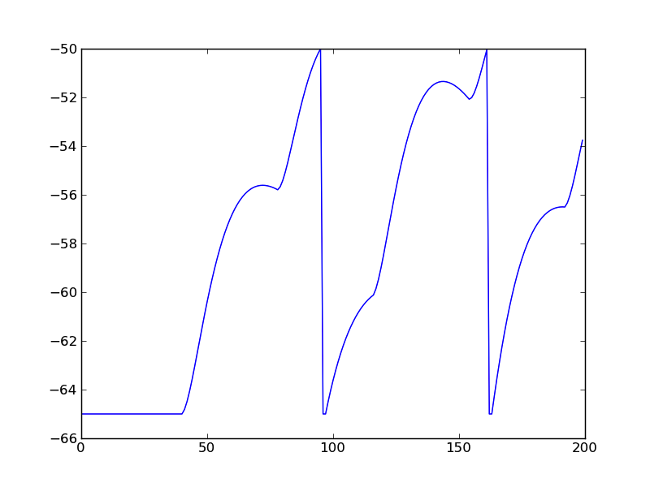
W=0.5, D=1
Brian
NEST
SpiNNaker
Membrane potential (mV)
Time (ms)

