Slide 1
15-213 Recitation 1: Basics
TA
22 Jan 2018

Slide 2
Introduction
<TAs put your info here>
<Put a sli.do or other link here>

Slide 3
Introduction
Welcome to 15-213/18-213/15-513!
Recitations are for…
Reviewing lectures
Discussing homework problems
Interactively exploring concepts
Previewing future lecture material
Please, please ask questions!

Slide 4
Course Details
How do I get help?
Course website: http://cs.cmu.edu/~213
Office hours: 5-9PM from Sun-Wed (Rooms: TBD)
5:30-9PM on Thu (Rooms: TBD)
Piazza
Definitely consult the course textbook
Carefully read the assignment writeups!
All labs are submitted to Autolab.
All labs should be worked on using the shark machines.

Slide 5
Today – “Bonus” Recitation
Git and programming labs
Linux Environment
ANSI C
Int Conversion and Operations

Slide 6
Git and Programming Labs
Every lab should be in Gitlab
Commit your work regularly

Slide 7
Before you use Gitlab, you must set up an ssh-key (Andrew credentials don’t work)
First check if you already have an ssh key:
cat ~/.ssh/id_rsa.pub should print a string
If it does not, run the command:
ssh-keygen –t rsa –C “Gitlab” –b 4096
Use the default file path (press Enter), and optionally type in a password. (press Enter if you don’t want one)
Run: cat ~/.ssh/id_rsa.pub
Your public key will be printed.
Highlight it with the mouse and copy

Slide 8
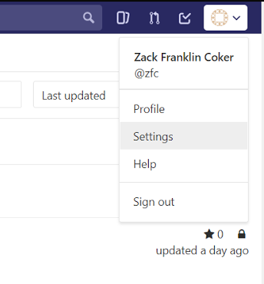
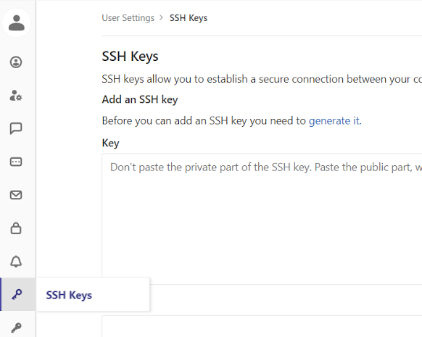
Add ssh key to Gitlab
Paste the public ssh key into the text field here

Slide 9
Steps for using Gitlab with handouts
Clone the repository on Gitlab into your private folder on the AFS
Download the handout from autolab
Copy the handout (scp, sftp, Filezilla, etc.) into the repository and move your terminal into the repository
Unpack the handout (tar –xvpf handout.tar)
Add the handout files to version control (git add –all)
Make a git commit (git commit)
Push the commit to Gitlab (git push)

Slide 10
Git setup on AFS
For those of you who have not set up Git on AFS – run the following commands on a shark machine (only needed once)
$ git config -–global user.name “your name”
$ git config -–global user.email <your Andrew email>
$ git config –global push.default simple

Slide 11
Clone your Gitlab repository
From your private folder in AFS (you probably want to make a 15-213 in the private folder with mkdir to hold all the files from the class)
Follow the instructions on Create new repository to move your repository to your private folder
Example:
git clone git@git.ece.cmu.edu:<andrewid>/datalab-213s18
cd datalab-213s18

Slide 12
Git setup on AFS
Download datalab handout from autolab
Transfer files over to your datalab-213s18 directory on AFS using Filezilla, sftp, or scp
scp <path>andrewid@shark.ics.cs.cmu.edu:<path>
tar –xvpf datalab-handout.tar
rm datalab-handout.tar
mv datalab-handout/** ./
git add –all
git commit –m “adding handout”
git push –u origin master

Slide 13
Future commits on Gitlab
Add you name in the comment on bits.c in the datalab-handout
Add the changes in your repository to the next commit:
git add –u
Avoid git add –all after committing the handout unless you set up a .gitignore file. It is bad practice to commit .o files and executables!
git push

Slide 14
Git branch example
Let’s say you want to do something risky that you may want to revert later.
git checkout –b <new_branch_name>
echo “risky addition” > test.txt
git add test.txt
git commit –m “added risky change”
git push origin <new_branch_name>
git checkout master
Risky changes have been saved but they are not in your current branch – no test.txt file

Slide 15
More information on Git can be found in the Linx/Git bootcamp slides
Feel free to ask TAs for help with Git.

Slide 16
Linux Environment
Vim – Run vimtutor to learn using vim
Emacs – Run “Ctrl-h t” – Emacs tutorial
Good to use editors with auto-indent and nice color schemes
We will help you set up vim in the next slides

Slide 17
Setting up Vim
1. We’ll start by editing the vim configuration file
“.vimrc”, a file in your home directory
2. From the Shark machine command line, run:
vim ~/.vimrc
3. Vim has a few “modes” that you will switch between. For now:
“normal” mode: run commands, save/quit, text manipulation
If you press , you end up here
Type “:w” (colon, w, ) to save your file, and type “:q” (colon, q, ) to quit
Press “i” to enter “insert” mode
““insert” mode: works like a typical editor (type/delete text, move around with arrow keys)

Slide 18
Setting up Vim
Enter the code below into “~/.vimrc”.
colorscheme desert
set mouse=a
set number
set cursorline
set colorcolumn=81
set tabstop=4
set shiftwidth=4
set softtabstop=4
set expandtab
set smartindent

Slide 19
What is ANSI C?
This is not ANSI C.
unsigned int foo(unsigned int x)
{
x = x * 2;
int y = 5;
if (x > 5) {
x = x * 3;
int z = 4;
x = x * z;
}
return x * y;
}
Within two braces, all declarations must go before any expressions.

Slide 20
What is ANSI C?
This is ANSI C.
This is not ANSI C.
unsigned int foo(unsigned int x)
{
int y = 5;
x = x * 2;
if (x > 5) {
int z = 4;
x = x * 3;
x = x * z;
}
return x * y;
}
unsigned int foo(unsigned int x)
{
x = x * 2;
int y = 5;
if (x > 5) {
x = x * 3;
int z = 4;
x = x * z;
}
return x * y;
}

Slide 21
Integer Conversions
Signed <-> Unsigned
Bit pattern is maintained but reinterpreted
If there is a mix of unsigned and signed in single expression, signed values implicitly cast to unsigned

Slide 22
Integer Conversions Truncation
Drop top k bits:
X1 = x_{w–1} , x_{w–2} ,…, x₀
k
w
X
• • •
• • •
• • •
X 1
• • •
w

Slide 23
Truncation: Examples
No sign change
Sign change
-16 | 8 | 4 | 2 | 1
0 | 0 | 0 | 1 | 0
-16 | 8 | 4 | 2 | 1
0 | 1 | 0 | 1 | 0
2 =
10 =
 | -8 | 4 | 2 | 1
 | 0 | 0 | 1 | 0
 | -8 | 4 | 2 | 1
 | 1 | 0 | 1 | 0
2 =
-6 =
2 mod 16 = 2
10 mod 16 = 10U mod 16 = 10U = -6
-16 | 8 | 4 | 2 | 1
1 | 1 | 0 | 1 | 0
-16 | 8 | 4 | 2 | 1
1 | 0 | 1 | 1 | 0
-6 =
-10 =
 | -8 | 4 | 2 | 1
 | 1 | 0 | 1 | 0
 | -8 | 4 | 2 | 1
 | 0 | 1 | 1 | 0
-6 =
6 =
-6 mod 16 = 26U mod 16 = 10U = -6
-10 mod 16 = 22U mod 16 = 6U = 6

Slide 24
Integer Conversions Expansion
Make k copies of sign bit:
X 1 = x_{w–1} ,…, x_{w–1} , x_{w–1} , x_{w–2} ,…, x₀
k copies of MSB
w
X
• • •
• • •
X 1
• • •
• • •
k
w

Slide 25
Sign Extension: Examples
Positive number
Negative number
-16 | 8 | 4 | 2 | 1
0 | 1 | 0 | 1 | 0
-16 | 8 | 4 | 2 | 1
1 | 0 | 1 | 1 | 0
10 =
-10 =
-32 | 16 | 8 | 4 | 2 | 1
0 | 0 | 1 | 0 | 1 | 0
-32 | 16 | 8 | 4 | 2 | 1
1 | 1 | 0 | 1 | 1 | 0
10 =
-10 =

Slide 26
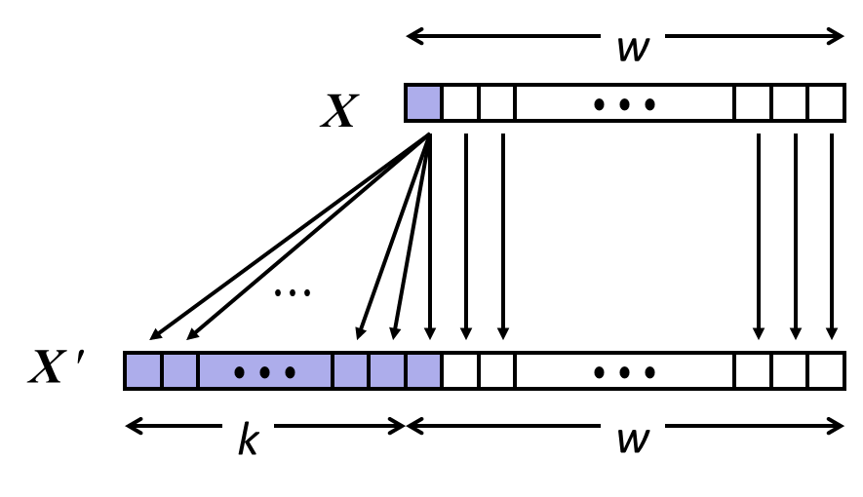
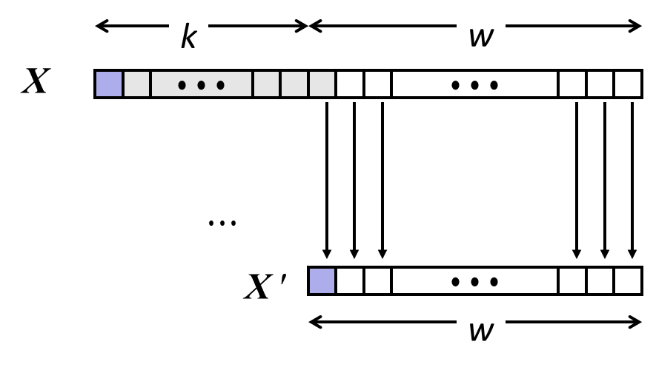
Sign Extension and Truncation
Sign Extension
Truncation

Slide 27
Problems – Truncation
Convert the given 4 bit decimal numbers to 3 bit numbers in unsigned interpretation
0
2
9
11
15

Slide 28
Problems – Truncation
Convert the given 4 bit decimal numbers to 3 bit numbers in unsigned interpretation
0 0
2 2
9 1
11 3
15 7

Slide 29
Problems – Truncation
Convert the given 4 bit decimal numbers to 3 bit numbers in two’s compliment interpretation
2 2
9 1
11 3
15 -1

