Slide 1
Crypto in CTF
zywu@Bamboofox & DSNS
Benson Chen@Bamboofox & DSNS

Slide 2
Outline
How to use OpenSSL toolkit
  Command line
  Programming API
Breaking RSA using tools
An example of Crypto-like vulnerability: “Padding Oracle”
Crypto in CTF

Slide 3
Crypto Scheme will cover
Asymmetric encryption
  Public encryption
    Key pair: K_{pub} and K_{priv}
    Encrypt with K_{pub}
    Decrypt with K_{priv}
  Pros: open
  Cons: slow
  Example: RSA
Digest
  Message authentication code
  Example: MD5, SHA-1, SHA-2
Symmetric encryption
  Classic encryption
    Only one key: K_{priv}
    Encrypt and decrypt both with K_{priv}
  Pros: fast
  Cons: handshake
  Example: AES

Slide 4
Breaking RSA - Introduction
RSA

Slide 5

Introduction to OpenSSL
Open-source implementation of SSL and TLS protocols
Useful toolkit of cryptographic
Many bugs and vulnerabilities

Slide 6
OpenSSL – RSA in Command Line
Gen Private Key
  openssl genrsa -out priv.pem
View Private Key
  openssl rsa –text –in priv.pem –out priv.pem.info
    modulus = N
    privateExponent = d
    publicExponent = e
    prime1 = p
    prime2 = q
Extract Public Key
  openssl rsa –in priv.pem –pubout –out pub.pem
View Public Key
  openssl rsa –text –pubin –in pub.pem –out public.pem.info
    modulus = N
    publicExponent = e

Slide 7
OpenSSL – RSA in Command Line
Encrypt
  openssl rsautl –encrypt –pubin –inkey pub.pem –in plaintext –out ciphertext1
  openssl rsautl –encrypt –pubin –inkey pub.pem –in plaintext –out ciphertext2
  vim –d cipheretext1 ciphertext2
Decrypt
  openssl rsautl -decrypt -inkey priv.pem -in ciphertext1 -out cipheretext1.decrypt
  openssl rsautl -decrypt -inkey priv.pem -in ciphertext1 -out cipheretext2.decrypt
  vim –d cipheretext1.decrypt ciphertext2.decrypt

Slide 8
OpenSSL – AES in Command Line
Encrypt
  openssl enc –aes128 -e -in plaintext -out c.aes.1
  openssl enc –aes128 -e -in plaintext -out c.aes.2
  vim –d c.aes.1 c.aes.2
Decrypt
  openssl enc –aes128 -d -in c.aes.2 -out c.aes.1.dec
  openssl enc –aes128 -d -in c.aes.2 -out c.aes.2.dec
  vim –d c.aes.1.dec c.aes.2.dec

Slide 9
OpenSSL – Digest in Command Line
Never use MD5
SHA-1
  openssl dgst -sha1 plaintext
  openssl dgst -sha1 plaintext
SHA-2
  openssl dgst –sha256 plaintext
  openssl dgst –sha512 plaintext

Slide 10
Breaking RSA
RSA
Open Problem
  Given <N,e> , possible to factor N in polynomial-time?
RSA vulnerability
  Key length too short -> Factor the N
  Misuse of protocol

Slide 11
Breaking RSA – Factoring N
Practice 1 – RSA1
  http://train.cs.nctu.edu.tw/problems/8
You have
  pub.pem #The RSA public key
  aeskey.rsa.enc #The AES key encrypted by RSA
  flag.jpg.aes.enc #The ciphertext encrypted by AES
You need to
  Break the RSA then get the AES key
  Decrypted the flag.jpg.aes.enc using that AES key

Slide 12
Breaking RSA – Factoring N
Tools
  http://factordb.com/
  yafu
    Tool download: http://sourceforge.net/projects/yafu/
    Usage: factor(N)
  Cado-NFS
    Tool download: http://cado-nfs.gforge.inria.fr/
  Mesieve
    Tool download : https://github.com/Tojaj/rsa-algorithm/tree/master/msieve-1.51
Tools to construct .pem with given p, q, e, d.
  rsatool
    https://github.com/ius/rsatool

Slide 13
Programming with OpenSSL API
Practice 2 – RSA2
  http://train.cs.nctu.edu.tw/problems
C
  https://www.openssl.org/docs/ssl/ssl.html
Python
  https://pypi.python.org/pypi/pycrypto
  https://pypi.python.org/pypi/pyOpenSSL/0.15.1
Ruby
  http://ruby-doc.org/stdlib-2.0.0/libdoc/openssl/rdoc/OpenSSL.html

Slide 14
Crypto in CTF

Slide 15
Crypto in CTF -
Some skills you should have
Background knowledge is necessary
  Cryptography, Protocols, Ciphers, Algorithm…
  Writing code is necessary
  Crypto in CTF needs to implement attack
  If you like ACM-ICPC, maybe you will like crypto. There are many things relate to algorithm
You cannot hate MATH
  Math is not the most important part of crypto in CTF
  But in Public-key encryption is all about math

Slide 16
Crypto in CTF -
In the CTF you need to
Observe, try and learn!
  Think about what you have learned
  Observe the source code’s algorithm weakness
  Observe the protocol weakness
  Try to attack
  Learn new things if necessary
Discuss with your teammate
If you have some idea, write it into math equations
Implement!

Slide 17
Crypto in CTF -
In the CTF you don’t need to
Open IDAPro, GDB …
(but in some situation you need to)
Worry about your teammate will solve your problem
Worry about your teammate will blame on you. Since that they don’t know what you are doing

Slide 18
其實打CTF只需要…
興趣+耐心+求知慾
程式能⼒, 逆向⼯程, 密碼學, 演算法, 資訊隱藏, 鑑識分析, 滲透測試, … , etc
這些都可以慢慢學 XD
- by 0xddaa

Slide 19
An example of
Crypto-like vulnerability: “Padding Oracle”

Slide 20
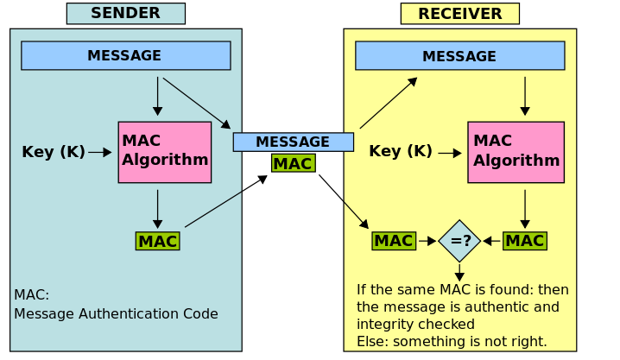
Introduction
Message Authentication Code (MAC)
  Ensure integrity of message
  Ensure authenticity

Slide 21
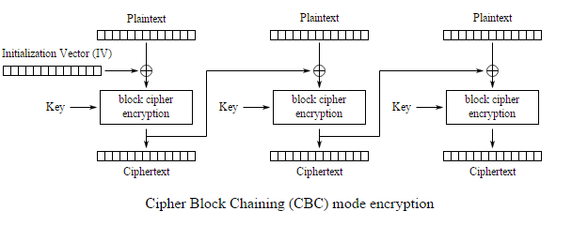
Introduction
MAC implemented by Block cipher (e.g. AES) is called C-MAC
Block Cipher Mode
  Divide plaintext into several blocks and apply same encryption algorithm to each block
  Cipher Block Chaining (CBC)

Slide 22
Padding-oracle attacks
The following slides are taken from the Cryptography course on Coursera, taught by Professor Jonathan Katz

Slide 23
Overview
In the definition of CCA-security, the attacker can obtain the decryption of any ciphertext of its choice (besides the challenge ciphertext)
  Is this realistic?
We show a real-world scenario where:
  One bit about decrypted ciphertexts is leaked
  This can be exploited to learn the entire plaintext

Slide 24
CBC mode
m₁
m₂
m_{t}
IV
⊕
⊕
⊕
…
F_{k}
F_{k}
F_{k}
c₀
c₁
c₂
c_{t}

Slide 25
Arbitrary-length messages?
Message → encoded data → ciphertext
  Assume message is an integral # of bytes
PKCS #5 encoding:
  Let L be the block length (in bytes) of the cipher
  Let b be the # of bytes that need to be appended to the message to get length a multiple of L
    1 ≤ b ≤ L, note b ≠ 0
  Append b (encoded in 1 byte), b times
    I.e., if 3 bytes of padding are needed, append 0x030303

Slide 26
Decryption?
To decrypt:
  Use CBC-mode decryption to obtain encoded data
  Say the final byte of encoded data has value b
    If b=0 or b > L, return “error”
    If final b bytes of encoded data are not all equal to b, return “error”
    Otherwise, strip off the final b bytes of the encoded data, and output what is left as the message

Slide 27
Example (L=8)
AB
01
4F
21
00
7C
02
02
AB
01
4F
21
00
7C
02
02

Slide 28

c
k
k
c ← Enc_{k}(m)
Dec_{k}(c')
c’
error?
Padding oracle!

Slide 29
Padding oracles
Padding oracles frequently present in web applications
Even if an error is not explicitly returned, an attacker might be able to detect differences in timing, behavior, etc.

Slide 30
Main idea of the attack
Given two-block ciphertext IV, c
  Encoded data = F_{k}⁻¹(c) ⊕ IV
Main observation: If an attacker modifies the ith byte of IV, this causes a predictable change (only) to the ith byte of the encoded data

Slide 31
F_{k}⁻¹(c):
XX
XX
XX
XX
XX
XX
XX
XX
⊕
IV:
AB
01
4F
21
00
7C
02
9E
=
Encoded
data:
XX
XX
XX
XX
06
XX
06
XX
06
XX
06
XX
06
“Success”
“Error”

Slide 32
F_{k}⁻¹(c):
XX
XX
XX
XX
XX
XX
XX
XX
⊕
0x02 ⊕ 0x06 ⊕ 0x07
0x9E ⊕ 0x06 ⊕ 0x07
AB
01
00
01
02
41
4F
4E
21
20
00
01
7C
7D
02
03
9E
IV:
9F
=
Encoded
data:
XX
XX
07
06
07
06
07
06
07
06
07
06
07
06
07
XX ⊕ 41 = 07
XX ⊕ 01 = (XX ⊕ 41) ⊕ (41 ⊕ 01)
XX ⊕ 01 = 07 ⊕ 40 = 47
“Success!”

Slide 33
Attack complexity?
≤ L tries to learn the # of padding bytes
≤ 2⁸ = 256 tries to learn each plaintext byte

Slide 34
CCA-security: a summary
Chosen-ciphertext attacks represent a significant, real-world threat
Modern encryption schemes designed to be CCA-secure
Will see an example of a CCA-secure scheme next week

