Slide 1
Measuring Phenotype Semantic Similarity using Human Phenotype Ontology
Jiajie Peng* (jiajiepeng@nwpu.edu.cn)
Hansheng Xue (xhs1892@gmail.com)
Yukai Shao (shaoyk@bankcomm.com)
Xuequn Shang (shang@nwpu.edu.cn)
Yadong Wang* (ydwang@hit.edu.cn)
Jin Chen* (chen.jin@uky.edu)
Notes:
The topic of my talk is “Measuring Phenotype Semantic Similarity using Human Phenotype Ontology”

Slide 2
Outline
Background
Methods
Results
Future work
研究现状
1
Notes:
My presentation includes four parts. First, I will introduce the background and the problem we focus on. Second part is our measure to calculate the semantic similarity using Human Phenotype Ontology. Then, I will show you some interesting experiments and the corresponding results. Some future works were introduced in the last part.

Slide 3
Background
Introduction to the problem
Recently, phenotype similarity has been effectively applied to model patient phenotype data.
However, the existing measurements are revised based on the Gene Ontology-based term similarity models, which are not optimized for human phenotype ontologies.
2

Slide 4
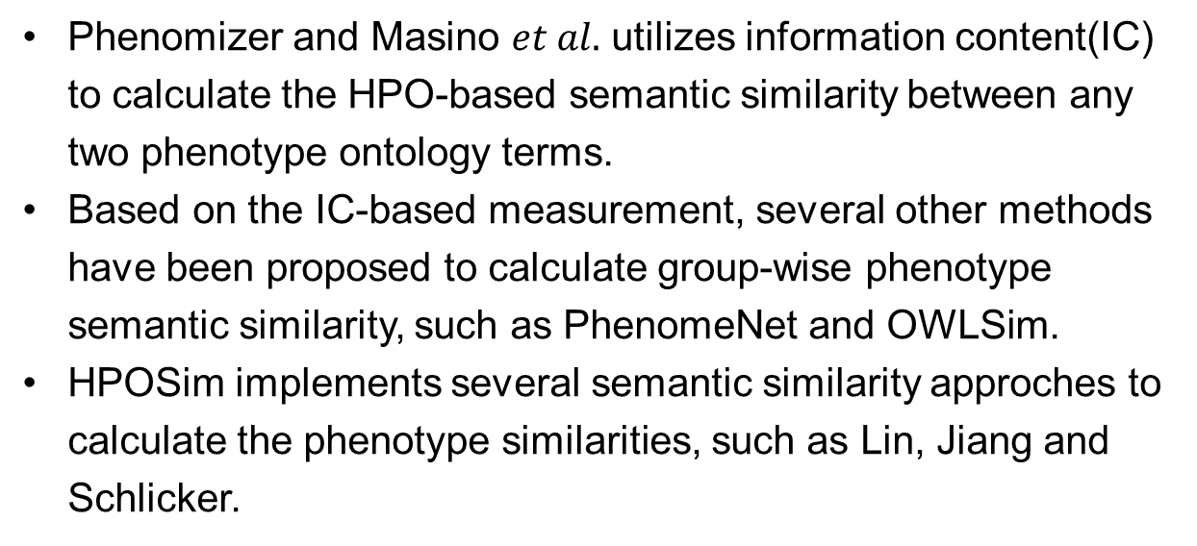
Background
Existing Methods
Phenomizer and Masino $et al.$ utilizes information content(IC) to calculate the HPO-based semantic similarity between any two phenotype ontology terms.
Based on the IC-based measurement, several other methods have been proposed to calculate group-wise phenotype semantic similarity, such as PhenomeNet and OWLSim.
HPOSim implements several semantic similarity approches to calculate the phenotype similarities, such as Lin, Jiang and Schlicker.
3
Notes:
And then we do some research on existing methods.

Slide 5
Background
Summary of Existing Methods
The aforementioned approaches calculate phenotype semantic similarities based on the designs optimized for measuring GO-based semantic similarity without taking the unique properties of HPO into account.
First, the biological meaning of the HPO structure is different with that of GO.
Second, patient phenotypes are in general not well recognized and annotated.
4

Slide 6
Methods
Advantages of PhenoSim
In this article, we present a new approach called PhenoSim to calculate the phenotype semantic similarity based on HPO.
PhenoSim is a novel semantic similarity approach that is specially optimized for HPO.
We develop a novel path-constrained Information Content(IC) to calculate the similarity between two HPO terms.
PhenoSim constructs a phenotype network and exploits a PageRank-based method to model the noises in the patient phenotype data set.
5

Slide 7
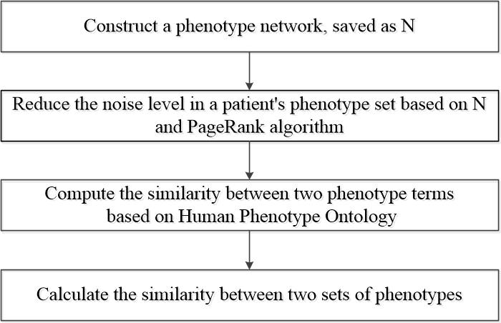
Methods
Steps of PhenoSim
6

Slide 8

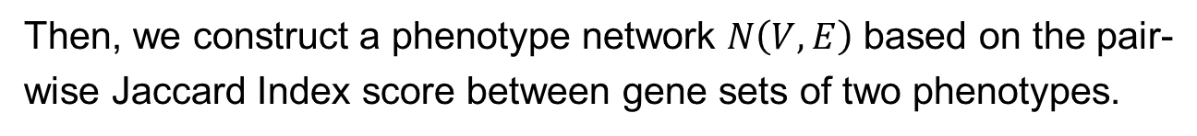

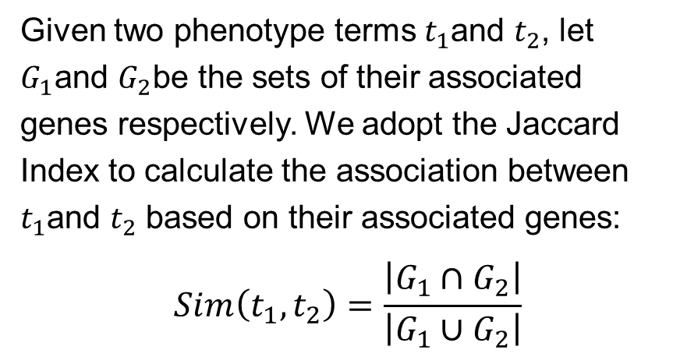



Methods
Step 1: Phenotype Network Construction
$$g_{1}$$
Given two phenotype terms $t_{1}$and $t_{2}$, let $G_{1}$and $G_{2}$be the sets of their associated genes respectively. We adopt the Jaccard Index to calculate the association between $t_{1}$and $t_{2}$ based on their associated genes:
$$Sim\left(t_{1},t_{2}\right)=\frac{\left|G_{1}∩G_{2}\right|}{\left|G_{1}∪G_{2}\right|}$$
$$p_{1}$$
$$g_{2}$$
$$p_{2}$$
…
$$g_{3}$$
Example of calculating associations between two phenotypes
Then, we construct a phenotype network $N\left(V,E\right)$ based on the pair-wise Jaccard Index score between gene sets of two phenotypes.
7

Slide 9
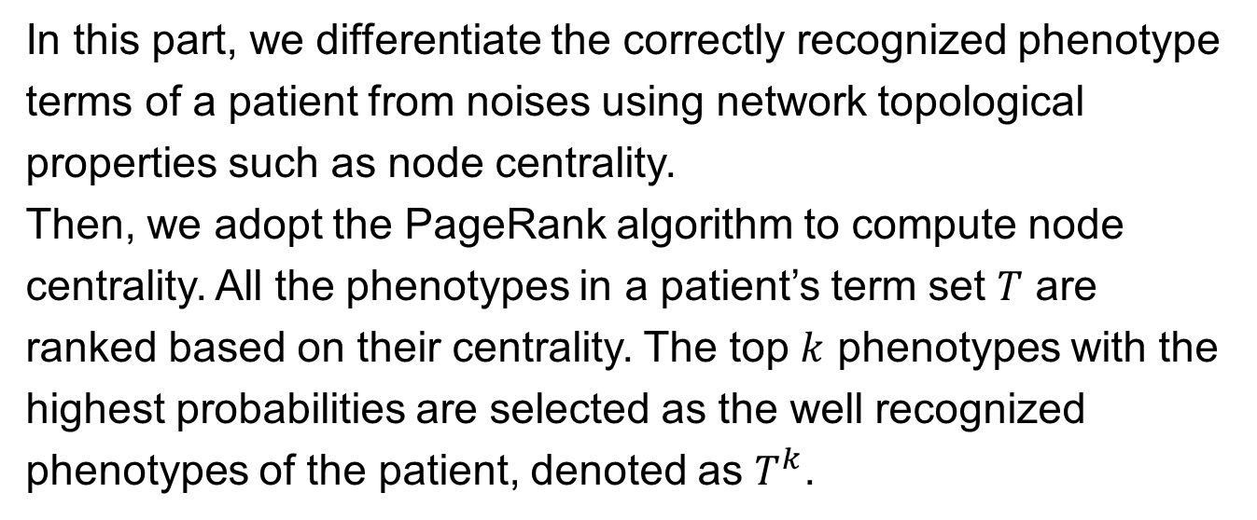
Methods
Step 2: Phenotype Network Noise Reduction
In this part, we differentiate the correctly recognized phenotype terms of a patient from noises using network topological properties such as node centrality.
Then, we adopt the PageRank algorithm to compute node centrality. All the phenotypes in a patient’s term set $T$ are ranked based on their centrality. The top $k$ phenotypes with the highest probabilities are selected as the well recognized phenotypes of the patient, denoted as $T^{k}$.
8

Slide 10
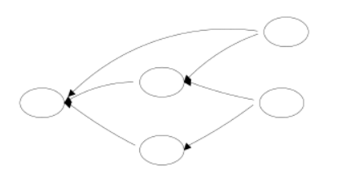
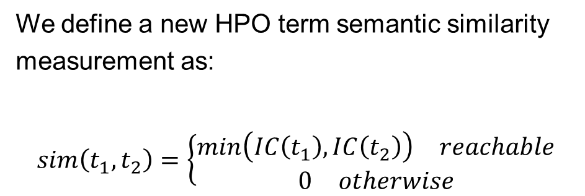
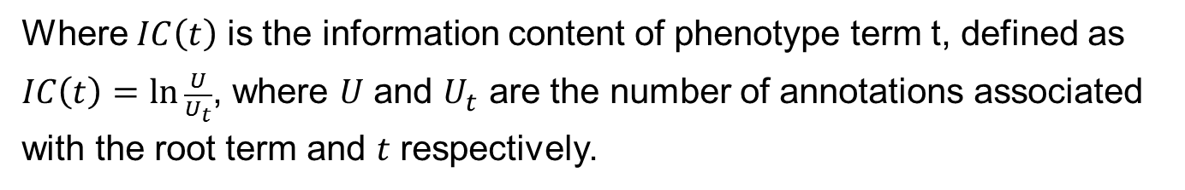
Methods
Step 3: Measuring Phenotype Similarity
We define a new HPO term semantic similarity measurement as:
$$sim\left(t_{1},t_{2}\right)=\left\{\begin{aligned}\begin{matrix}min\left(IC\left(t_{1}\right),IC\left(t_{2}\right)\right) & reachable\end{matrix} \\ \begin{matrix}0 & otherwise\end{matrix}\end{aligned}\right.$$
Figure of DAG
Where $IC\left(t\right)$ is the information content of phenotype term t, defined as $IC\left(t\right)=\ln{\frac{U}{U_{t}}}$, where $U$ and $U_{t}$ are the number of annotations associated with the root term and $t$ respectively.
9

Slide 11
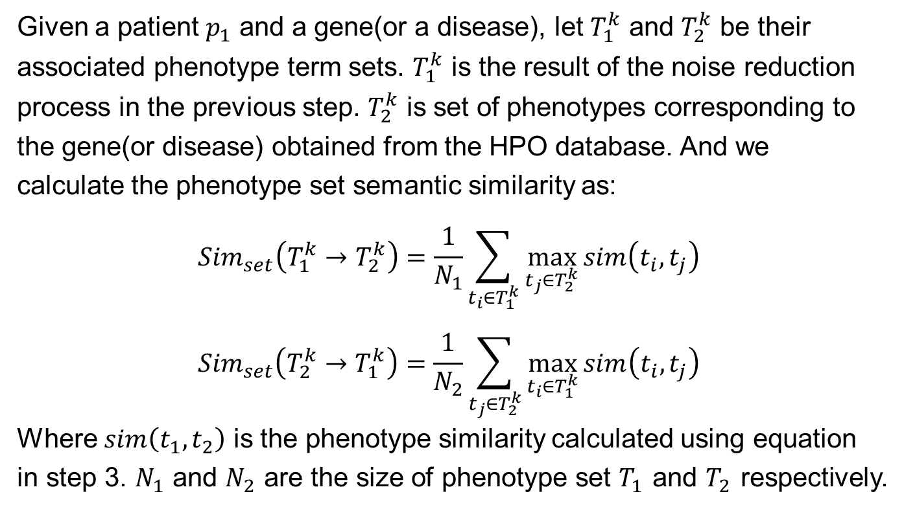
Methods
Step 4: Measuring Phenotype Set Similarity
Given a patient $p_{1}$ and a gene(or a disease), let $T_{1}^{k}$ and $T_{2}^{k}$ be their associated phenotype term sets. $T_{1}^{k}$ is the result of the noise reduction process in the previous step. $T_{2}^{k}$ is set of phenotypes corresponding to the gene(or disease) obtained from the HPO database. And we calculate the phenotype set semantic similarity as:
$${Sim}_{set}\left(T_{1}^{k}→T_{2}^{k}\right)=\frac{1}{N_{1}}\sum_{t_{i}∈T_{1}^{k}}{\max_{t_{j}∈T_{2}^{k}}{sim\left(t_{i},t_{j}\right)}}$$
$${Sim}_{set}\left(T_{2}^{k}→T_{1}^{k}\right)=\frac{1}{N_{2}}\sum_{t_{j}∈T_{2}^{k}}{\max_{t_{i}∈T_{1}^{k}}{sim\left(t_{i},t_{j}\right)}}$$
Where $sim\left(t_{1},t_{2}\right)$ is the phenotype similarity calculated using equation in step 3. $N_{1}$ and $N_{2}$ are the size of phenotype set $T_{1}$ and $T_{2}$ respectively.
10

Slide 12
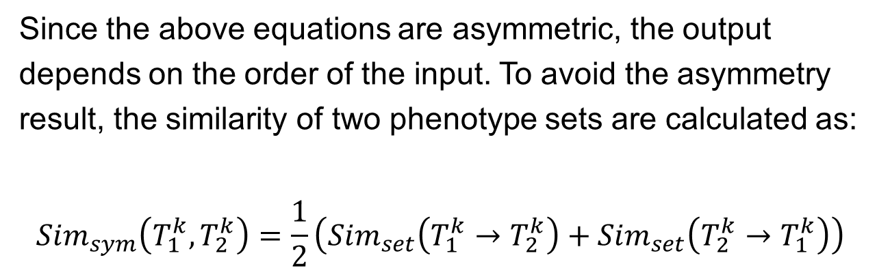
Methods
Step 4: Measuring Phenotype Set Similarity
Since the above equations are asymmetric, the output depends on the order of the input. To avoid the asymmetry result, the similarity of two phenotype sets are calculated as:
$${Sim}_{sym}\left(T_{1}^{k},T_{2}^{k}\right)=\frac{1}{2}\left({Sim}_{set}\left(T_{1}^{k}→T_{2}^{k}\right)+{Sim}_{set}\left(T_{2}^{k}→T_{1}^{k}\right)\right)$$
11

Slide 13
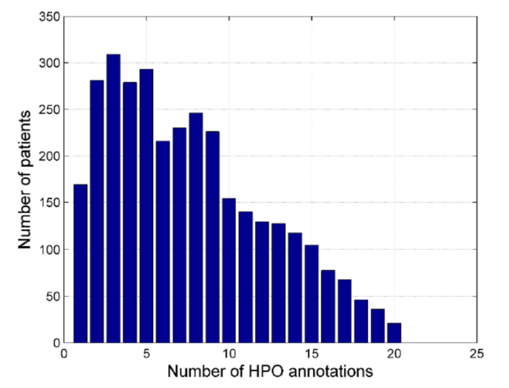
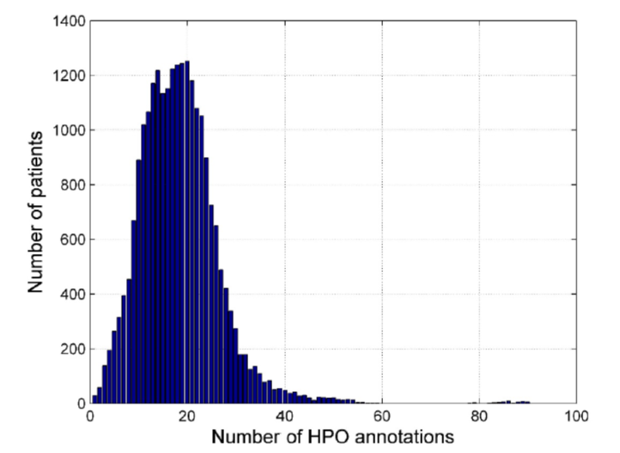
Results
Data Preparation
For performance evaluation, we first generated simulated patients based on the curated disease phenotype feature set used in [7].
And we generated three types of datasets, “optimal patients with known causative genes”, “noisy patient data with known causative genes” and “noisy patient data with known diseases”.
Figure: noisy patient with known causative gene
Figure: noisy patient with known disease
[7] A. J. Masino, E. T. Dechene, M. C. Dulik, A. Wilkens, N. B. Spinner, I. D. Krantz, J. W. Pennington, P. N. Robinson, and P. S. White, “Clinical phenotype-based gene prioritization: an initial study using semantic similarity and the human phenotype ontology,” BMC bioinformatics, vol. 15, no. 1, p. 1, 2014.
12

Slide 14
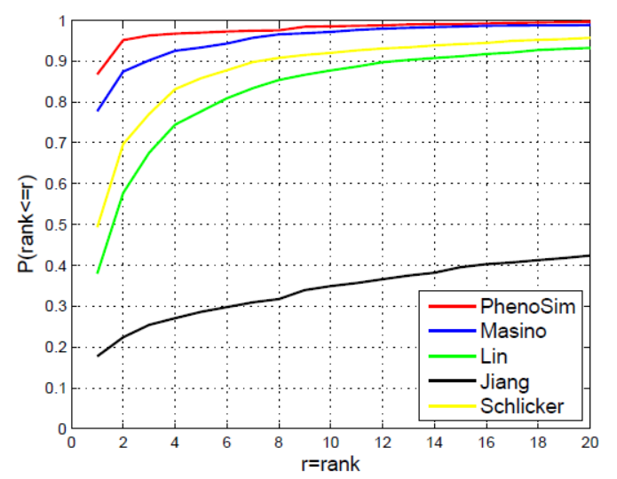
Results
Performance Evaluation on Causative Gene Prediction
Figure :Cumulative distribution of the rank of the causative genes on the “noisy patient data with known causative genes” dataset. The x-axis is the threshold for the causative gene rank. The y-axis is the ratio of patients satisfying the ranking threshold.
13

Slide 15
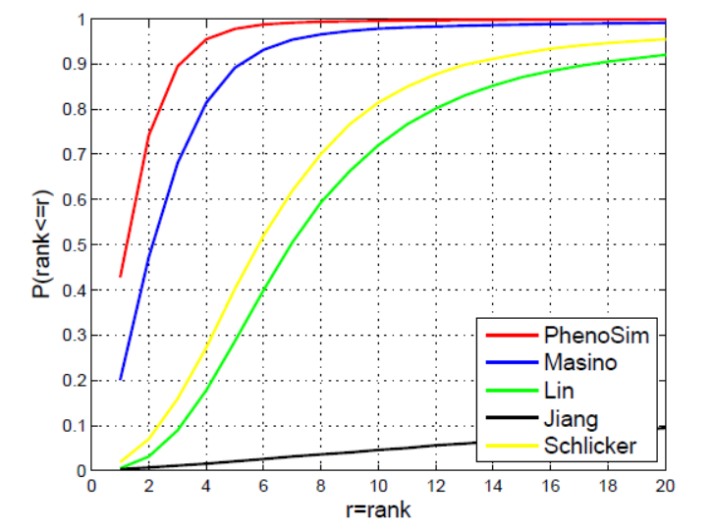
Results
Performance Evaluation on Disease Prediction
Figure :Cumulative distribution of the rank of the patient-associated diseases on the “noisy patient data with known diseases” dataset. The x-axis is the threshold for the disease rank. The y-axis is the ratio of patients satisfying the ranking threshold.
14

Slide 16
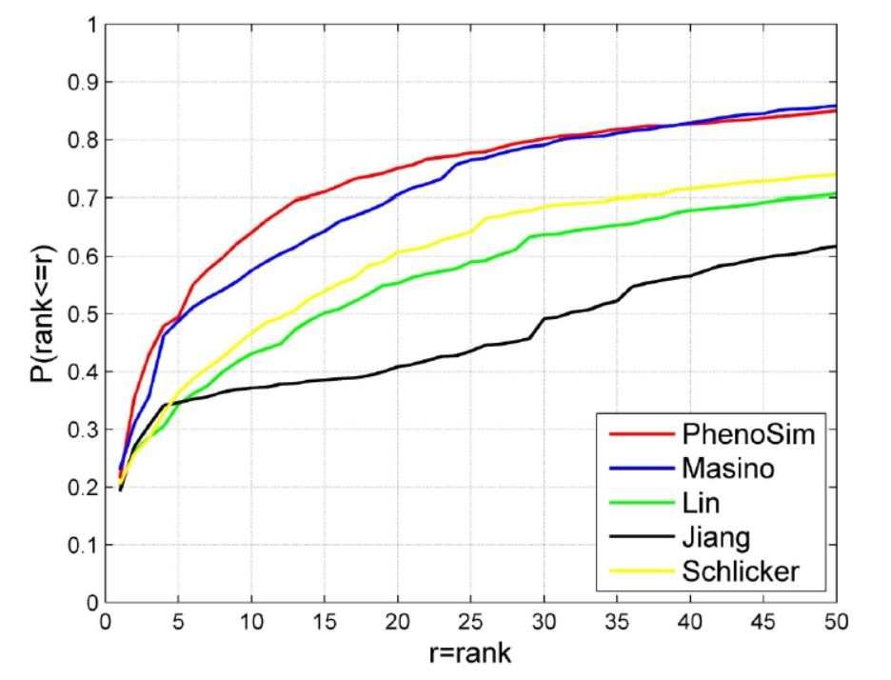
Results
Performance Evaluation on Disease Prediction
Figure :Cumulative distribution of the rank of the patient-associated diseases on the “optimal patient data with known causative genes” dataset. The x-axis is the threshold for the disease rank. The y-axis is the ratio of patients satisfying the ranking threshold.
15

Slide 17
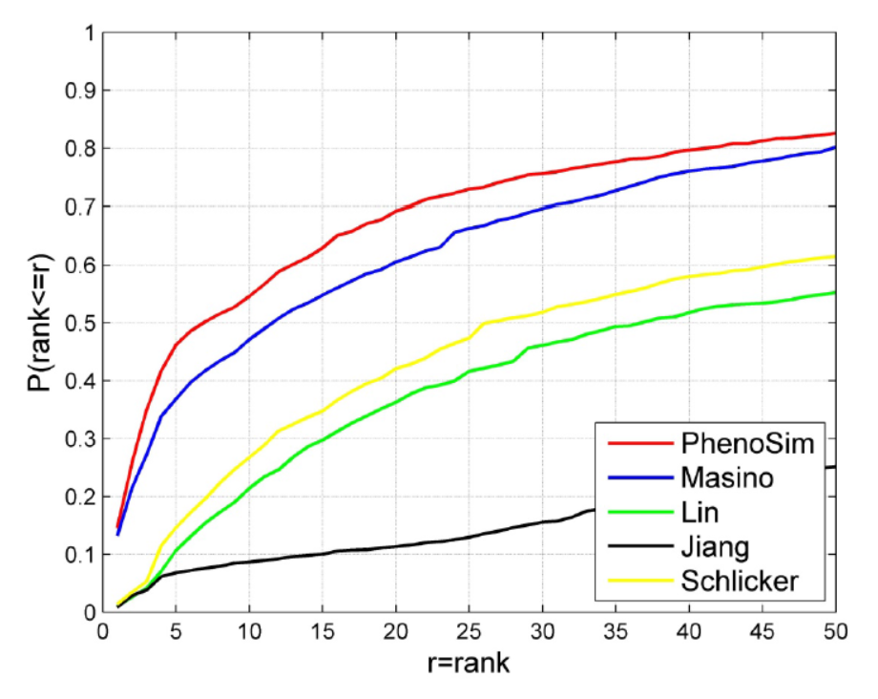
Results
Performance Evaluation on Disease Prediction
Figure :Cumulative distribution of the rank of the patient-associated diseases on the “noisy patient data with known causative genes” dataset. The x-axis is the threshold for the disease rank. The y-axis is the ratio of patients satisfying the ranking threshold.
16

Slide 18
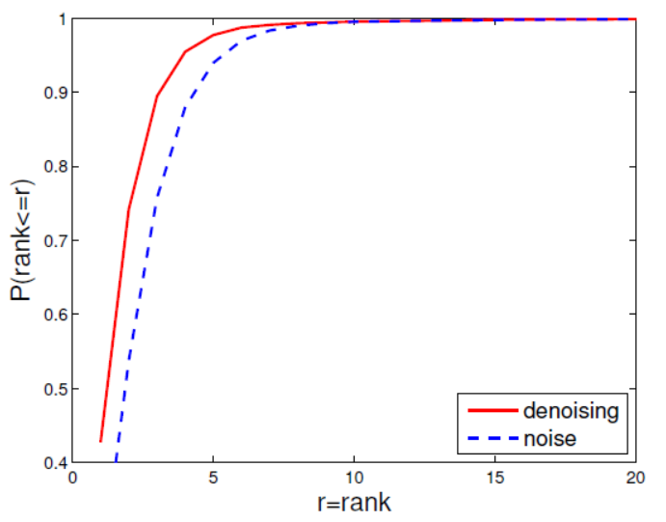
Results
Effectiveness of Noise Reduction
Figure :Comparison of the cumulative disease-ranking distributions of the original PhenoSim and the revised PhenoSim without noise reduction. The x-axis is the ranking threshold. The y-axis is the ratio of patients satisfying the ranking threshold. The red line and blue dash line represent the methods with and without noise reduction respectively.
17

Slide 19
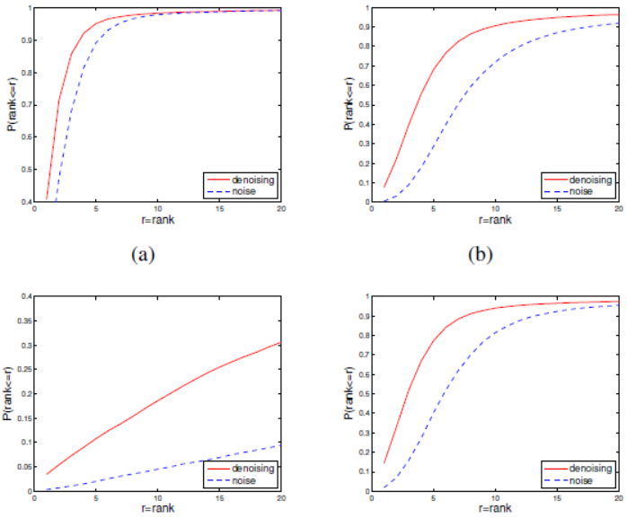
Results
Effectiveness of Noise Reduction
Figure :Comparison of cumulative distribution of the disease rank for Masino (a), Lin (b), Jiang (c) and Schlicker (d) methods with and without noise reduction. The x-axis is the ranking threshold. The y-axis is the ratio of patients satisfying the ranking threshold. The red line and blue dash line represent the methods with and without noise reduction, respectively.
18

Slide 20
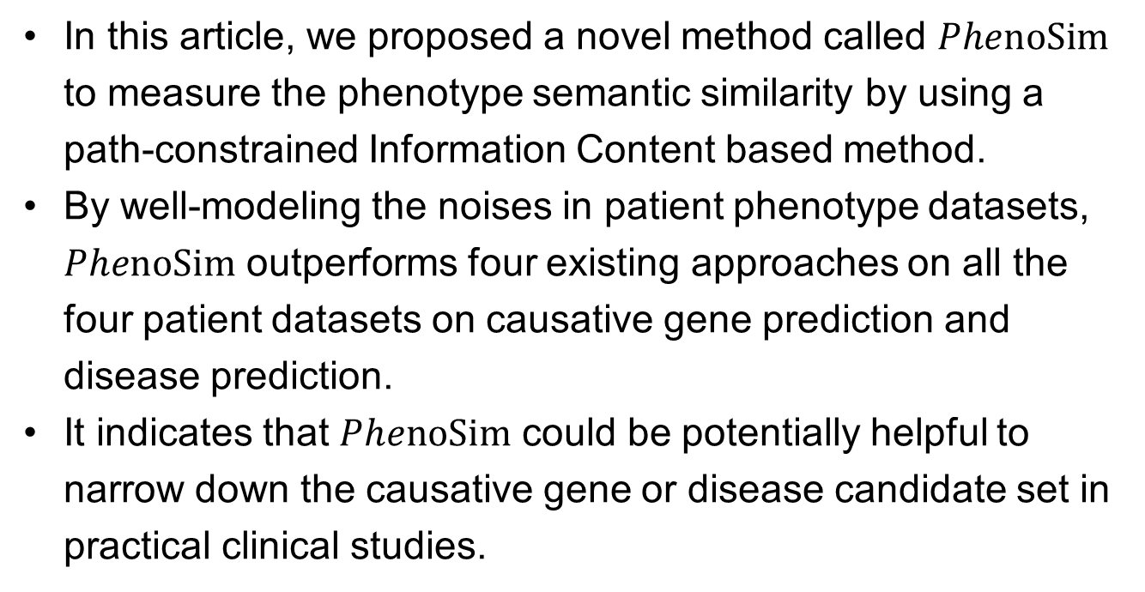
Conclusion
In this article, we proposed a novel method called $PhenoSim$ to measure the phenotype semantic similarity by using a path-constrained Information Content based method.
By well-modeling the noises in patient phenotype datasets, $PhenoSim$ outperforms four existing approaches on all the four patient datasets on causative gene prediction and disease prediction.
It indicates that $PhenoSim$ could be potentially helpful to narrow down the causative gene or disease candidate set in practical clinical studies.
19

Slide 21








Acknowledgment
20

