Slide 1
Predicting Disease-related Genes using Integrated Biomedical Networks
Jiajie Peng (jiajiepeng@nwpu.edu.cn)
Hansheng Xue(xhs1892@gmail.com)
Jin Chen* (chen.jin@uky.edu)
Yadong Wang* (ydwang@hit.edu.cn)
Notes:
The topic of my talk is “Predicting Disease-related Genes using Integrated Biomedical Networks”.

Slide 2
Outline
Background
Methods
Results
Future work
Notes:
My presentation includes four parts. First, I will introduce the background and the problem we focus on. Second part is our measure to predict disease-related genes using integrated biomedical network. Then, I will show you some interesting experiments and the corresponding results. Some future works were introduced in the last part.

Slide 3
Outline
Background
Methods
Results
Future work

Slide 4
Introduction to Problem
Identifying the genes associated to human diseases is crucial for disease diagnosis and drug design.
The advance in biotechnology enables researchers to produce multi-omics data, enriching our understanding on human diseases, and revealing complex relationships between genes and diseases.
None of the existing computational approaches is able to integrate the large amount of omics data into a weighted integrated network and use it to enhance disease related gene discovery.

Slide 5
Existing Methods
The network-based approaches for disease-related gene identification can be loosely grouped into three categories:
Directed neighbor counting
Shortest path length approach
Predict relationship using global network structure

Slide 6
Summary of Existing Methods
Directed Neighbor Counting
The idea is that if a gene is connected to one of the known disease genes, it may be associated with the same disease.
Shortest Path length Approach
The idea is that measuring the closeness between a disease gene and a candidate gene.
Using Global Network Structure
Such as Random Walk with Restart(RWR), Propagation Flow, Markov Clustering and Graph Partitioning.

Slide 7
Outline
Background
Methods
Results
Future work

Slide 8
Advantages of SLN-SRW
We propose a new algorithm, Simplified Laplacian Normalization-Supervised Random Walk (SLN-SRW), to define edge weights in an integrated network and use the weighted network to predict gene-disease relationship.
SLN-SRW is the first approach, to the best of our knowledge, to predict gene-disease relationships based on a weighted integrated network.
SLN-SRW adopts a Laplacian normalization based method to avoid the bias, which is affected by the super hub nodes in an integrated network.
To prepare inputs for SLN-SRW, we constructs a new heterogeneous integrated network based on three widely used biomedical ontologies and biological databases.

Slide 9
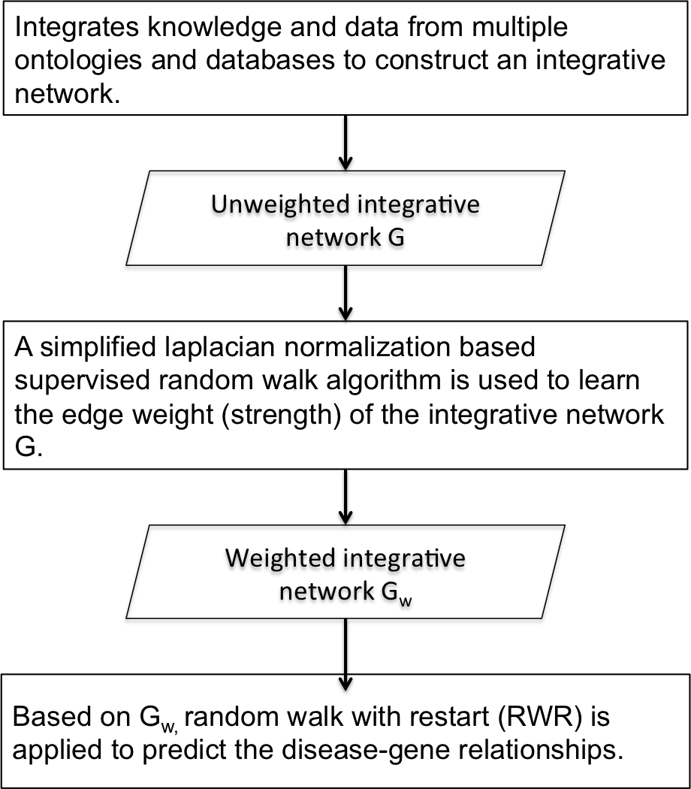
Steps of SLN-SRW
SLN-SRW has three main steps:

Slide 10
Step 1: Constructing Integrated Network
The network construction process has four steps:
Extracting information from heterogeneous data sources
Unifying biomedical entity IDs
Constructing the integrated network
Edge initial weight assignment
Notes:
The network construction process has four steps. First, Extracting information from heterogeneous data sources. Second, Unifying biomedical entity IDs. Third, Constructing the integrated network. Forth, Edge initial weight assignment. And I will introduce four steps in detail.
In the first step, Ontology parser and database parser have been developed for ontology and database data extraction respectively. The ontology parser process the OBO file and the ontology annotation file, since HPO,DO and GO are all in Open Biomedical Ontologies(OBO) format. The database parser process files in Tab Separated Values(TVS), Common Separated Values(CSV), and Extensible Markup Language(XML) format. The outputs of the two parsers are pair-wise relations and their properties between two biomedical entities.
Then, the second step is unifying biomedical entity IDs. The same pair-wise relation may be extracted from multiple data sources with different identifiers. To avoid confusion, we provide a distinct ID number for each biomedical entity by mapping all types of identifiers to the ones provided in the Unified Medical Language System(UMLS). After unifying the entity IDs from multiple data sources, each entity only has one identifier in the database. Finally, we removed the identifiers that cannot be mapped to UMLS.
After unifying biomedical entity IDs, we constructed the integrated network. The binary relations extracted from multiple data sources form an integrated network, in which nodes are biomedical entities and edges are the relationships between the entities.
Finally, we assign the initial edge weight t(u,v) to every edge <u,v> according to its edge type and the evidence code associated to the edge, where both u and v are nodes in G. Specifically, for the edge types that have edge confidence scores in the source databases, we use the confidence scores directly. For the edge types that do not have confidence scores but are associated with evidence codes, we manually assign initial edge weights based on their edge evidence codes. The edge initial weights are between 0 and 1, and the experimentally verified edges have higher initial weights than computational predictions. Note that for the edges that have two or more evidences in E, the initial weights are calculated as the maximal weight of all the valid evidence codes.

Slide 11
Step 2: Weighing Edges in Integrated Network
The approach to weigh the importance of different edge types consists of three parts:
Laplacian normalization on edge weights
Edge weight optimization-problem formation
Edge weight optimization-our solution

Slide 12
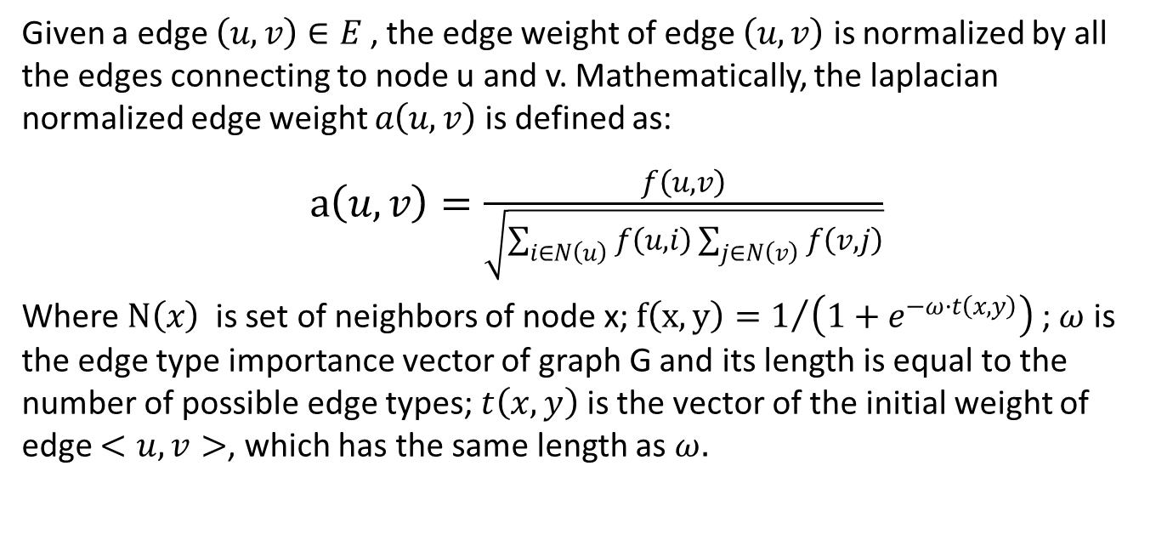
Step 2: Weighing Edges in Integrated Network
Laplacian normalization on edge weights:
Given a edge $\left(u,v\right)∈E$ , the edge weight of edge $\left(u,v\right)$ is normalized by all the edges connecting to node u and v. Mathematically, the laplacian normalized edge weight $a\left(u,v\right)$ is defined as:
$a\left(u,v\right)=\frac{f\left(u,v\right)}{\sqrt{\sum_{i∈N\left(u\right)}{f\left(u,i\right)}\sum_{j∈N\left(v\right)}{f\left(v,j\right)}}}$
Where $N\left(x\right)$ is set of neighbors of node x; $f\left(x,y\right)=1/{\left(1+e^{−ω·t\left(x,y\right)}\right)}$ ; $ω$ is the edge type importance vector of graph G and its length is equal to the number of possible edge types; $t\left(x,y\right)$ is the vector of the initial weight of edge $<u,v>$, which has the same length as $ω.$
Notes:
From the previous step, we can get an integrated network G with manually assigned initial edge weights, and the aim of this step is to automatically re-assign all the edge weights, such that the weighted network $G_{w}$ can be used for more precise disease gene prediction. To achieve this goal, we develop a new edge weight optimization algorithm based on Supervised Random Walks(SRW). SRW combines the information from network structure with the node and edge level attributes, which can guide the random walk on the network. By running SRW, we except to re-assign weights to all the edges, such that the random walker from a disease node is more likely to visit the nodes representing the associated genes. However, the training process of supervised random walks can be significantly affected by the hub nodes in the network. To solve this problem, we propose a Laplacian normalization method to weigh the importance of different types of edges in an integrated network.

Slide 13
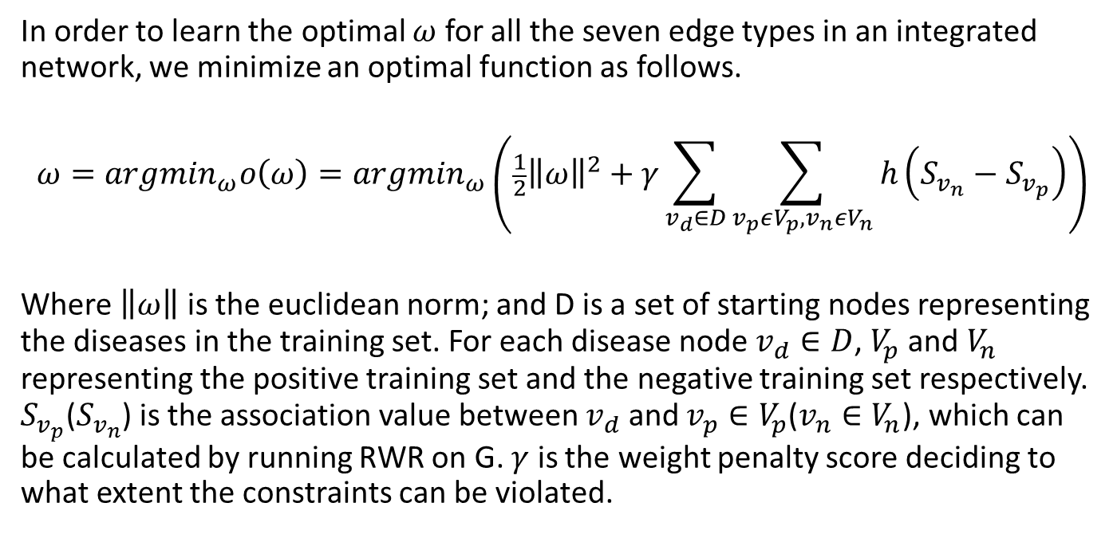
Step 2: Weighing Edges in Integrated Network
Edge weight optimization – problem formation:
In order to learn the optimal $ω$ for all the seven edge types in an integrated network, we minimize an optimal function as follows.
$$ω={argmin}_{ω}o\left(ω\right)={argmin}_{ω}\left(\frac{1}{2}{\left\|ω\right\|}^{2}+γ\sum_{v_{d}∈D}{\sum_{v_{p}εV_{p},v_{n}εV_{n}}{h\left(S_{v_{n}}−S_{v_{p}}\right)}}\right)$$
Where $\left\|ω\right\|$ is the euclidean norm; and D is a set of starting nodes representing the diseases in the training set. For each disease node $v_{d}∈D$, $V_{p}$ and $V_{n}$ representing the positive training set and the negative training set respectively. $S_{v_{p}}$($S_{v_{n}}$) is the association value between $v_{d}$ and $v_{p}∈V_{p}$($v_{n}∈V_{n}$), which can be calculated by running RWR on G. $γ$ is the weight penalty score deciding to what extent the constraints can be violated.

Slide 14
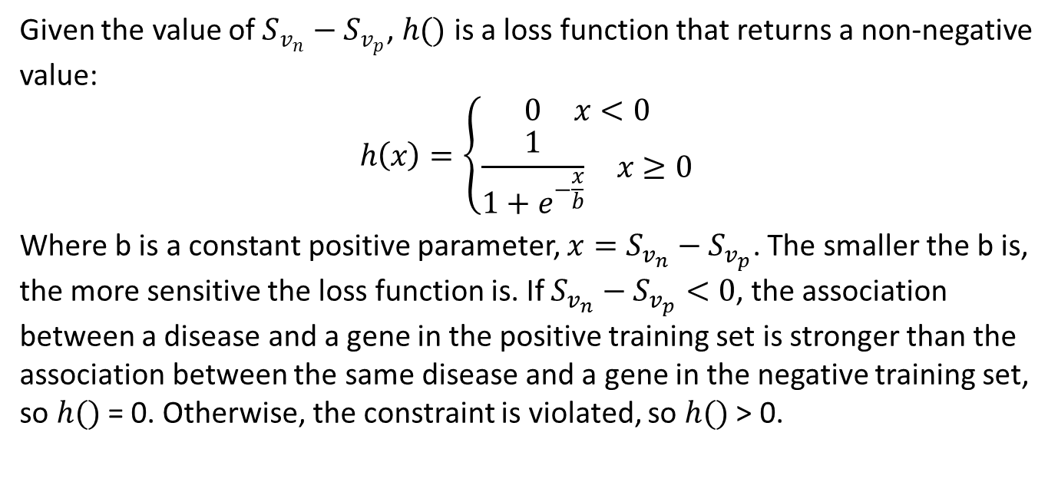
Step 2: Weighing Edges in Integrated Network
Edge weight optimization – problem formation:
Given the value of $S_{v_{n}}−S_{v_{p}}$, $h()$ is a loss function that returns a non-negative value:
$$h\left(x\right)=\left\{\begin{aligned}\begin{matrix}0 & x<0\end{matrix} \\ \begin{matrix}\frac{1}{1+e^{−\frac{x}{b}}} & x≥0\end{matrix}\end{aligned}\right.$$
Where b is a constant positive parameter, $x=S_{v_{n}}−S_{v_{p}}$. The smaller the b is, the more sensitive the loss function is. If $S_{v_{n}}−S_{v_{p}}<0$, the association between a disease and a gene in the positive training set is stronger than the association between the same disease and a gene in the negative training set, so $h()$ = 0. Otherwise, the constraint is violated, so $h()$ > 0.

Slide 15
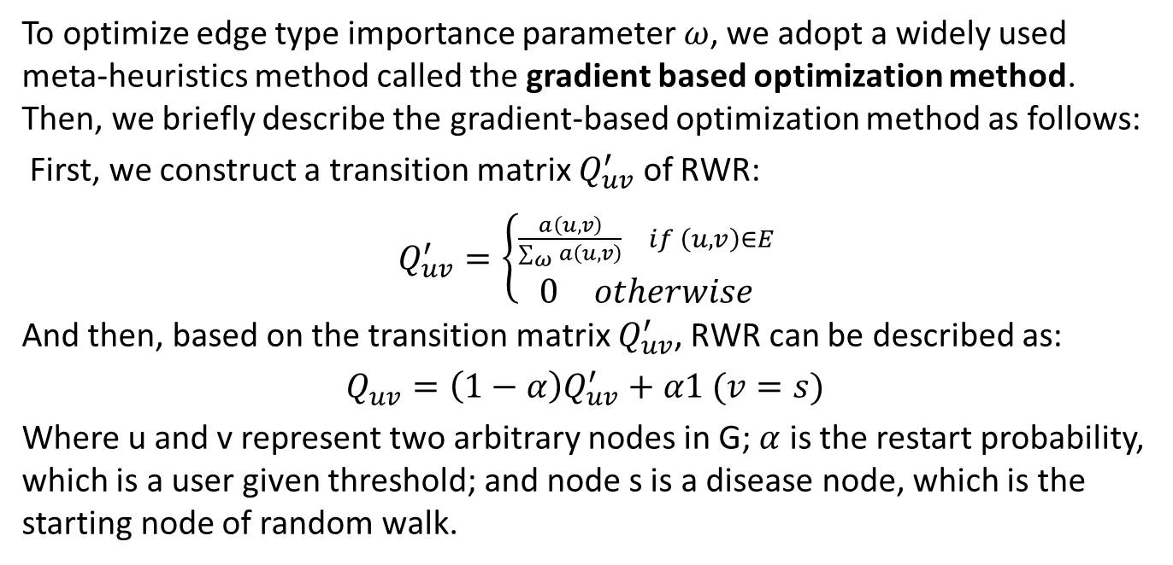
Step 2: Weighing Edges in Integrated Network
Edge weight optimization – our solution:
To optimize edge type importance parameter $ω$, we adopt a widely used meta-heuristics method called the gradient based optimization method. Then, we briefly describe the gradient-based optimization method as follows:
First, we construct a transition matrix $Q_{uv}^{′}$ of RWR:
$Q_{uv}^{′}=\left\{\begin{aligned}\begin{matrix}\frac{a\left(u,v\right)}{\sum_{ω}{a\left(u,v\right)}} & if \left(u,v\right)∈E\end{matrix} \\ \begin{matrix}0 & otherwise\end{matrix}\end{aligned}\right.$
And then, based on the transition matrix $Q_{uv}^{′}$, RWR can be described as:
$Q_{uv}=\left(1−α\right)Q_{uv}^{′}+α1 (v=s)$
Where u and v represent two arbitrary nodes in G; $α$ is the restart probability, which is a user given threshold; and node s is a disease node, which is the starting node of random walk.

Slide 16
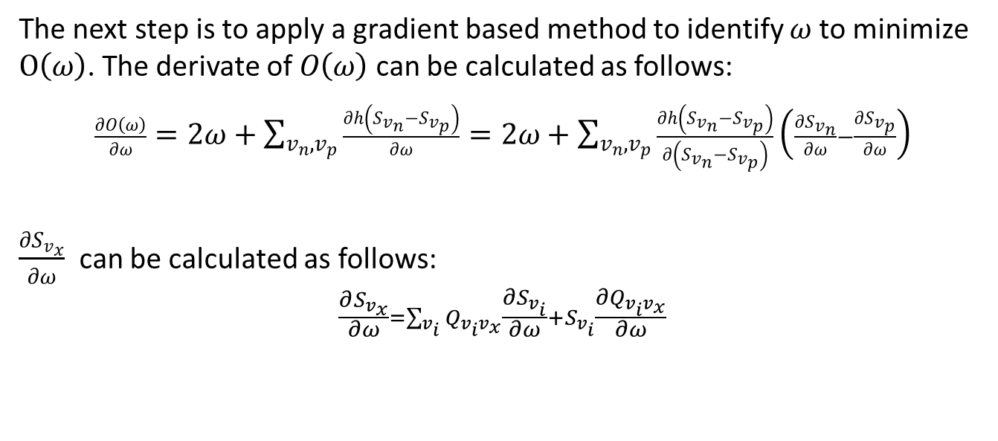
Step 2: Weighing Edges in Integrated Network
Edge weight optimization – our solution:
The next step is to apply a gradient based method to identify $ω$ to minimize $O\left(ω\right)$. The derivate of $O\left(ω\right)$ can be calculated as follows:
$\frac{∂O\left(ω\right)}{∂ω}=2ω+\sum_{v_{n},v_{p}}{\frac{∂h\left(S_{v_{n}}−S_{v_{p}}\right)}{∂ω}}=2ω+\sum_{v_{n},v_{p}}{\frac{∂h\left(S_{v_{n}}−S_{v_{p}}\right)}{∂\left(S_{v_{n}}−S_{v_{p}}\right)}}\left(\frac{∂S_{v_{n}}}{∂ω}−\frac{∂S_{v_{p}}}{∂ω}\right)$
$\frac{∂S_{v_{x}}}{∂ω}$ can be calculated as follows:
$$\frac{∂S_{v_{x}}}{∂ω}=\sum_{v_{i}}{Q_{v_{i}v_{x}}\frac{∂S_{v_{i}}}{∂ω}+S_{v_{i}}\frac{∂Q_{v_{i}v_{x}}}{∂ω}}$$

Slide 17
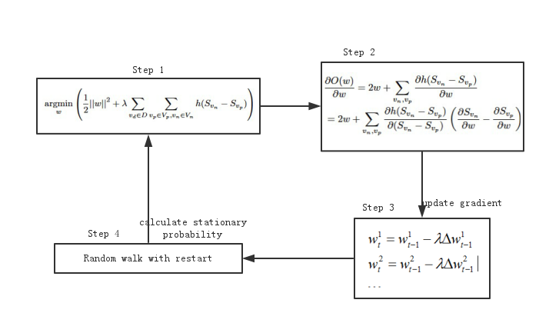

Step 2: Weighing Edges in Integrated Network
Edge weight optimization – our solution:
The process of obtaining $ω$ has four steps:
Notes:
Practically, the process of obtaining $ω$ has four steps. Firstly, we initial the $O\left(ω\right)$ based on the initial parameters. Secondly, the derivative $\frac{∂O\left(ω\right)}{∂ω}$ is calculated in step 2. Thirdly, based on the derivative, we can update the gradient to obtain an updated parameter $ω$. Fourthly, taking the updated $ω$ as input, step 4 calculates the stationary probability of the RWR. In the process, the iteration for derivative calculation and the RWR algorithm are two key steps.

Slide 18
Step 3: Predicting relationship using RWR
After estimating the edge weight of the integrated network, we can directly apply RWR on the weighted network to predict the relationship between diseases and genes.

Slide 19
Outline
Background
Methods
Results
Future work

Slide 20
Results
In the test experiments, we compare SLN-SRW with SRW and RWR, where the latter has been widely used in network-based disease gene prediction, on a real and a synthetic data set.
Real data set: we select 430 disease-gene edges from the integrated network as the positive set, and generate 430 edges as the negative set.
Synthetic data set: we generated 300 scale-free networks using the Copying model, and each network contains 1000 nodes.
Notes:
To test the performance of SLN-SRW, we select 430 disease-gene edges from the integrated network as the positive set. In the positive set, there are 16 diseases, each of which has at least five known disease-associated genes in the integrated network. The disease-gene pairs included in the negative set are generated in two steps. First, we select a disease $d$ from the positive set. Second, we repeatedly and randomly select genes that do not connect to $d$ in the integrated network $G$. The number of the randomly selected genes is the same as the number of genes that connect to $d$ in the positive set. We repeat the process until all disease nodes in the positive set are elected. Both positive and negative sets are evenly divided into two parts randomly, one for training and the other for testing.
For the synthetic set, specifically, we generated a scale-free network with 1000 nodes using the Copying model. The generation process starts with three connected nodes. We connect a new node $u$ to any of the existing nodes, which are selected at random with probability 0.8 or with probability proportional to the node degree. Parameter $b$ is equal to 0.03 in all the experiments. Then, we randomly choose one of the original three nodes as the start point $v$. Based on the edge strength determined by $w^{′}$, we run RWR starting from v and ranked the other nodes via the stationary probability. We select top 20 nodes that directly connect with $v$ as the positive training set, and select the nodes that do not connect with $v$ as the negative set.

Slide 21
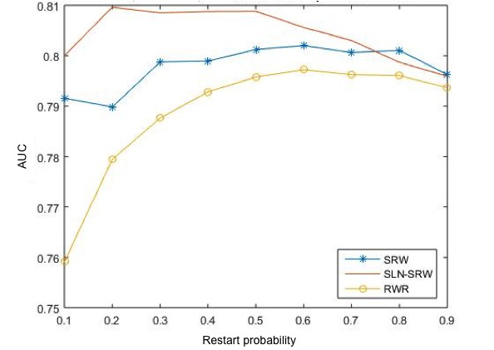
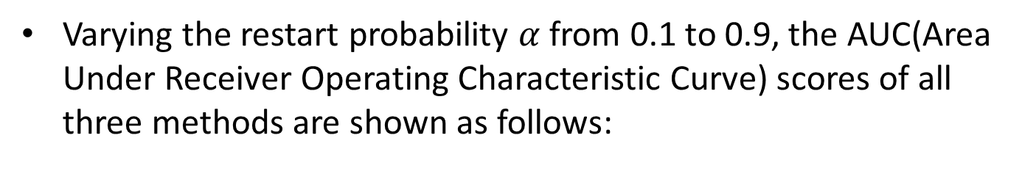
Performance Comparison on Real Data Set
Varying the restart probability $α$ from 0.1 to 0.9, the AUC(Area Under Receiver Operating Characteristic Curve) scores of all three methods are shown as follows:
Notes:
If $α$ = 0.2, SLN-SRW method reaches the highest AUC score 0.81, whereas SRW and RWR have the highest AUC scores if $α$ = 0.6, indicating that SLN-SRW can find the disease genes which are far from the disease node.

Slide 22
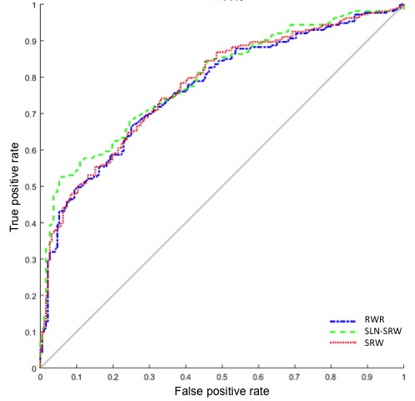
Performance Comparison on Real Data Set
Comparing the performance of all the three methods using the Receiver Operating Characteristic (ROC) curve.
Notes:
In our test, the AUC score of SLN-SRW (0.79) is the highest. Especially, the true positive rate of SLN-SRW is significantly higher than RWR and SRW while its false positive rate keeps low. This is important for disease gene predict, since researchers usually select candidate disease genes with a stringent threshold, which corresponds to a low false positive rate.

Slide 23
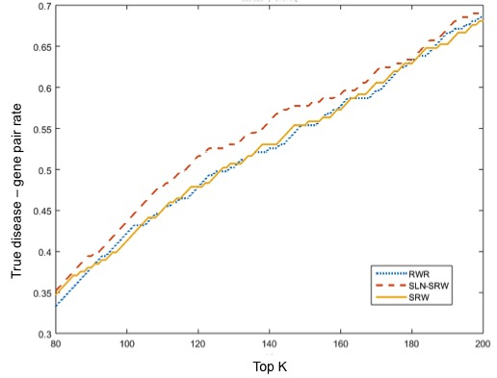
Performance Comparison on Real Data Set
Finally, we ranked the predicted disease genes to check whether the true disease-related genes have higher ranks than the other genes.
Notes:
The figure shows that the prediction result of SLN-SRW contains more known disease-related genes than SRW and RWR at a majority of the top $k$ levels, indicating that the edge weighing process in SLN-SRW has contributed significantly to the high recall of the results.

Slide 24
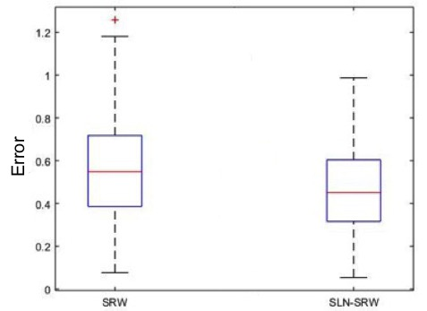
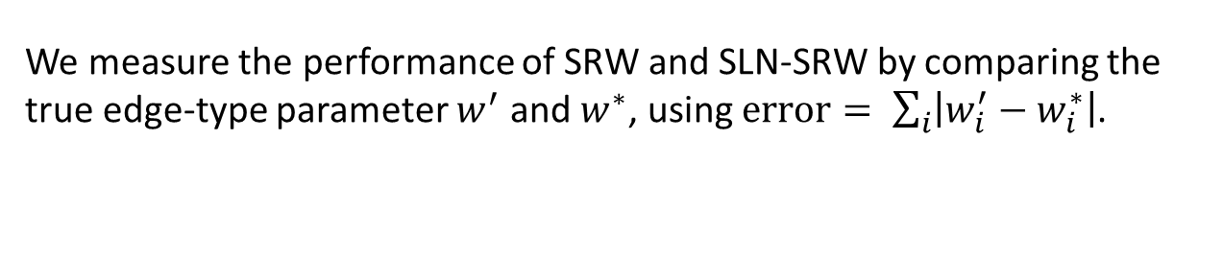
Performance Comparison on Synthetic Data Set
We measure the performance of SRW and SLN-SRW by comparing the true edge-type parameter $w^{′}$ and $w^{∗}$, using $error= \sum_{i}{\left|w_{i}^{′}−w_{i}^{∗}\right|}$.
Notes:
After repeating the experiment 100 times, we find that the error of SLN-SRW is significantly lower than that of SRW (t-test $p−value<0.05$) indicating that SLN-SRW performs better than SRW.

Slide 25
Outline
Background
Methods
Results
Future work

Slide 26
Future work
SLN-SRW will be applied to networks with different edge densities and qualities to test its robustness.
We will apply SLN-SRW on more recent datasets and examine the results using both biological experiments and literature.

Slide 27
Key References
[1] Wang X, Gulbahce N, Yu H: Network-based methods for human disease gene prediction. Briengs in functional genomics 2011, 10(5):280-293.
[2] Ala U, Piro RM, Grassi E, Damasco C, Silengo L, Oti M, Provero P, Di Cunto F: Prediction of human disease genes by human-mouse conserved coexpression analysis. PLoS Comput Biol 2008, 4(3):e1000043.
[3] Kann MG: Advances in translational bioinformatics: computational approaches for the hunting of disease genes. Briengs in bioinformatics 2009, :bbp048.
[4] Navlakha S, Kingsford C: The power of protein interaction networks for associating genes with diseases. Bioinformatics 2010, 26(8):1057-1063.
[5] Browne F, Wang H, Zheng H: A computational framework for the prioritization of disease-gene candidates. BMC genomics 2015, 16(Suppl 9):S2.

Slide 28

National High Technology Research and
Development Program of China
The Start Up Funding of the Northwestern Polytechnical University
Notes:
This project is funded by national natural science foundation of china, National High Technology Research and Development Program of China and the Start Up Funding of the Northwestern Polytechnical University.

