Slide 1
PhenoSimWeb: a web tool for measuring and visualizing phenotype similarities using HPO
Hansheng Xue
School of Computer Science and Technology
Harbin Institute of Technology, shenzhen

Slide 2
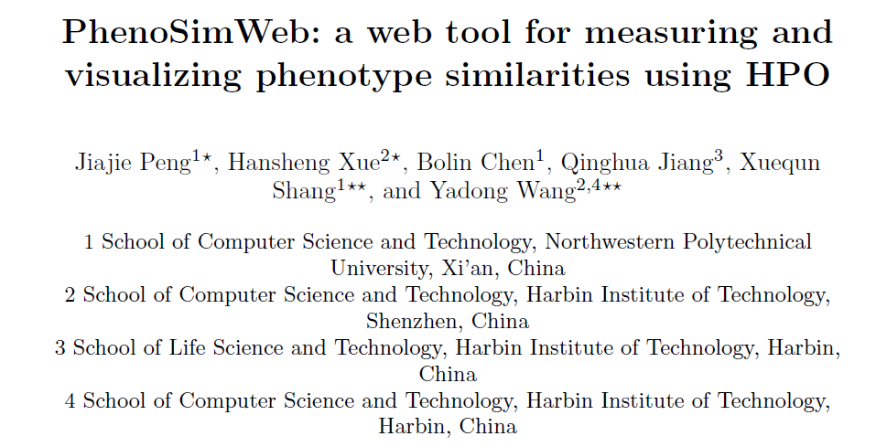

Slide 3
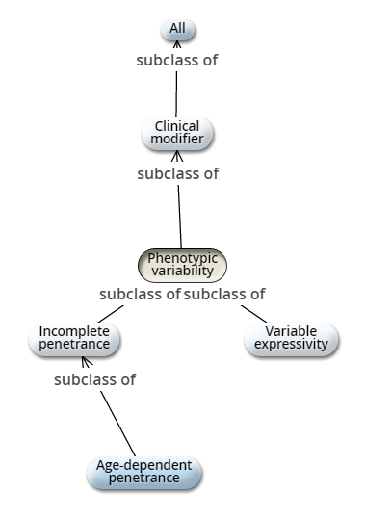
Background
Human Phenotype Ontology(HPO):
a. The HPO is one of the most popular bioinformatics resources, which was constructed by Robinson et al. in 2008.
b. The HPO currently contains over 11,000 terms, each of which describes an individual phenotypic anomaly.
c. The terms are arranged in a directed acyclic graph and(DAG) are connected by is-a (subclass-of) edges, such that a term represents a more specific or limited instance of its parent term(s).
In recent study, HPO-based phenotype semantic similarity has been effectively applied to model patient phenotype data .

Slide 4
Background
Main researches and Drawbacks:
a. None of existing methods take into account the unique features of HPO. And we proposed a novel path-constrained Information Content to fill this gap.
b. None of existing tools allow text that describes phenotype features as input, neglecting that symptoms of patients are always described as text not HPO terms.
c. Most existing tools ignore the effect of visualization and simply list the experimental results as the final output.
In this article, we present a novel web application named PhenoSimWeb to measure phenotype similarities based on HPO and to visualize the similarity using an intuitive graphical interface.

Slide 5
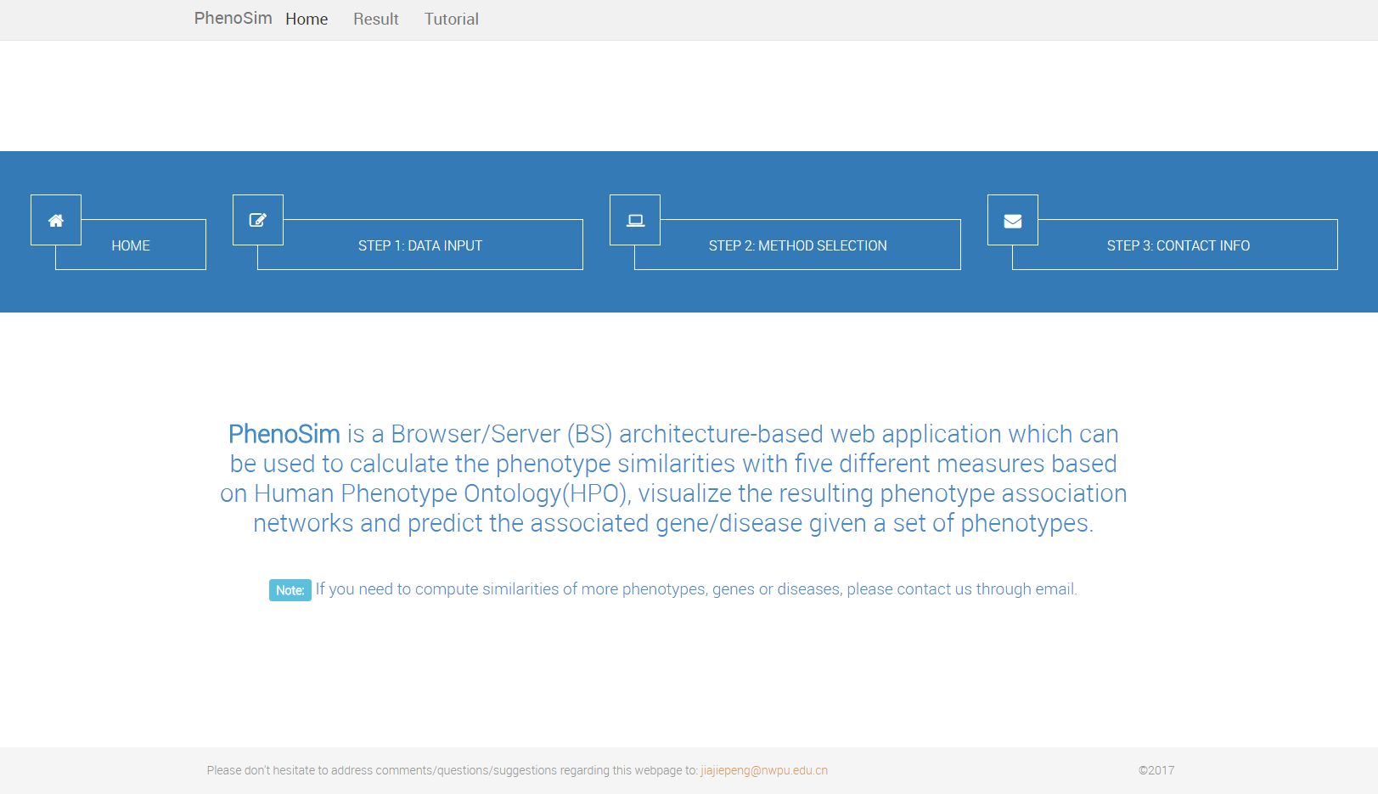
Background
Advantages of PhenoSimWeb:
a. PhenoSimWeb supplies researchers with a measurement based on the design optimized for unique features of HPO.
b. PhenoSimWeb allows text that describes phenotype features as input.
c. PhenoSimWeb contains an intuitive and easy-to-use visualization interface to visualize phenotype association network.
The main webpage of PhenoSimWeb

Slide 6
PhenoSimWeb
Main introduction:
a. The back-end of PhenoSimWeb is implemented using Java SDK 7, Python 2.7 and web framework Web.py.
b. PhenoSimWeb uses MySQL to manage dataset.
c. JavaScript Object Notation(JSON) and Asynchronous JavaScript and XML(AJAX) are used for data transmission.
d. PhenoSimWeb uses Cytoscape.js and HTML5 Canvas as the graphics engine for the association network visualization.
PhenoSimWeb is a Browser/Server architecture-based web application which can be used to calculate the phenotype similarities based on HPO, visualize the association between phenotypes, and predict the associated genes/diseses given a set of phenotypes.

Slide 7
PhenoSimWeb
Main functional modules:
a. Given a list of phenotypes, calculate the pairwise similarities among the input phenotypes.
b. Given a list of genes or diseases, calculate the pairwise similarities by aggregating the similarities of phenotypes associated to given genes or diseases.
c. Given a list of phenotypes, identify the most associated genes or diseases with the given phenotypes based on their HPO-based similarity.
Two operations to execute:
a. To type in a set of phenotypes and specify the corresponding parameters
b. To visualize and download the phenotype similarities
7

Slide 8
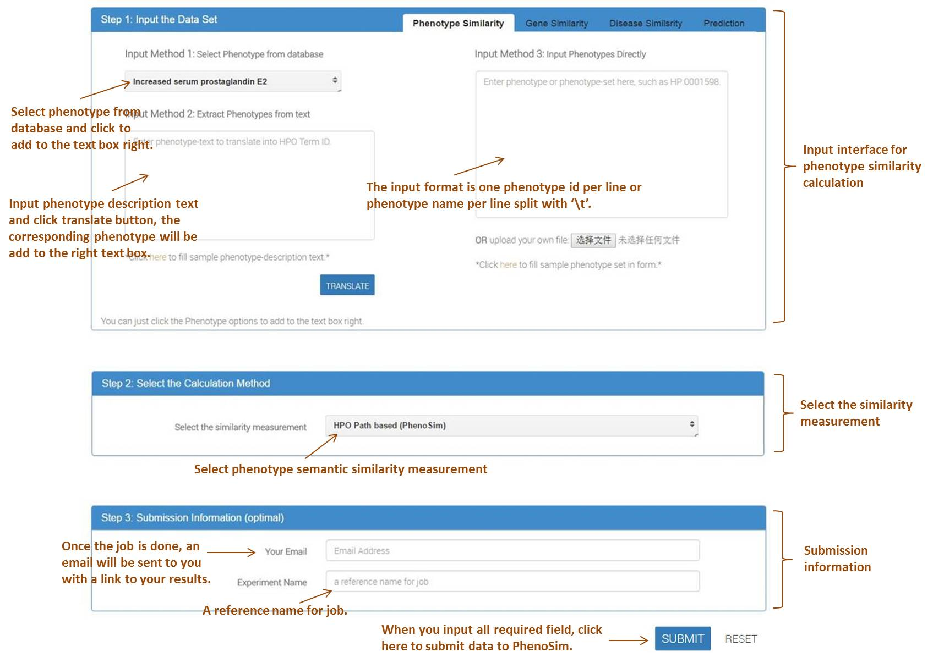
User Interface of PhenoSimWeb
The whole process can be divided into three parts, including:
inputing phenotype, gene or disease dataset,
choosing phenotype similarity measurement,
typing in experimental user information optionally.
Figure. The main input webpage of PhenoSimWeb
8
8
Notes:
Key to the refinement operation is a novel way to project flows such that the sanctity of the clustering algorithm is maintained.

Slide 9
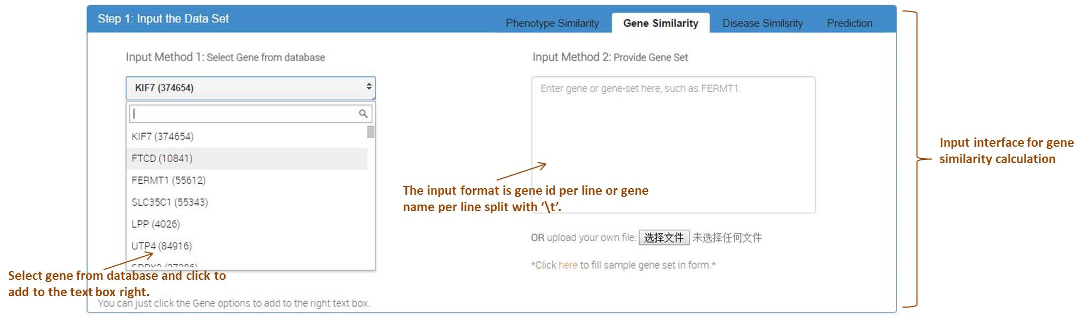
Input interface for gene (or disease) similarity calculation
Figure. The input webpage of calculating genes similarity. This part provides two types of input, including inputting gene set directly and selecting gene from database.
Notes:
to simply normalize the columns of the adjacency matrix to sum to 1

Slide 10
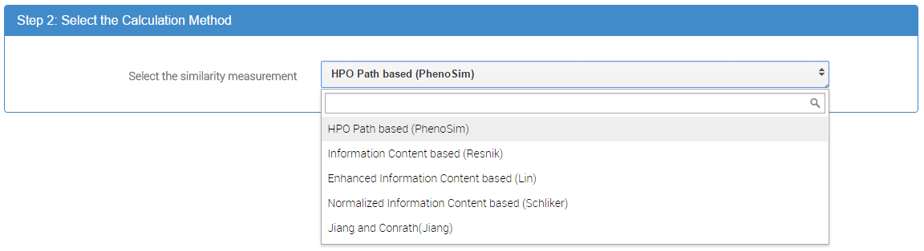
Input interface for choosing phenotype similarity measurement
Figure. PhenoSimWeb supplies five state-of-art phenotype semantic similarity measurements for all the users, including PhenoSim, Information Content based (Resnik), Enhanced Information Content based (Lin), Normalized Information Content based (Schlicker) and Jiang-Conrath Measure (JC).
Notes:
This is what allows MCL to “overfit” the graph by outputting too many clusters.

Slide 11
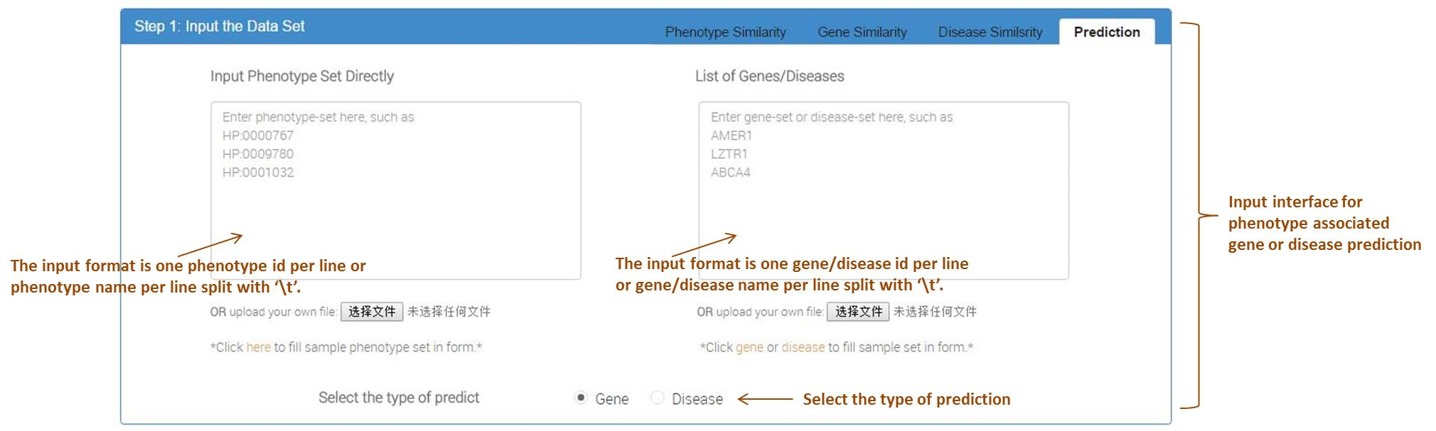
Input interface for phenotype associated gene or disease prediction
Figure. The input webpage of predicting similar genes or diseases. Users input phenotypes set in the left text box, gene or disease set in the right text box and select the type of predict.
Notes:
This is what allows MCL to “overfit” the graph by outputting too many clusters.

Slide 12
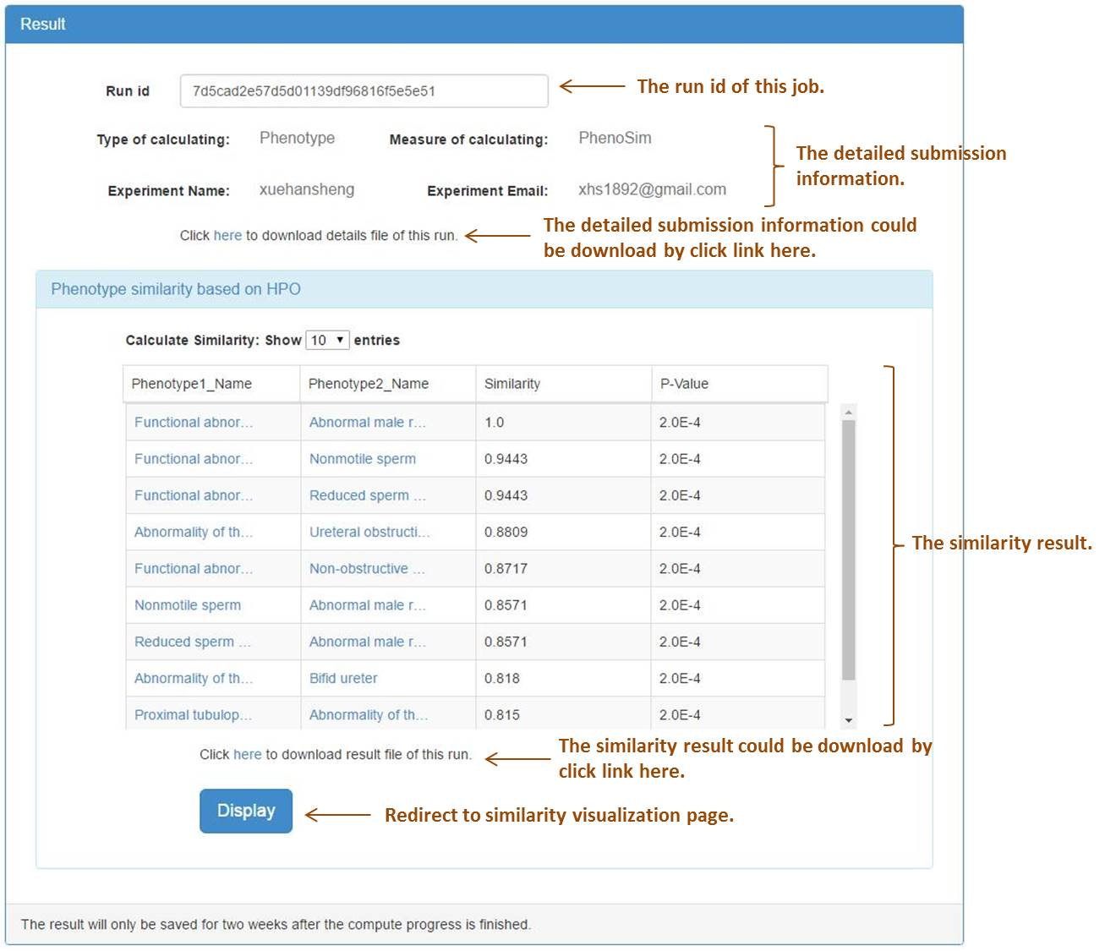
The webpage of displaying experimental results
Figure. The calculation results of the phenotype list. And PhenoSim calculated the corresponding P-Value in addition to the semantic similarity.
Notes:
This is what allows MCL to “overfit” the graph by outputting too many clusters.

Slide 13
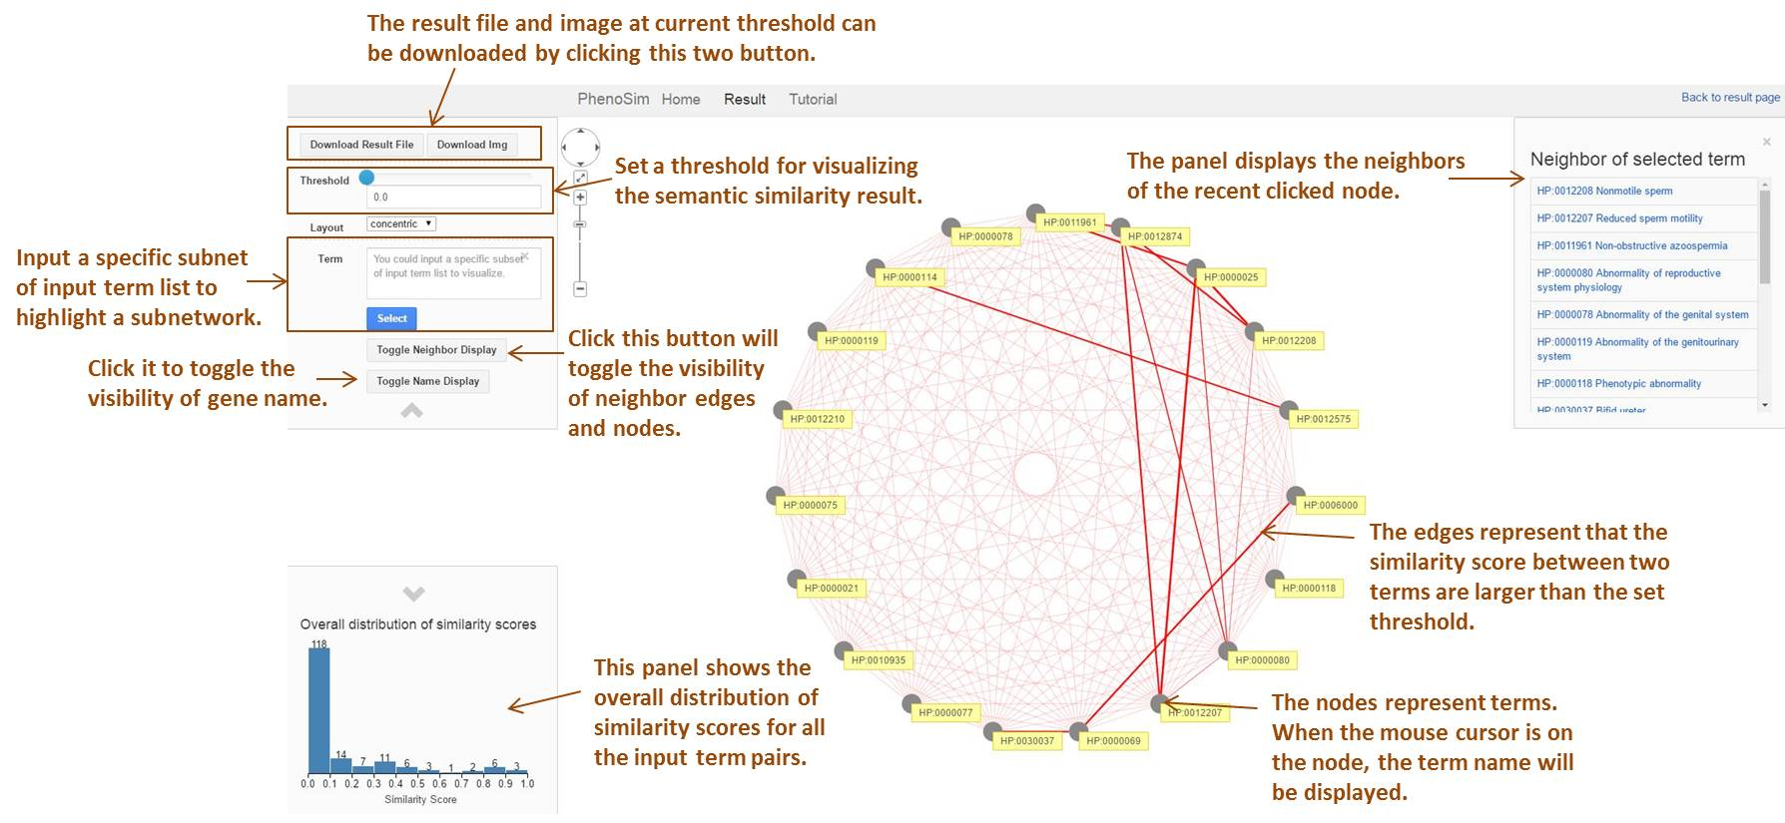
Visualization Interface of PhenoSimWeb
Figure. The visualization interface of PhenoSimWeb to explore phenotype, gene or disease functional similarities based on HPO.
Notes:
This is what allows MCL to “overfit” the graph by outputting too many clusters.

Slide 14
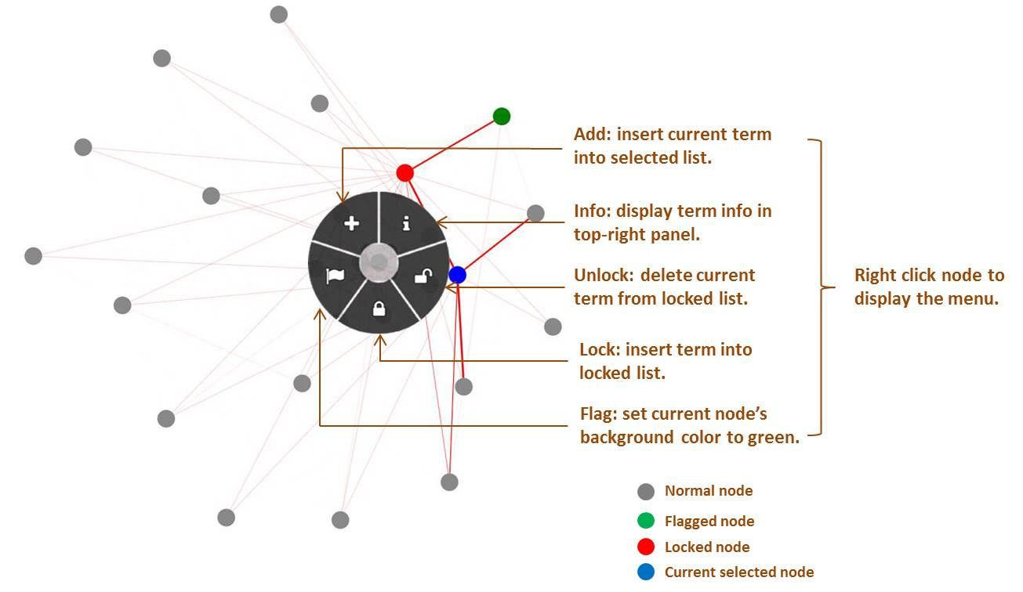
Visualization Interface of PhenoSimWeb
Figure. The node operation panel of visualization interface.

Slide 15
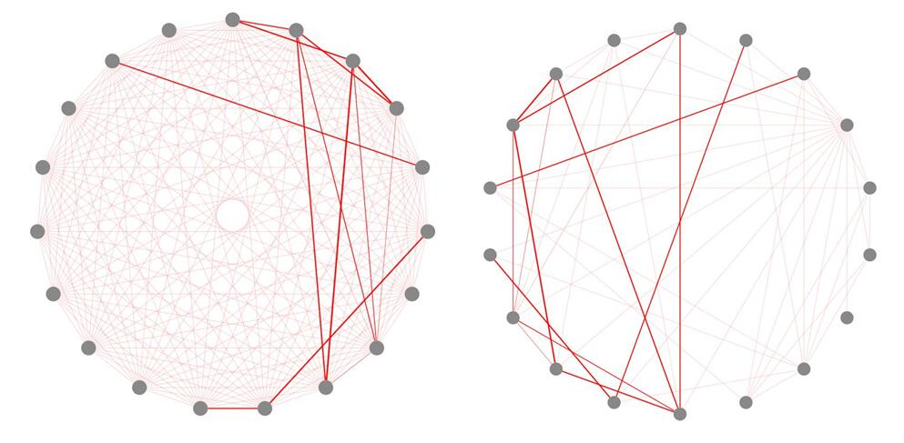
Visualization Interface of PhenoSimWeb
Figure. The comparison diagram of two contrasting phenotype association network with different phenotype-to-phenotype similarity thresholds. The edge threshold of left one is 0 and right is 0.1.

Slide 16
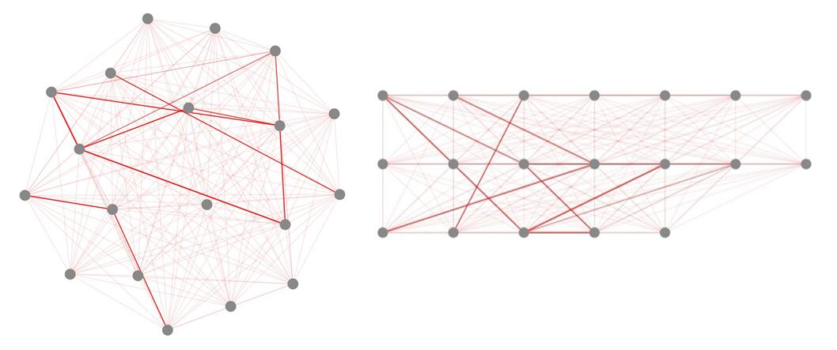
Visualization Interface of PhenoSimWeb
Figure. The comparison diagram of visualizing phenotype association network with two different graph layouts. The type of cola and grid are used in the left and right figure respectively.

Slide 17
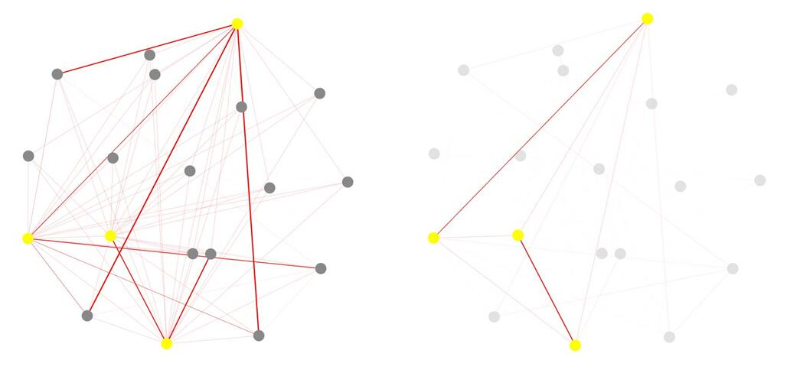
Visualization Interface of PhenoSimWeb
Figure. The comparison diagram of constructing subnetworks by selecting interested phenotypes. The right one displays that four interested phenotypes (HP:0000080, HP:0000069, HP:0030037 and HP:0000025) are chosen. The left one displays all the chosen nodes and their direct connected neighbors.

Slide 18
Conclusion
a. PhenoSimWeb is a novel web application, which allows researchers to compute phenotype similarity with five different measurements conveniently and visualize the resulting phenotype association networks with an easy-to-use visualization interface.
b. PhenoSimWeb contains three main functional modules: measure phenotype similarity, calculate gene or disease similarity, and identify the most associated genes or diseases with the given phenotype set.
c. PhenoSimWeb allows text that describes phenotype features as input.

Slide 19






Acknowledgment

Slide 20
Thank you

