Slide 1
Digital Earth GEOG-104 Week 2: Geographic Coordinate System
Yi Qiang

Slide 2
Locations
How do you communicate locations?
Place name: Sanders Hall
Address: 2424 Maile Way, Honolulu, HI-96822
Spatial relations: North of Hawaii Hall, Maile Way and University Avenue
Numerical coordinates: 21.299977, -157.818923

Slide 3
Locations
The most important function of maps is telling where things are – communicating locations
Maps need a locational reference system to determine where to put things on map
The locational reference system is the transformation between locations on map and location in the reality.

Slide 4
Coordinate Systems
There are two types of coordinate systems:
A geographic coordinate system is used to locate objects on the curved surface of the earth.
A projected coordinate system is used to locate objects on a flat surface—a paper map or a digital map displayed on a flat computer screen.
To build a accurate coordinate system to define locations, we need know the size and shape of the earth.

Slide 5
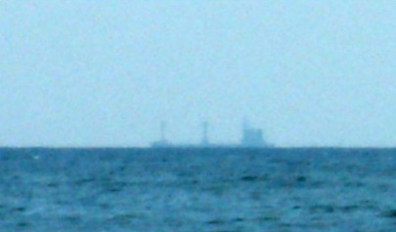
The Earth as a Sphere
We’ve known for 2000 years that the Earth is a Sphere (since Aristotle), from visual observations of spherical horizon, circular shadow of moon eclipse
When a ship is at the horizon, its lower part is invisible due to Earth's curvature. This was one of the first arguments favouring a round-Earth model.

Slide 6
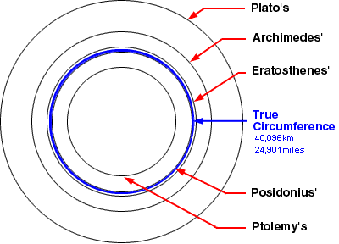
The Earth as a Sphere
However, determine the size of our spherical earth was a daunting task for our ancestors.
Ancient astronauts posted different estimation of the size of the earth.

Slide 7
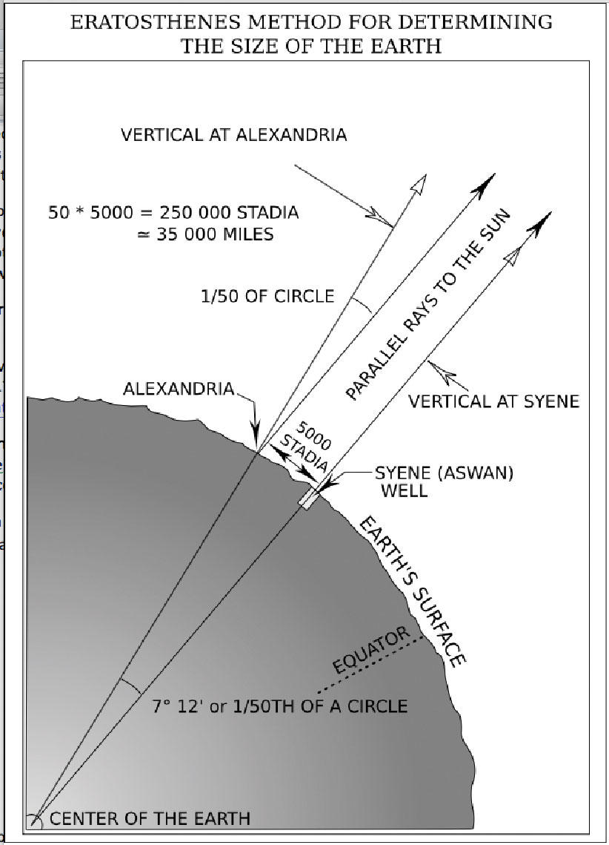
Eratosthenes estimated the earth’s circumference is 45,700 – 47,960km (14 – 19% greater than the current value 40,075km)
Where is the error from?

Slide 8
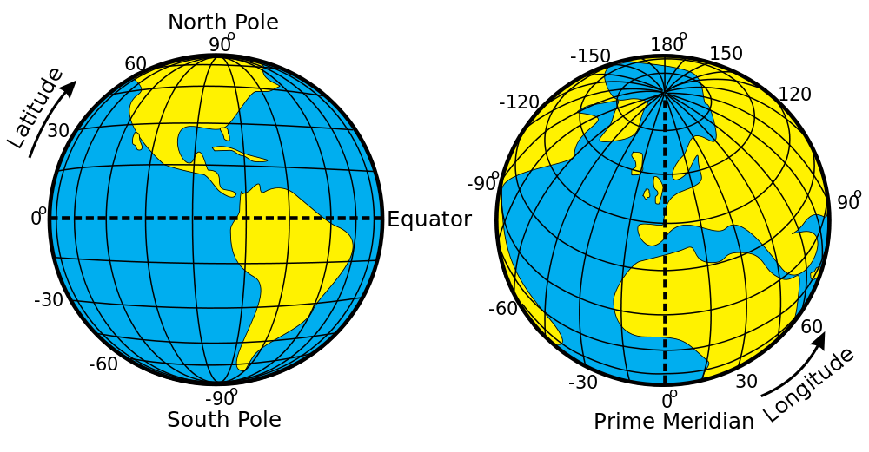
The Graticule
Once the shape and size of the earth were known, mapmakers need a system to define locations on the surface.
Hipparchus (Greek astronomer, 190-125 BC) proposed parallels and meridians.
The network of intersecting lines of latitude and longitude is called the graticule
The numbering system for parallels and meridians is called latitude and longitude.
Parallel
Meridians

Slide 9
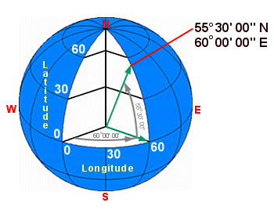
Latitude and longitude
Latitude
North-south angular distance from the equator
Range from 0° at the equator to 90° at the poles
Longitude
Angle from the prime meridian along the equator
There different prime meridians – the mostly used is the Greenwich Meridian
Range from 0° to 180°
Example:
21°18'02.0"N 157°49'09.1"W

Slide 10
Format of latitude and longitude
The latitude and longitude include a numerical number to represent the angle degree, and a N/S/E/W or +/- sign to represent the direction of the angle.
degrees minutes seconds: 40° 26′ 46″ N 79° 58′ 56″ W
degrees decimal minutes: 40° 26.767′ N 79° 58.933′ W
decimal degrees: 40.446° N 79.982° W (decimal degree = dd + mm/60 + ss / 3600)
Degree with plus/minus: 40.446°, - 79.982°
Lattitude: + means north of the equator, - means south of that
Longitude: + means east of the prime meridian, - means west of that

Slide 11
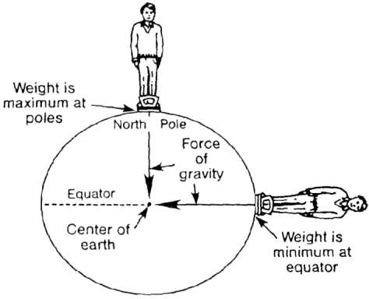

The earth's shape is a ellipsoid
As the centuries passed, scientists and explorers began to realize that the earth was not a perfect sphere.
British scientists, led by Isaac Newton, theorized that the centrifugal force from the earth's rotation would force the earth to "spread out" from east to west as it rotated about its axis.
In 1753, a French survey expedition (Cassini et al.) took measurements at the equator in Peru and at the Arctic circle in Lapland and determined that the earth was indeed bulging at the equator - the earth's shape is not a sphere but an ellipsoid.
$W$eight = Force of gravity – centrifugal force
If earth is spin around the polar axis, the centrifugal force is 0 at equator and maximum at poles.

Slide 12
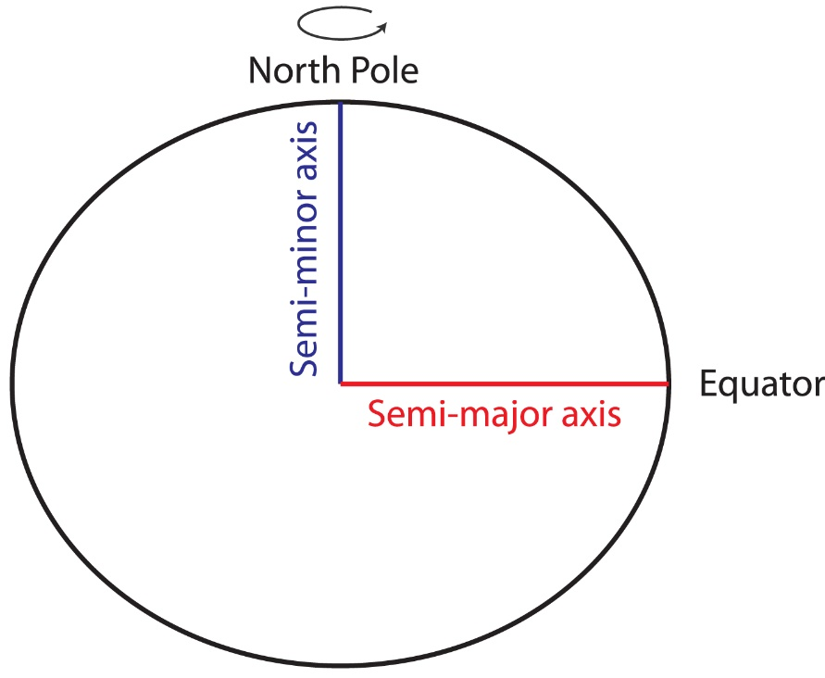
The earth's shape is a spheroid
Although the earth's shape is technically an ellipsoid, its major and minor axes do not vary greatly - its shape is so close to a sphere that it is often called a spheroid rather than an ellipsoid.
Slicing the earth in half from pole to pole will result in an eclipse with slightly shorter polar radius (semiminor axis) and slightly longer equatorial radius (semimajor axis).
The semimajor axis is 21km or 0.3% longer than the polar radius.

Slide 13
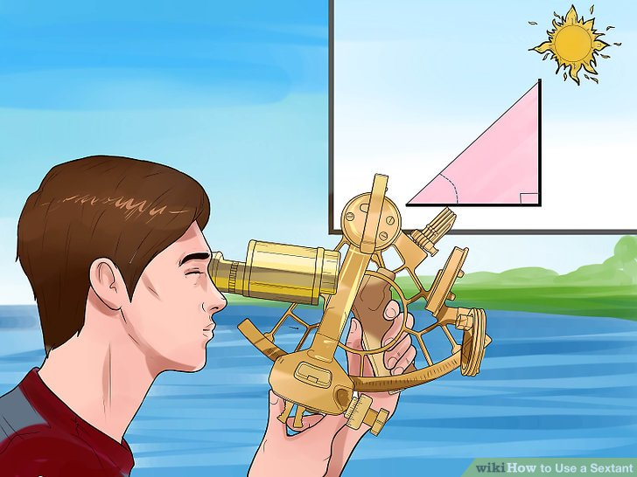
Determine Geodetic Latitude and Longitude
Through the angle of a celestial object (e.g. sun or Polaris), you can determine your latitude and longitude.
You can determine locations from the reference table (Nautical Almanac) according to the angle of the celestial objects and the date of observation.

Slide 14
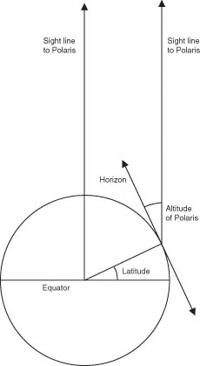
Determine latitude using Polaris
The angle from the Polaris to horizon is the latitude

Slide 15
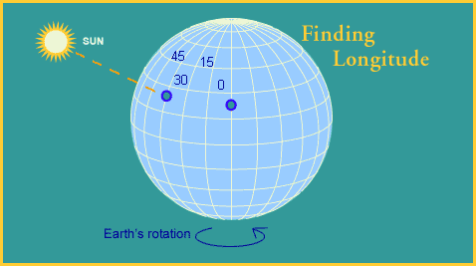
Determine latitude using Polaris
Determine longitude according to the angle the sun moved during a certain time period

Slide 16
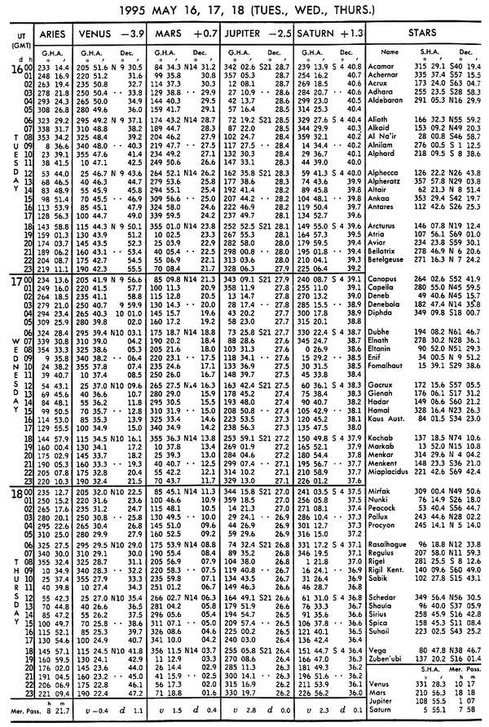
Nautical Almanac

Slide 17
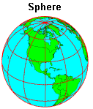
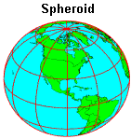
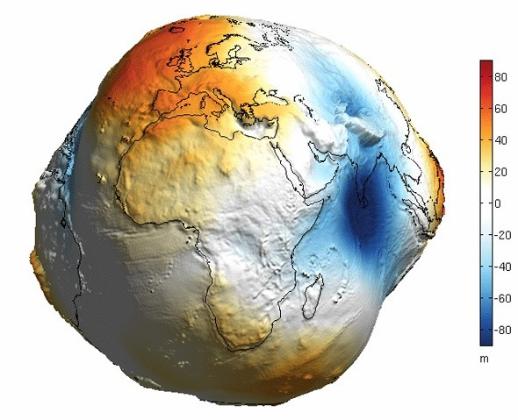
The shape of the Earth
Sphere (Aristotle)
Spheroid (Newton, Cassini)
Up-to-date satellite technologies

Slide 18
The shape of the Earth
Why Earth is not a spheroid?
Topography (mountains, valleys, ocean, land)
Uneven gravity (uneven material in the earth)
Earth rotation (uneven centrifugal force)
Instead of spheroid, we need a model to more accurately describe the shape of the earth.

Slide 19
GEOID
The shape of the earth when all its topography were removed – a surface of mean sea level rise.
An "equipotential surface" because the potential energy associated with the earth's gravitational pull is equivalent everywhere on the surface.
A three-dimensional statistical surface that fits as closely as possible gravity measurements taken at millions of locations around the world.
Revised periodically when additional and more accurate gravity measurements become available.
Some are solved only for limited areas; GEOID03, for instance, is calculated only for the continental U.S.

Slide 20
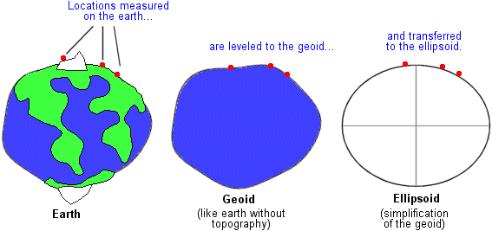
Simplification of Geoid
Although the earth is best represented by the geoid, coordinate systems are applied to the simpler model of a spheroid (ellipsoid) - mathematically and computationally efficient
Actual measurements of location (whether made by ground survey or satellite) conform to the geoid surface and have to be mathematically transformed to positions on the spheroid.
The transformation cause different degrees of inaccuracy at different locations.

Slide 21
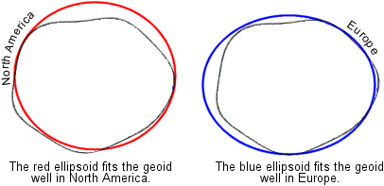
Simplification of Geoid
A single spheroid does not fit all parts of the geoid equally well.
Different spheroids are used to will minimize the inaccuracy in different areas of interest.

Slide 22
Datum
Defines the geometric relationship between an ellipsoid and a coordinate system.
Mapping Lag/Long on a specific point the earth surface (geoid).
A datum is defined by:
a spheroid (major-, minor-axis)
An initial reference point (origin point), where the coordinates (lag/long) are the same as that on geoid.

Slide 23
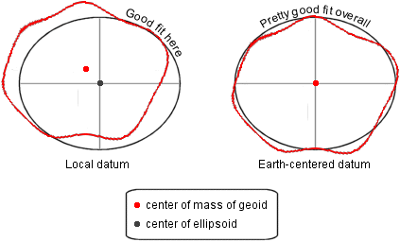
Global and local datum
An earth-centered datum is better for mapping the world, a local datum is better for mapping a small piece of it.
Earth-centered datums, in particular WGS84, are becoming a standard because they work equally well for everyone
Local datums, e.g. the North American Datum of 1927 (NAD27), minimize differences between the geoid and the ellipsoid in the U.S..

Slide 24
Earth-centered datums
World Geodetic System of 1984 (WGS84)
The datum on which GPS coordinates are based and probably the most common datum for GIS data sets with global extent.
Soviet Geodetic System of 1990 (SGS90)
Similar to WGS84, this is the datum on which GLONASS coordinates are based. (GLONASS, or the Global Navigation Satellite System, is Russia's counterpart to the GPS system.)
North American Datum of 1983 (NAD83)
NAD83 is a correction of NAD27 coordinates that is based on both earth and satellite measurements. Unlike NAD27, however, it is an earth-centered datum, not a local datum. Its coordinates are very similar to WGS84 coordinates and can be used interchangeably with them.

Slide 25
Local datums
Datum | Origin | Origin coordinates | Spheroid used
NAD27 | Meades Ranch, Kansas | 33° 13' 26.686" N 98° 32' 30.506'' W | Clarke 1866
ED50 | Potsdam, Germany | 52° 22' 51.45" N 13° 03' 58.74" E | International 1924
Tokyo | Tokyo Observatory | 35° 39' 17.51" N 139° 44' 40.50" E | Bessel
Indian | Kalianpur, India | 24° 07' 11.26" N 77° 39' 12.57" E | Everest

Slide 26
Horizontal and vertical datums
Horizontal datums map lag/long to a point on the earth surface (geoid) - what we’ve talked about
Vertical datums, by contrast, are the reference values for a system of elevation measurements. The job of a vertical datum is to define where zero elevation is—this is usually done by determining mean sea level, a project that involves measuring tides over a cycle of many years.

