Slide 1
Applied Geographic Information Systems and GIS Programming Day 8: Spatial Modeling
Yi Qiang
Department of Geography
University of Hawaii - Manoa

Slide 2
What is Modeling
‘Modeling’ is one of the most overloaded terms anywhere
Generally, a model is a (simplified ) description of reality (static reproduction, conceptual description)
Modeling can (or should) be considered as an entity or process

Slide 3
Spatial Modeling (GIS Modeling)
A process that uses geographical data about the spatial relationship of features to understand and address a particular problem in the real world.
The aim of spatial modeling is to derive a meaningful representation of events, occurrences or processes by making use of the power of spatial analysis
Making use of combined functional capabilities such as analytical tools for spatial and non-spatial computation, GIS and programming languages
The focus is on the meaning of the model - modeling is more than just combining analytical tools

Slide 4
Static and Dynamic
Static modeling is the series of steps required to achieve some final result.
Calculating risk index in the national forest
Derive the service areas of cities
Dynamic modeling is performed in a similar fashion, but has additional parameters requiring several iterations of the model.
e.g. Agent-based model and cellular automata
Land cover change
Disease outbreak modeling
Spread of wildfires, heavy rain, etc.

Slide 5
Example of Static Modeling
Land cover
Reclassify
Land cover risk score
Focal
Statistics
Smoothed land cover risk
Raster
calculator
Overall risk index
Elevation
Slope
Slope
Reclassify
Slope risk score
Focal
Statistics
Smoothed slope risk
The workflow of the previous lab

Slide 6
Example of Dynamic Model
For example, Cellular Automata and Agent-Based Model
Cells
t1
t2
Transition rules
Game of life
Transition rules:
If a live cell has >= 3 live neighbors, it dies, as if over-population
If a live cell has <= 1 live neighbors, it dies, as if under-population
If a live cell has 2 live neighbors, it survive to the next step.
If a dead cell has 2 live neighbors, it will be come alive, as if reproduction

Slide 7
Why Model?
Developing a model for a GIS analysis allows for repeat testing of a hypothesis using different data.
The model is usually coded in a GIS, so that the steps are performed automatically.
Easier reproduction of results.
Simplification of workflow.
Informs the computer how to conduct a series of steps that would be impractical for you to do manually.

Slide 8
Reproducibility
To perform an analysis, you must have your workflow clearly defined.
This ensures that you are performing the steps in the correct order using the appropriate tools.
Avoid missteps, especially when there can be hours of computer processing between steps.
The GIS model can be exported as a graphic flowchart or a modeling data structure.

Slide 9
Workflow Efficiency
There are many repetitive steps you will take in your daily workflow.
Streamlining the process saves you time.
Making the workflow and model parameters consistent:
If you always start working in a File Geodatabase with specific resolution and projection information, a model for generating your specialized GDB can be created.

Slide 10
Human Inefficiency
You physically cannot perform the steps as fast as GIS can produce the results.
Certain steps, such as iteration through a feature set would be prohibitively time consuming.
You must perform the same steps 21 times to clip data to each individual NJ county.
Calculate deforested rates in all protected forests
Minimize the amount of time spent on manipulating GIS to perform complex analyses.

Slide 11
Spatial Modeling in ArcGIS
ArcGIS has a drag-and-drop interface to ArcToolbox called ModelBuilder allowing you to develop a flow chart of your GIS workflow.
This flowchart is then run step by step to perform your analysis.
ArcGIS allows for custom scripting that can be added to ArcToolbox, introducing greater functionality.
Custom export scripts, specialized versions of existing tools, develop tools not available in ArcToolbox.

Slide 12
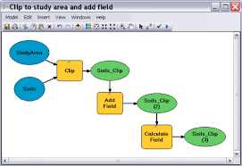
Spatial modeling in ArcGIS
ModelBuilder
Python Interface
import arcpy from arcpy import env
from arcpy.sa import *
env.workspace = "C:/sapyexamples/data" outSlope = Slope("elevation", "DEGREE") outSlope.save("C:/sapyexamples/output/outslope01")

Slide 13
Spatial modeling in ArcGIS
ModelBuilder
Pros:
Graphic user interface, user-friendly
No programming needed
Integrated in ArcGIS, dynamically linked with the visualization
Cons:
Only support limited logical controls
Python Interface
Pros:
Support more logical controls and expressions
Efficient in building large models
Cons:
Needs to learn programing
Not graphic user interface
Not dynamically linked to the visualization

Slide 14
ModelBuilder

Slide 15
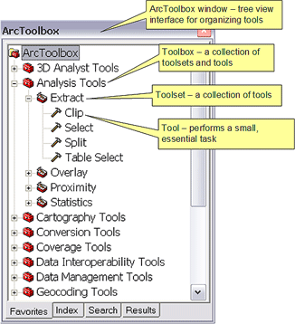
ArcToolbox
Geoprocessing tools are the basic elements of spatial models
The ArcToolbox window is an organized “library” where you find, manage, and execute geoprocessing tools.
Geoprocessing tool
ArcToolBox in ArcGIS

Slide 16
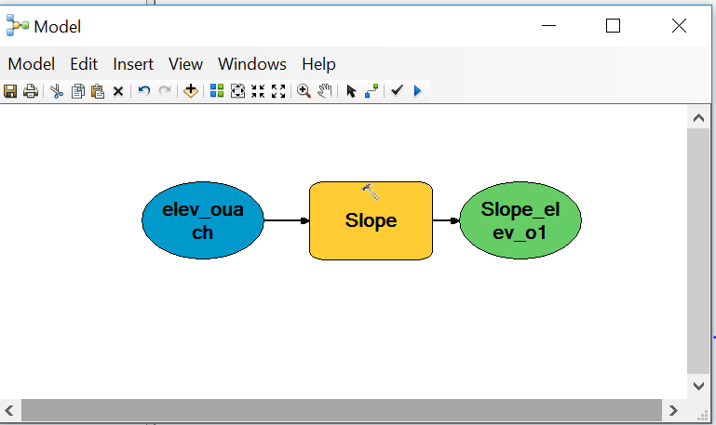
Geoprocessing tool
An wrapped program that conducts certain spatial analysis
Can be viewed as boxes that take input and generate output

Slide 17
Geoprocessing tool
Syntax of the “Slope” tool in ArcGIS help
Input
Parameter | Explanation | Data Type
in_raster | The input surface raster. | Raster Layer
output_measurement (Optional) | Determines the measurement units (degrees or percentages) of the output slope data. DEGREE — The inclination of slope will be calculated in degrees. PERCENT_RISE — Keyword to output the percent rise, also referred to as the percent slope. | String
z_factor (Optional) | Number of ground x,y units in one surface z unit. The z-factor adjusts the units of measure for the z units when they are different from the x,y units of the input surface. The z-values of the input surface are multiplied by the z-factor when calculating the final output surface. If the x,y units and z units are in the same units of measure, the z-factor is 1. This is the default. If the x,y units and z units are in different units of measure, the z-factor must be set to the appropriate factor, or the results will be incorrect. For example, if your z units are feet and your x,y units are meters, you would use a z-factor of 0.3048 to convert your z units from feet to meters (1 foot = 0.3048 meter).
Output
Name | Explanation | Data Type
out_raster | The output slope raster. It will be floating point type. | Raster

Slide 18
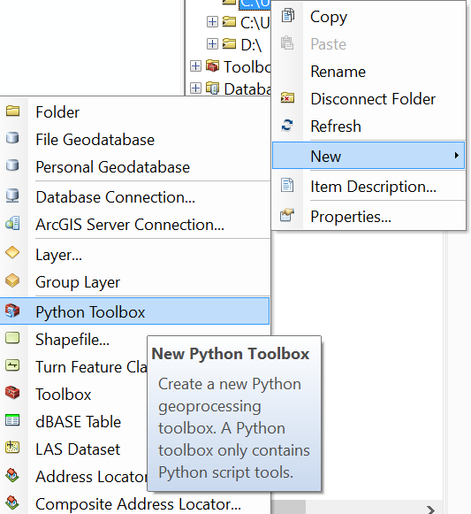
Creating a New Toolbox
Creating your own Toolbox is not just for organizational purposes. It allows you to create your own geoprocessint tools.
You can add the created tool into ArcToolbox and re-use it
You can also share the tool with others

Slide 19
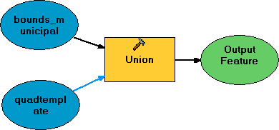
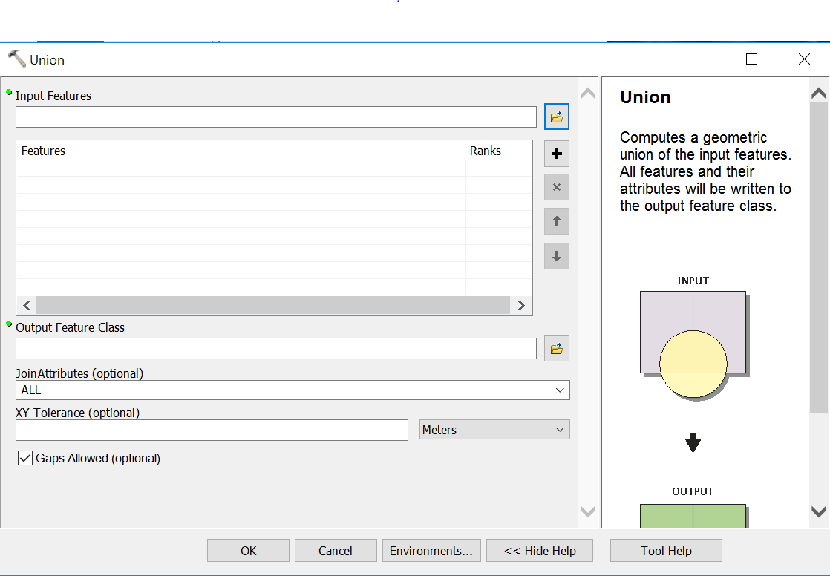
How ModelBuilder Works
Drag layers you want to participate into the model
Drag tools you want to use into the model
Output layers, tables, objects shown in green
Connect the features using arrows
Order matters to certain tools (Clip)

Slide 20
Elements in a Model
Geoprocessing tool: a wrapped program that operate a certain analytical or processing task**
Variable: Input and output of tools, which usually are GIS data
Connector: Directed connection among tools, variables, and parameters
Logical controls: logical operators that control the workflow of the model

Slide 21
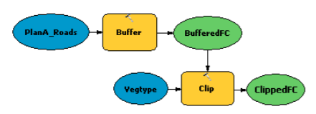
Elements in a Model
Tools
Output
Input

Slide 22
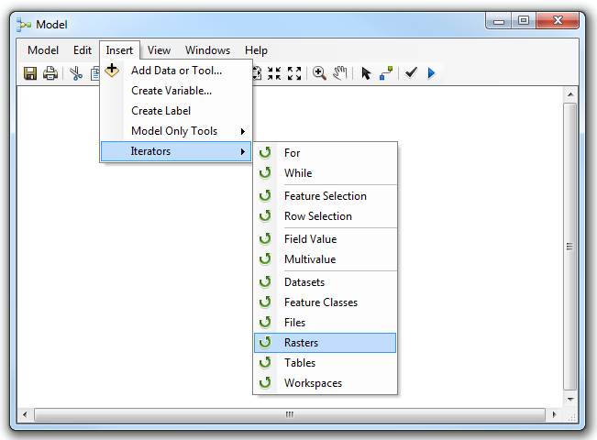
Logical controls (Iterators)

Slide 23
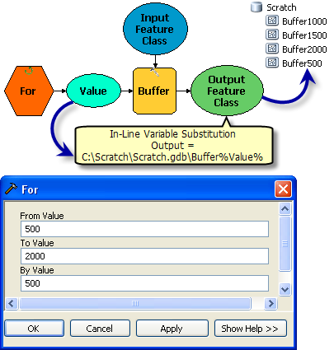
Iterators: For

Slide 24
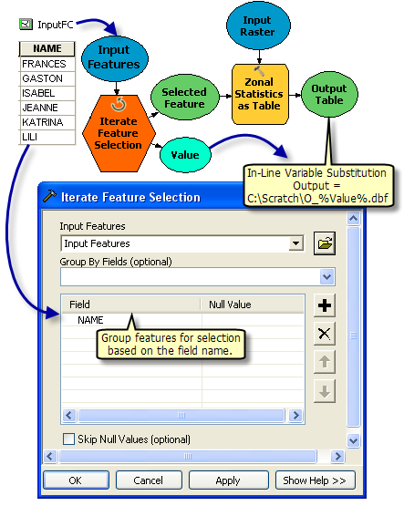
Iterators:
Iterate feature selection

Slide 25
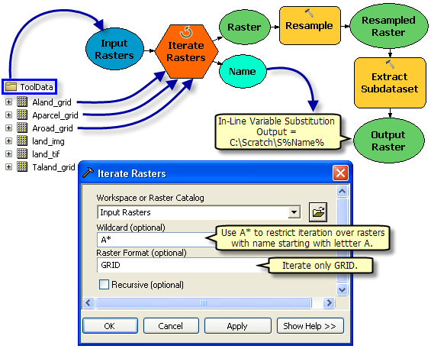
Iterators:
Iterate Raster

Slide 26
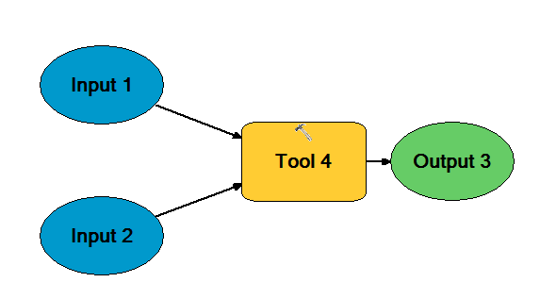
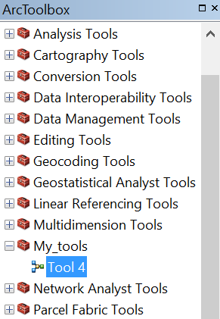
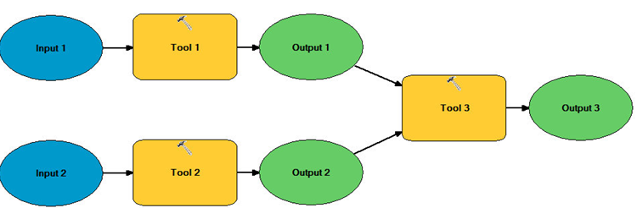
A model can be a geoprocessing tool
A model with multiple tools can be wrapped as a tool
Tool 4

Slide 27
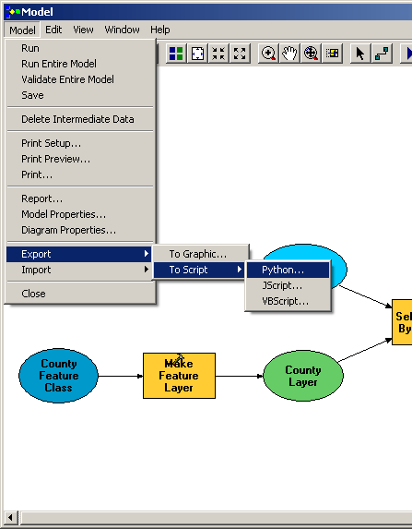
Additional Functionality
The Model can be expanded further, with more data and tools
The Model can be exported into a scripting language, allowing for greater modeling capabilities.

Slide 28
Additional Functionality
Python is the default (and recommended) scripting language for ModelBuilder
Cursor-based analysis: For each individual feature in a layer, perform some analysis
For each "vacant" polygon, is it surrounded by environmentally sensitive features?
Count each feature's vertices, rings
Internet access: automatically download data, then analyze

Slide 29
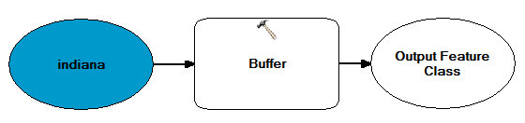
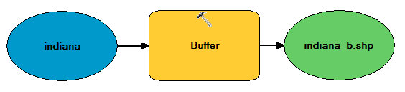
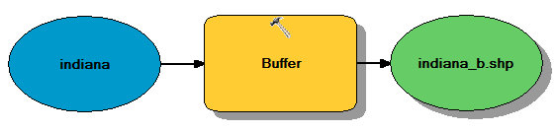
Model Run States
Not ready to run – input is set, tool parameters are not
Ready to run
Already Run (tool and output are shadowed)

Slide 30
Python in ArcGIS

Slide 31
What is Python
One of the most popular programming language in academia
Easy to learn/read/use
Abundant open-source packages for spatial analysis, statistics, data mining, and visualization
Large user group - you are not alone
Reproducible science - executable documentation of your research
Drawback: interpreted language - not as fast compiled languages (C, Fortran)

Slide 32
Python Interface of ArcGIS
Another way to use ArcGIS functionalities (other than ModelBuilder and manual manipulation)
Chain and execute the geoprocessing tools in a logical sequential
Highly customizable - you can combine your program and ArcGIS built-in processing tools
Python scripts can be run as
commands in ArcGIS console
an external Python editor (an integrated development evironment, or IDE).
Drawbacks:
Not free (you need license) and not open-source (blackbox)

Slide 33

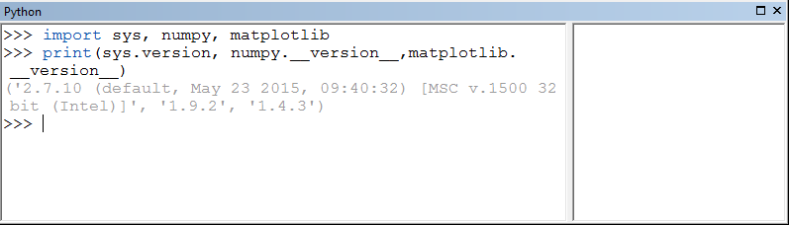
Python Interface of ArcGIS
Python console in ArcMap

