Slide 1
Lucene knowledge

Slide 2
Lucene overview
Create index
Search keywords
Lucen files construction
Lucene analyzer
Lucene query
Lucene filter

Slide 3
Lucene overview
1.What is full text search?
2.What is Lucene?

Slide 4
Lucene overview
1. Construction data → database, meta data...
2. Non-construction data → text, email,HTML...

Slide 5
Lucene overview
1.Serial scanning & Full text search
2. Full text search:
Create index first, then search information by index

Slide 6
Lucene overview
What is Lucene?
1. Lucene is used to search information.
2. Lucene is Java framework, but it is not only in Java, for example, C,C++,Ruby,Python...
3. Lucene is a project of Apach and open-source
4. Now, Lucene is used in Apple, Eclipse,Fedex(联邦快递),OpenCouseWare(麻省理工在线课程)...
5. Lucene's the latest version is 4.0, but it is beta version

Slide 7
Lucene overview
Create index
Search keywords
Lucen files construction
Lucene analyzer
Lucene query
Lucene filter

Slide 8
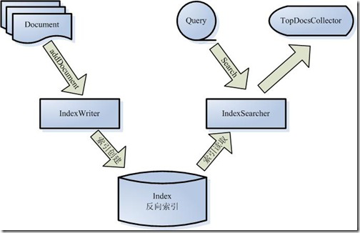
Create index
How to work of Lucene?

Slide 9
Create index
How to build Lucene index?

Slide 10
Create index
1. Prepare the text which you want to be indexed.
For example:
hello.txt: Hello, Lucene! I am Rudy, nice to meet you.

Slide 11
Create index
2. Put the text to Tokenizer
2.1. Split text into one by one word--> hello, lucene, I, am...
2.2. Remove punctuation mark -->”!”,”.”...
2.3. Remove stop words → a,an,the... (“to”?)

Slide 12
Create index
3. Put token to linguistic processor
3.1. Change keywords to lower keywords:Car-->car
3.2. Reduces keywords:cars-->car
3.3. Change past to primitive:was-->is
3.4. Get terms:hello, lucene....

Slide 13
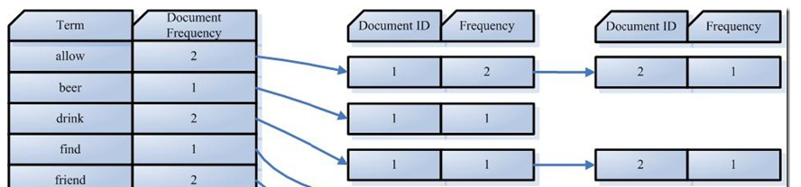
Create index
4. Put terms to indexer
4.1. Create dictionary by terms
4.2. Sort terms by letters--> a,b,c..
4.3. Put terms in posting list

Slide 14
Create index
Index procedure:
a. create a IndexWriter to achieve index.
b. create a Document file which will be indexed
c. put different fields in document.
d. IndexWrite invoke addDocument to put index in index_file.

Slide 15
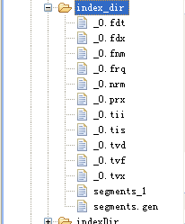
Create index
Lucene generates files format -->

Slide 16
Lucene overview
Create index
Search keywords
Lucen files construction
Lucene analyzer
Lucene query
Lucene filter

Slide 17
Search keywords
How to search keywords by Lucene index?

Slide 18
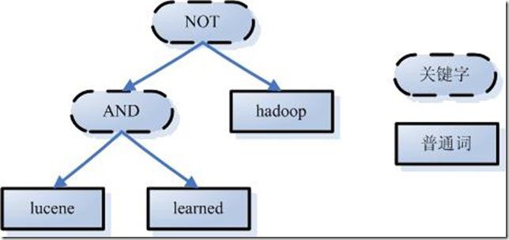
Search keywords
1. Input keywords which you want to be searched
2. Analyzer keywords and construct grammar tress
3. Get documents from index files.
4. Sort result documents.
For example: search → lucene AND learned NOT hadoop

Slide 19
Search keywords
Search procedure:
a. IndexReader reads index files in compute memory from disk.
b. create a IndexSearch to prepare to search.
c. use QueryParse to analyze query sentence.
d. IndexSearch invoke search method to get search result which is TopScoreDocCollector.

Slide 20
Lucene overview
Create index
Search keywords
Lucen files construction
Lucene analyzer
Lucene query
Lucene filter

Slide 21
Lucen files construction
What's index files?

Slide 22
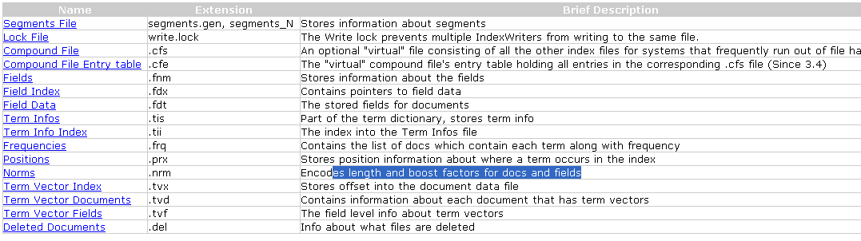
Lucen files construction
For detail information, please see Lucene API

Slide 23
Lucen files construction
Index relationship layers
Index---> Segment-->document-->Field-->Term
Example: HelloLucene.java for segmengs

Slide 24
Lucen files construction
Field
a. Field.Store.YES & Field.Store.NO
b. Field.Index.ANALYZED & Field.Index.NO...
c. Field.TermVector.YES & Field.TermVector.NO...

Slide 25
Lucen files construction
Document
a. Multi-doucments & One document
b. Why need multi-documents?
c. Why need multi-fields?

Slide 26
Lucen files construction
Stop words & extend words
a. What's stop words and extend words?
b. How to add stop words in index files?
c. How to add extend words in index files ?
d. Does they necessary?
e. What about Chinese stop words and extends words?

Slide 27
Lucen files construction
Document
a. Document create, update, delete
b. There are so many document, can they be merged?

Slide 28
Lucen files construction
a. Does Lucene just index text document?
b. If there are word, PDF, excel... documents, how to do ?
c. Whether Lucene can be combined with database?

Slide 29
Lucen files construction
Lucnen directory
a. SimpleFSDirectory
b. RAMDirectory
c. MockDirectoryWrapper
......

Slide 30
Lucene overview
Create index
Search keywords
Lucen files construction
Lucene analyzer
Lucene query
Lucene filter

Slide 31
Lucene analyzer
What is analyzer of Lucene?
What about Chinese analyzer?

Slide 32
Lucene analyzer
Analyzer: Change field string to basic terms, but for different analyzers, they process results are different.
Note: Analyzer is very important for index and query.

Slide 33
Lucene analyzer
Some common analyzers
a. WhitespaceAnalyzer: it just split string by space, but not deal with token stream. For example, stopwrods, lower or upper words.
b. SimpleAnalyzer: it change all words to be lower words, but it would ignore number.
c. StopAnalyzer: it would remove stopwrods from string, you can define your stopwrods.
d. StandardAnalzyer: it is core analyzer of Lucene, it can match email, stopwrods, lower or upper words, sign....
( Does it almighty(万能的)? )

Slide 34
Lucene analyzer
About Chinese analyzer
a. StandardAnalyzer
b. SmarChineseAnalyzer
c. PaodingAnalyzer.
d. IKAnalyzer.

Slide 35
Lucene analyzer
StardardAnalyzer
Split Chinese words one by one words
Its terms include Chinese stopwrods
If you want to search Chinese idiom, it will cost much time and memory

Slide 36
Lucene analyzer
PaodingAnalyzer
It can split Chinese words well, for example stopwords, extendwords, Chinese idiom....
However, it does not support 3.6 or above versions of Lucene
Paoding does not provides API documents for its users.

Slide 37
Lucene analyzer
SmarChineseAnalyzer & IKAnalyzer
a. They can be sued to split Chinese words in phrase.
b. However, SmartChineseAnalyzer is not smarter than IKAnalyzer, for example, the words “一个”,in SmartChineseAnalyzer, it is split into “一个”, in IKAnalyzer, it is split into “一”, “一个”.
c. For stopwords and extendwords, it is easy to define in IKAnalzer, but for SmartChineseAnalyzer, it is difficult.
d. It is easy to read IKAnalyzer API document

Slide 38
Lucene overview
Create index
Search keywords
Lucen files construction
Lucene analyzer
Lucene query
Lucene filter

Slide 39
Lucene query
For sophisticated query

Slide 40
Lucene query
If I want to query a word which is between “c-f” letter in a field ?
For example, “dog” can be searched,but “apple” can not be searched.
It can be used TermRangeQuery.

Slide 41
Lucene query
If I want to query a number which is between “1-10” in a field ?
For example “5” can be searched,but “11” can not be searched.
It can be used NumericRangeQuery

Slide 42
Lucene query
If I want to query a group words which are in a filed?
For example, “apple” and “banana” are in fruit field. I want to search them.
It can be used MultiPhraseQuery

Slide 43
Lucene query
If I want to query different words which are in different fields ?
For example, “apple” is in fruit field, “tomato” is in vegetable field. I want to search them.
It is used BooleanQuery which can encapsulated many query .

Slide 44
Lucene query
If I want to use wildcard query?
If I want to use phrase query?
If I want to use Fuzzy query?
.....

Slide 45
Lucene query
There are so many query subclass, how do I use them?
For this condition, we can use Lucene grammar:
title:"The Right Way" AND text:go,
te?t, test*, te*t, roam~, "jakarta apache"~10,
"jakarta apache" OR jakarta, NOT "jakarta apache" ,
"jakarta apache" -"jakarta lucene"

Slide 46
Lucene overview
Create index
Search keywords
Lucen files construction
Lucene analyzer
Lucene query
Lucene filter

Slide 47
Lucene filter
What about filter of Lucene?
What can filter do for us?

Slide 48
Lucene filter
a. You can use filter to achieve authority distribution
b., You can use filter to filter some sensitive keywords
c. You can use filter to cache result to improve function
d. you can use filter to achieve range query
.....

Slide 49
Other functions
a. You can be high lighter some keyword of results, as like BaiDu
b. You can spell check keywords if users input words are puzzle, as like Google
......

Slide 50
Over!

