Slide 1
Project Title
Team Members here
(Mentor name here)
First AI Winter School in AI December 2018

Slide 2
Project Description
Say what the project will achieve here
First AI Winter School in AI December 2018

Slide 3
Key Benefits
Say why the project is important here
First AI Winter School in AI December 2018

Slide 4
High level Methodology
It is hard even for people to distinguish the difference in the leaves
Basic approach is to train the network for classification using multi-class crossentropy
But we have adopted to use the triplet loss as we think by providing strong positive and negative example it will help
to bring the pictures of the same class together
of different class farther apart in feature space
First AI Winter School in AI December 2018

Slide 5
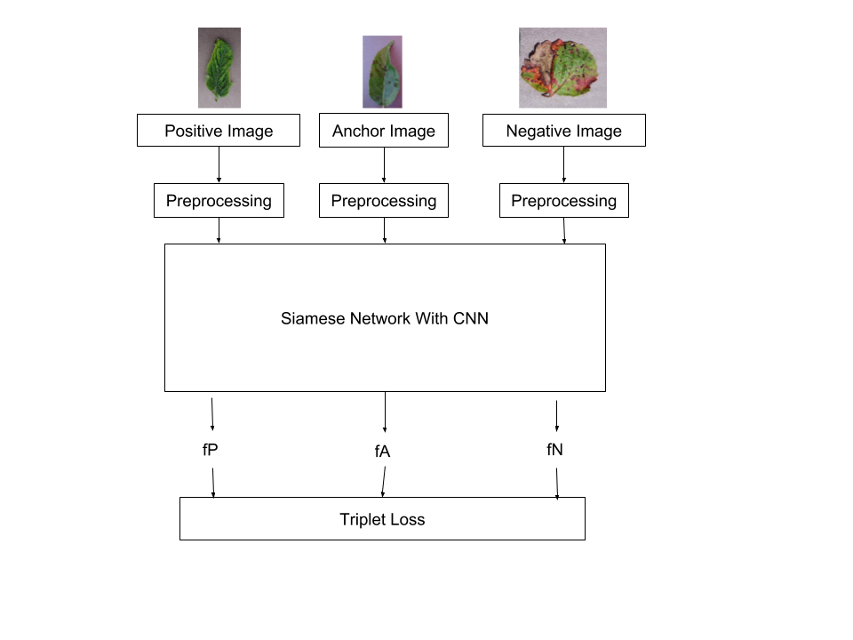
Training
A Siamese network using CNN
Train the model using Triplet loss
Preprocessing basically consists of mean normalization and resizing
Selection of Positive and and Negative Image
For every anchor image of class, we pass through the siamese network and obtain the feature vector of images.
Select the image of the same class with least similarity in feature vector as positive image
Select the image of the different class with most similarity in feature vector as negative image
First AI Winter School in AI December 2018

Slide 6
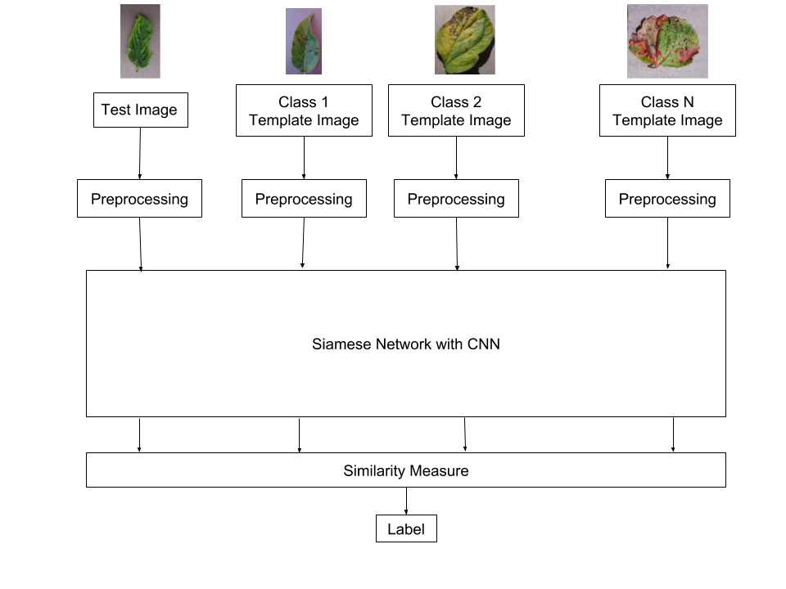
Testing
Pass in the network and calculate the similarity measure between the template image of individual class
First AI Winter School in AI December 2018

Slide 7
Additional information (optional)
Provide more information here if needed e.g. commercialisation, environmental, societal opportunities etc.
First AI Winter School in AI December 2018

