Slide 1
k-Max Pooling in Computer Vision
Team 11 Day 11
Aviskar KC
Bipin KC
Dev Vats
Kartikesh Mishra
Li Qiang
Nishant Nikhil
Nishesh Awale
Puja Kandel
Srijana Raut
Mentor :- Dr. Binod Bhattarai
First AI Winter School in AI December 2018

Slide 2
Idea Description
We propose the use of K-max pooling instead of max pooling in last layers of ConvNets which process Images.
We will talk about
MaxPool
Basics
Applications
K-max Pool
Basics
Applications in Natural Language Processing
Why not used in Computer Vision
Proposal
Why to use k-max pooling in Computer Vision
How to use k-max pooling in Computer Vision
Pros
Cons
Notes:
Refer https://computersciencewiki.org/index.php/Max-pooling_/_Pooling for more.

Slide 3
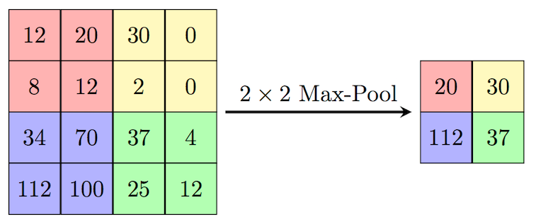
Max pooling in General

Slide 4
Max pooling in NNs
Pooling is used mostly after convolutional neural networks to reduce the dimensionality without the usage of any parameters.
Helps in Translation Invariance. Even if the image is moved a little, the max pool would be same.
Of course we lose the positions, little work in this section:
An Intriguing Failing of Convolutional Neural Networks and the CoordConv Solution (Liu et al, 2018)
Many different types of pooling
Max Pooling
Average Pooling
Adaptive Pooling (To get constant size output form variable input)
Notes:
Refer https://computersciencewiki.org/index.php/Max-pooling_/_Pooling for more.

Slide 5
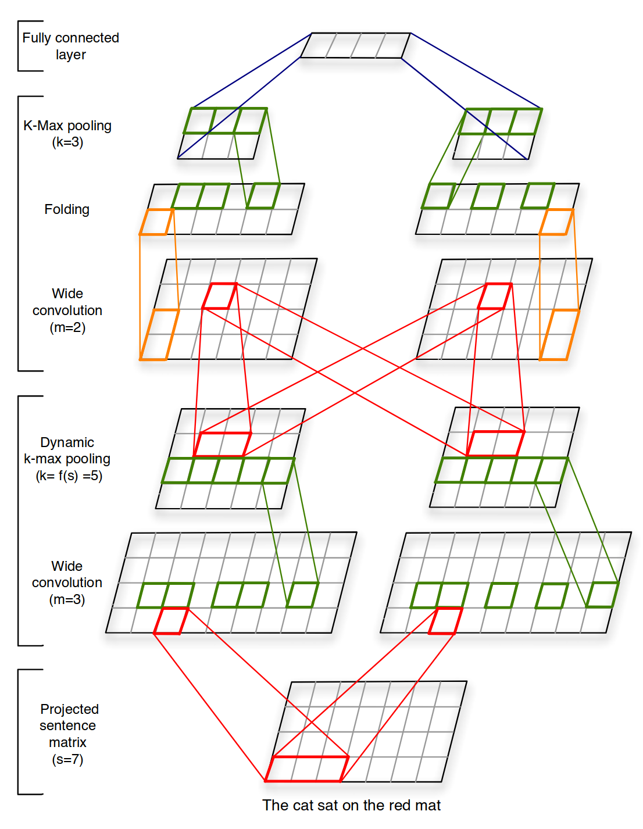
K-Max pooling in NLP
A modification to max pooling where rather than choose the single max value, we take K max values
Proposed in Kalchbrenner et al, 2014 (A Convolutional Neural Network for Modelling Sentences)
For words, it makes sense because even the neighbouring words can significantly alter the sense.
Example: "I am not there at the school to feed the cats", there are many significant words in the sentence which are neighbouring and might get lost if we just consider the 1-max pooling.
K-max pooling is already an established technique in NLP.

Slide 6
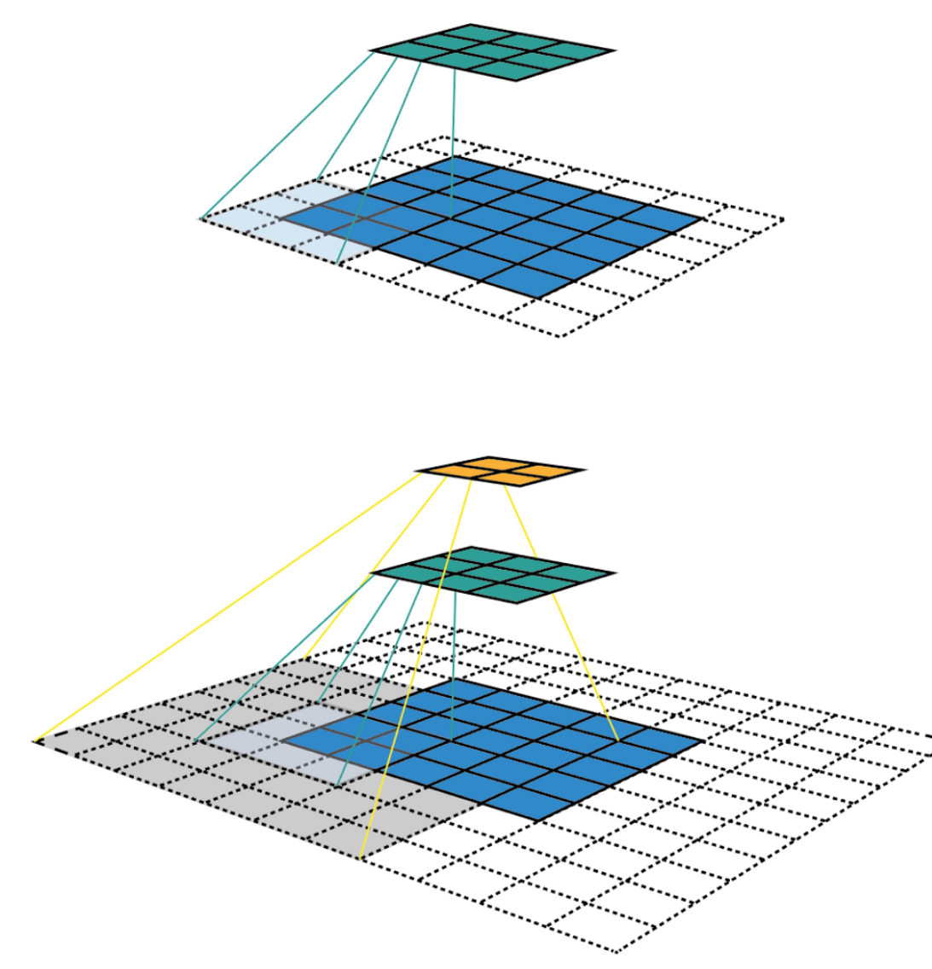
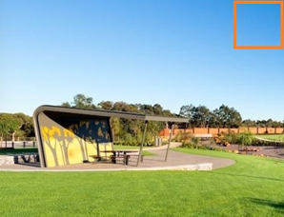
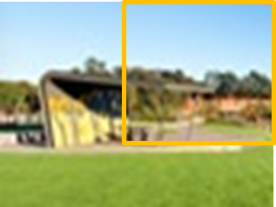
Why not and Why K-max pooling in CV?
In the initial layers the receptive field is too small, There is not much variation in a 3*3 or 5*5 receptive field.
So taking just one max value makes sense.
But that is only for initial layers, in the final layers the receptive field increases.
Notes:
The similar idea of NLP can be implemented in the field of computer vision.
This way we capture the information extracted from single kernel in many 2-dim arrays.
Thus we may be able to accurately classify images which are very busy, busy in the sense that it has many components in a single image.

Slide 7
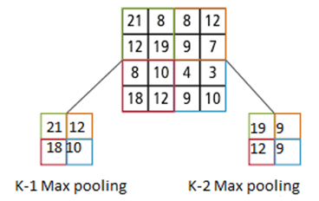
How to do K-max pooling in CV?
In the initial layers when the receptive field is small, we use k = 1 (which means the max pooling)
And we increase it gradually
For example in a linear fashion.
So, for a hands on example, if we have
an image of size 32*32
After applying conv(5*5) it gets to 28*28
And then 2-max pooling it gets to 14*14*2
This isn’t able to do much dimensionality reduction, so we propose to add a 1*1 conv layer ahead of it which would change the 14*14*k to 14*14*1, in this way model would be able to switch between max pooling, k-max pooling and k-average pooling.
Notes:
It is same as the traditional max pooling but what is changed is that we get k number of features set instead of a single one.
Basically we do maximum value pool then second maximum value pool and same until kth number.
We can see the example in the figure where we take k-1 max pool and k-2 max pool.

Slide 8
How to do K-max pooling in CV?
Image
Conv
Features
MaxPool
Existing MaxPool

Slide 9
How to do K-max pooling in CV?
Image
Conv
Features
MaxPool
Existing MaxPool
Image
Conv
k-MaxPool
Features
1*1 Conv
32*32
32*32*3
16*16*3*2
16*16*3
Proposed k-MaxPool

Slide 10
Generalization to existing poolings
As the k-max pooling is succeeded by 1*1 conv layer
The k-max pooling can generalize to the existing pooling methodologies
This would make k-Max Pooling as a plug and play module for existing architectures
Why a 1*1
The whole point of max pool is dimensionality reduction and providing translation invariance
There is a trade off between the dimensionality reduction and the number of parameters.
Extreme case of k-Max Pooling is a conv layer itself.
1
0
0
Max Pooling
1
1
1
k-Average Pooling

Slide 11
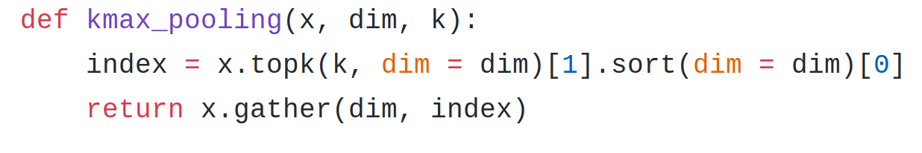
Small Code Snippet in PyTorch

Slide 12
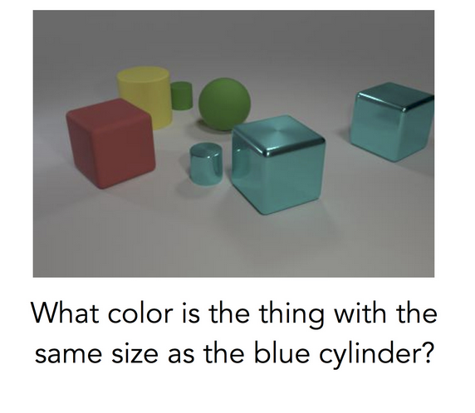
Pros and Cons
Pros
Features would be able to consider more than one feature, and in this sense would be able to learn richer representations.
In all of the current architectures
An extra case we can think of is (image)
Even though the image is cleaner, the question requires many steps of reasoning: rather than simply recognizing the main object in the image, the model must first find the blue cylinder, locate the other object with the same size, and then determine its color. This is a complicated computation, and it’s a computation specific to the question that was asked. ~ BAIR blog
Cons
Extra Parameters
Overfitting maybe?

Slide 13
In a nutshell
Apply max pool on initial layers
Then start increasing k for kMax Pool in a linear manner. Somewhat around the linear formula:
K/L * l
Where L is the number of layers
K is a hyperparameter
We take ceil value
We apply 1*1 conv filters on top of the k-Max Pooling layer so that the network learns how much weightage it needs to give to the k Maximum values.
The next step is to train a simple ConvNet with kMax Pooling on ImageNet to see if it works
Questions?

Slide 14
Thank You

