Slide 1
Handwriting Tutor for children
Rashik Shrestha
Raj Kumar Pradhan
Reema Prajapati
Regent Vaidya
Santosh Khanal
Abishek Prasanna
Chanda Hyoju
Daking Rai
Manish Chaulagain
Prabin Raj Shakya
Mentor: Sujaya Neupane
First AI Winter School in AI December 2018

Slide 2

Project Description
Personalised learning for 2-6 years aged kid
First AI Winter School in AI December 2018

Slide 3
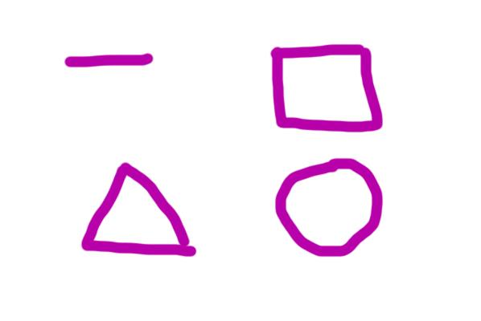
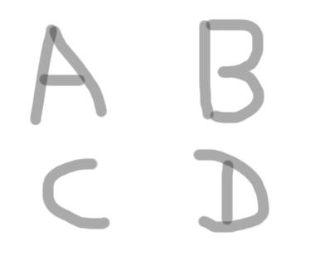
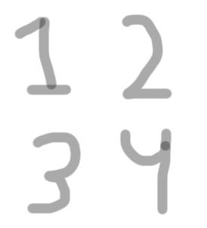
Project Description
Teach kids to draw shapes and write alphabets and numbers
First AI Winter School in AI December 2018

Slide 4
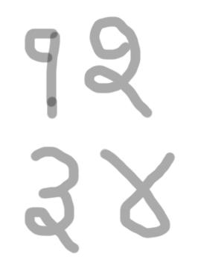
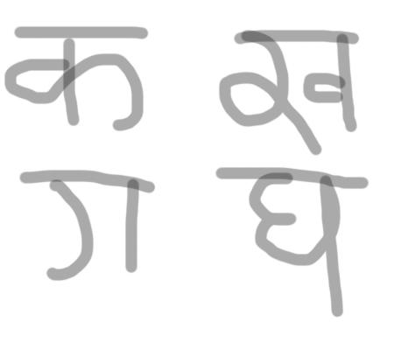
Project Description
Teach Kids to write Nepali alphabets and numbers
First AI Winter School in AI December 2018

Slide 5
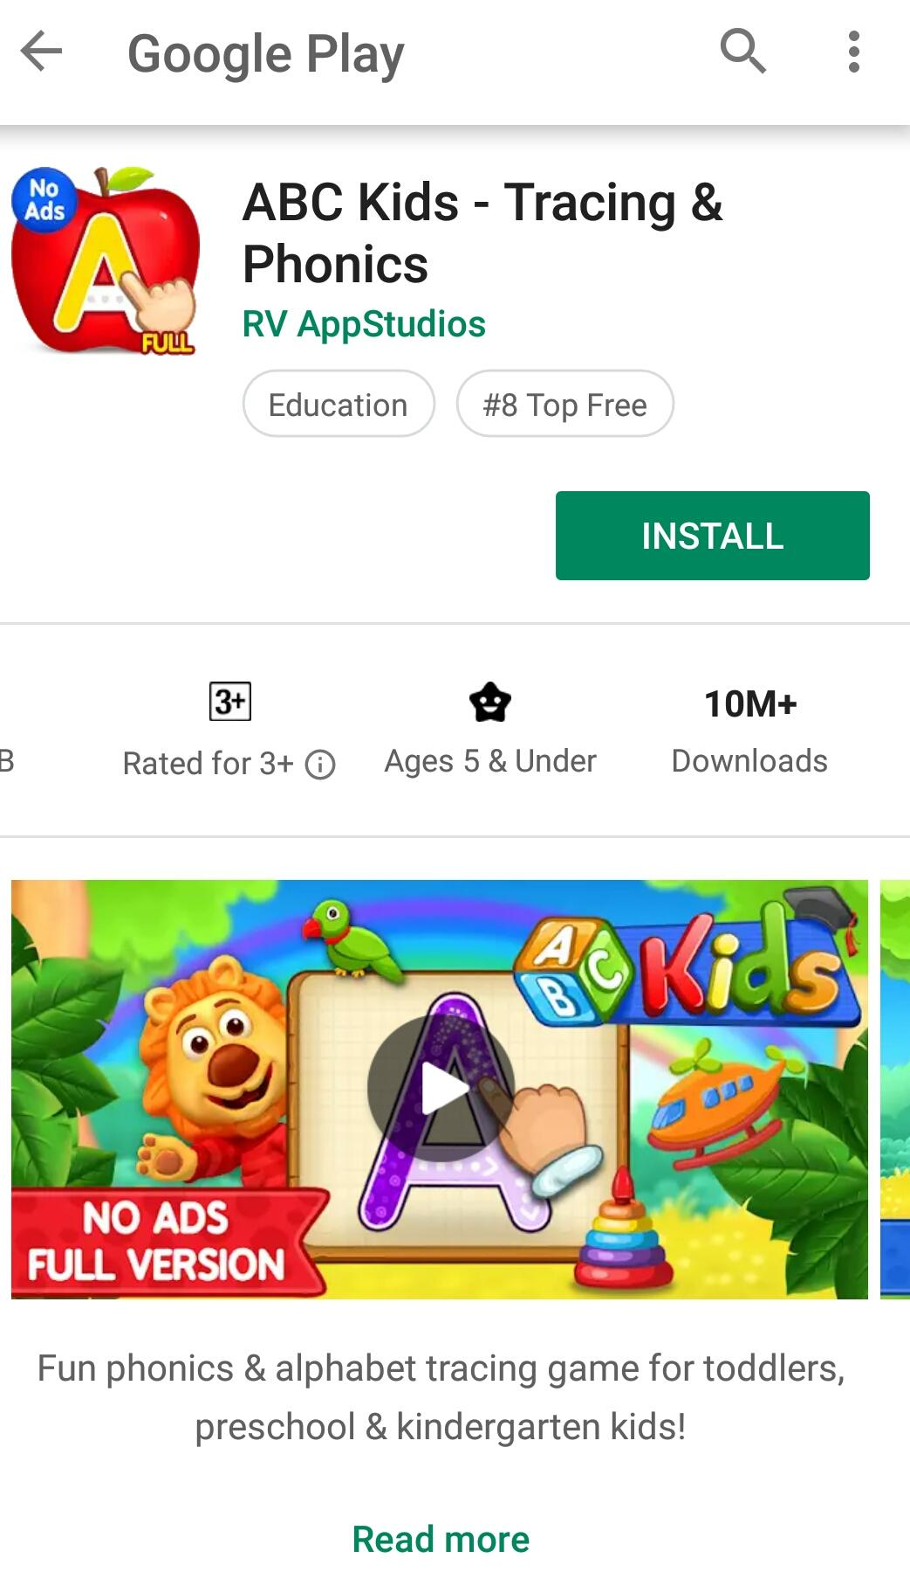

Key Benefits
First AI Winter School in AI December 2018
First AI Winter School in AI December 2018

Slide 6
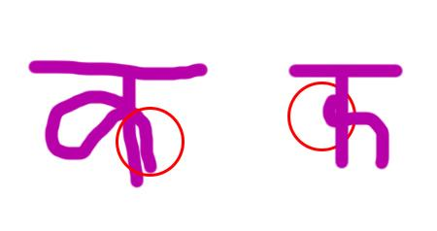
Key Benefits
Personalised learning through tracking the mistakes and providing exercises to help overcome the mistake
First AI Winter School in AI December 2018

Slide 7
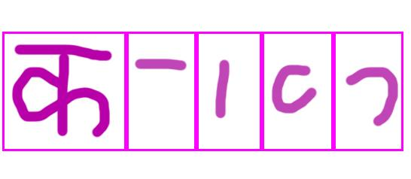
Key Benefits
First AI Winter School in AI December 2018
First AI Winter School in AI December 2018

Slide 8
High level Methodology
Attention to compare image patches to compute similarity and judge parts that are misspecified.
Omniglot dataset has a collection of handwriting samples in multiple different languages. DHCD dataset has a collection of about 2000 images per Nepali alphabet.
Convolutional feature comparison on raw pixel data, to compare corresponding portions in two images.
First AI Winter School in AI December 2018
First AI Winter School in AI December 2018

Slide 9
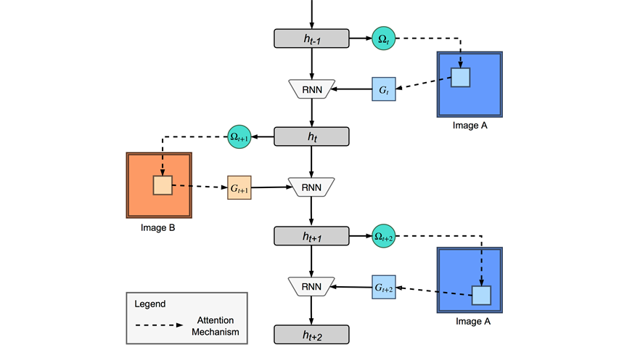
Method details – 1
First AI Winter School in AI December 2018
First AI Winter School in AI December 2018

Slide 10
Method details – 2 (optional)
First AI Winter School in AI December 2018
First AI Winter School in AI December 2018

Slide 11
Thank You

