Slide 1

English for Information Technology
Dept of information management, Yuanze University
Autumn 2026

Slide 2
Luke Miao
Instructor
::::::Education History::::::
Institute of Network Learning Technology,
National Central University, doctoral candidate
School of Education,
University of Oulu, Finland, master’s degree
School of Education,
Jiangxi Normal University, bachelor’s degree

Slide 3


Textbooks & Materials
Printed copy available at University Library:

Slide 4
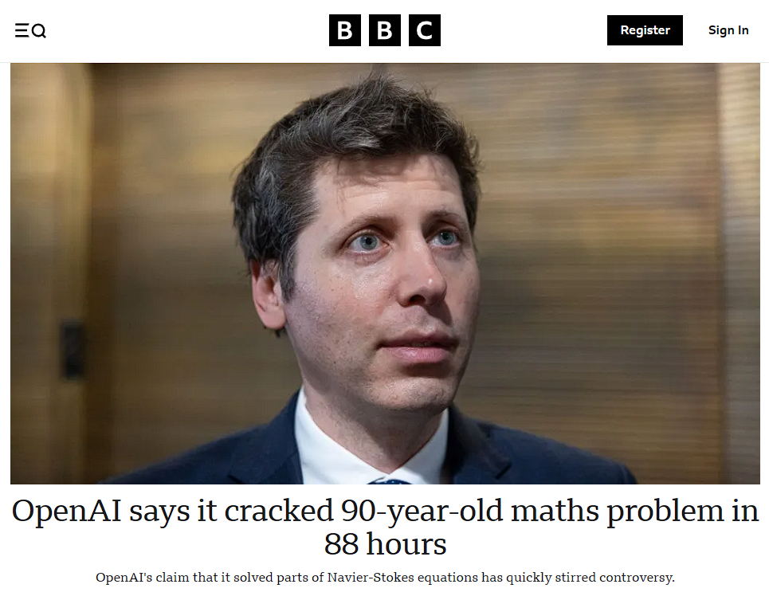
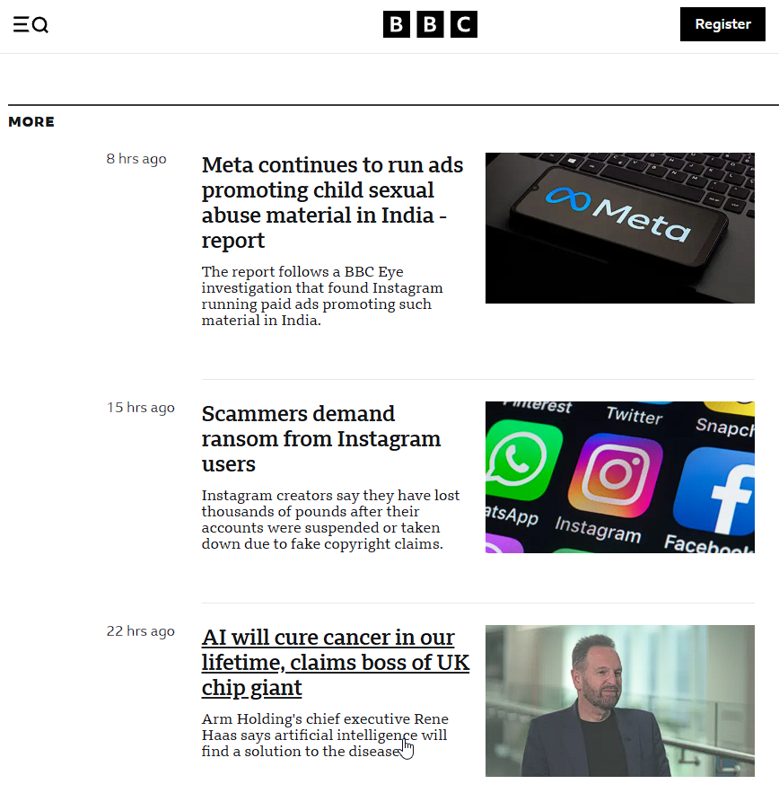
Online Resources

Slide 5

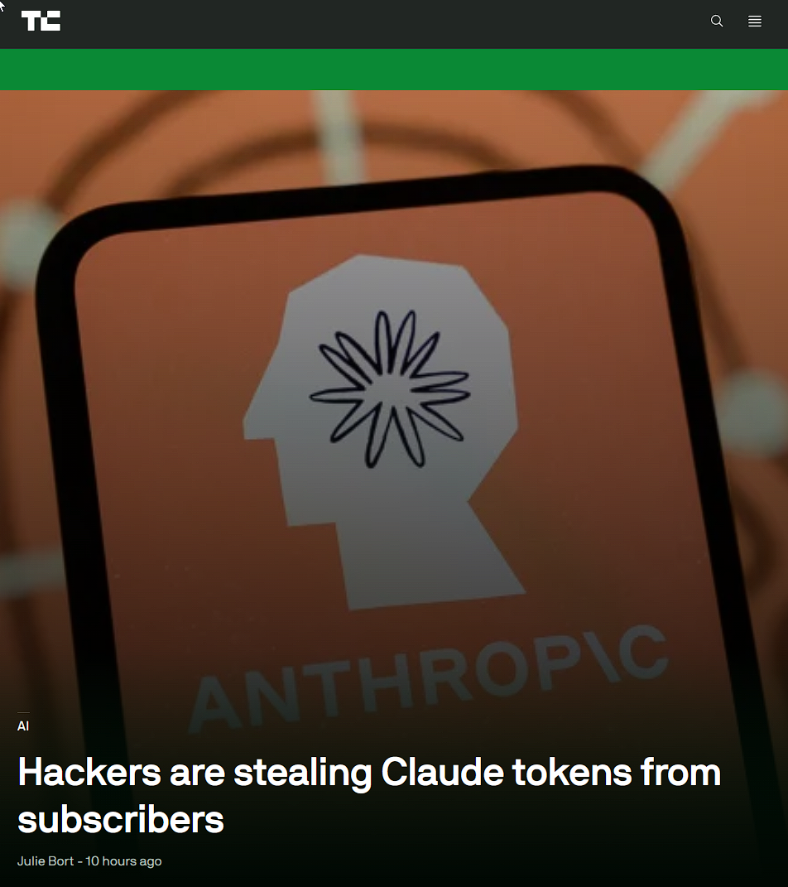
Online Resources

Slide 6

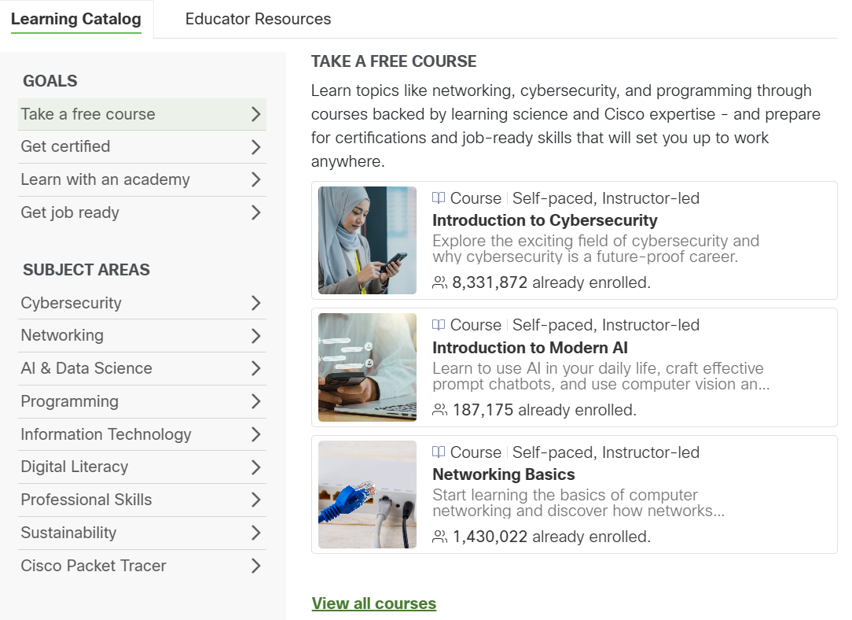
Optional Online Resources
AI & Data Science
Information Technology
Professional Skills
Digital Literacy

Slide 7
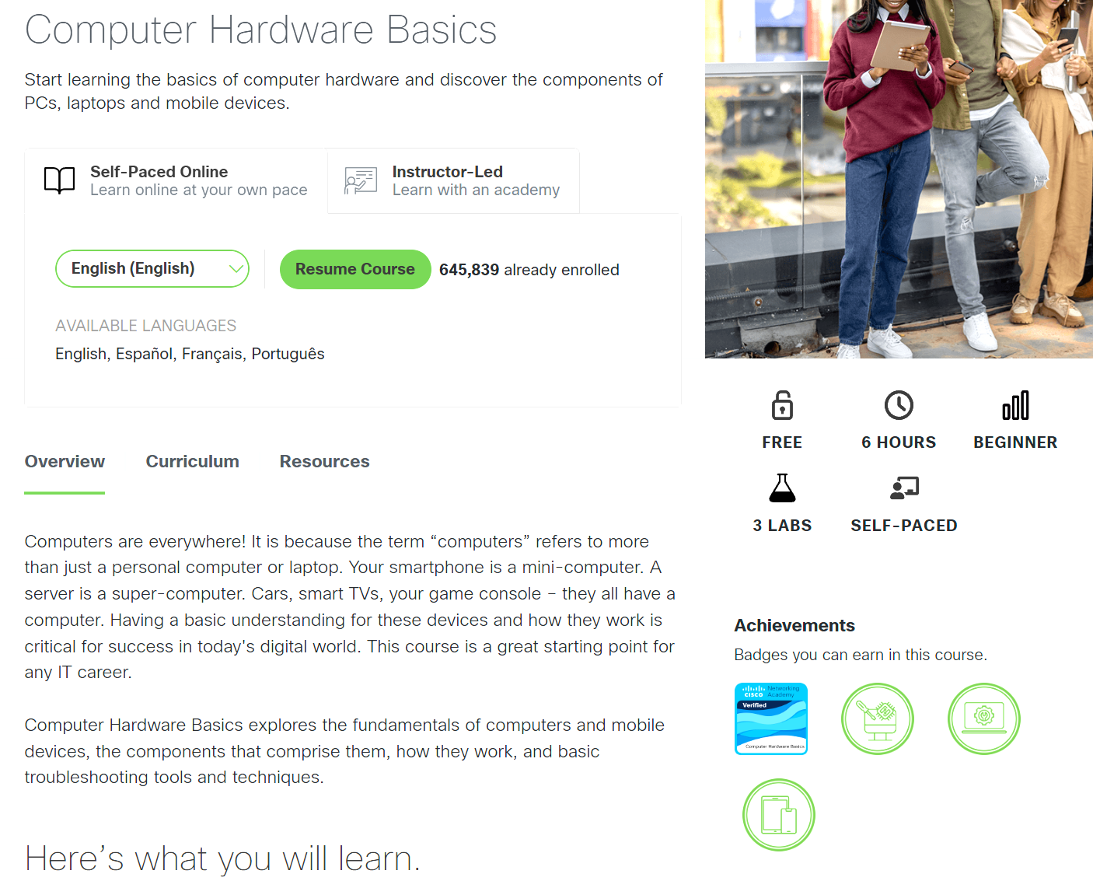



Optional Online Resources

Slide 8
Ready for some challenges?
Read tech news in English on a daily basis.
Listen to English podcasts or YouTube channels related to technology and innovation.
Join online IT forums or communities (Stack Overflow, Reddit programming threads) and practice asking/answering questions in English.
Pair up with a study buddy and commit to speaking only English during group projects or coding practice.
Practice writing short reflections in English after each class—summarize what you learned in your own words.

Slide 9
An immersive environment for yourself
Try to use as much as English as possible in every situation of your campus life
Switch the language of your computer/phone to English
Find some good English dictionaries or browser extensions for translation

Slide 10

Don’t be afraid of mistakes
  Mistakes are integral to your growth, without which there is no way to grow your language muscle.
  Between the You at the moment, and the Future You, stands a journey seasoned with mistakes.
  They are low stake in class, no penalty for making them in my class.
  You will thank yourself for enduring the mistakes you make early on.

Slide 11
Schedule
Week | Content
1-2 | Working in IT
3-4 | IT Systems
5-6 | Data communication
7 | Administration
8 | Mid-term report
9-10 | Development
11-12 | Choice
13-14 | Interactions
15-16 | Final Exam
17-18 | Interactive Group Project: Video/Audio Creation

Slide 12
Individual & Group Work
Q&As are mostly individual, and pair-
In-class discussion/report is generally conducted in pairs/trios/small groups (of no more than 5 members each)
Assignments will be a mix of individual and group work
    Peer-assessment encouraged.
Participation in the Discussion Board (on portal) highly encouraged

Slide 13
Grading
1 Attendance & Participation 30%
2 Assignments 20%
3 Mid-term exam 20%
4 Final exam 30%

Slide 14
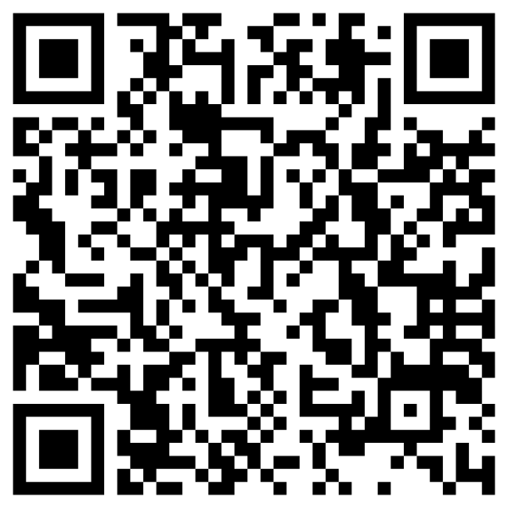
A quick survey
What are you here for?
  A relaxed afternoon
  An adventure packed with challenges
What do you plan to improve most,
  Reading
  Listening
  Writing
  Speaking
  All above
What language do you prefer the instructor to use for this course?
  English
  Chinese
  A mix of both?

Slide 15

Break the ICE –A Self-introduction
20 sec
Your name, hometown, hobbies, etc.
1or 2 adjectives to describe who you are.

Slide 16
Table Talk — Small Group Intros
1 Setup
  Form groups of 5–6 with the students sitting near you.
2 TEAM Building
  Each person introduces themselves with three things:
    Your name
    One thing you're good at (IT-related or not)
    One thing you suck at (IT-related or not)
3 SHARE TIME
  Each group appoints a member to share the memorable introduction(s) of the group.

