Slide 1

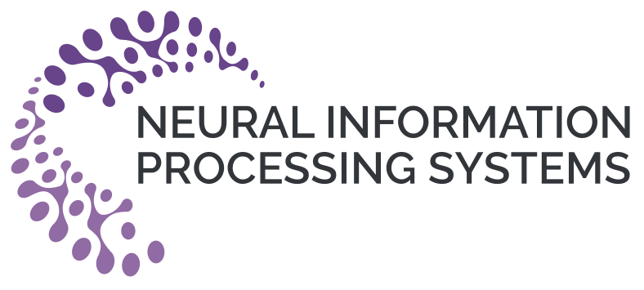


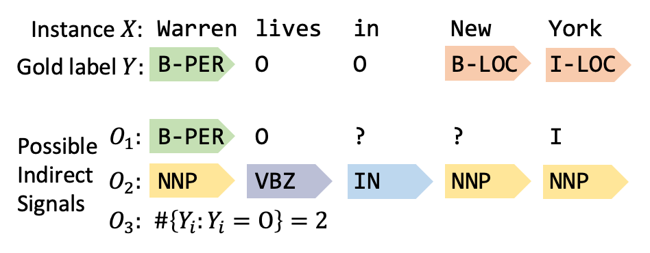
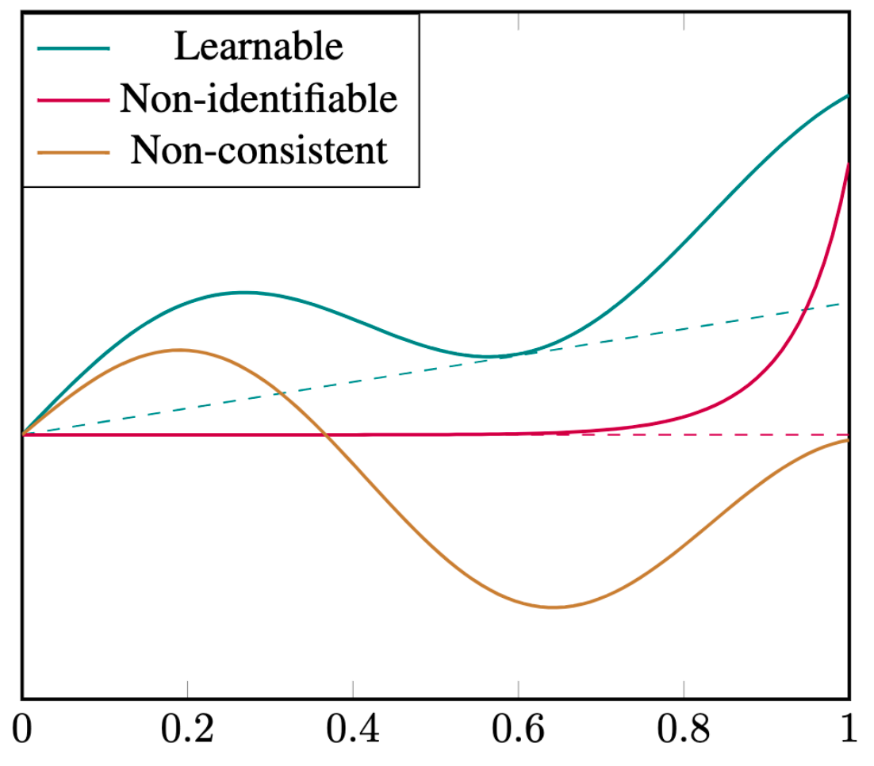
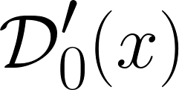
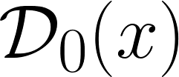
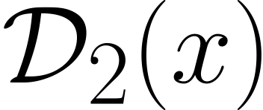
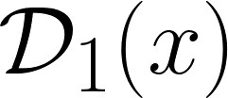
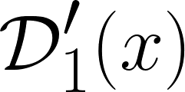
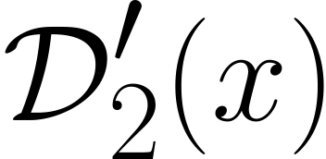

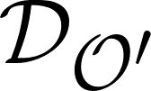
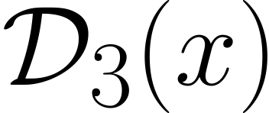

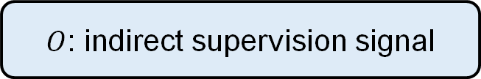
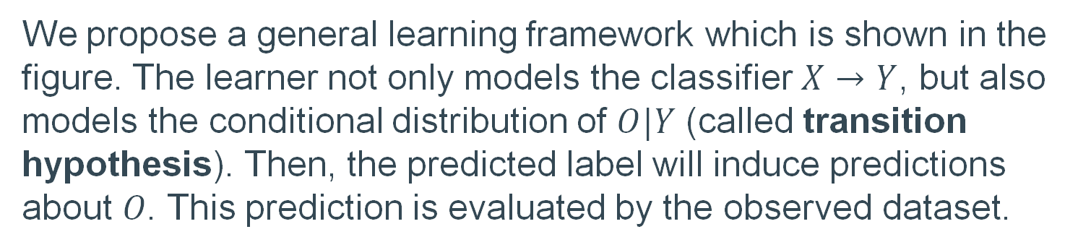
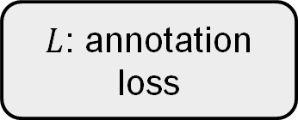
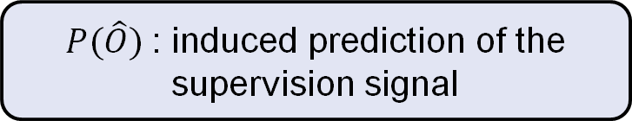

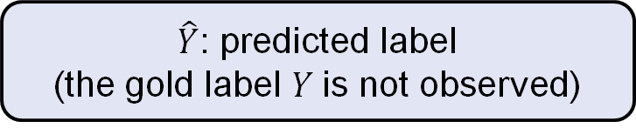
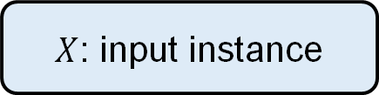
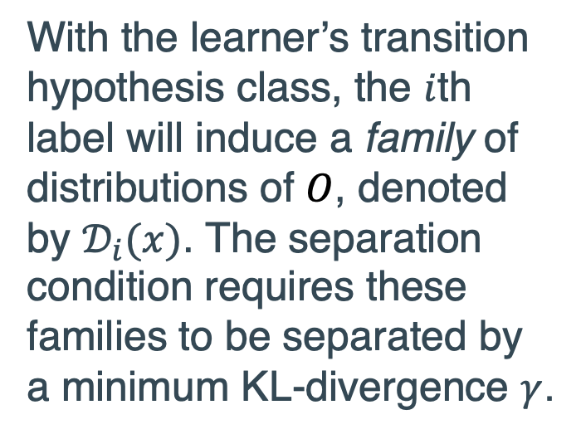
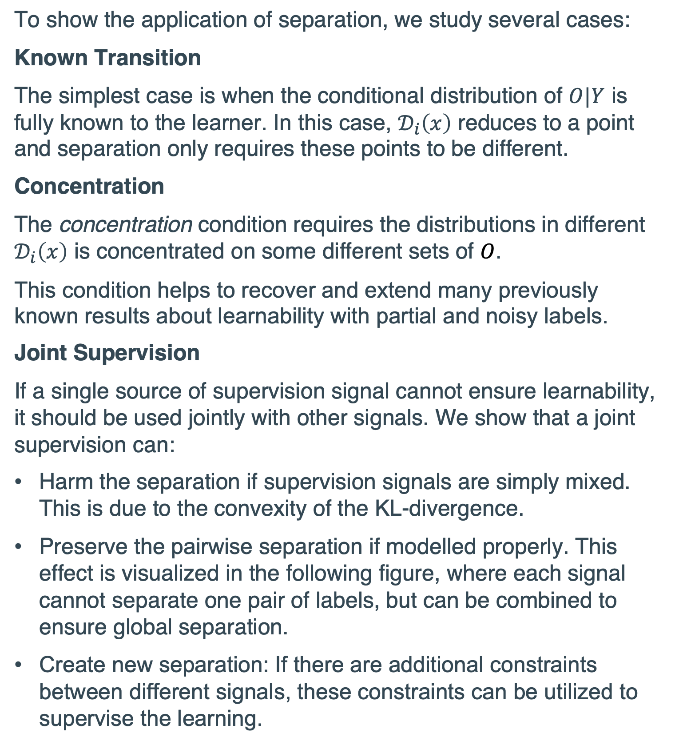
Learnability with Indirect Supervision Signals
Kaifu Wang¹, Qiang Ning², Dan Roth¹
¹University of Pennsylvania.
²Amazon, work done while at the Allen Institute for AI and at the University of Illinois at Urbana-Champaign
1. Motivation
3. General Learnability Conditions
5. Applications
In many machine learning problems, the gold annotations for the unlabeled instance are expensive or inaccessible. To alleviate this issue, the observation of a dependent variable (denoted by $O$) of the true label is often used as an indirect supervision signal.
Taking the named entity recognition (NER) tagging as example:
Our goal is to study the learnability with indirect supervision. In words, whether the optimal hypothesis can be well approximated given a sufficiently large dataset of indirect signals.
The main challenge is how to quantify the usable information contained in the indirect signal, which not only depends on the joint distribution of the gold label and the indirect signal, but also depends on the learner’s prior information about this distribution.
We show that learnability can be guaranteed if the following three conditions are satisfied:
Complexity: the model should have a finite VC-dimension.
Consistency: the optimal hypothesis should have the lowest annotation loss on average.
Identifiability: a suboptimal classifier should induce higher annotation loss than the lowest on average.
The last two conditions can be visualized in the following plot of annotation loss and the classification error.
To show the application of separation, we study several cases:
Known Transition
The simplest case is when the conditional distribution of $O|Y$ is fully known to the learner. In this case, $𝒟_{i}\left(x\right)$ reduces to a point and separation only requires these points to be different.
Concentration
The concentration condition requires the distributions in different $𝒟_{i}\left(x\right)$ is concentrated on some different sets of $O$.
This condition helps to recover and extend many previously known results about learnability with partial and noisy labels.
Joint Supervision
If a single source of supervision signal cannot ensure learnability, it should be used jointly with other signals. We show that a joint supervision can:
Harm the separation if supervision signals are simply mixed. This is due to the convexity of the KL-divergence.
Preserve the pairwise separation if modelled properly. This effect is visualized in the following figure, where each signal cannot separate one pair of labels, but can be combined to ensure global separation.
Create new separation: If there are additional constraints between different signals, these constraints can be utilized to supervise the learning.
Minimal Expected Annotation Loss
2. Learning Framework
We propose a general learning framework which is shown in the figure. The learner not only models the classifier $X→Y$, but also models the conditional distribution of $O|Y$ (called transition hypothesis). Then, the predicted label will induce predictions about 𝑂. This prediction is evaluated by the observed dataset.
Classification Error
4. The Separation Condition
We further propose a sufficient condition for consistency and identifiability, called "separation”, which characterizes the learner’s prior information about the indirect signal.
+
=
Dataset
$O$: indirect supervision signal
$X$: input instance
Classification
Hypothesis
With the learner’s transition hypothesis class, the $i$th label will induce a family of distributions of $O$, denoted by $𝒟_{i}(x)$. The separation condition requires these families to be separated by a minimum KL-divergence $γ$.
Update
Acknowledgments
$\hat{Y}$: predicted label
(the gold label $Y$is not observed)
This work was supported by the Army Research Office under Grant Number W911NF-20-1-0080 and by contract FA8750-19-2-0201 with the US Defense Advanced Research Projects Agency (DARPA).
Transition
Hypothesis
Update
$P(\hat{O})$: induced prediction of the supervision signal
$L$: annotation loss
Probability Simplex

