Slide 1
KnowSemLM : A Knowledge Infused Semantic Language Model
Haoruo Peng, Qiang Ning, Dan Roth
CoNLL-2019

Slide 2

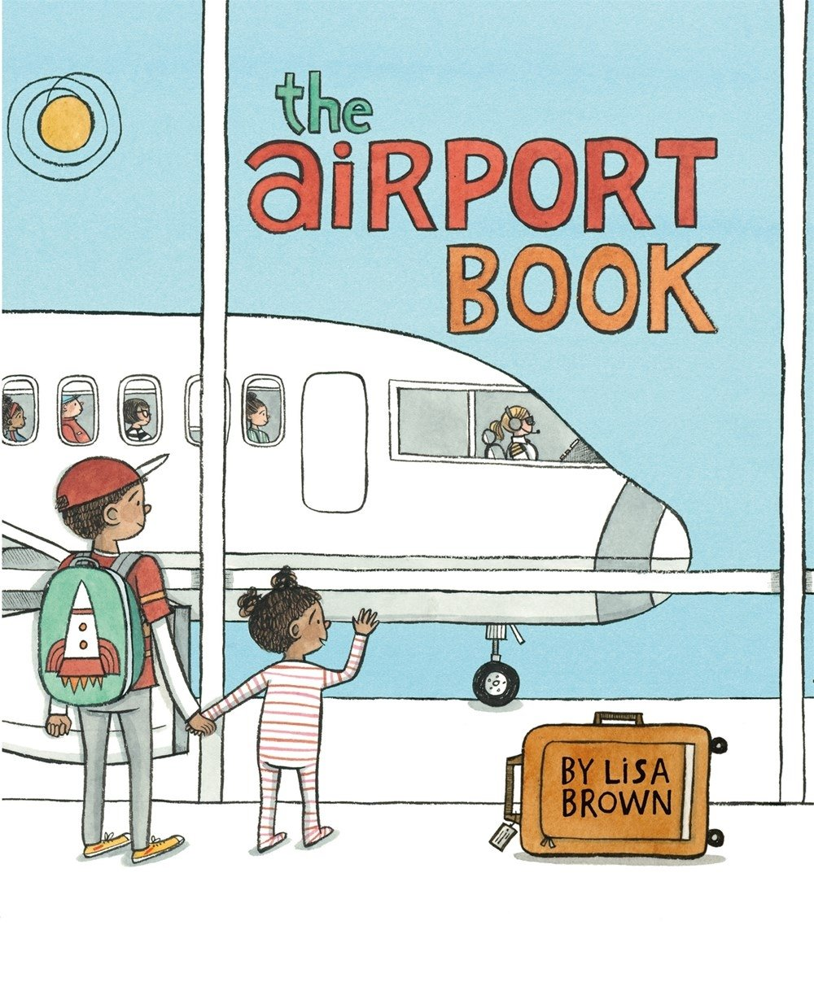

A Motivating Example …
... Jim checked in at the counter, took his luggage to the security area, got cleared ten minutes in advance, and waited for his plane ...
What would Jim do next?
… Jim got on the plane … → Probable
… Jim bought snacks for lunch … → Probable
… Jim started working on his laptop … → Probable
… Jim went to his office … → Improbable
How do humans learn to make the judgement?
Notes:
Either read, and generalize the knowledge into explicit concepts represent the current way of learning languages

Slide 3


Story in the Event Level
Text of a Story
Event
Event
Event
All possible events
Expected Events
From
Related Corpus
Expected Events
From
Human Experience
Notes:
LM + the focus of the paper is on how to utilize the knowledge Goal: predicting future events more accurately by incorporating knowledge into the event sequence modeling Rely on statistical co-occurrence – can be learned from text
Rely on deterministic knowledge – learned by human experience

Slide 4
Recap - Event Sequence Modeling based on Abstractions
Expected Events
From
Related Corpus
Event
Event
Event
Frame Semantics as Events
Event Sequence Modeling → Language Modeling (i.e. SemLM)
Abstractions on Semantic Frames
Frame Disambiguation (e.g. commit.01 / arrest.01 / … )
Subject & Object (e.g. PER[new] / ARG[new] / … )
Sentiment (e.g. NEG / NEU / … )
... Steven Avery committed murder. He was arrested, charged and tried ...
PER[new]-commit.01-ARG[new](NEG)
ARG[new]-arrest.01-PER[old](NEU)
ARG[new]-charge.05-PER[old](NEU)
ARG[new]-try.01-PER[old](NEG)
[Peng et al, 2017; Peng & Roth, 2016]

Slide 5
This work - KnowSemLM
Expected Events
From
Related Corpus
Main Contribution: (Explicit) Knowledge Infusion
Knowledge Representation
Knowledge Inference
Knowledge Acquisition
Event
Event
Event
Better Predictions
Expected Events
From
Human Experience
Predictions

Slide 6
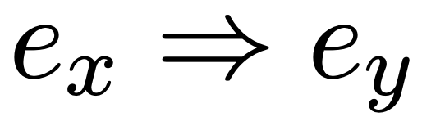
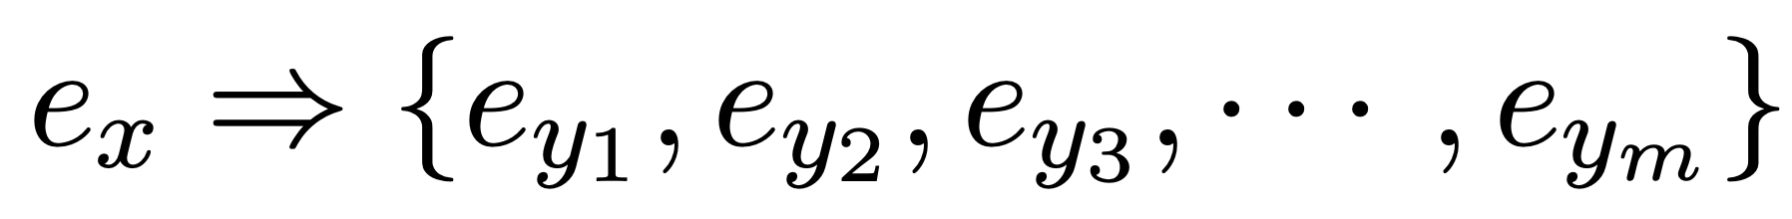
Knowledge Representation
The knowledge of one event leads to another, i.e.
e.g. The police arrested Jack because he killed someone. PER[*]- kill.01-*[*](*) ⇒ *[*]-arrest.01-PER[old](*)
One event may lead to multiple different outcomes
e.g. Jack killed John, but he escaped from police. PER[*]- kill.01-*[*](*) ⇒ PER[old]-escape.01-*[*](*)
Event Causality Knowledge Base
KB_{EC}
…
e_{x1}
e_{x2}
…
…

Slide 7
Knowledge Inference
Overall KnowSemLM computational framework
vec
vec
Sequence Generation
Model
e_{t-2}
e_{t-1}
…
FES-RNNLM
vec
…
e_{t}
vec
e_{t+1}
…
Knowledge Selection
Model
vec
e_{y1}
KB_{EC}
…
vec
e_{x1}
e_{y2}
…
…

Slide 8
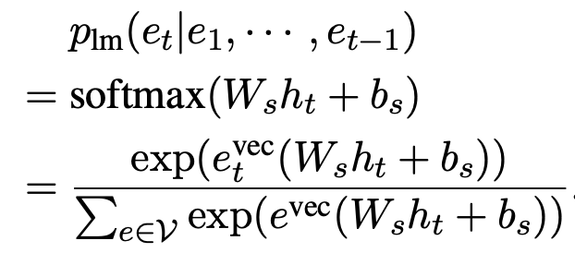
Knowledge Inference
FES-RNNLM
RNN built on top of event vector representations
vec
vec
e_{t-2}
e_{t-1}
…
vec
e_{t}
…

Slide 9
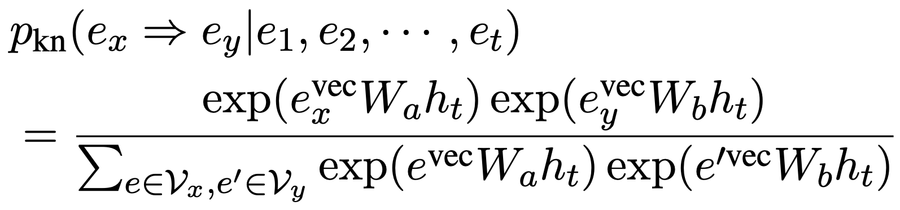
Knowledge Inference
Knowledge Selection Model
Bi-focal attention of previous events
vec
vec
e_{t-1}
e_{t}
…
vec
e_{y1}
KB_{EC}
…
vec
e_{x1}
e_{y2}
…
…

Slide 10
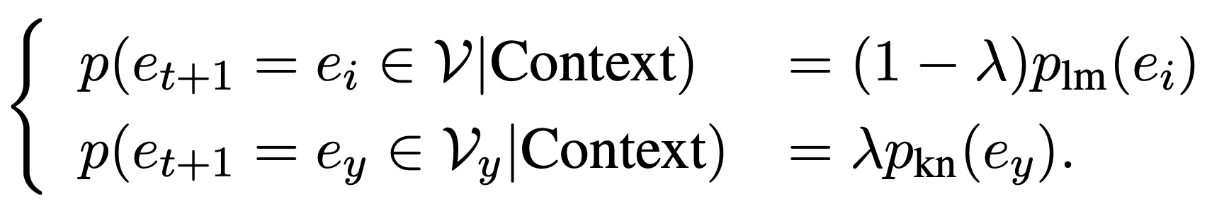
Knowledge Inference
Sequence Generation Model
Copying mechanism
LM
vec
e_{i}
vec
e_{t+1}
KN
vec
e_{y}

Slide 11
Knowledge Acquisition
Statistical Way
Retain cases where the direction of the event causality pairs is obvious from a statistical standpoint
Declarative Way
Manually write down based on event templates (in some application scenarios)
Transitivity Expansion
If Event_{A} ⇒ Event_{B} and Event_{B} ⇒ Event_{C} , then Event_{A} ⇒ Event_{c}
Only perform once to balance between coverage and cleanness
… The police arrested Jack because he killed someone …
because
PER[*]- kill.01-*[*](*) ⇒ *[*]-arrest.01-PER[old](*)
In Flight Scenario: “Someone has to wait for a plan before getting on it.”
PER[*]-wait.01(for)-plane[*](*) ⇒ PER[*]-get.01(on)-plane[*](*)
Notes:
Output is the same: explicit event causality pair

Slide 12
Model Training
Data: NYT Corpus (excluding hold-out data)
Objective: Maximize overall sequence probability
Other details:
For RNNLM, we implement the LSTM with a layer of 64 hidden units
Dimension of the event vector representation is 200
Size of the event vocabulary is ∼4M

Slide 13
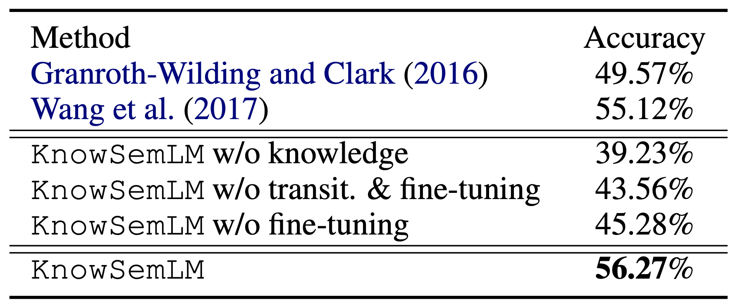
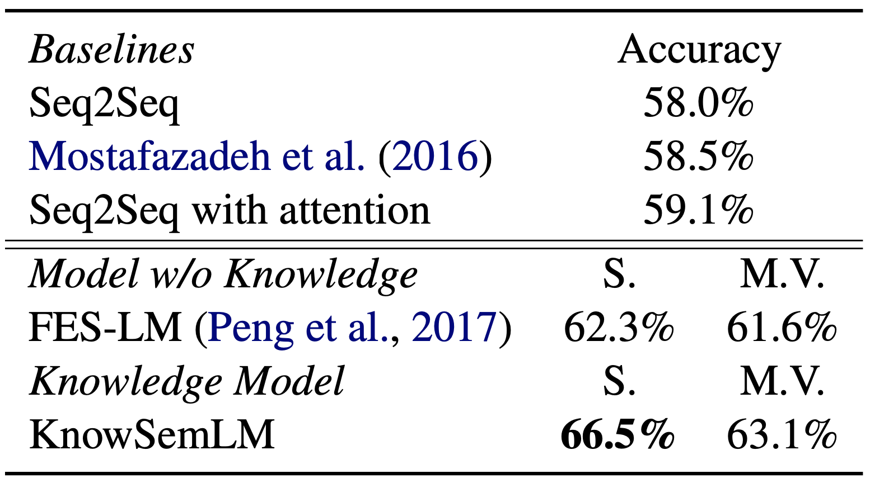
Evaluations
Application for Event Cloze Test / Story Prediction
Event Cloze Test - MCNC task [Granroth-Wilding and Clark, 2016] Recover the event from an event chain given multiple choices
Story Prediction - ROCStories dataset [Mostafazadeh et al., 2017] Predict the fifth sentence from a four-sentence story given two choices
Knowledge Acquisition: Statistical Way on NYT training data
Fine-tuning on the development data

Slide 14
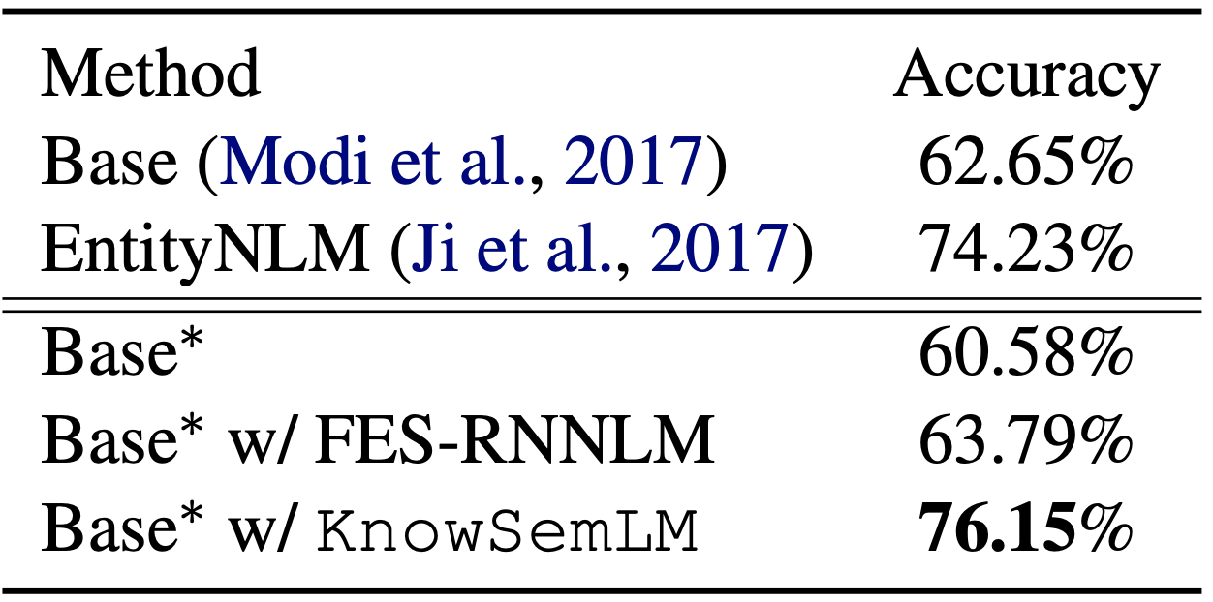
Evaluations
Application for Referent Prediction
InScript Corpus [Modi et al. 2017]
Predict the referent of an entity (or a new entity) given the preceding text
Knowledge Acquisition: Declarative Way
Add conditional probabilities as additional features on the re-implemented Base Model

Slide 15
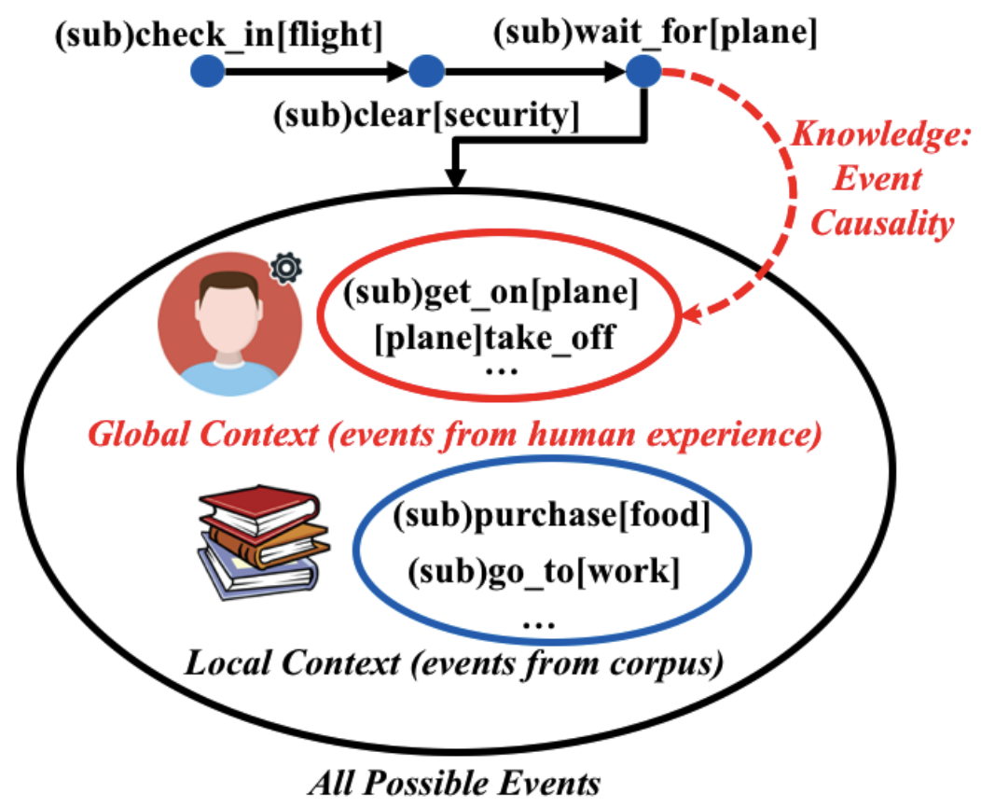
Conclusion
A knowledge infused computational framework to better predict future events on an abstracted event level.
Notes:
This paper proposes KnowSemLM, a knowledge infused semantic LM. It utilizes both local context (i.e., what has been described in text) and global context (i.e., causality knowledge about events) to predict future events.

