Slide 1

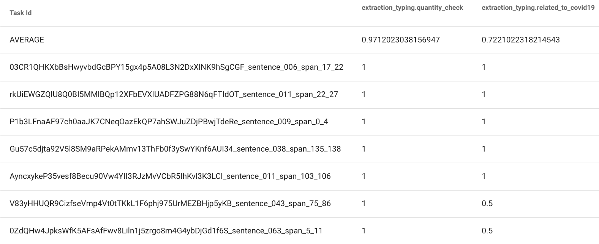
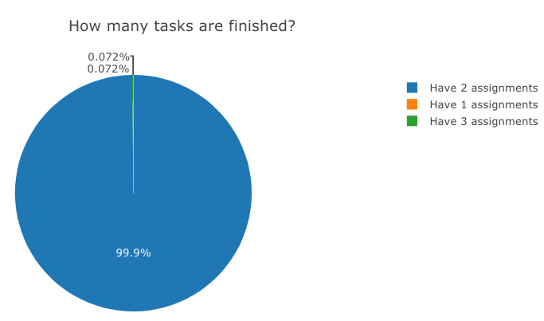
Easy, Reproducible and Quality-Controlled Data Collection with CROWDAQ
Qiang Ning¹ Hao Wu² Pradeep Dasigi³ Dheeru Dua⁴ Matt Gardner³
Robert L. Logan IV⁴ Ana Marasović³ Zhen Nie²
¹Amazon (work finished at the Allen Institute for AI) ²Hooray Data Co., Ltd. ³Allen Institute for AI ⁴University of California Irvine
Abstract
Usage
High-quality and large-scale data are key for many AI systems.
Three common challenges
Designing a user-friendly annotation interface
Training annotators efficiently
Dataset reproducibility
CROWDAQ addresses issues above
Customizable UI construction (no frontend expertise required)
Annotator qualification management via user-defined multiple-choice exams
Standardized data collection pipeline that one can use to simply “pay and collect”
CROWDAQ is open-source and provisioned by Hooray Data for free.
Access CROWDAQ
https://www.crowdaq.com/
Demo user: emnlp-demo
Password:
Please contact us for registration.
Real-time inter-annotator agreement monitoring
Real-time progress monitoring

