Slide 1




Foreseeing the Benefits of Incidental Supervision
Hangfeng He†, Mingyuan Zhang†, Qiang Ning‡*, and Dan Roth†
†University of Pennsylvania
‡Amazon
*Part of this work was done while the author was at Allen Institute for AI.
EMNLP, 2021

Slide 2


Incidental Supervision Signals
Given the task of NER, what types of signals can we use?
Gold Annotations
Unlabeled texts
ORG
Partial Annotations
Noisy Annotations
O
I-ORG
Auxiliary Annotations
Constraints
Same labels in NER
Knowledge
Cross-lingual Annotations

Slide 3



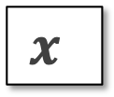


Incidental Supervision [Roth, AAAI’17]
Incidental signals
Inductive Incidental Signals
Partial labels, noisy labels, auxiliary labels, constraints, etc.
Transductive Incidental Signals
Cross-domain signals, cross-lingual signals, cross-modal signals, etc.
Mixed Incidental Signals
Partial + noisy, partial + constraints, cross-domain + noisy, etc.
Supervised Signals
Incidental Signals
Can we provide a unified framework for incidental signals, and quantify the extent to which various incidental signals can help the target task?

Slide 4
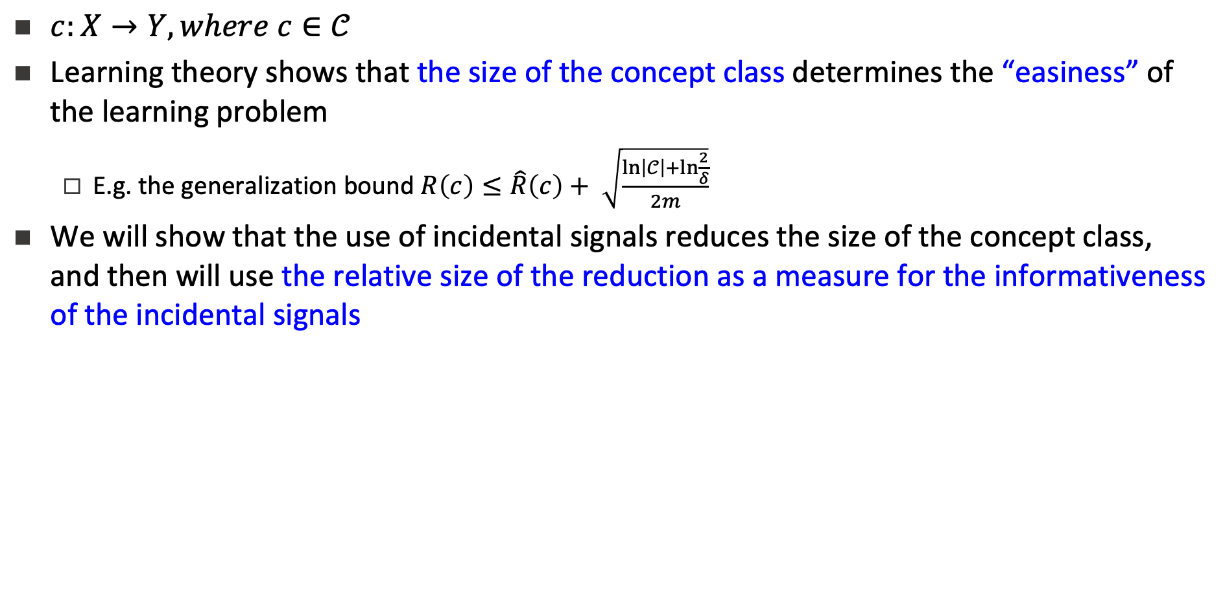
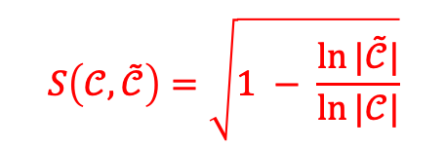




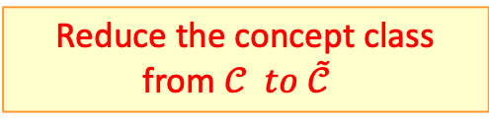
The Impact of Incidental Signals on the Concept Class
Incidental Signals
Original Concept Class
Reduced Concept Class

Slide 5
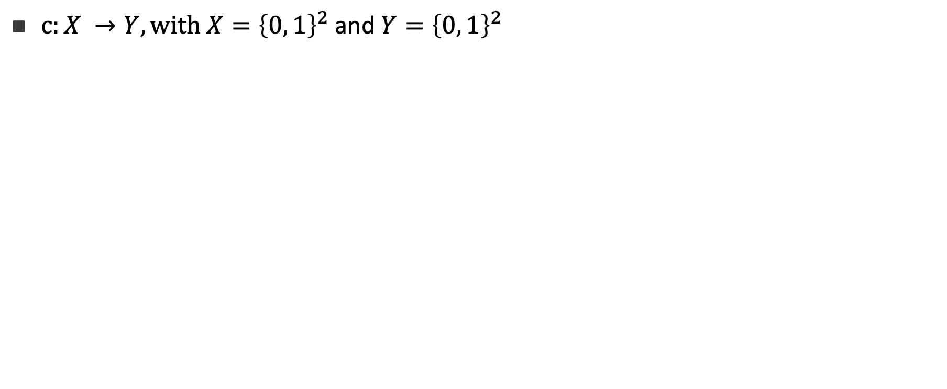


An Example with Partial Data
00
00
00
00
01
01
01
01
x=00
x=01
x=10
x=11
10
10
10
10
11
11
11
11
x=00
0?
x=11
?1
Partial dataset
00
00
00
01
01
01
01
x=00
x=01
x=10
x=11
10
10
11
11
11

Slide 6

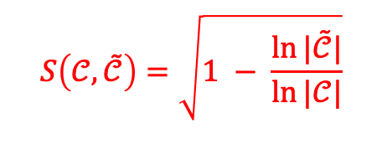



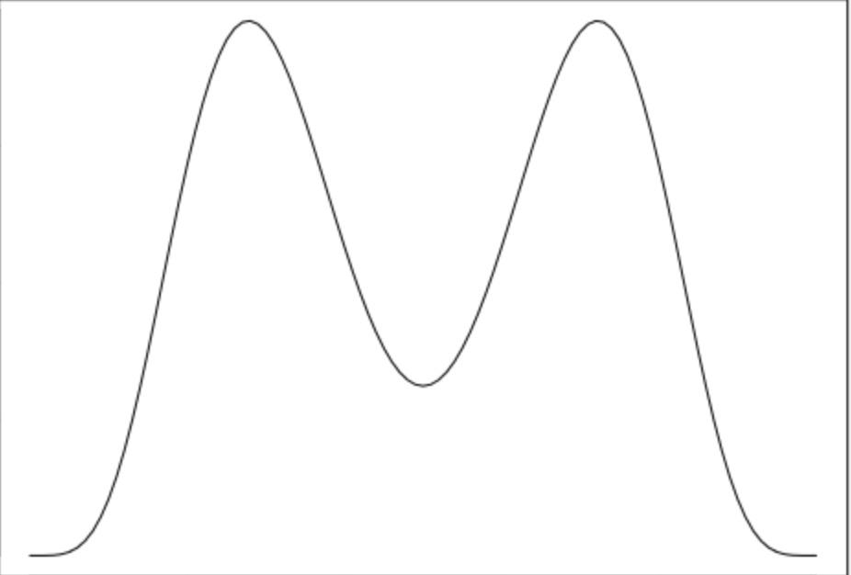
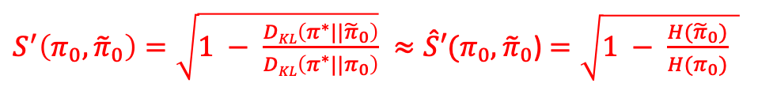

PABI: A Unified PAC-Bayesian Informativeness Measure
Incidental Signals
PAC Setting
Original Concept Class
Reduced Concept Class
Incidental Signals
PAC-Bayesian Setting
Concept Class with Probability Measure
Can handle the infinite concept class case

Slide 7
Learning with Various Inductive Incidental Signals
Main Task
Named entity recognition (NER)
Data
Ontonotes 5.0 (18 types of named entities)
Basic Model
Two-layer NNs with 5-gram features
Algorithm
Bootstrapping with incidental signals
Initialize the model by training it on the gold signals
An EM algorithm on the large-scale incidental signals
Improve the inference stage with incidental signals
Setting
200K word-level examples
Partial Annotations
ORG
Noisy Annotations
O
I-ORG
Constraints
What are our expectations when we add various incidental signals to small amounts of gold annotations?
Can we determine, ahead of time, the relative benefits of partial data, noisy data and constraints?

Slide 8
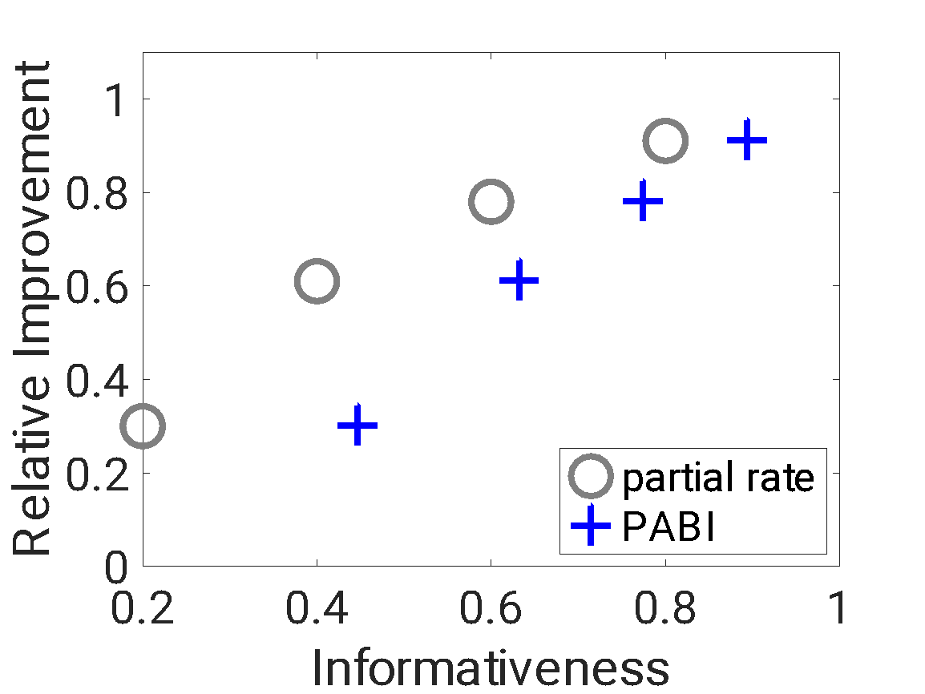
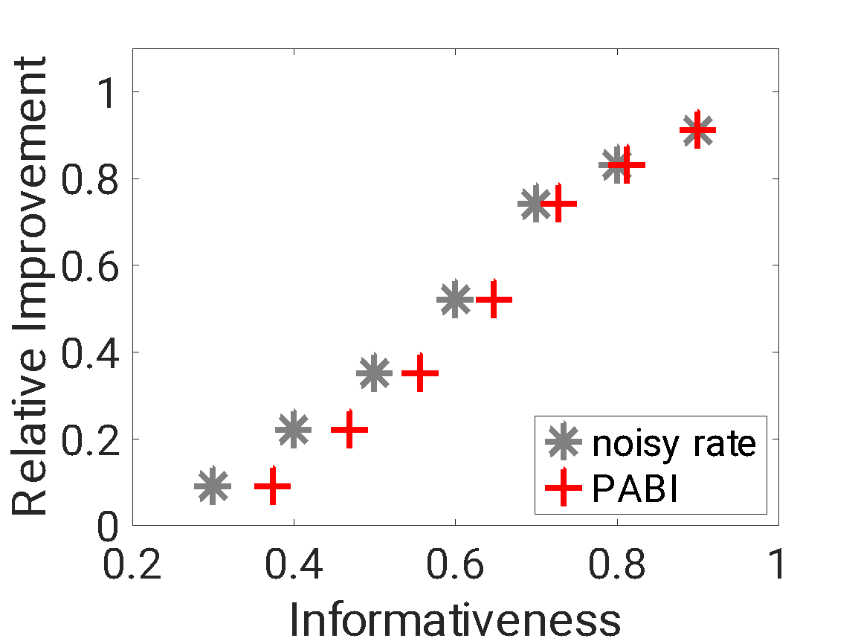
Results: Individual Inductive Signals
Partial supervision: the relation between the relative improvement and the informativeness for partial signals with different unknown partial rates
Noisy supervision: the relation between the relative improvement and the informativeness for noisy signals with different noise rates
It is not surprising that:
(1) Signals with lower unknown partial rates lead to higher improvement
(2) Signals with lower noise rates lead to higher improvement

Slide 9
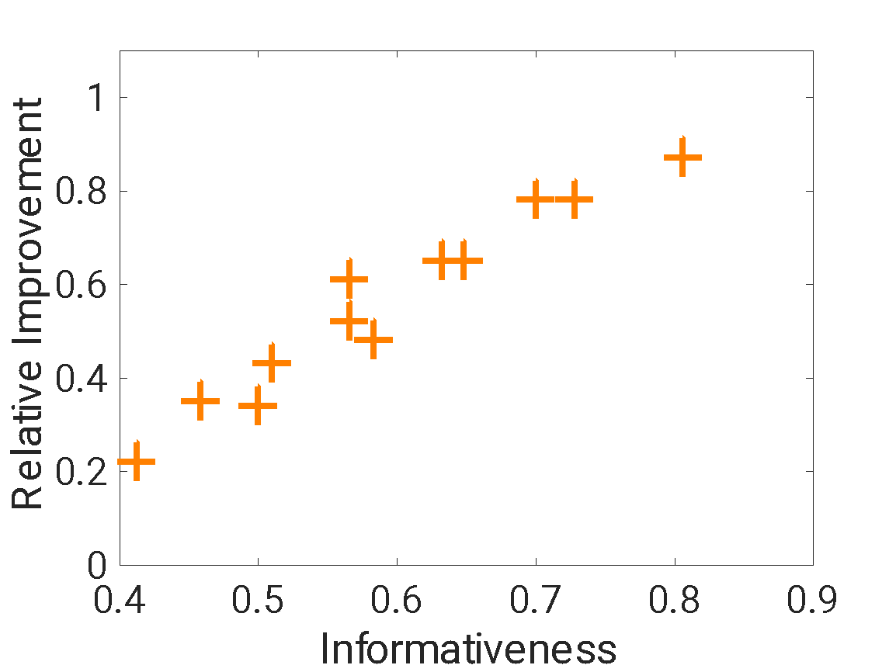
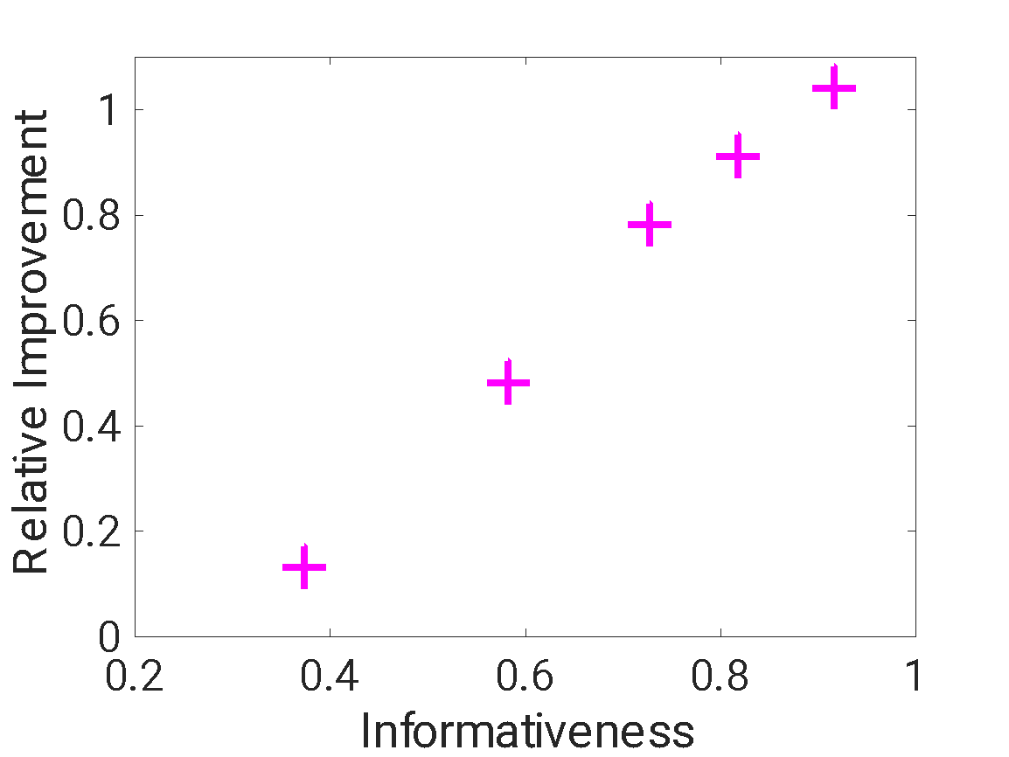
Results: Mixed Inductive Signals
Partial + noisy supervision: the relation between the relative improvement and the informativeness for signals with both partial and noisy signals
Partial + constraints supervision: the relation between the relative improvement and the informativeness for signals with both partial labels and constraints
The (relative) benefits from the mixed signals (e.g., a dataset is both partial and noisy) cannot be determined in existing frameworks, but our framework can handle it.

Slide 10
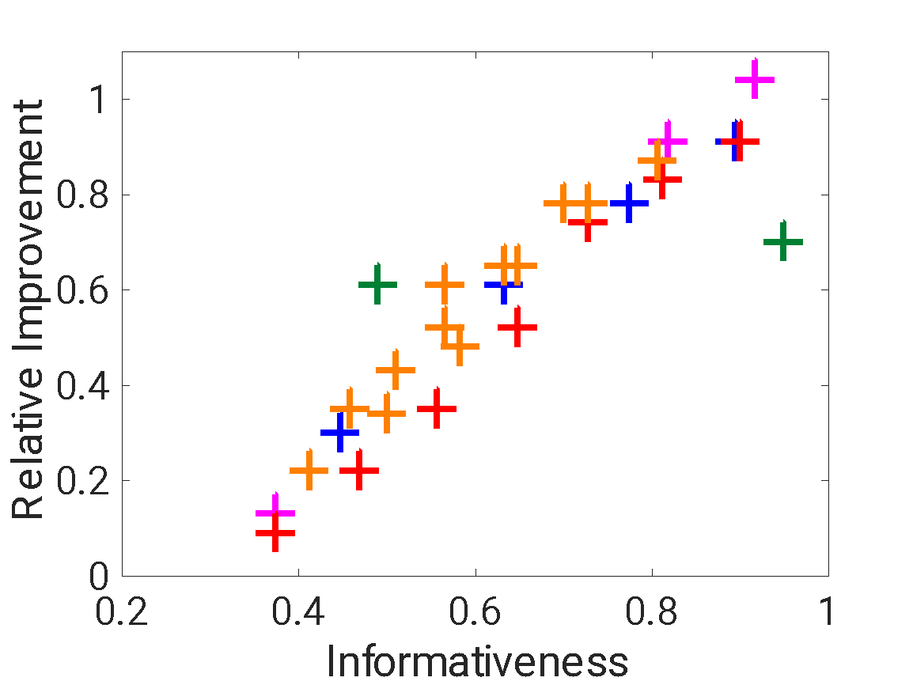
Results: Various Inductive Signals
Take away:
The informativeness of a signal predicts the improvement provided by the signal.
Key Insight:
It is possible to compare (and predict) the potential contribution of incidental supervision of different types with PABI.
The relation between the relative improvement and PABI for various incidental signals: partial labels, noisy labels, auxiliary labels, partial + noisy, and partial + constraints.
The Pearson’s correlation coefficient is: 0.92
The Spearman's rank correlation coefficient is: 0.93

Slide 11
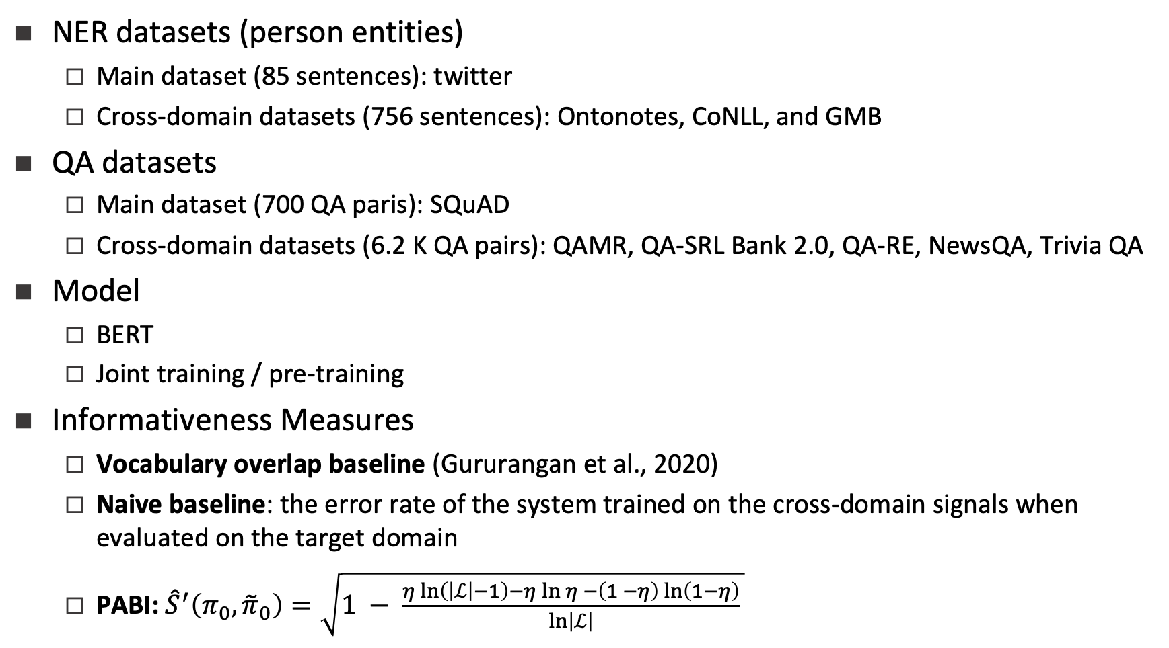
Experiments: Cross-Domain Signals

Slide 12
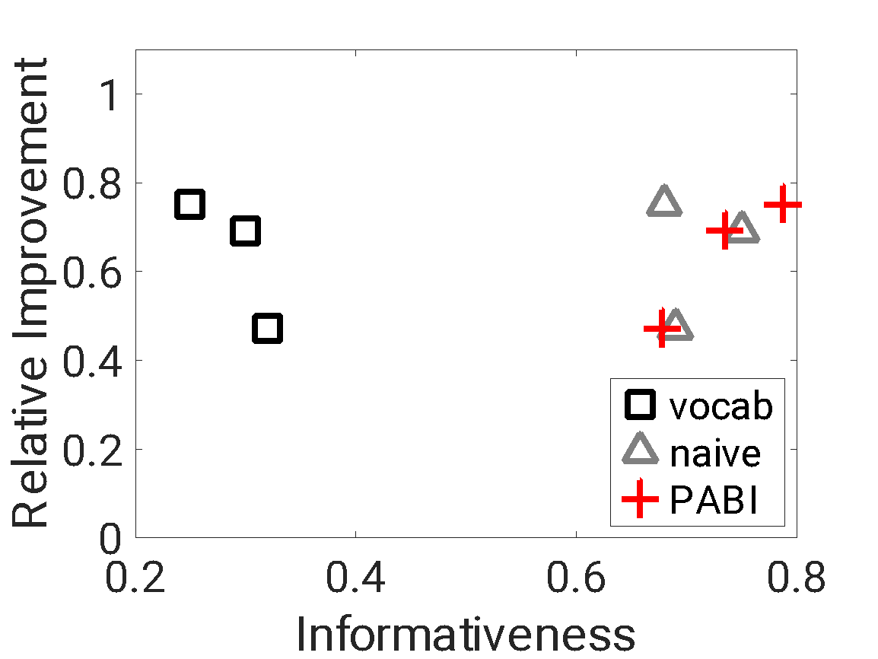
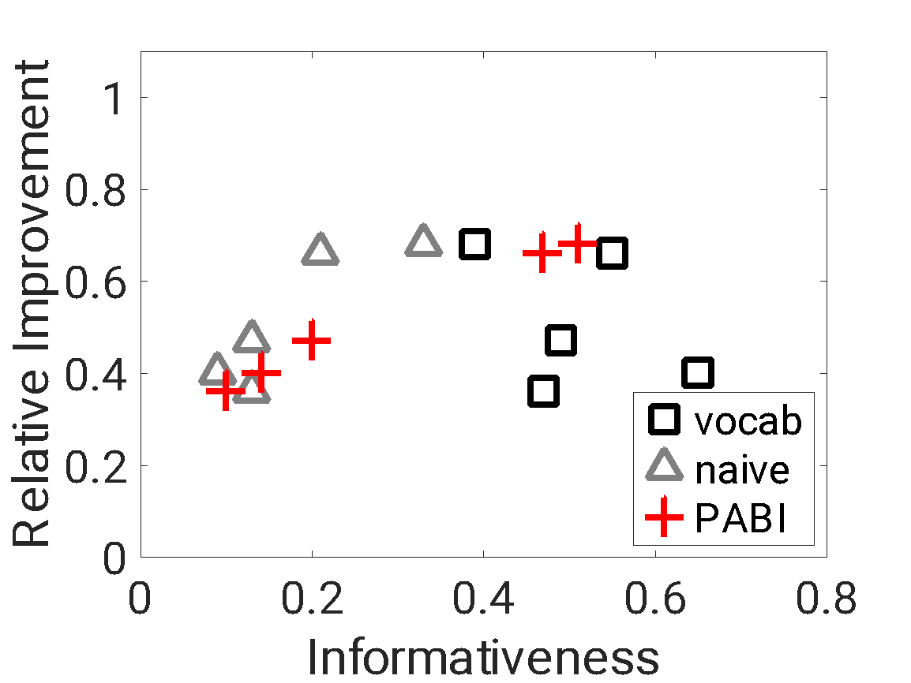
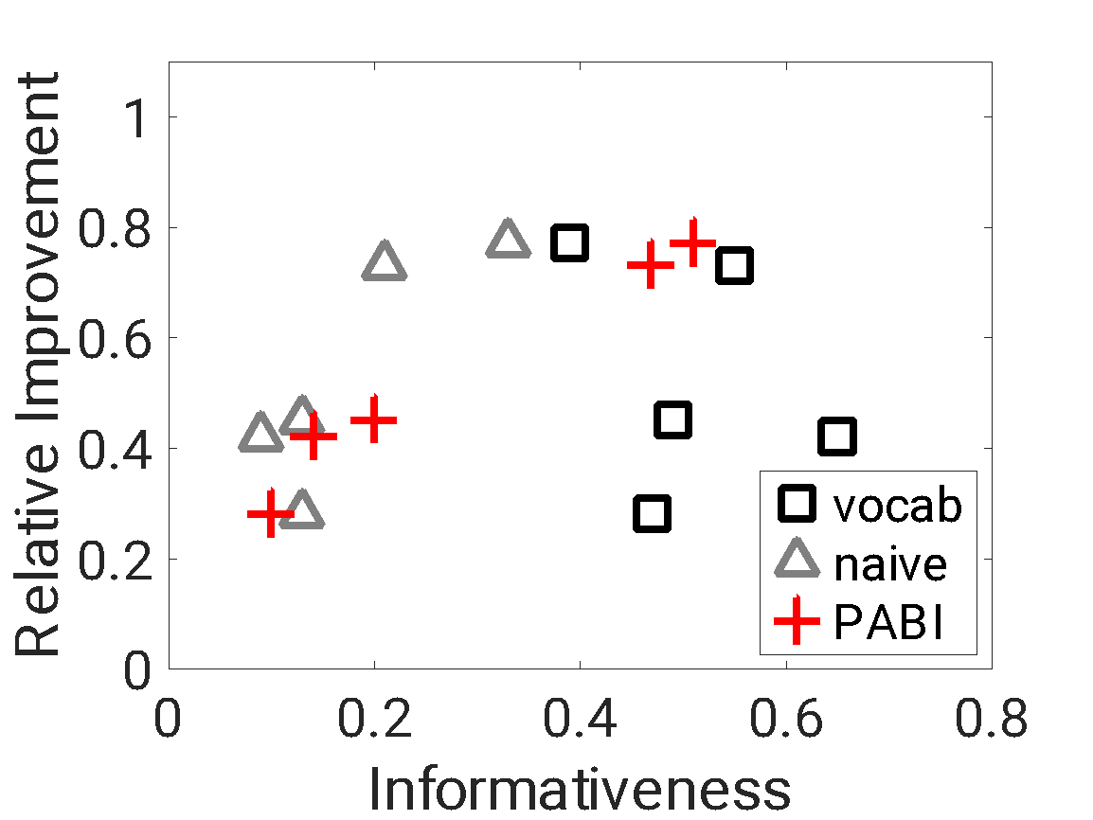
Results: Cross-Domain Signals
(a) Joint-training NER with baselines and PABI
(b) Joint-training QA with baselines and PABI
(c) Pre-training QA with baselines and PABI
Correlation between informativeness measures (baselines or the PABI) and relative improvement (via joint training or pre-training) for cross-domain NER and cross-domain QA.
The Pearson's correlation of three informativeness measures (PABI, naïve baseline, vocabulary overlap baseline) in the three cases are: 0.96/0.19/-0.85, 1.00/0.88/-0.40, 0.99/0.85/-0.30.

Slide 13
Discussions
Contributions
PABI: A unified PAC-Bayesian informativeness measure for incidental signals
Experiments on NER and QA support the effectiveness of PABI on quantifying the value of a wide range of incidental signals
Partial labels, noisy labels, constraints, auxiliary signals, cross-domain signals, and some combinations of them
Discussion of Factors in PABI
Base model performance (the size of gold signals)
The size of incidental signals
Data distribution
Algorithm
Cost-sensitive loss

