Slide 1









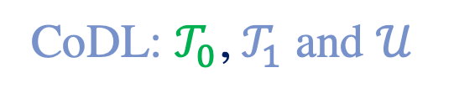




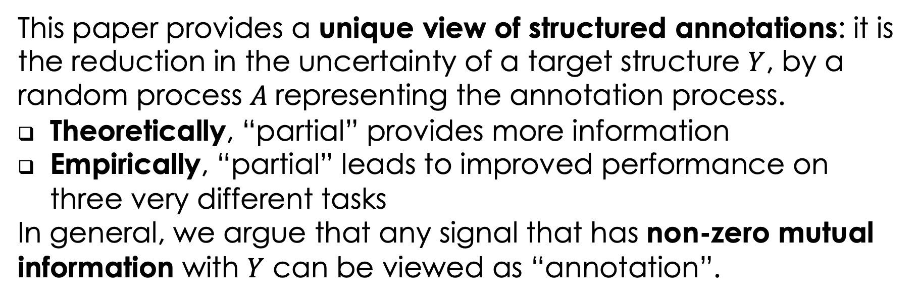







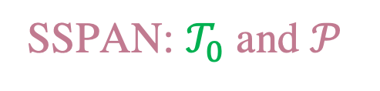


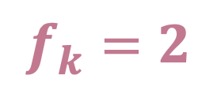
Partial Or Complete, That’s The Question
Qiang Ning¹, Hangfeng He², Chuchu Fan¹, Dan Roth^{1,2}
¹Department of Electrical and Computer Engineering, University of Illinois at Urbana-Champaign
²Department of Computer and Information Science, University of Pennsylvania
Background
Motivation
Many learning tasks are structured. Considering the structure in the learning/prediction phase leads to structured learning/prediction. However, the effect of structure on data collection has received less attention.
Structure: a set of variables that are not independent (mathematical definition shown in Sec. “Theory”).
A common perception: “partial” data are of low quality and should be avoided in data collection.
This paper challenges it and provides a more principled understanding for “partial”.
Temporal relation extraction
(no time loops)
Semantic role labeling
(one phrase, one label)
Image part labeling
Considering structures in different phases
Before
[ACL’18a]
[LREC’02]
🔴 FOREHEAD
[CVPR’18]
Data Collection
This Paper
I met with him at JFK before flying to Paris on Thursday.
PREDICATE
🔴 LEFT_EYE
met (1)
met (2)
flying
Be_Included
The boy gave a frog to the girl.
NECK
🔴
🔴 TORSO
Learning
Structured Learning
Thursday
Time
Arg0
Arg0
Arg0
Prediction
Structured Prediction
(met, Thursday) is either “before” or “included”
“frog” and “girl” cannot be “Arg0” anymore
“NECK” is in the red box instead of the blue one
This paper aims to provide a better (both theoretical and empirical) understanding of the role of structure in data collection for structured tasks.
Motivation: if we annotate a structure only partially, the remaining part is constrained to a smaller space; that is, some “information” of the remaining part has been explained by existing annotations. This is a benefit of “partial” that is overlooked previously [*SEM’18].
Approach: Partial Or Complete
Theory
To study the effect of structure on data collection, we investigate two data collection paradigms:
Complete: complete as many structures as possible; the cost is leaving some structures empty
Early stopping: evenly distribute the annotation budget to all structures; the cost is only getting partial annotations
We train two systems accordingly and compare their performances on the same test set.
Structure: a vector of $d$ random variables: $Y=\left[Y_{1},Y_{2},…,Y_{d}\right]∈C\left(ℒ^{d}\right)⊆ℒ^{d}$, where $ℒ$ is the label set.
Two simple cases:
When the variables are independent:$C\left(ℒ^{d}\right)=ℒ^{d}$
When the structure is so “strong” that it requires all variables to share the same label: $C\left(ℒ^{d}\right)=\{\left[ℓ_{1},ℓ_{1},…,ℓ_{1}\right],\left[ℓ_{2},ℓ_{2},…,ℓ_{2}\right],…,[ℓ_{\left|ℒ\right|},ℓ_{\left|ℒ\right|},…,ℓ_{|ℒ|}\}$
Complete annotation: All variables are labeled and a unique point in $C\left(𝓛^{d}\right)$ is determined.
Partial annotation: A subset of $C\left(ℒ^{d}\right)$ is determined, which contains the “true” structure.
Let $f_{k}$ be the size of the feasible subset if $k$ out of $d$ variables are labeled.
$f_{0}=\left|C\left(ℒ^{d}\right)\right|≥f_{1}≥f_{2}≥⋯≥f_{d}=1$
Chain structure in ranking problems:
Linear chain with a transitivity constraint.
When $k$ out of $d$ comparisons are given, the structure is a partial order.
$f_{k}:$ # of linear extensions of these partial orders; need simulations to estimate $I_{k}$ [ToC’91].
Bipartite graph structure in assignment problems:
Assign $d$ agents to $d′$ tasks (w.l.o.g, $d<d^{′}$) such that each agent handles exactly one task, and each task can only be handled by at most one agent.
When $k$ out of $d$ agents are assigned, we need to assign the remaining $d^{′}−k$ tasks to $d−k$ agents.
$I_{k}=\log{\frac{d^{′}!}{\left(d^{′}−k\right)!}}$
Sequence tagging problems:
Shallow Parsing, NER, etc., are key examples.
O cannot be immediately followed by I.
No closed-form solution to $I_{k}$; need dynamic programming simulations.
Training Phase
$$𝒯_{0}$$
(b) Partial
(a) Complete
same budget
same budget
$$𝒯_{1}$$
$$𝒰_{0}$$
$$𝒰$$
$$𝒫$$
$$𝒰_{0}$$
$$𝒫$$
No annotation
Complete annotation
CoDL: $𝒯_{0}$, $𝒯_{1}$ and $𝒰$
SSPAN: $𝒯_{0}$ and $𝒫$
1
1→2→3→4
Or
1→3→2→4
$$I_{k}−I_{k−1}$$
$$𝒯_{test}$$
2
3
$$f_{k}=2$$
Partial order
4
Testing Phase
Define: $I_{k}≜\log{|C(𝓛^{d})|}−E[\log{f_{k}}]$
Measures how much of $C\left(ℒ^{d}\right)$ has been disqualified by $k$ labels.
Define: A $k$-partial annotation $A_{k}$ is a vector of random variables $A_{k}=\left[A_{k,1},A_{k,2},…,A_{k,d}\right]∈{\left(ℒ∪⊓\right)}^{d}$, where $⊓$ is a special character for no label yet, s.t.
$\sum_{i=1}^{d}{𝕀(A_{k,i}≠⊓)}=k$
$P\left(Y|A_{k}=a_{k}\right)=P(Y|Y_{j}=a_{k,j},j∈𝒥)$, where $𝒥=\left\{j:a_{k,j}≠⊓\right\}$
$A_{k}$ means k variables in $Y$ are correctly labeled
Theorem: $I_{k}$ is the mutual information between $Y$ and $A_{k}$ when both $Y$ and the $k$ variables labeled in $A_{k}$ follow uniform distributions.
Algorithm: CoDL & SSPAN
CoDL: constraint-driven learning; can be seen as “structured self-learning” [ACL’07]
SSPAN: structured self-learning with partial annotations; can be seen as a straightforward extension of CoDL [*SEM’18]
Implications of the curves above:
Diminishing return of new labels
Better to annotate a structure partially than completely
The slope may be an indicator for the strengths of structures
The SSPAN Algorithm
Input: $𝒯={\left\{\left(x_{i},y_{i}\right)\right\}}_{i=1}^{N}, 𝒫={\left\{\left(x_{i},a_{i}\right)\right\}}_{i=N+1}^{N+M}$
Initialize $ℋ=LEARN\left(𝒯\right)$
While convergence not reached, do
$\tilde{𝒫}=∅$
Foreach $\left(x_{i},a_{i}\right)∈𝒫$ do
${\hat{y}}_{i}=INFERENCE\left(x_{i};ℋ\right)$, s.t.
$${\hat{y}}_{i}∈C(𝒴^{d})$$
${\hat{y}}_{i,j}=a_{i,j}, ∀a_{i,j}≠⊓$ ⭐️
$\tilde{𝒫}=\tilde{𝒫}∪\left\{x_{i},{\hat{y}}_{i}\right\}$
$ℋ=LEARN\left(𝒯+\tilde{𝒫}\right)$
Return $ℋ$
Experiments
Seq Tagging
(chunking)
Bipartite Graph
(semantic role classification)
Chain
(temporal relation extraction)
Results:
Partial > Complete
The stronger a structure, the more improvement from partial.
partial
complete
partial
complete
partial
complete
complete
complete
partial
partial
complete
SSPAN is conceptually a hard-EM algorithm for structured learning tasks. Without ⭐️, SSPAN goes back to CoDL.
partial
[CoNLL’00, NIPS’01]
[CoNLL’05, LREC’18]
[ACL’18b, EMNLP’18]
Conclusion
References
[ToC’91] G. Brightwell and P. Winkler. Counting linear extensions is #p-complete. [CoNLL’00] TK Sang and S. Buchholz. Introduction to the CoNLL-2000 shared task: Chunking. [NIPS’01] V. Punyakanok and D. Roth. The use of classifiers in sequential inference. [LREC’02] P. Kingsbury and M. Palmer. From Treebank to PropBank. [CoNLL’05] X. Carreras and L. Marquez. Introduction to the CoNLL-2005 shared tasks: Semantic role labeling. [ACL’07] MW Chang, L. Ratinov, and D. Roth. Guiding semi-supervision with constraint-driven learning. [ACL’18a] Q. Ning, Z. Feng, H. Wu, and D. Roth. Joint reasoning for temporal and causal relations. [ACL’18b] Q. Ning, H. Wu, and D. Roth. A multi-axis annotation scheme for event temporal relations. [CVPR’18] J. Choi, J. Krishnamurthy, A. Kembhavi, and A. Farhadi. Structured set matching networks for one-short part labeling. [EMNLP’18] Q. Ning, B. Zhou, Z. Feng, H. Peng, and D. Roth. CogCompTime: A tool for understanding time in natural language. [LREC’18] D. Khashabi et al. CogCompNLP: Your swiss army knife for NLP. [*SEM’18] Q. Ning, Z. Yu, C. Fan, and D. Roth. Exploiting partially annotated data for temporal relation extraction.
Acknowledgement
The Allen Institute for Artificial Intelligence (allenai.org); the IBM-ILLINOIS Center for Cognitive Computing Systems Research (C3SR) - a research collaboration as part of the IBM AI Horizons Network; Contract HR0011-15-2-0025 with the US Defense Advanced Research Projects Agency (DARPA); the Army Research Laboratory (ARL).
This paper provides a unique view of structured annotations: it is the reduction in the uncertainty of a target structure $Y$, by a random process $A$ representing the annotation process.
Theoretically, “partial” provides more information
Empirically, “partial” leads to improved performance on three very different tasks
In general, we argue that any signal that has non-zero mutual information with $Y$ can be viewed as “annotation”.

