Slide 1






A Meta-framework for Spatiotemporal Quantity Extraction from Text
Qiang Ning*, Ben Zhou, Hao Wu
Haoruo Peng, Chuchu Fan, Matt Gardner*
*work started while Qiang and Matt were at AI2
Notes:
Hello everyone. My name is Qiang from Alexa AI. Today I'm very happy to share a work of mine that started when I was at AI2, and an outcome of collaboration with folks from many different places.

Slide 2
When COVID appeared in 2020…
Notes:
When COVID first appeared in the US, there were a great number of news articles covering various aspects of the pandemic. It was desired to have a dedicated tool that can extract and synthesize information from all of them, in all places, in all time points. This is important for, either better understanding the situation for policy makers, or for many applications built on top of this database.

Slide 3
Event-centric NLP
These interesting statistics are actually so-called “events”
Beyond “local” text understanding, event-centric NLP requires integrating information about events from various facets
participants, types, relationships, commonsense, causality, etc.
Among these, time & location of events are the focus of this work

Slide 4
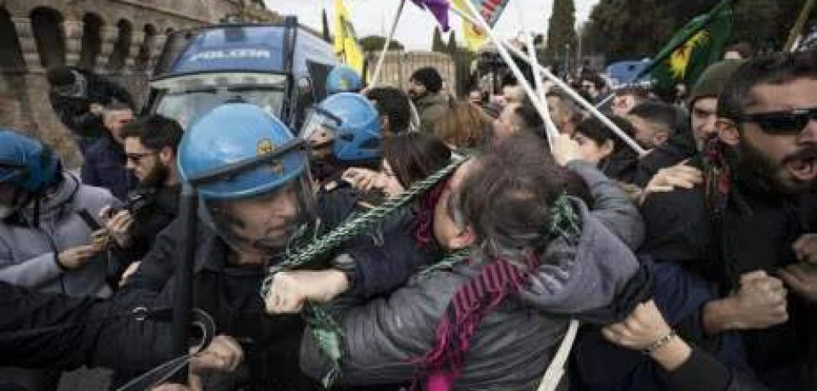
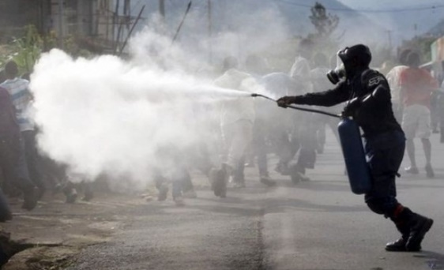
Time is important for event understanding
People were angry
Police used tear gas
Time
People were angry first, and then the police used tear gas.
Notes:
Time is important for story understanding. For instance, let's look at two events: people were angry and police used tear gas. If this is the temporal ordering, people got angry first and followed by tear gas. It leaves us with the impression that people may have turned anger into violence. And that's why tear gas was used.
(22'')

Slide 5
Same events, different temporal ordering
Police used tear gas
People were angry
Time
Police used tear gas first, and then people were angry.
Notes:
However, if we reverse the temporal ordering, then we get a different story, where people were angry at the police because they had used tear gas inappropriately.
(12'')

Slide 6


Location is important for event understanding
People were angry
Police used tear gas
Icon credits to Artdabana@Design from the Noun Project
Notes:
Typically there’s no causal relationship between these two events because they’re from different places in the world

Slide 7
Introduction
This paper proposes a meta-framework for studying spatiotemporal phenomena of quantity events.
Quantity events: numbers associated with events
Spatiotemporal: when and where did this event happen?
Meta-framework: problem formulation, re-usable data annotation pipeline, and baseline models
The purpose is to help researchers
Understand the challenges we’ve met with & the logic behind our design choices
Study modeling opportunities on the 3 datasets we release, especially in terms of transfer learning
Be able to extend to new domains more easily
Since this is a meta-framework with many details, we’ll only be able to cover the main idea in this talk.

Slide 8
SteQE: Spatiotemporal Quantity Extraction
Task Formulation
We draw on ideas from existing NLP tasks to defines SteQE as four information extraction tasks: quantity recognition, typing, spatial grounding, and temporal grounding.
Annotation Collection
We release a shareable and extensible crowdsourcing pipeline on Crowdaq that facilitates fast and reliable data annotation. We release data from three sociopolitical events: the COVID-19 pandemic, Black Lives Matter (BLM) protests, and 2020 California wildfires.
Modeling
We propose a T5 baseline model for its flexibility across tasks and easy domain transfer.
Notes:
This is a summary of our contributions.
While each of these has analogues in the literature, our combination of them into a complete picture of quantity events is novel.

Slide 9
Task Formulation

Slide 10
SteQE: Task Formulation
Monday, Sep 14 2020
Title: Change in western US weather to bring wildfire and smoke relief for some, high fire danger for others
…Over 4.6 million acres of land are actively burning across the West , with most of these blazes ongoing in California, Washington and Oregon, according to the National Interagency Fire Center. Many of these blazes exploded in size during a high wind event around the Labor Day holiday. At least 35 people have been killed along the West coast as a result of the blazes, and tens of thousands have been forced to evacuate, according to The Associated Press…
[DCT] [Title t₁, t₂, t₃, …] [Body Text b₁, b₂, …,q₁, q₂,…, q_{m}, … b_{n}]
Predict
tokens
Type
Location
Time span
Notes:
given an article, time, and its title, we arrange these in the following format, and the SteQE task is decomposed into 4 subtasks: ....

Slide 11
SteQE: Task Formulation
1. Quantity Recognition
Similar to named entity recognition (NER), quantity recognition is defined as a text span detection problem.
Compare the “a” in: “a patient” vs “a group of patients”
Compare “five cases” vs “the fifth case”
Check our paper for discussion over these situations
[DCT] [Title t₁, t₂, t₃, …] [Body Text b₁, b₂, …,q₁, q₂,…, q_{m}, … b_{n}]
Predict
tokens
Type
Location
Time span

Slide 12
SteQE: Task Formulation
2. Quantity Typing
Predefined label set
A clear event type is important for subsequent spatiotemporal grounding, but some quantities have multiple types, and some have multiple interpretations. This work thus makes two design choices to mitigate these issues.
Single-typing: “[three] men were hospitalized 5 days after being tested positive”
We enforce single-typing by providing an order of importance. For instance, hospitalization is more important than tested positive, so the spatiotemporal extent of “three” will be that of hospitalizations.
Handling multiple interpretations: “[20%] of the tenants were infected”
Excluding quantities with multiple interpretations [used in this work]
Providing special instructions to choose from interpretations
Notes:
We can consider the time span of 20% as the exact date when the infection rate became 20% or the entire span, or as the entire span when infection rate was zero all the way up to 20%. We've identified a couple of types to exclude in this work, but an obvious alternative is to make a choice and teach annotators to disambiguate in this case.

Slide 13
SteQE: Task Formulation
3. Spatial Grounding
To ground real-world events to a real-world locale
Format
choose from a predefined set of questions to determine the country (U.S. vs non-U.S.) and state,
use free text for the name of the city
use span selection for more granular locale information (e.g., a pork plant)
Granularity
the most specific location mentioned in the text that contains all individual cases of a quantity event

Slide 14
SteQE: Task Formulation
4. Temporal Grounding
To ground each real-world quantity event to a single time span
Format
A time span consists of two time points, and the key is the format for time points.
Select calendar dates from our UI (e.g., Feb 1st, 2021)
When a time point is unclear based on the text, we allow annotators to simply select “Unknown”
Granularity
Given the nature of news events, it is often enough to be specific up to “day”
The best over-estimate of the gold time span based on text

Slide 15
SteQE: Task Formulation
4. Temporal Grounding
Overall quantity: We identified a special type of quantity – overall quantity – that needs special attention in practice
“There have been [3 million] COVID-19 positive cases so far”. The start time is the beginning of the pandemic, but people do not always agree on when that was. The disagreement comes from
the pandemic started at different times in different regions
one may argue that the pandemic started either since the first confirmed case, or since the lockdown.
We allow “overall” as a label for the start time of a quantity.
Notes:
This debate over start-time is not an NLP problem, so instead of inventing a new mechanism to resolve this, we simply allow ``overall'' as a label for the start time of a quantity.

Slide 16
SteQE: Task Formulation (Recap)
Quantity Recognition
Quantity Typing
Spatial Grounding
Temporal Grounding
We were only able to describe our design choices from a high level in this talk.
We recommend the readers to check the paper for reasons behind those design choices.

Slide 17
Annotation Collection

Slide 18
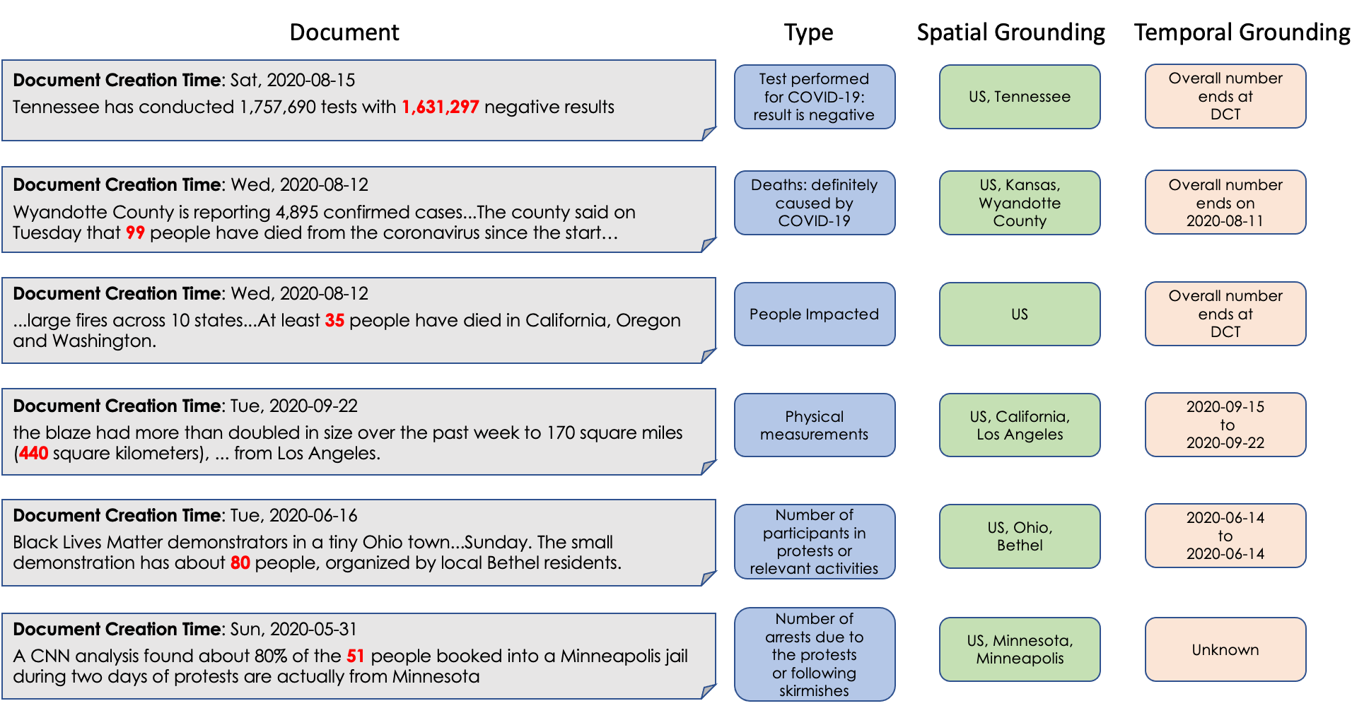
Data Preview
Notes:
This is what our data looks like. We're not going to read everything. Please pause your video and double check the examples, and we'll simply skip it here.

Slide 19
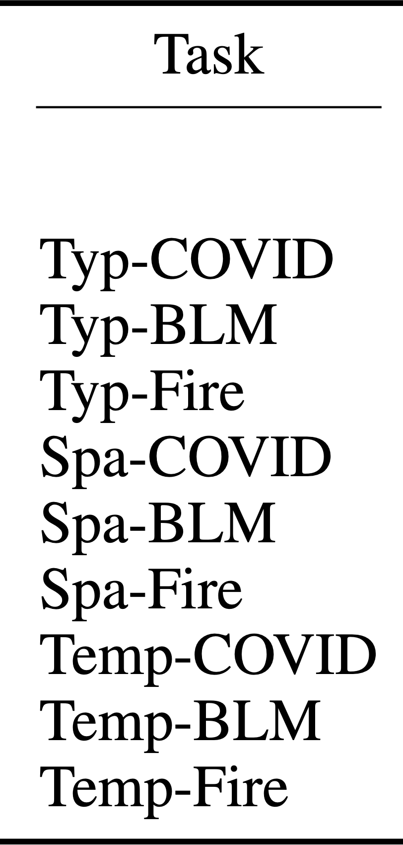
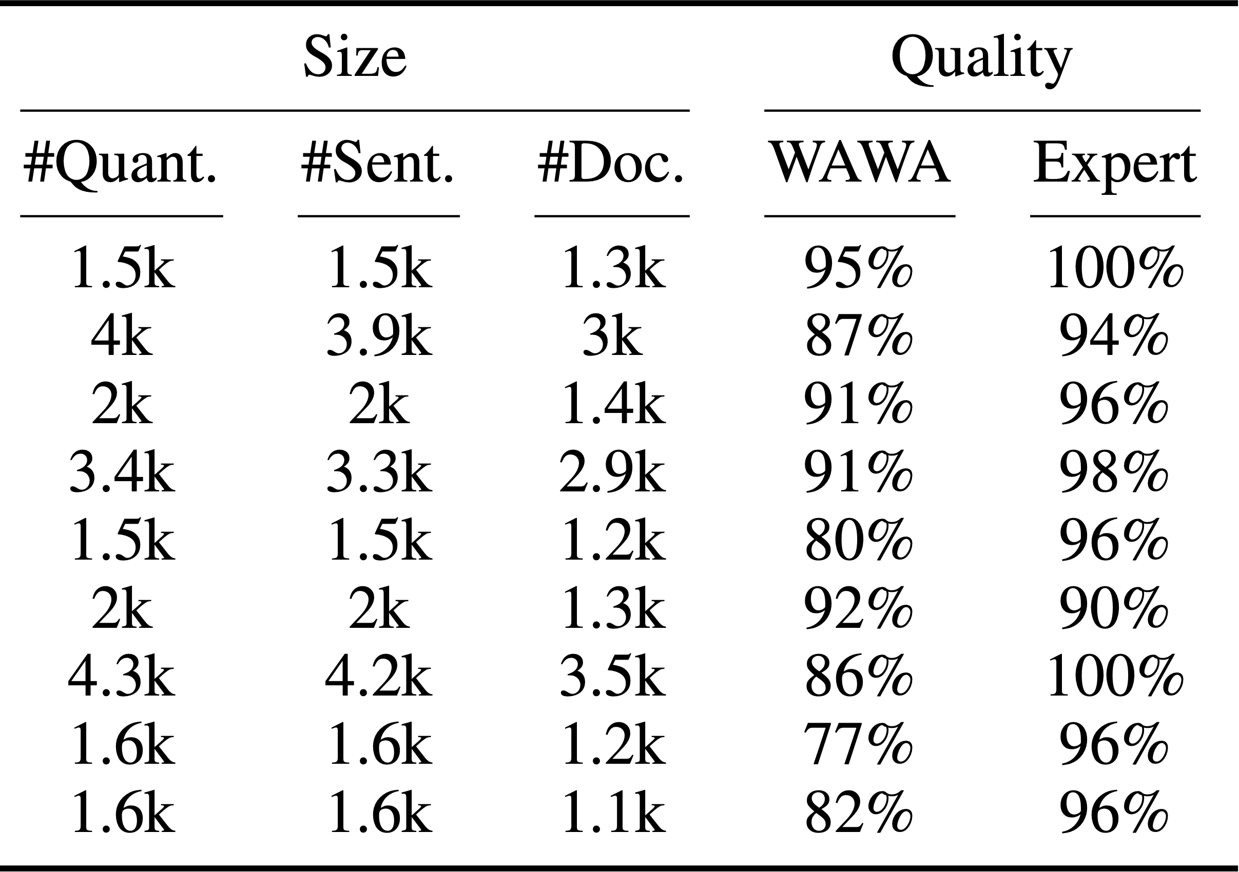
Data Statistics
* ”Quantity Recognition” achieved near-perfect performance in practice so we skipped in this talk
Notes:
This is the data statistics. We'd like to call for attention to the size and quality of the data.

Slide 20
Data Statistics
* ”Quantity Recognition” achieved near-perfect performance in practice so we skipped in this talk

Slide 21
Crowdaq: A platform for data annotations
“Easy, Reproducible and Quality-Controlled Data Collection with CROWDAQ.” Ning et al., EMNLP, 2020 (demo paper).
http://www.crowdaq.com/
Notes:
The data was collected on Crowdaq, a tool developed to make crowdsourcing easier. Feel free to pause the video and double check the information and URL on this slide. We'd like to call out that the pipeline is released and everyone can reproduce the annotation guidelines, exams, and UIs.

Slide 22
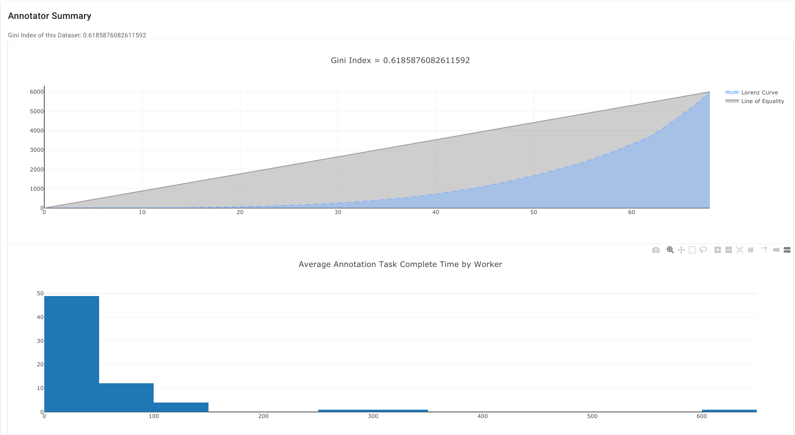
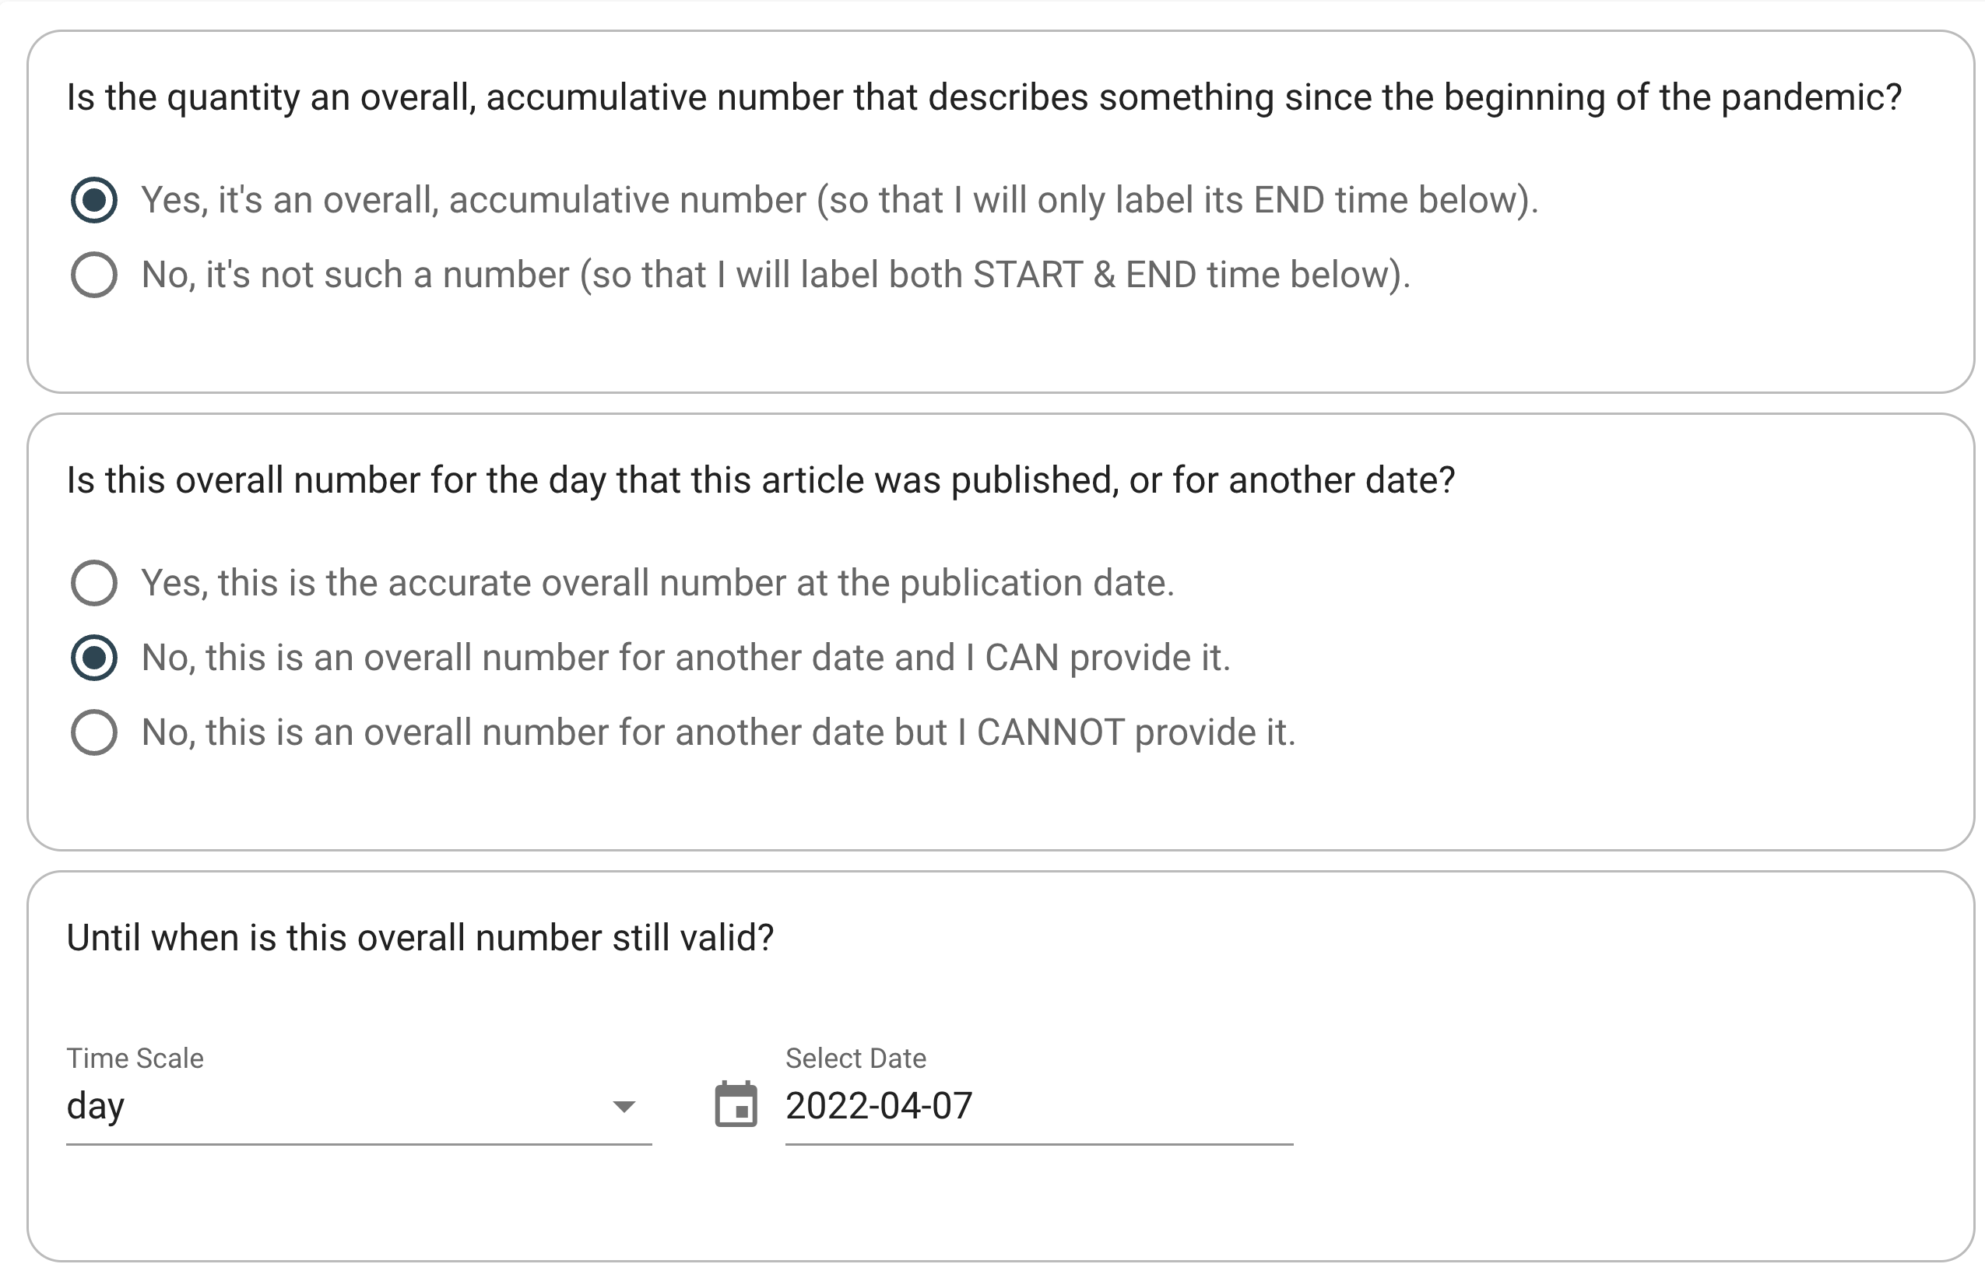
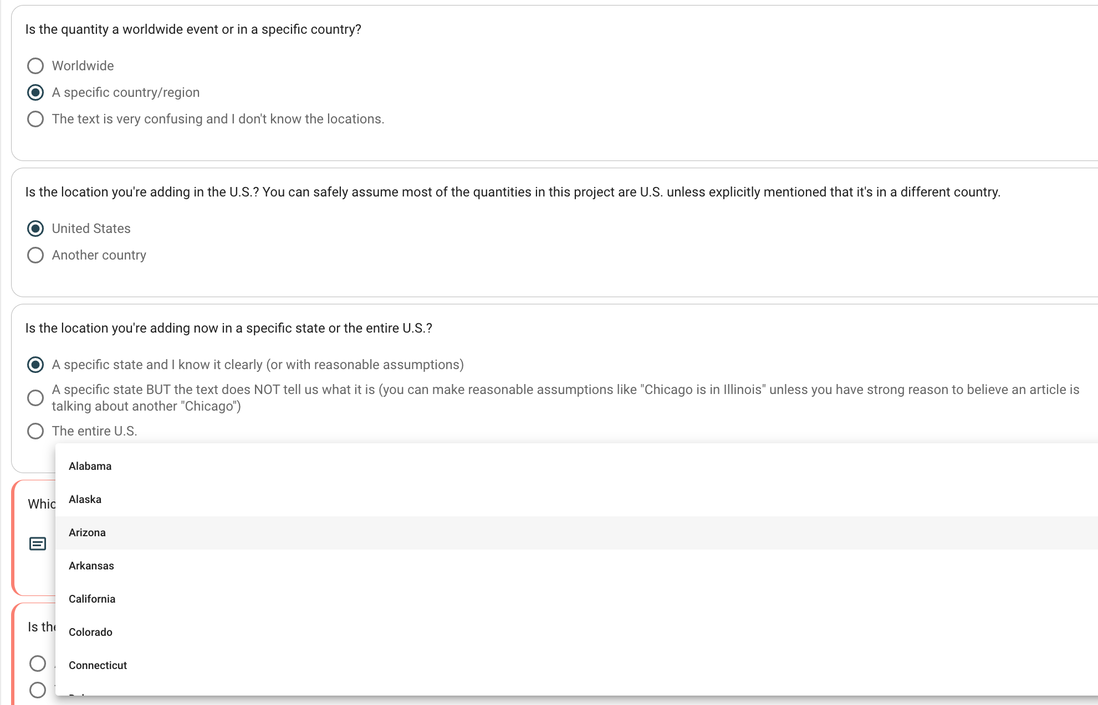
Annotation UI on Crowdaq
Check these links:
Quantity typing: UI
Spatial grounding: UI
Temporal grounding: UI
Notes:
Temporal: https://dev2.crowdaq.com/w/task/acl2021_stqe/covid_quantity_temporal/BAloiPw61DN3giY6aoKgHp2q9uwoOSzqu1JxITdAjWXq6RIRaN_sentence_015_span_34_41
Spatial: https://dev2.crowdaq.com/w/task/acl2021_stqe/covid_quantity_spatial/gWJKQxmNRgVVnkzj4E0UODENo11RurC1HZubwnjXSU6IS34UcS_sentence_016_span_88_94

Slide 23
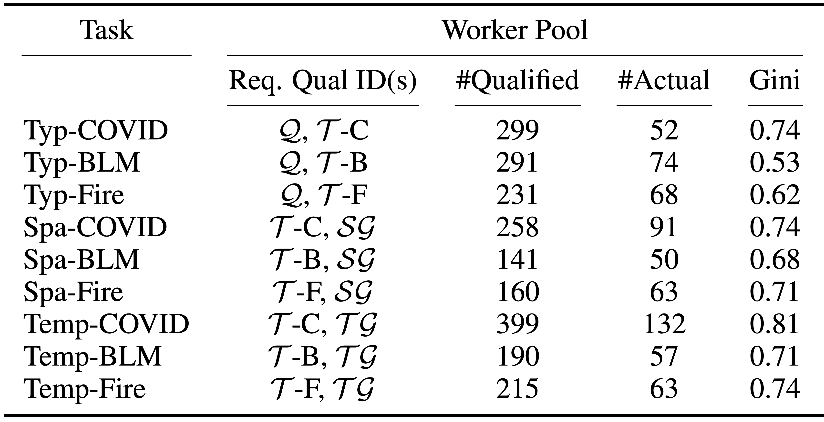
Worker Statistics
Crowdaq enables easy organization of hundreds of workers & their qualifications
Notes:
Here we're showing that crowdaq enables ...

Slide 24
Worker Statistics
Crowdaq enables easy organization of hundreds of workers & their qualifications

Slide 25
Modeling

Slide 26
Modeling
Quantity Recognition
Token classification with BERT (ignored in this talk)
Typing and Spatiotemporal Grounding
Format labels as token sequences
Learnt with T5-large
T5 input
T5 gold output*
Typing Model
… over the past week to <MARKER> 170 square miles …
Physical measurements
Spatial Model
… over the past week to <MARKER> 170 square miles …
US, California, Log Angeles
… over the past week to <MARKER> 170 square miles …
2020-09-15
2020-09-22
Temporal Model
*Note: some keywords are replaced with special tokens
Notes:
We propose models that fulfill individual components as detailed in the problem formulation, which includes quantity recognition, typing, spatial grounding, and temporal grounding. Quantity recognition is done with BERT under a token classification setting. We omit its implementation detail in this talk. Typing, spatial and temporal grounding are done with T5-large using its generative sequence-to-sequence training objective. We use input documents as T5’s input and format the labels in individual tasks into a sequence of tokens as the expected generation output. For example, given the document that includes the quantity of 170 square miles, we place a marker token to the left of the quantity span to indicate which quantity the model should focus on. The typing model will be supervised to generate a sequence of the label, which in this case is physical measurements, and the spatial model will be supervised to generate US, California, Los Angeles. We replace some tokens with special T5 vocabularies to avoid confusion.

Slide 27
Experiments
Metrics:
Typing: Accuracy
Spatial: Exact Match (city/state level)
Temporal: Overall (binary), Non-Overall (start/end)
Datasets: COVID-19, BLM, CalFire
Test set: Each domain has 500 fully annotated test quantities
Settings & Baselines:
In-domain vs all-domain
Naïve baselines (case by case for each task)
Notes:
Naturally, we include three evaluation tasks. For typing, we use accuracy as the metric, for spatial, we use exact match, and evaluate on both city and state level. For time, the first metric we use is a binary accuracy metric, evaluating whether a model can successfully tell if the quantity is an overall number ending on DCT. The second metric evaluates those quantities that are not overall numbers, which are more challenging.
We evaluate both start and end time exact-match in that case. For each domains, we use 500 fully annotated quantities for evaluation.
We compare models that are trained on only in-domain supervision, and those that are trained on all domain’s supervision. We also compare with a set of naive baselines that are designed for each task.

Slide 28
Results - Typing
Naïve: predict the most popular type in each domain
Notes:
Typing is an easy task.

Slide 29
Results – Spatial EM (City)
Naïve: predict the nearest city mention of the quantity span

Slide 30
Results – Temporal Overall (binary)
Naïve: always predict “overall number ending on DCT”

Slide 31
Results – Temporal Non-overall End time
Naïve: always predict the document creation time

Slide 32
Summary
Spatiotemporal semantics are important for quantity events in practice
SteQE is a new meta-framework for studying these semantics
This problem formulated for the first time
Annotation pipeline via Crowdaq released
T5 and transfer learning opportunities
SteQE is extensible to different domains and we tested it on COVID, BLM, and Wildfires
Visit https://github.com/steqe for more details
Notes:
37''

Slide 33
Event-centric NLP
These interesting statistics are actually so-called “events”
What’s event-centric NLP?
switching research focus from “what the text says” to “what’s happening”
What’re the requirements?
Beyond “local” text understanding, event-centric NLP requires integrating information about events from various facets: participants, types, relationships, commonsense, causality, etc.
Among these, time & location of events are the focus of this work

Slide 34
SteQE: Task Formulation
3. Spatial Grounding
Granularity
the most specific location mentioned in the text that contains all individual cases of a quantity event
Title: [Six] COVID-19 cases emerge in South Portland
Text: SOUTH PORTLAND, Maine -- A facility for people with cognitive disabilities reports having [six] COVID-19 cases…
Spatial grounding for [six]: US → Maine → South Portland → A facility for people with cognitive disabilities
S. Portland
- cases
Maine
A facility for disabilities

Slide 35
SteQE: Task Formulation
4. Temporal Grounding
Granularity
The best over-estimate of the gold time span based on text
First event
Last event
- cases
Time
Gold time span
Best over-estimate based on text

Slide 36
Worker Statistics
Crowdaq enables easy organization of hundreds of workers & their qualifications

Slide 37
Results – End-to-end
Naïve: same spatial and temporal naïve methods

Slide 38
Discussion

Slide 39
Use Cases
Study spatiotemporal quantity extraction on each of the 3 datasets released in this work
Study transfer learning for spatiotemporal phenomena
Adopt the Crowdaq pipeline developed in this work for a new domain
Other applications: information verification, social science, etc.

Slide 40
Information Verification
Discrepancy between two sources
Source 1 (therapidian.org at May 11 2020, 19:43:00): …Statewide , there are 47,552 cases , 4,484 deaths , and 22,686 recoveries confirmed …
Source 2 (wzzm13.com at May 11 2020, 06:54:00): GRAND RAPIDS , Mich. -- … The total number of cases is 47,552 and 4,584 have died , according to the data from Michigan 's Dept…
NYT data base: 4,584 total death in Michigan on 5/11/2020. Our hypothesis is that Source 1 made a typo.

Slide 41
Information Verification
Discrepancy between two time points (same source)
Apr 3, 2020: Pennsylvania has 7,016 cases of COVID-19 with 18 in Adams County, and 23 in Franklin County. There are 17,589 cases in Virginia with 121 in Loudoun County. West Virginia has 217 cases of coronavirus, 12 in Jefferson County, and 27 in Berkeley County.
May 8th 2020: Pennsylvania has 7,016 cases of COVID-19 with 18 in Adams County, and 23 in Franklin County. West Virginia has 217 cases of coronavirus, 12 in Jefferson County, and 27 in Berkeley County.
NYT database: 1,706 cases in Virginia with 121 in Loudoun County. Our hypothesis is that the website found that the red sentence was wrong so they deleted it afterward.

Slide 42
COVID-19 cases
Less mentioning of China and World case numbers
Started mentioning NJ
Less mentioning of New York & US after a sharp increase
Notes:
There’re also some interesting phenomena that we’d like to share. Not necessarily solid; after all we’re not social scientists, but just sharing what we find in our data

