Slide 1
Theoretical Analysis of Indirect Supervision Indirectly Supervised Natural Language Processing (Part IV)
Qiang Ning
AWS AI Labs
July 2023
ACL Tutorials
Indirectly Supervised Natural Language Processing

Slide 2
What to expect
We pose the challenge to define a principled way to measure the benefits of these signals to a given downstream task, and the challenge to further understand why and how these signals can help reduce the complexity of the learning problem in theory.
Main papers
[EMNLP’21] Foreseeing the Benefits of Incidental Supervision
[NeurIPS’20] Learnability with Indirect Supervision Signals

Slide 3
Let’s Walk Through A Toy Example

Slide 4




Task: Pair-wise Relationship Between Entities
Thanks to Freepik and Flaticon for creating and sharing the icons freely.

Slide 5
Six Pairs of Relationships
2 possibilities
2 possibilities
2 possibilities
2 possibilities
2 possibilities
2 possibilities
If each relation can choose from a label set of 2 labels, then there are 2⁶ possibilities.

Slide 6
Six Pairs of Relationships
Known
Known
2 possibilities
2 possibilities
2 possibilities
Known
Suppose that we already know the label for 3 pairs of them. The total number of possibilities is reduced from 2⁶=64 to 2³=8. In other words, we still know nothing about the remaining 3 pairs of relationships.

Slide 7
Introducing A Structure Among the Entities
Known
Known
2 possibilities
2 possibilities
2 possibilities
Known
Now, assume that we learn more information about the problem!
the pair-wise relation between entities is an “order relation”
all of the entities create a Directed Acyclic Graph (DAG)

Slide 8
Introducing A Structure Among the Entities
Now with 3 known edges, we have a “partial order.”

Slide 9
Introducing A Structure Among the Entities
Now with 3 known edges, we have a “partial order.”
There are only 3 possibilities to describe the entities now (also known as the linear extensions of the partial order).
Remember the number of possibilities would have been 2³=8 if we hadn’t known this structure.

Slide 10
A Relevant Example in NLP is Temporal Relationship Classification
ripping
monitor
Temporal relation graph: Nodes are events and edges are temporal relationships. It is more complex than a DAG because the edges can choose from more than two directions (depending on the setup, there can be as many as 13^{[1]} labels representing the temporal relationship between two events).
But the concept remains the same – the uncertainty is reduced because of the structure of the problem.
hurt
cascaded
ordered
BEFORE
BE_INCLUDED
BE_INCLUDED
AFTER
BEFORE
INCLUDES
EQUAL
ripping
monitor
monitor
cascaded
Time
We “indirectly” learn something about the red edge from other edges.
[1] Joint Reasoning for Temporal and Causal Relations. Ning et al., ACL’18.

Slide 11

Partial or complete, that’s the question [NAACL’19]
Training Phase
(a) Complete
(b) Partial
same budget
same budget
$$𝒯_{test}$$
Testing Phase

Slide 12
Partial or complete, that’s the question [NAACL’19]
partial
complete
+: p<5%
++: p<1%
++
++
++
++
++
++
++
++
+
Even if some annotations are partial, we “indirectly” learn information about the unannotated edges, so when we have a fixed budget, we can gain more “information” and achieve higher performance.
How do we quantify the information brought by the structure?

Slide 13
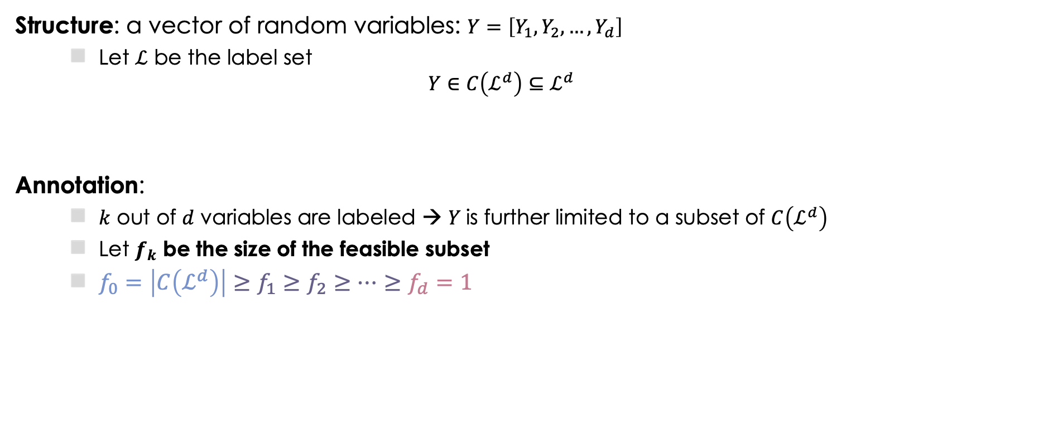


Quantifying Information: Problem Setup
Structure: a vector of random variables: $Y=\left[Y_{1},Y_{2},…,Y_{d}\right]$
Let $ℒ$ be the label set
$$Y∈C\left(ℒ^{d}\right)⊆ℒ^{d}$$
Annotation:
$k$ out of $d$ variables are labeled → $Y$is further limited to a subset of $C\left(ℒ^{d}\right)$
Let $f_{k}$ be the size of the feasible subset
$f_{0}=\left|C\left(ℒ^{d}\right)\right|≥f_{1}≥f_{2}≥⋯≥f_{d}=1$
d=6 variables to be labeled
The relation network should be a DAG
Not all assignments are valid
(aka “constraints”)
$f_{k}$ be the size of the feasible subset
No annotation
Complete annotation
k=3 out of d=6 variables are labeled
$$f_{k}=3$$

Slide 14
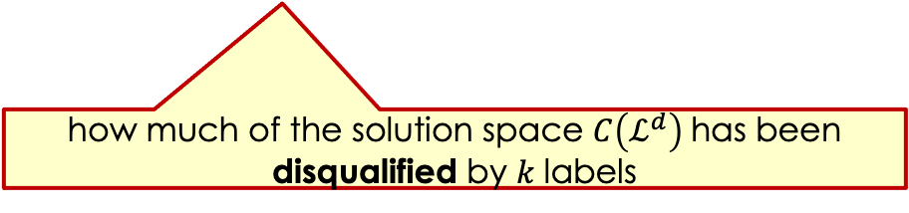
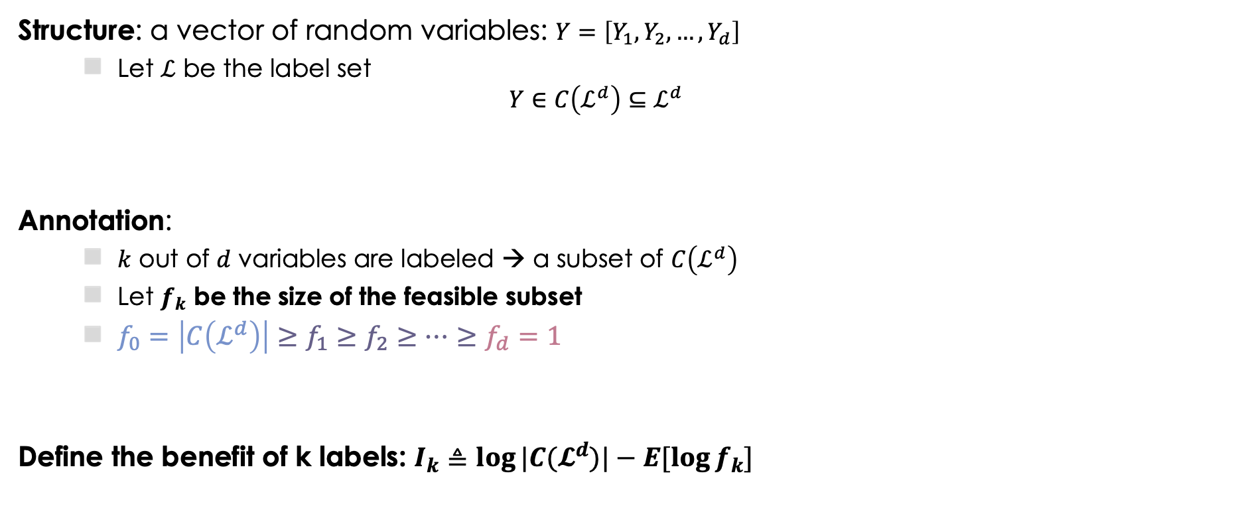
Quantifying Information: Problem Setup
Structure: a vector of random variables: $Y=\left[Y_{1},Y_{2},…,Y_{d}\right]$
Let $ℒ$ be the label set
$$Y∈C\left(ℒ^{d}\right)⊆ℒ^{d}$$
Annotation:
$k$ out of $d$ variables are labeled → a subset of $C\left(ℒ^{d}\right)$
Let $f_{k}$ be the size of the feasible subset
$f_{0}=\left|C\left(ℒ^{d}\right)\right|≥f_{1}≥f_{2}≥⋯≥f_{d}=1$
Define the benefit of k labels: $I_{k}≜\log{|C(𝓛^{d})|}−E[\log{f_{k}}]$
Not all assignments are valid
(aka “constraints”)
$f_{k}$ be the size of the feasible subset
No annotation
Complete annotation
how much of the solution space $C\left(ℒ^{d}\right)$ has been disqualified by 𝑘 labels

Slide 15

Quantifying Information: I_{k} for DAG
$$I_{k}:\text{The} \text{benefit} \text{of} \text{k} \text{labels} \text{is} \text{concave}$$
$$Δ_{k}=I_{k}−I_{k−1} \text{: }\text{The} \text{benefit} \text{of} \text{a} \text{new} \text{label} \text{is} \text{diminishing}$$

Slide 16
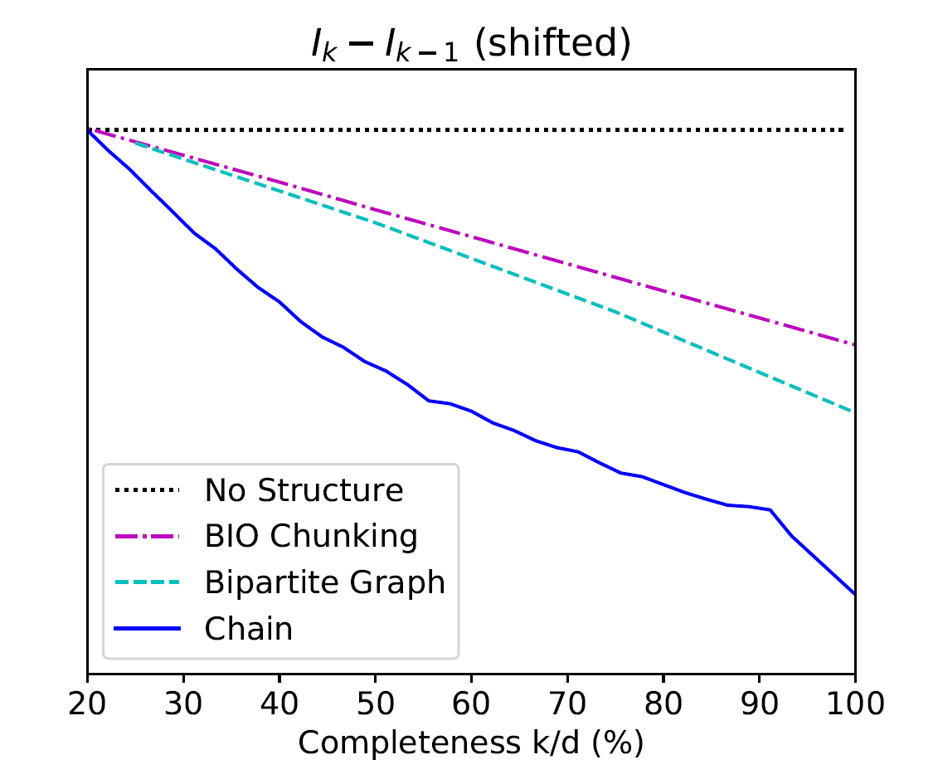
Quantifying Information: Other Types of Structures
$$Δ_{k}=I_{k}−I_{k−1} \text{: }\text{The} \text{benefit} \text{of} \text{a} \text{new} \text{label}$$
Seq Tagging
(chunking)
partial
complete
Seq Tagging
complete
partial
more concave
Bipartite Graph
(semantic role classification)
Chain
(temporal relation extraction)
partial
partial
complete
complete
complete
complete
partial
partial

Slide 17
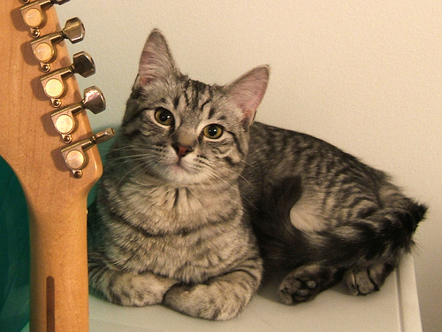
Many Examples
Temporal relation extraction
(no time loops)
Semantic role labeling
(one phrase, one label)
Image part labeling
Before
[CVPR’18]
I met with him at JFK before flying to Paris on Thursday.
🔴 FOREHEAD
PREDICATE
🔴 LEFT_EYE
Be_Included
The boy gave a frog to the girl.
NECK
🔴 TORSO
met (1)
met (2)
flying
🔴
Arg0
Arg0
Arg0
Thursday
Time
(met, Thursday) is either “before” or “included”
“frog” and “girl” cannot be “Arg0” anymore
“NECK” is in the red box instead of the blue one
Motivation: if we annotate a structure only partially, the remaining part is constrained to a smaller space; that is, some “information” of the remaining part has been explained by existing annotations.
Partial Or Complete, That’s The Question. Ning et al., NAACL19.

Slide 18
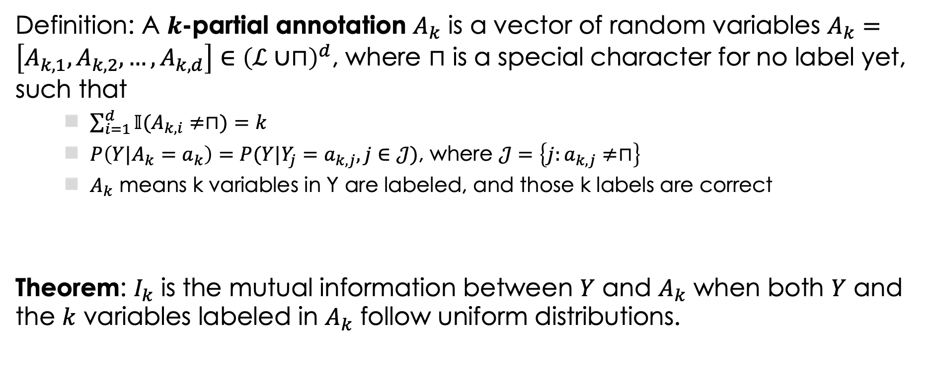
What is $I_{k}$ actually?
Definition: A $k$-partial annotation $A_{k}$ is a vector of random variables $A_{k}=\left[A_{k,1},A_{k,2},…,A_{k,d}\right]∈{\left(ℒ∪⊓\right)}^{d}$, where $⊓$ is a special character for no label yet, such that
$\sum_{i=1}^{d}{𝕀(A_{k,i}≠⊓)}=k$
$P\left(Y|A_{k}=a_{k}\right)=P(Y|Y_{j}=a_{k,j},j∈𝒥)$, where $𝒥=\left\{j:a_{k,j}≠⊓\right\}$
$A_{k}$ means k variables in Y are labeled, and those k labels are correct
Theorem: $I_{k}$ is the mutual information between $Y$ and $A_{k}$ when both $Y$ and the $k$ variables labeled in $A_{k}$ follow uniform distributions.

Slide 19
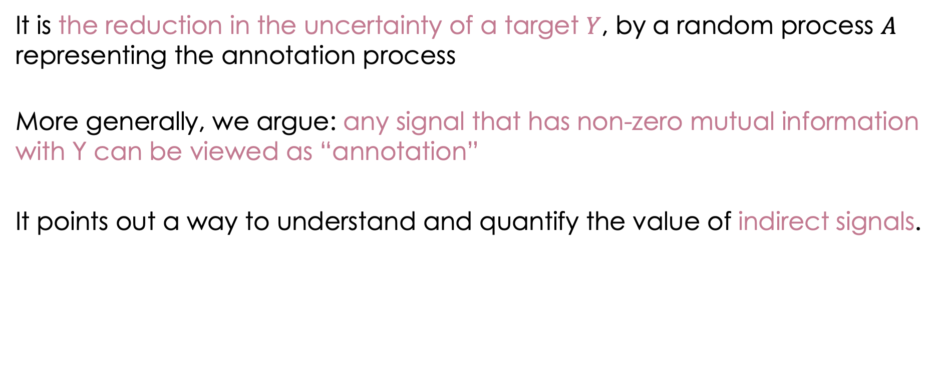
What’s annotation?
It is the reduction in the uncertainty of a target $Y$, by a random process $A$ representing the annotation process
More generally, we argue: any signal that has non-zero mutual information with Y can be viewed as “annotation”
It points out a way to understand and quantify the value of indirect signals.

Slide 20
Measuring the Benefits of Indirect Signals
Foreseeing the Benefits of Incidental Supervision. He et al., EMNLP21.

Slide 21


Indirect Supervision Signals
Can we provide a unified framework for indirect signals, and quantify the extent to which various indirect signals can help the target task?
Given the task of NER, what types of signals can we use?
Gold Annotations
Unlabeled texts
ORG
Partial Annotations
Noisy Annotations
O
I-ORG
Auxiliary Annotations
Constraints
Same labels in NER
Knowledge
Cross-lingual Annotations

Slide 22
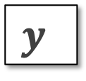

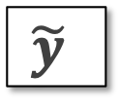
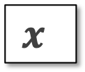

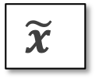
Indirect Supervision Signals
Indirect signals
Inductive indirect Signals
Partial labels, noisy labels, auxiliary labels, constraints, etc.
Transductive indirect Signals
Cross-domain signals, cross-lingual signals, cross-modal signals, etc.
Mixed indirect Signals
Partial + noisy, partial + constraints, cross-domain + noisy, etc.
Supervised Signals
Indirect Signals
Can we provide a unified framework for indirect signals, and quantify the extent to which various indirect signals can help the target task?

Slide 23
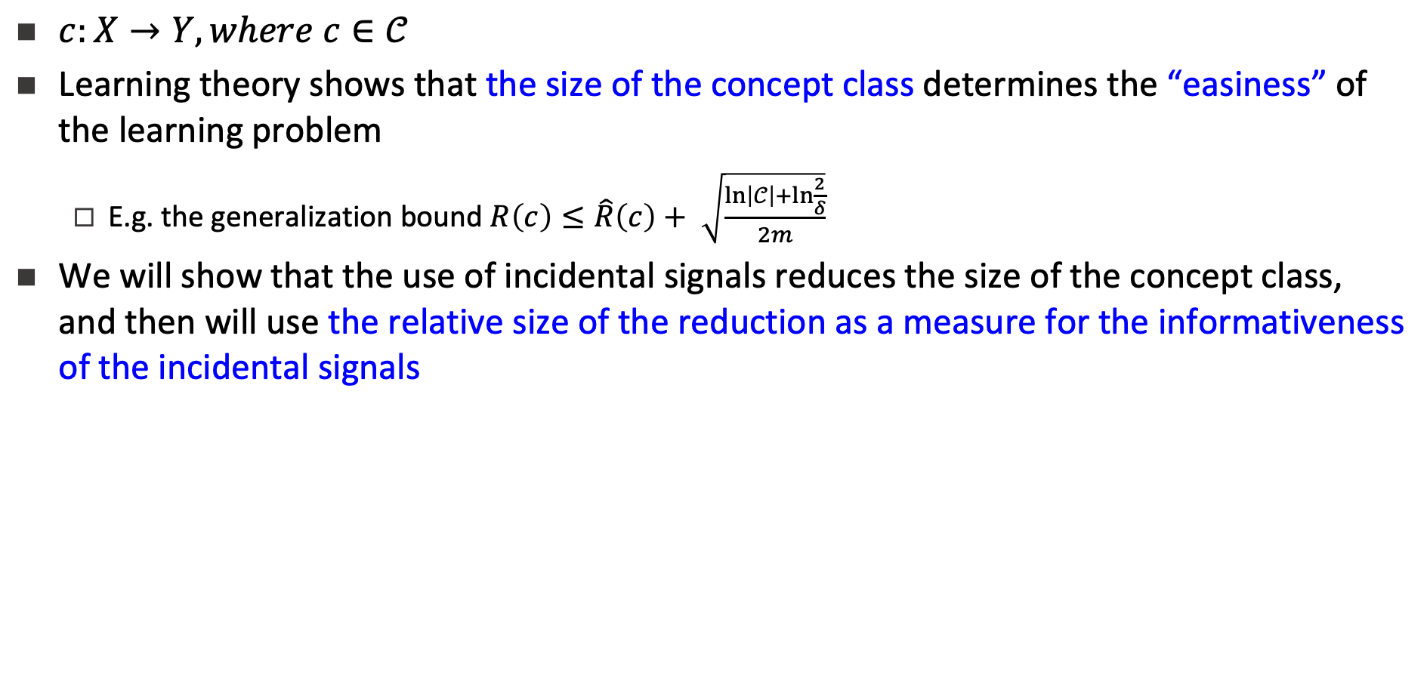
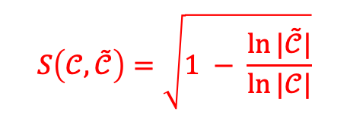


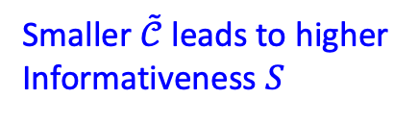

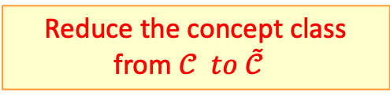

PABI: Impact of Indirect Signals
Recall: $I_{k}≜\log{|C(𝓛^{d})|}−E[\log{f_{k}}]$
Indirect Signals
Original Concept Class
Reduced Concept Class

Slide 24

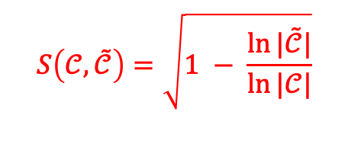



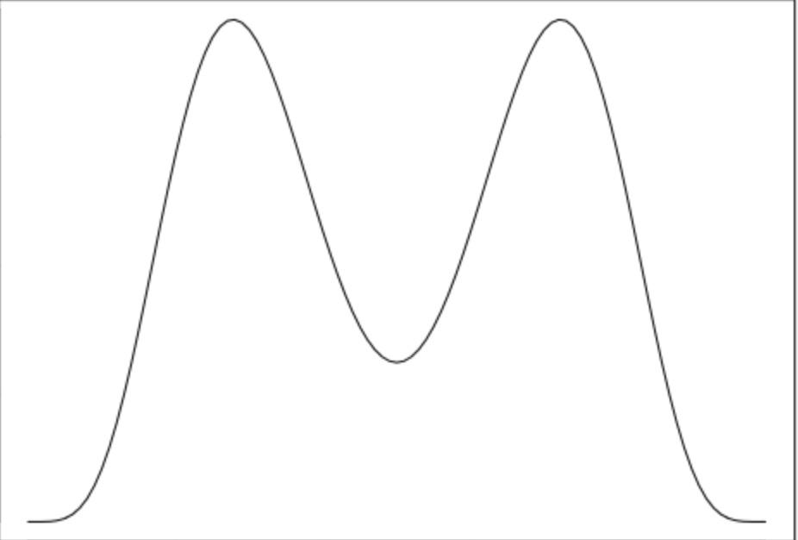
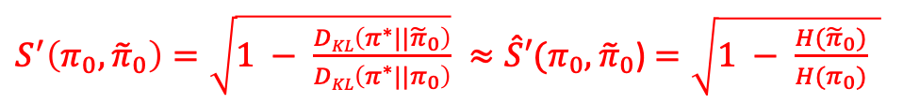

PABI: A Unified PAC-Bayesian Informativeness Measure
Indirect Signals
PAC Setting
Original Concept Class
PAC-Bayesian Setting ^{[1]}
Concept Class with Probability Measure
[1] PAC-Bayesian supervised classification: the thermodynamics of statistical learning. Catoni, 2007.
Can handle the infinite concept class case

Slide 25
Experiment
Main Task
Named entity recognition (NER)
Data
Ontonotes 5.0 (18 types of named entities)
Basic Model
Two-layer NNs with 5-gram features
Algorithm
Bootstrapping with indirect signals
Initialize the model by training it on the gold signals
An EM algorithm on the large-scale indirect signals
Improve the inference stage with indirect signals
Setting
200K word-level examples
Partial Annotations
ORG
Noisy Annotations
O
I-ORG
Constraints
What are our expectations when we add various indirect signals to small amounts of gold annotations?
Can we determine, ahead of time, the relative benefits of partial data, noisy data and constraints?

Slide 26
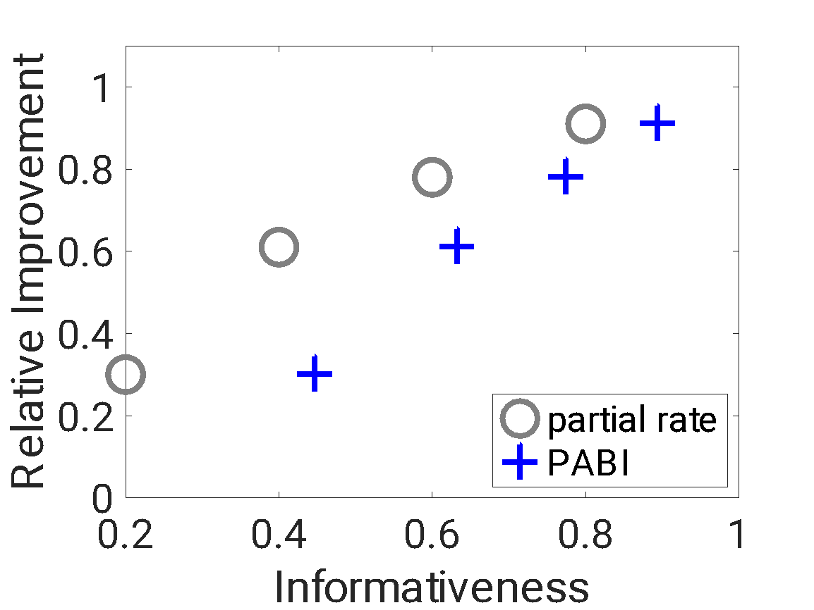
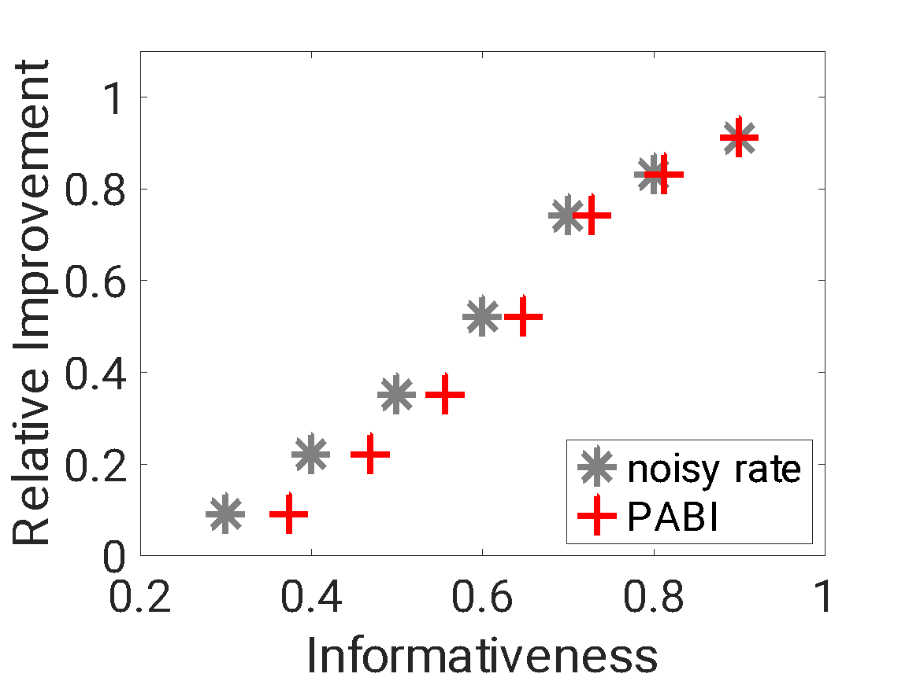
Results on NER (Ontonotes 5.0)
Partial supervision: relative improvement vs. the PABI score for partial signals with different partial rates
Noisy supervision: relative improvement vs. the PABI score for noisy signals with different noise rates
Before PABI, one might use partial annotation rate / noise rate as a proxy for the usefulness of an incidental dataset; it’s indeed a good proxy.

Slide 27
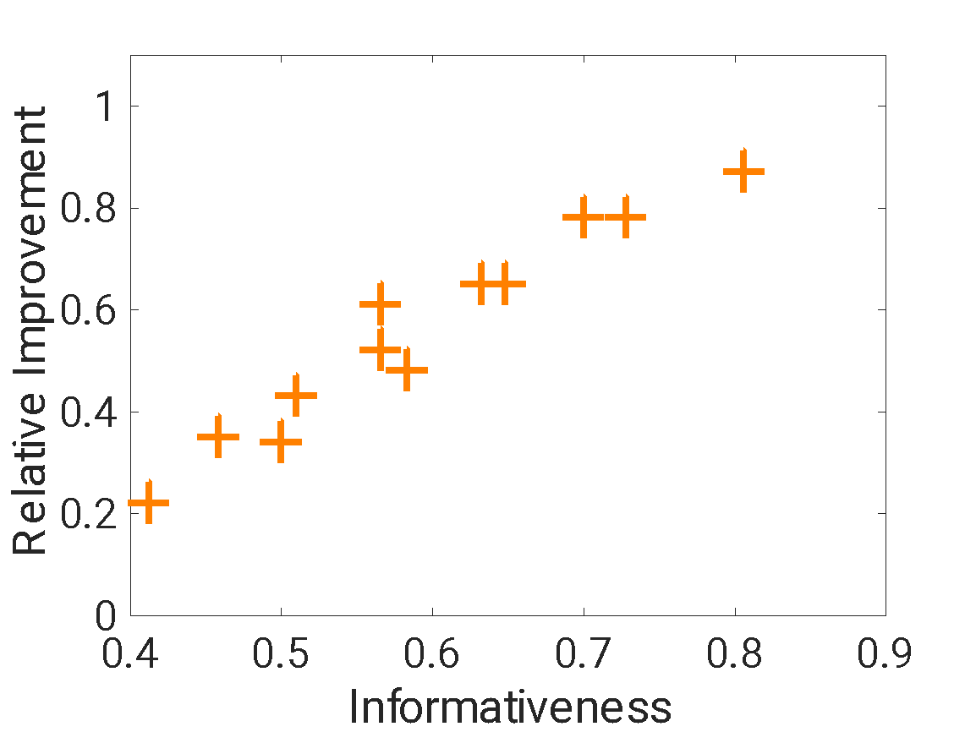
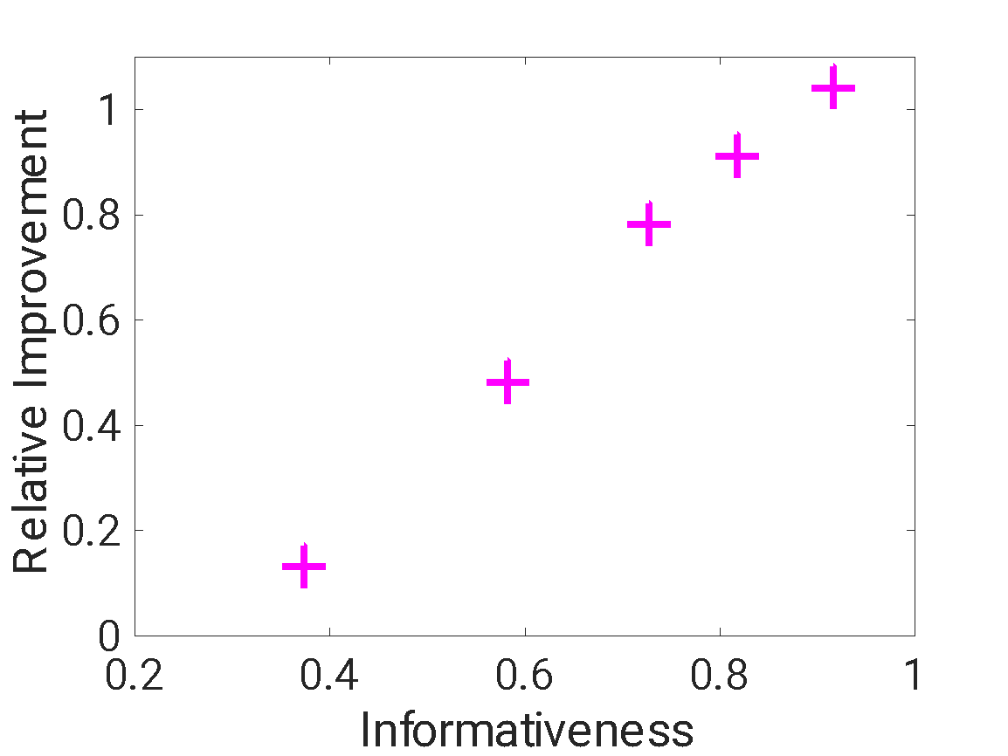
Results on NER (Ontonotes 5.0)
Partial + noisy supervision: relative improvement vs. the PABI score for data with both partial and noisy annotations
Partial + constraints supervision: relative improvement vs the PABI score for data with both partial labels and constraints
However, the (relative) benefits from the mixed signals (e.g., a dataset is both partial and noisy) cannot be determined in existing frameworks, this is where our PABI framework helps.

Slide 28
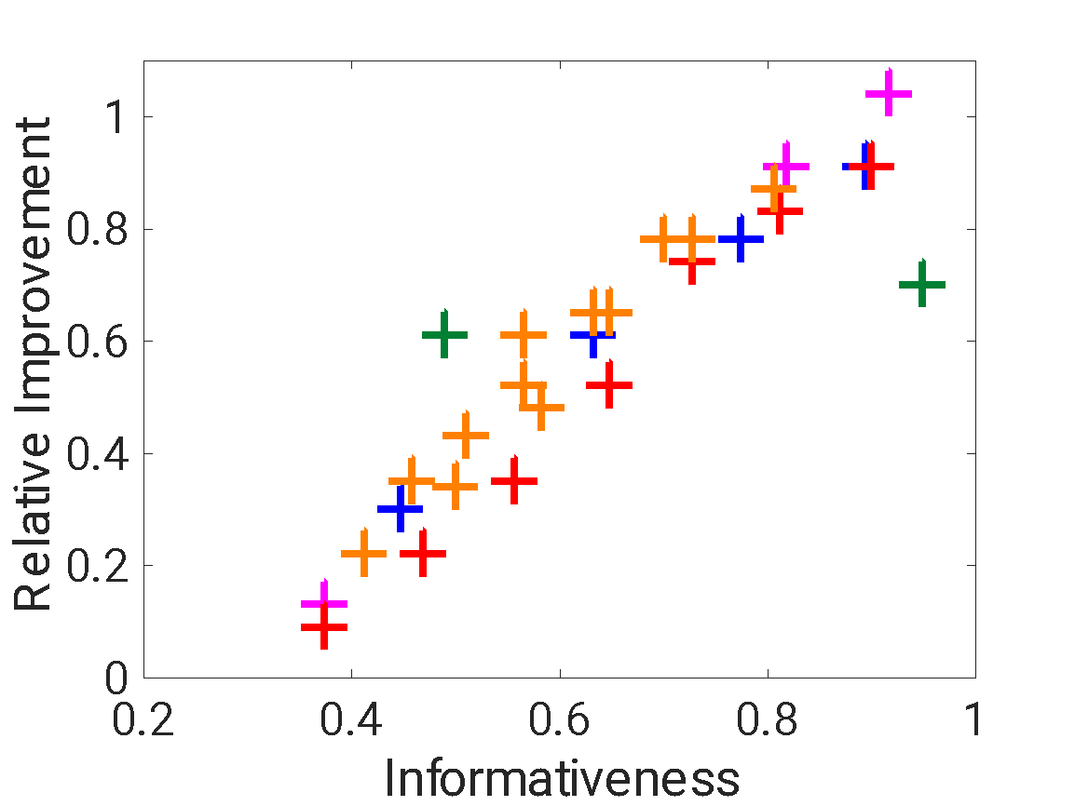
Results on NER (Ontonotes 5.0): Overlay
Take away:
The informativeness of a signal predicts the improvement provided by the signal.
Key Insight:
PABI is useful in comparison between the contribution of different types of indirect supervision signals.
The relation between the relative improvement and PABI for various indirect signals: partial labels, noisy labels, auxiliary labels, partial + noisy, and partial + constraints.
The Pearson’s correlation coefficient is: 0.92
The Spearman's rank correlation coefficient is: 0.93

Slide 29
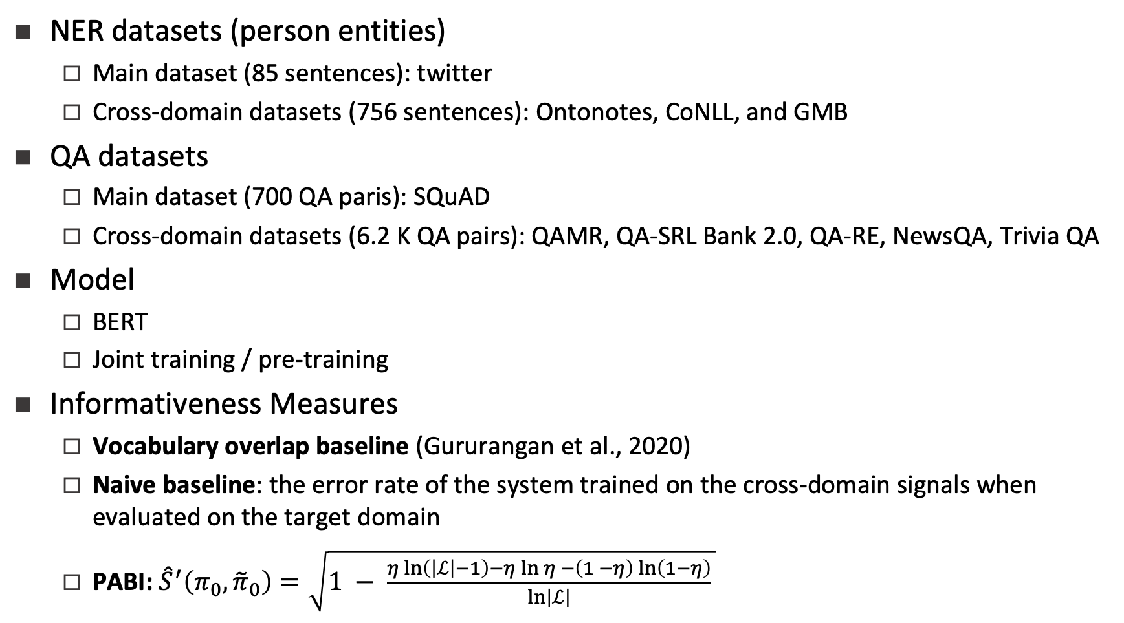
Experiments: Cross-Domain Signals

Slide 30
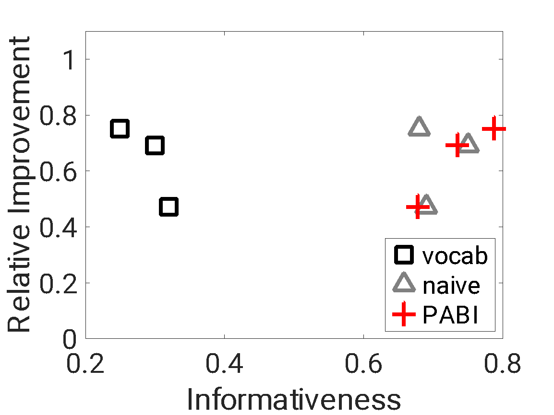
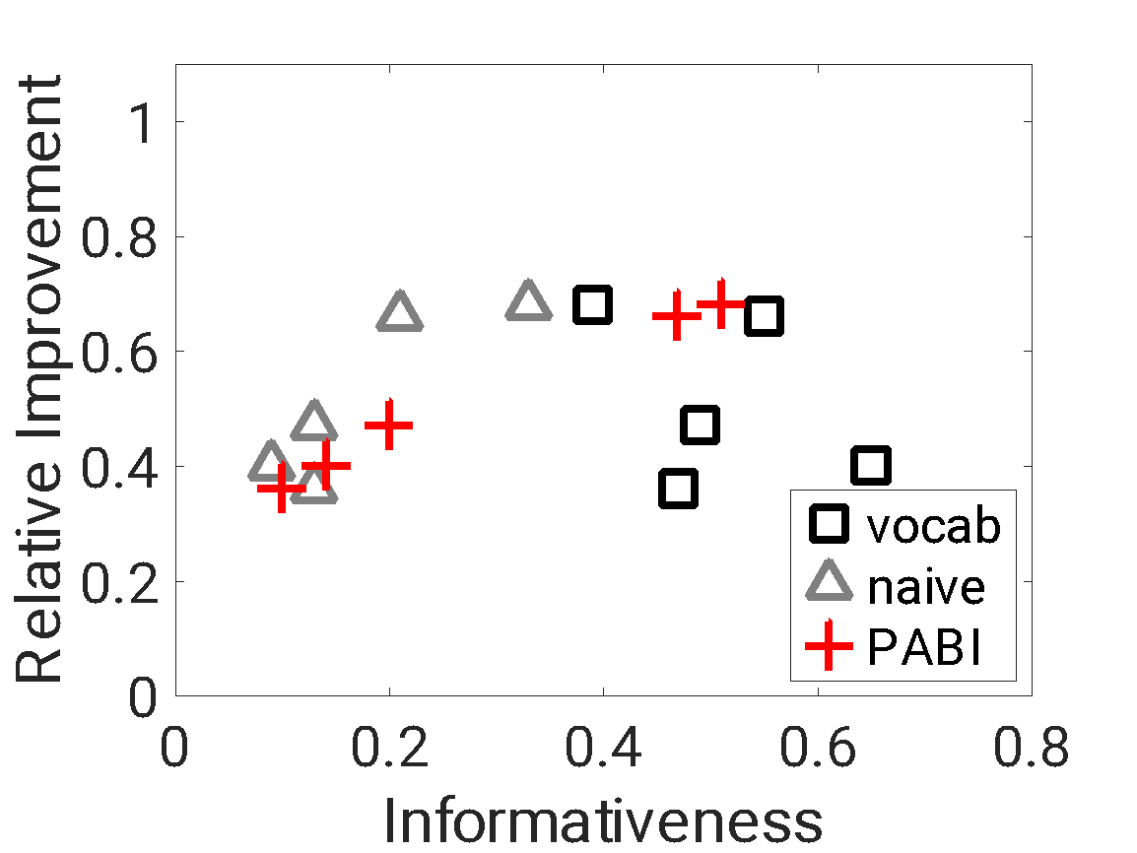
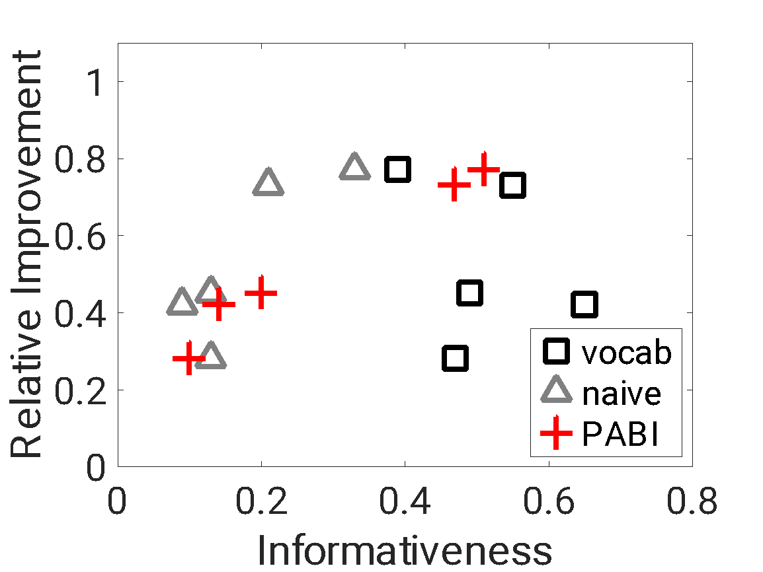
Results: Cross-Domain Signals
(a) Joint-training NER with baselines and PABI
(b) Joint-training QA with baselines and PABI
(c) Pre-training QA with baselines and PABI
Correlation between informativeness measures (baselines or PABI) and relative improvement for cross-domain NER and cross-domain QA.
The Pearson's correlation of three informativeness measures (PABI, naïve baseline, vocabulary overlap baseline) in the three cases are: 0.96/0.19/-0.85, 1.00/0.88/-0.40, 0.99/0.85/-0.30.

Slide 31
Discussions
Contributions
PABI: A unified PAC-Bayesian informativeness measure for indirect signals
Experiments on NER and QA support the effectiveness of PABI on quantifying the value of a wide range of indirect signals
Partial labels, noisy labels, constraints, auxiliary signals, cross-domain signals, and some combinations of them
Discussion of Factors in PABI
Base model performance (the size of gold signals)
The size of indirect signals
Data distribution
Algorithm
Cost-sensitive loss

Slide 32
Study of Learnability
Learnability with Indirect Supervision Signals. Wang et al., NeurIPS20.

Slide 33
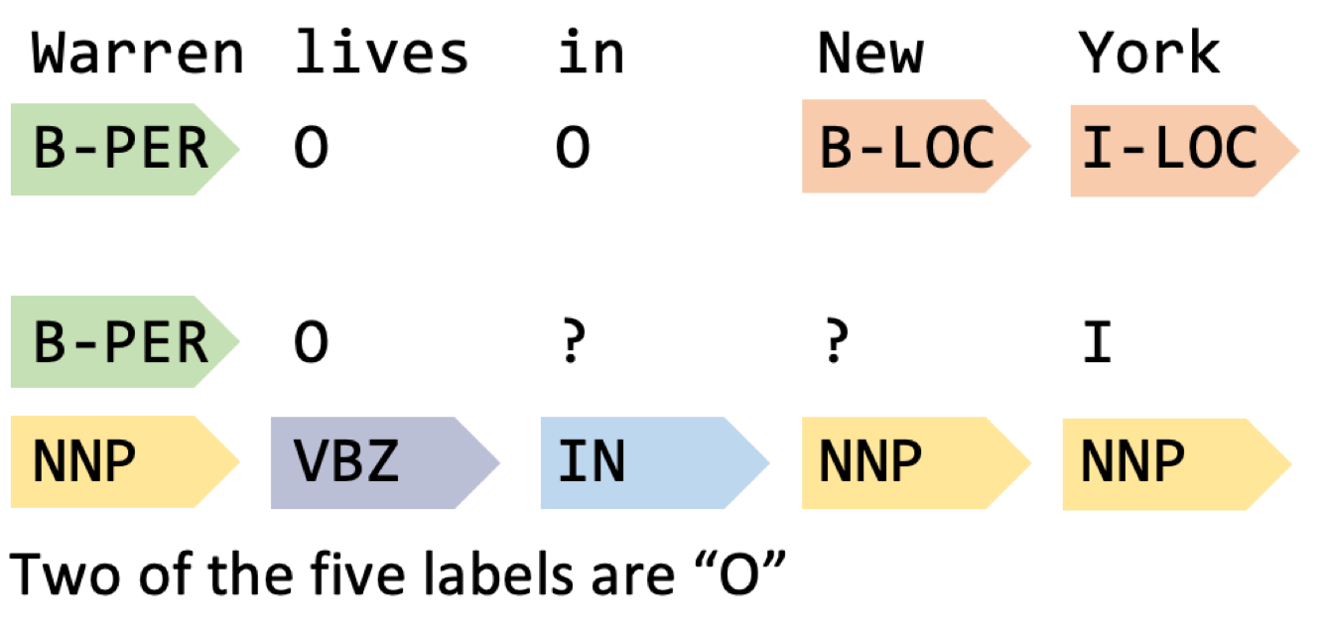
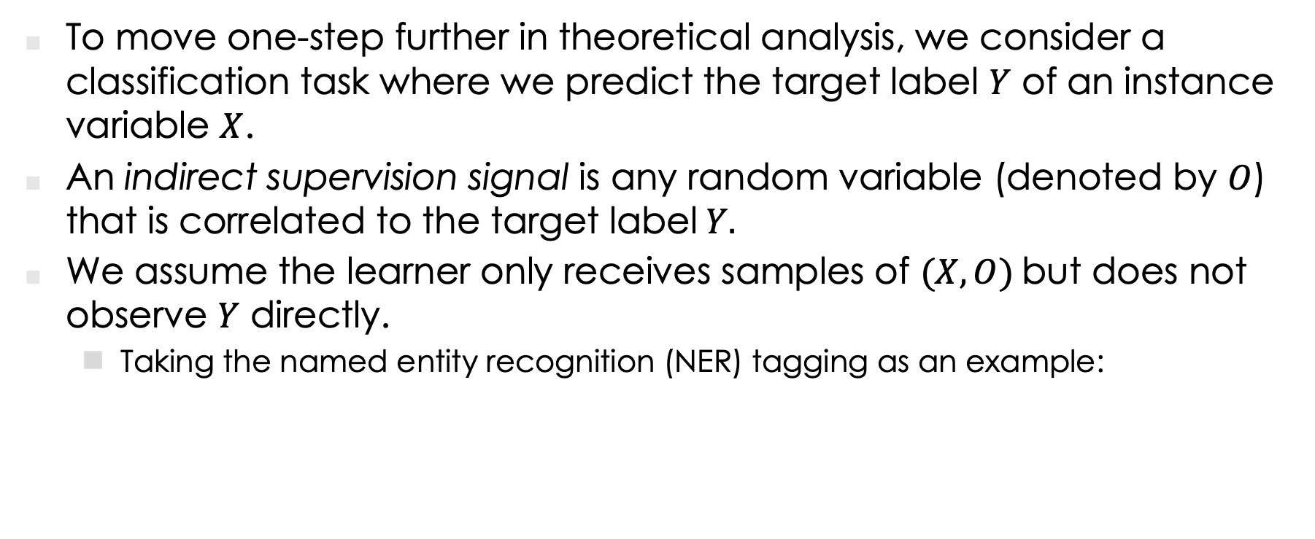
Recap
To move one-step further in theoretical analysis, we consider a classification task where we predict the target label $Y$ of an instance variable $X$.
An indirect supervision signal is any random variable (denoted by $O$) that is correlated to the target label$Y.$
We assume the learner only receives samples of $(X,O)$but does not observe $Y$ directly.
Taking the named entity recognition (NER) tagging as an example:
Instance X
Gold label Y
O₁
Indirect signals
O₂
O₃

Slide 34
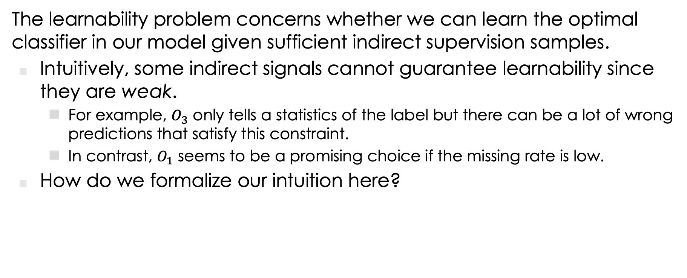
Intuition
The learnability problem concerns whether we can learn the optimal classifier in our model given sufficient indirect supervision samples.
Intuitively, some indirect signals cannot guarantee learnability since they are weak.
For example, $O_{3}$ only tells a statistics of the label but there can be a lot of wrong predictions that satisfy this constraint.
In contrast, $O_{1}$ seems to be a promising choice if the missing rate is low.
How do we formalize our intuition here?
Instance X
Gold label Y
O₁
Indirect signals
O₂
O₃

Slide 35
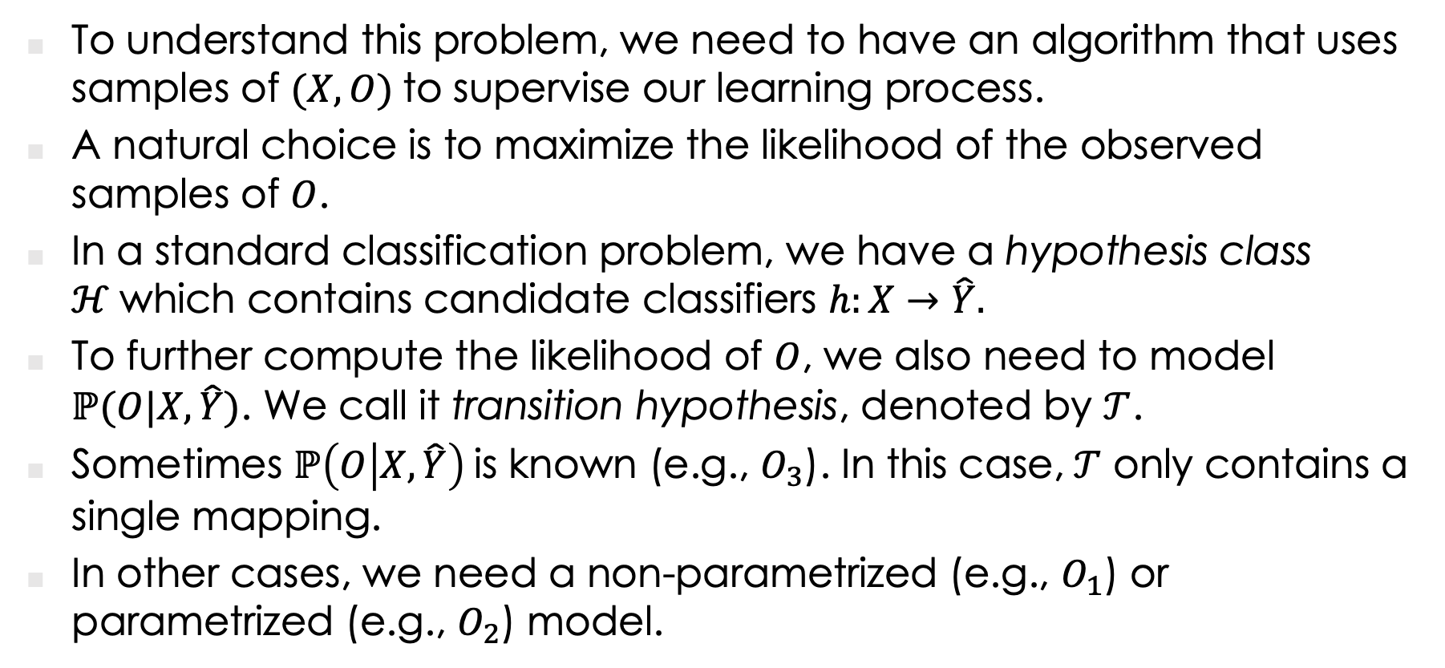
Problem Setup
To understand this problem, we need to have an algorithm that uses samples of $(X,O)$to supervise our learning process.
A natural choice is to maximize the likelihood of the observed samples of $O$.
In a standard classification problem, we have a hypothesis class $ℋ$which contains candidate classifiers $h:X→\hat{Y}.$
To further compute the likelihood of $O$, we also need to model $ℙ(O|X,\hat{Y})$. We call it transition hypothesis, denoted by $𝒯$.
Sometimes $ℙ\left(O | X,\hat{Y}\right)$is known (e.g., $O_{3}$). In this case,$𝒯$ only contains a single mapping.
In other cases, we need a non-parametrized (e.g., $O_{1}$) or parametrized (e.g., $O_{2}$) model.

Slide 36


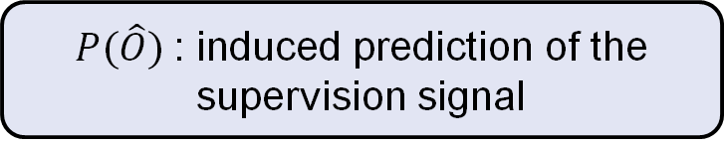

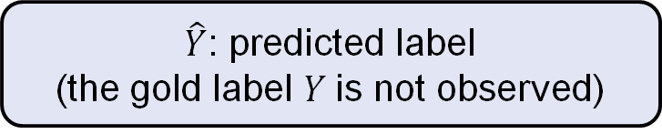

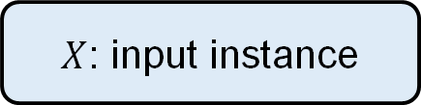
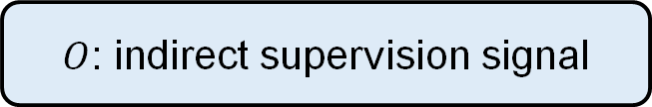
Problem Setup
The learner uses the prediction of $Y$ to induce predictions about $O.$This prediction is then evaluated by the observed dataset. The annotation loss is used to update the classifier and the transition hypothesis.
Dataset
$X$: input instance
$O$: indirect supervision signal
Classification Hypothesis $ℋ$
Update
$\hat{Y}$: predicted label
(the gold label $Y$is not observed)
Transition Hypothesis $𝒯$
Update
$P(\hat{O})$: induced prediction of the supervision signal
$ℓ_{𝒪}$: annotation loss

Slide 37
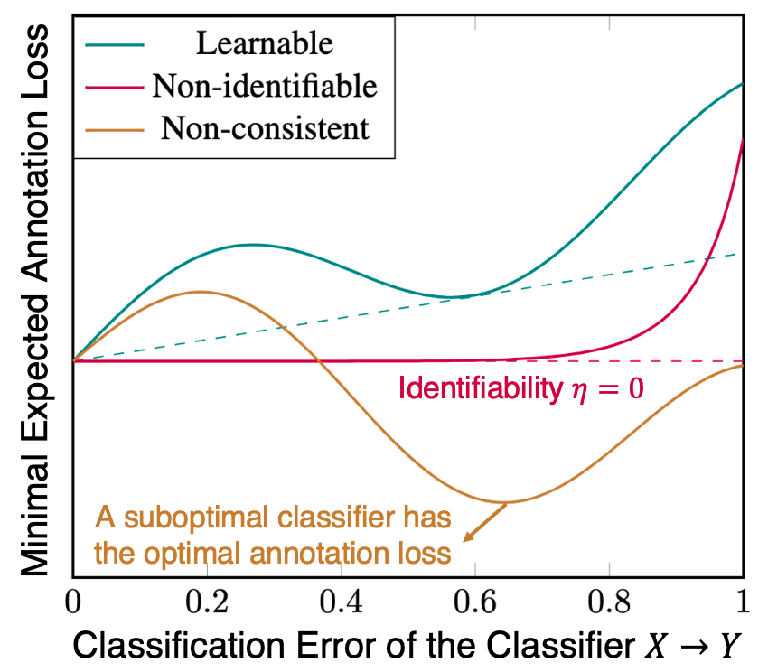

Learnability Condition: Illustration
To illustrate the learnability condition, we plot the the relationship between the classification error of a hypothesis $h$ and the minimum annotation loss (risk) it can have over choices of transition hypotheses.

Slide 38
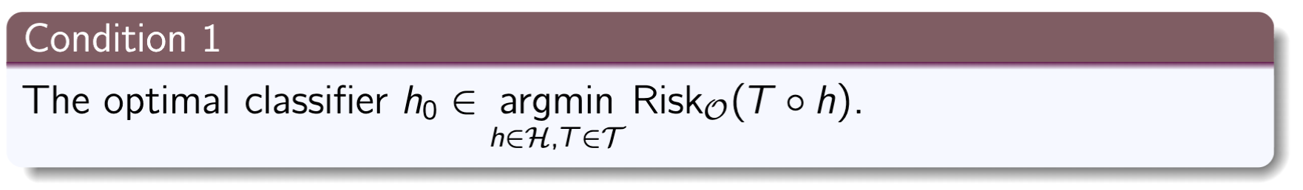
Learnability Condition 1: Consistency
The optimal classifier should be able to induce an optimal prediction of the indirect signal. Formally, we require:

Slide 39
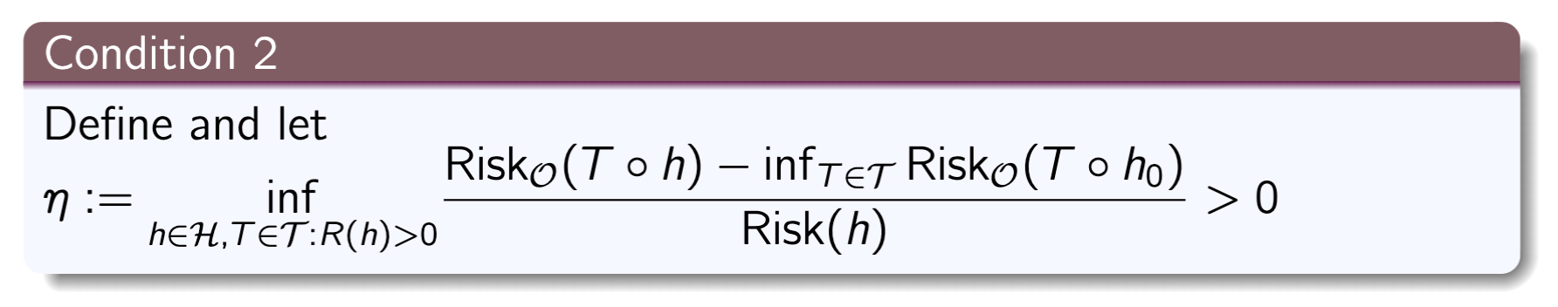
Learnability Condition 2: Identifiability
A suboptimal classifier should induce a strictly higher annotation loss than the lowest annotation loss on average. Formally, we require

Slide 40
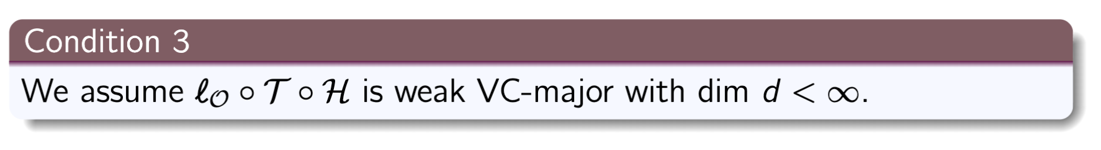
Learnability Condition 3: Complexity
The model should be “simple.” Complexity of a model can be described by (a generalized) VC-dimension. Formally, we require:

Slide 41
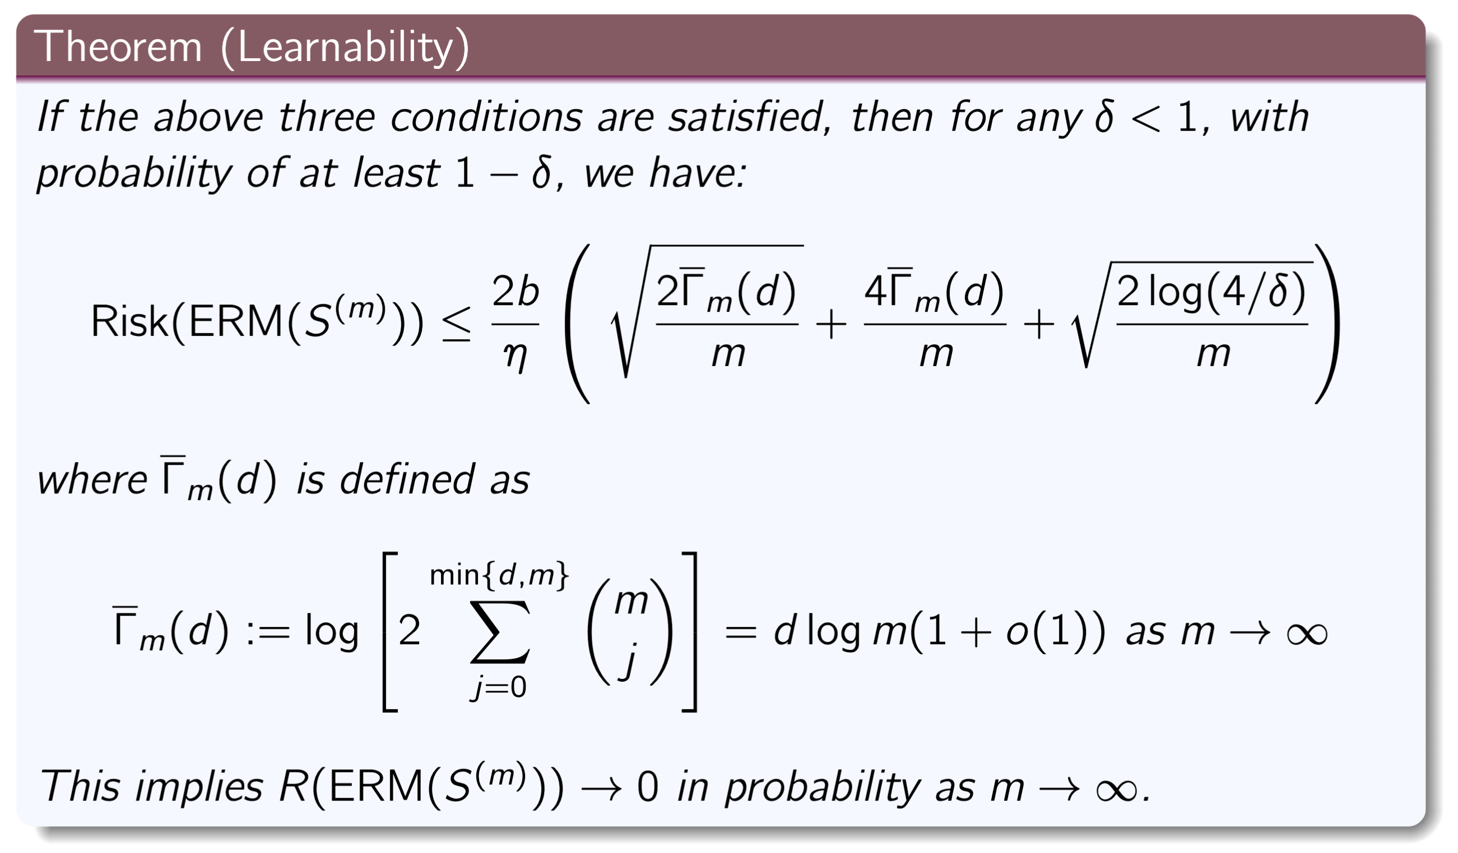
Learning Bound
Now we are able to state the main result:
In other words, we can find the optimal classifier as we have a large training set.

Slide 42
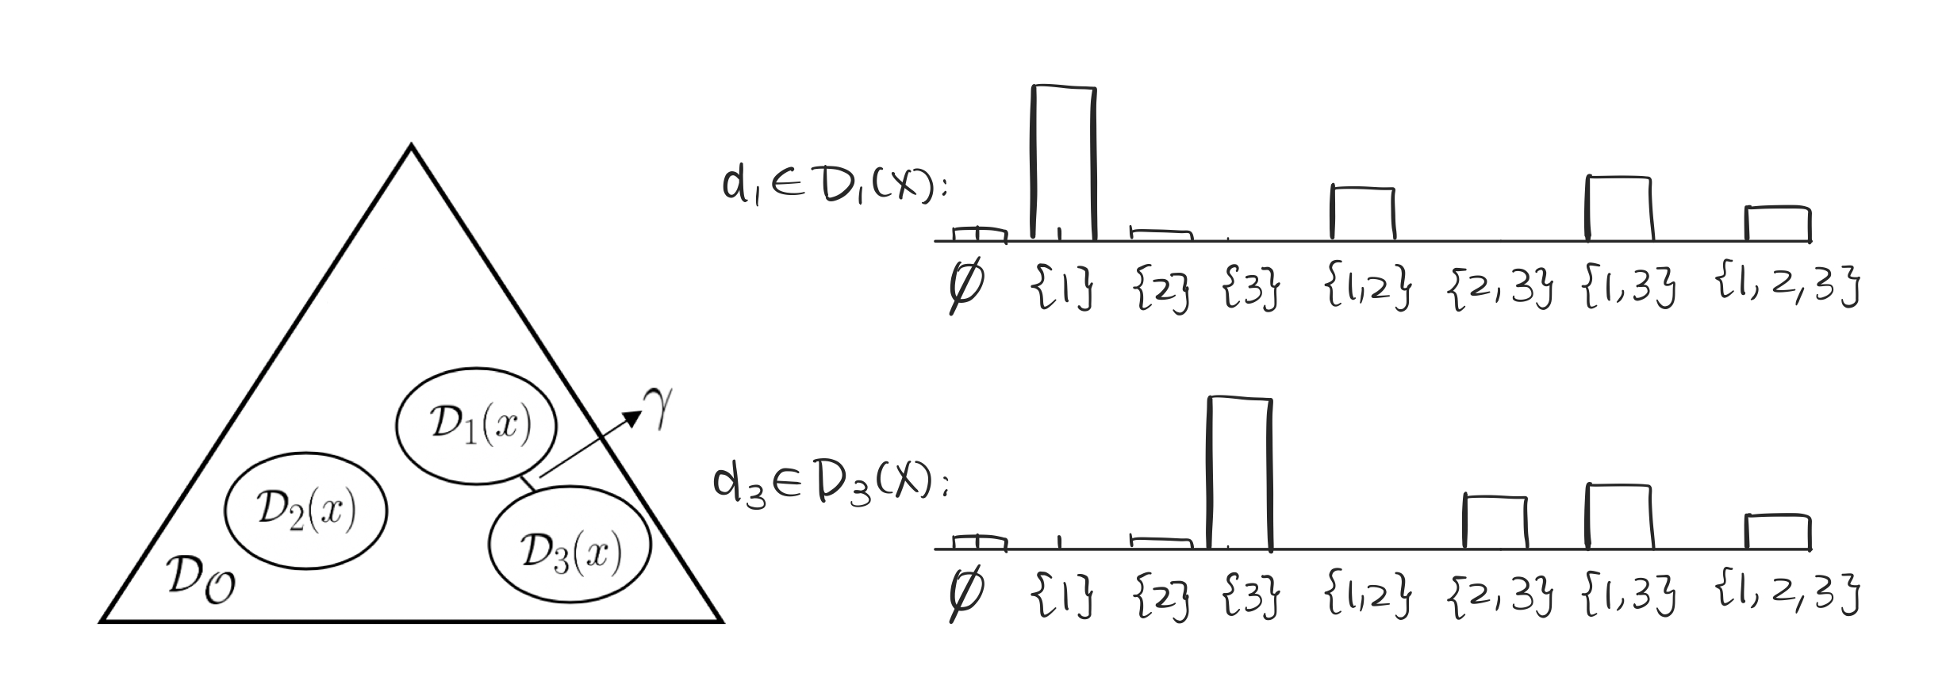
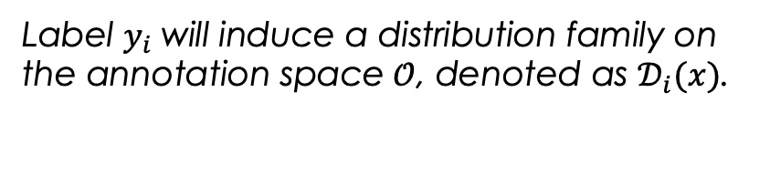
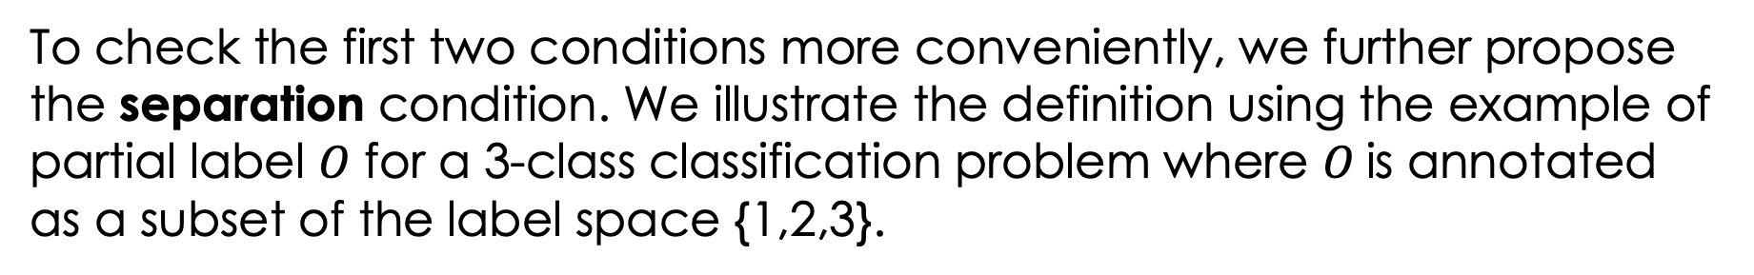
Separation
To check the first two conditions more conveniently, we further propose the separation condition. We illustrate the definition using the example of partial label $O$ for a 3-class classification problem where $O$is annotated as a subset of the label space {1,2,3}.
Label $y_{i}$will induce a distribution family on the annotation space$𝒪$, denoted as $𝒟_{i}(x)$.
Separation condition requires that different families be separated by a minimal distance $γ>0$.

Slide 43
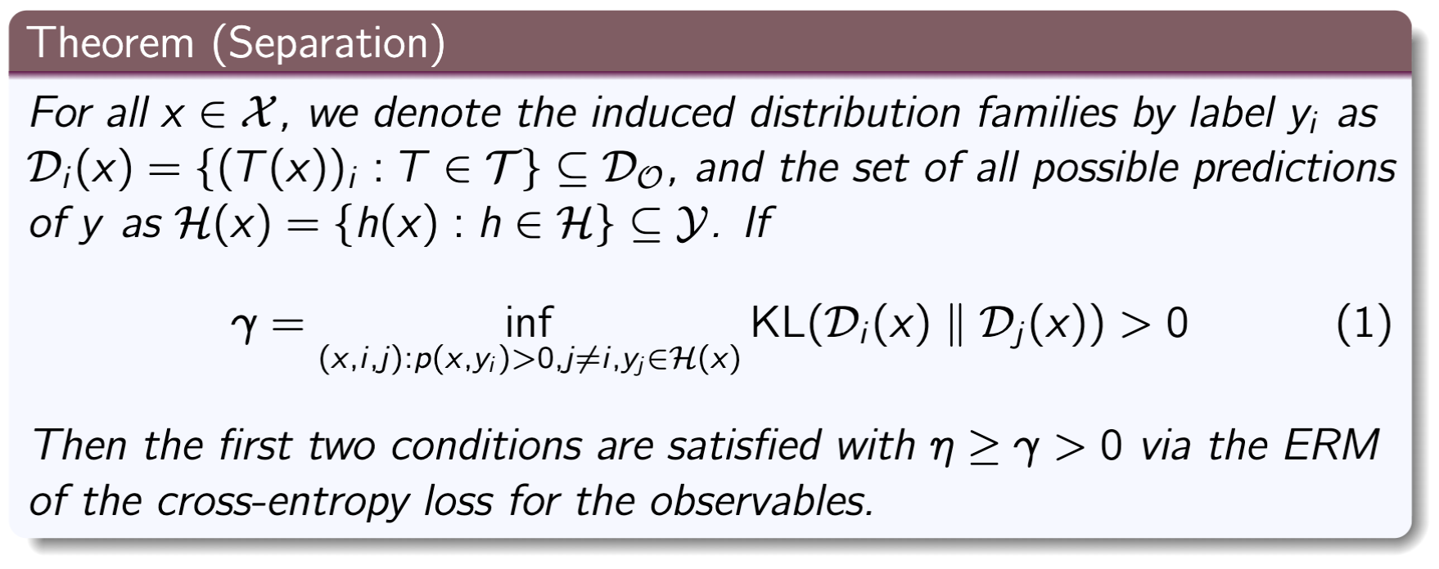
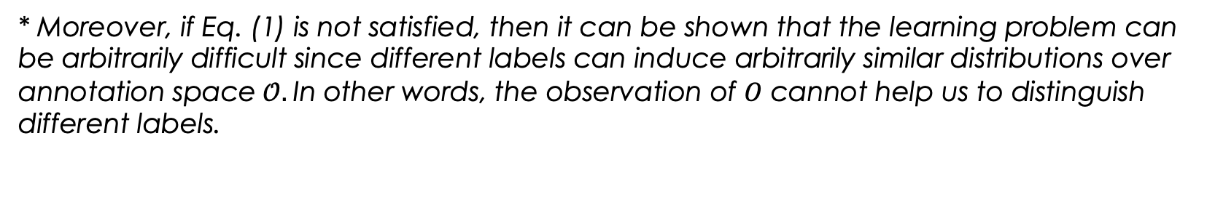
Separation: Formal Definition
* Moreover, if Eq. (1) is not satisfied, then it can be shown that the learning problem can be arbitrarily difficult since different labels can induce arbitrarily similar distributions over annotation space$𝒪.$In other words, the observation of $O$ cannot help us to distinguish different labels.

Slide 44
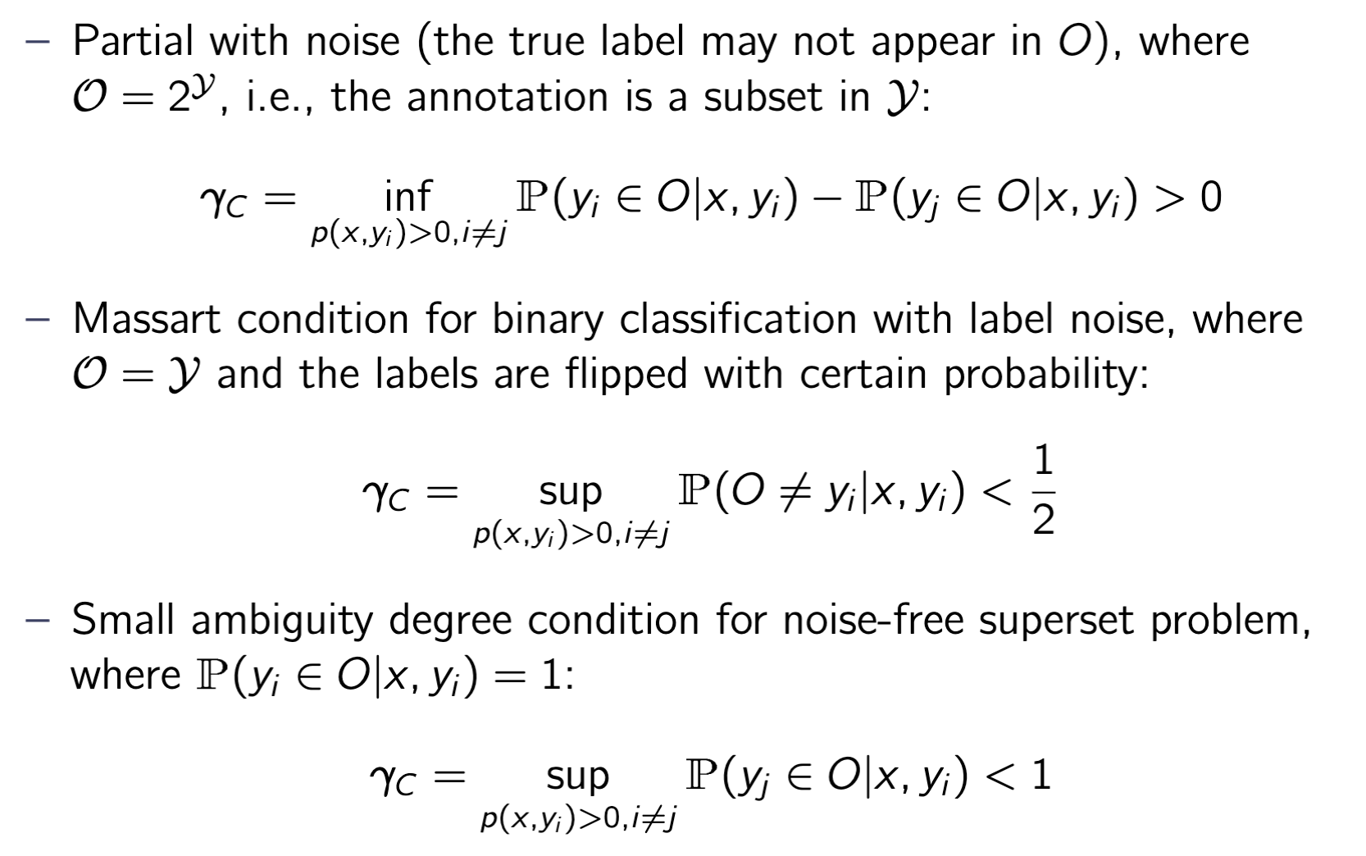
Application of the Notion of Separation
In this way, we can include many learning conditions for specific scenarios proposed in literature as special cases of separation:

Slide 45
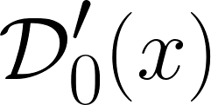







Application of Separation: Joint Supervision
If a single source of supervision signal cannot ensure learnability, it should be used jointly with other signals. We show that a joint supervision can:
Possibly preserve the pairwise separation if modeled properly. This effect is visualized in the following figure, where each signal cannot separate one pair of labels, but can be combined to ensure global separation.
+
=

Slide 46
Summary

Slide 47
Summary
We started with a toy example of DAG
Knowing part of a graph gives us information about the remaining of the graph
We used mutual information as a measure and demonstrated that partially annotating structured prediction problems led to better learning performance, because the uncertainty reduction was higher.
We continued to argue that indirect signals are those that have non-zero mutual information with the label of the target task.
This is supported in PAC and PAC-Bayesian theory because the reduction of uncertainty is actually a term in generalization bounds.
We defined PABI as a measure of usefulness of an indirect supervision dataset, and demonstrated its prediction power for actual performance gain on various NLP tasks.
We formally introduced the learnability conditions from indirect signals, and described a more convenient notion called “separation.”

Slide 48

Thank You

