Slide 1
Understanding Time In Natural Language: -- Structured Learning, Common Sense, And Data Collection
Presenter: Qiang Ning
Electrical and Computer Engineering
University of Illinois at Urbana-Champaign
Notes:
Hello everyone. My name is Qiang. I’m from ECE UIUC. I’m very happy to have this opportunity to give a job talk at AI2. My title today is understanding time in natural language. That’s also my thesis title.

Slide 2
A Bit About Myself
IEEE ISBI Best Paper Finalist
Obtained my Master’s degree in Elec. & Comp. Engr. from UIUC
Did an internship in ads ranking at Facebook; improved the overall ”ads score” by 1.1%
Topic: Signal Processing
2013
2016
2019
2015
2017
Obtained my Bachelor’s degree in Electronic Engineering from Tsinghua
Started my Ph.D. research in Prof. Dan Roth’s group
Expected to defend my Ph.D. thesis
Topic: NLP & ML
National Scholarship
YEE Fellowship
Notes:
Let’s get started with a bit information about myself. I got my bachelor’s degree in EE from Tsinghua University in 2013. In 2015, I got my master’s degree from ECE UIUC; my research then was on signal processing. Later I made a big decision to switch my direction to NLP & ML, and that led me to Prof. Dan Roth’s group in 2016. In 2017, I did an internship at FB, where I improved their overall ads revenue by roughly 1 point. Now I have passed my prelim exam and I’m expected to defend my thesis later this year. Here’re some highlights in each of my stage. As an undergrad, I won the National Scholarship of China (that’s a very high honor). At UIUC, I was on the finalist of IEEE ISBI and also awarded the YEE Fellowship.

Slide 3




Publications
Topic: Signal Processing
Topic: NLP & ML
IEEE SPL’13
IEEE EMBC’14
ISMRM14
IEEE ISBI’15
ISMRM’15
ISMRM’16 x 3
MRM’17
IEEE TBME’17
EMNLP17
NAACL’18
*SEM’18
LREC’18
ACL’18 x 2
EMNLP’18
NAACL’19 x 3*
TACL’19*
ISIT’19*
* under submission
Icon credits to The Noun Project
Notes:
Here’s a list of the venues of my publications. I think my experience in signal processing built a solid background for me in math, linear algebra, and statistics (especially statistical estimation); and most importantly, my way of doing research. In 2016, I started working on NLP. I’m very interested in this area, and as shown here, I’m progressing very well. Of course, I also hope I can continue this momentum at AI2.

Slide 4
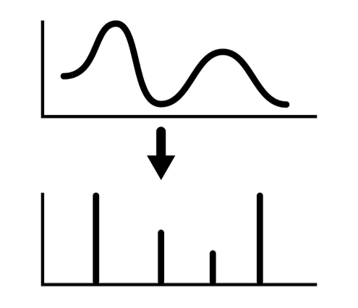
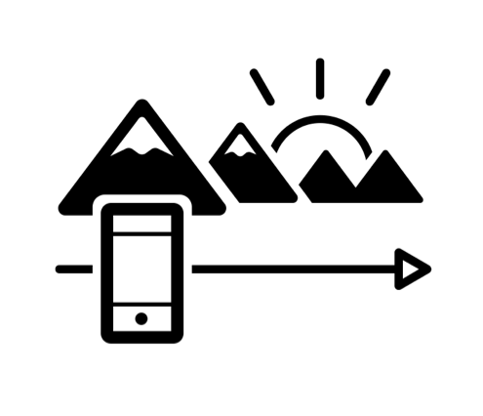




Research Expertise
Vector Spaces
Banach
Hilbert
Icon credits to The Noun Project

Slide 5
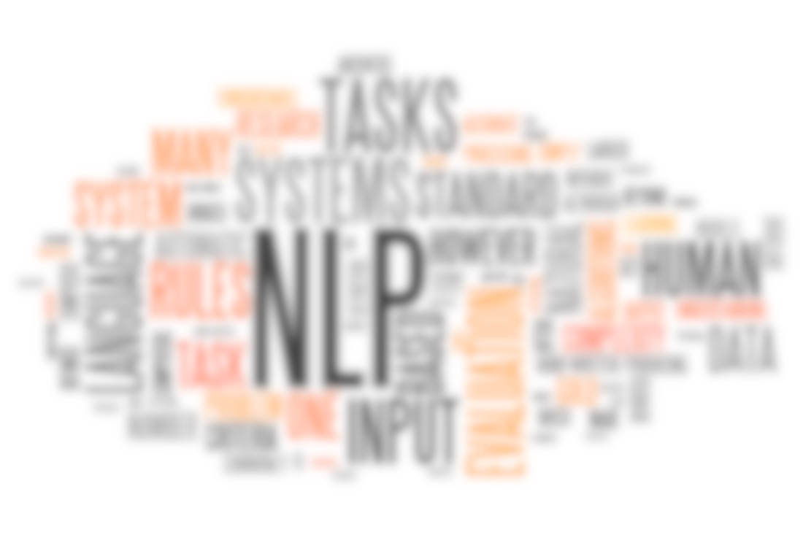
Ph.D. Thesis Research
Understanding time in natural language
Notes:
show the demo here. Everyday, we are using natural language, to describe what’s going on in our life, either in newspapers, or in social networks. Many things in our life are not static; instead, they’re evolving. For example, where one lives, which company one works for, or a conflict between countries. It is thus important to know when something happened for us to understand it.

Slide 6
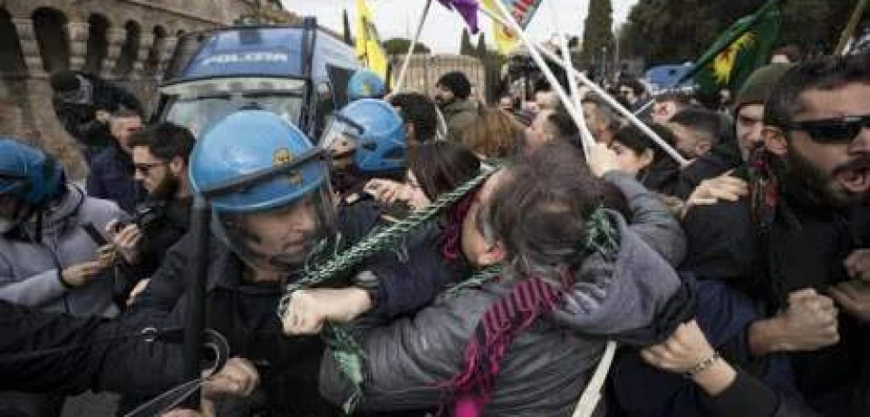
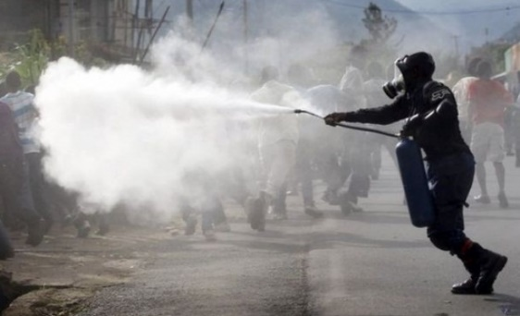
Understanding time in natural language
People were angry
Police used tear gas.
Time
People were angry (and ended in violent conflicts with the police)…The police finally used tear gas (to restore order).
Notes:
For example here we’re presented with two events, people were angry and police used tear gas.

Slide 7
Temporal Information Is Crucial
Police used tear gas.
People were angry
Time
The police used tear gas…People were angry at it.
Notes:
If we simply reverse the order of these events, the second story says that police used tear gas and then people were angry at it.

Slide 8
Temporal Relation (TempRel)
BEFORE
BE_INCLUDED
I met with him before leaving for Paris on Thursday.
My talk today mainly focuses on temporal relation (TempRel) extraction given events.
(Other temporal relations: AFTER, INCLUDES, and EQUAL)
Notes:
What do we mean by temporal relations? Here we know met is before leaving, and leaving was included in Thursday. Other temporal relations studied here are after, includes, and equal.

Slide 9
Temporal Relations Among Multiple Events
“Temporal Graph”
In Los Angeles that lesson was brought home today when tons of earth cascaded down a hillside, ripping two houses from their foundations. No one was hurt, but firefighters ordered the evacuation of nearby homes and said they'll monitor the shifting ground until March 23rd.
In other words, we want to label those edges in temporal graphs.
ripping
monitor
This task is difficult:
Temporal relation extraction | Literature F1 (%)
w/ gold events | low 50’s
w/o gold events | low 30’s
hurt
cascaded
ordered
BEFORE
BE_INCLUDED
Notes:
If we are given many events like this. (read the snippet). If we draw all the temprels, it would form a graph, which we call a temporal graph.

Slide 10
Temporal relation extraction | Literature F1 (%)
w/ gold events | low 50’s
w/o gold events | low 30’s
My F1 (%)
70’s
50’s
Challenges
How to Handle These Challenges
Interrelated events
Structured learning
[Transitivity] If A<B and B<C, then A<C
Temporal graphs are structured!
Lack of prior knowledge
Common sense
Temporal relations heavily rely on human’s prior knowledge
[Example] “More than 10 people have (VBN), police said. A car (VBD) on Friday in a group of men.”
Data collection
Insufficient data
[Labor intensive] #edges is quadratic in terms of #nodes
[Difficulty] Not only before/includes, but also involves whether a relation exists
The short way to describe my work over the last 2 years is that I improved the previous SOTA F1 by 20%.

Slide 11
Understanding time in natural language
Structured learning
A Structured Learning Approach to Temporal Relation Extraction (EMNLP’17)
Exploiting Partially Annotated Data in Temporal Relation Extraction (*SEM’18)
Partial or Complete, That’s The Question (submitted to NAACL’19)
An End-to-end Temporal Relation Extractor (submitted to NAACL’19)
Common sense
Improving Temporal Relation Extraction with a Globally Acquired Statistical Resource (NAACL’18)
Joint Reasoning for Temporal and Causal Relations (ACL’18)
A Question Answering Benchmark for Temporal Common-sense (submitted to NAACL’19)
KnowSemLM: A Knowledge Infused Semantic Language Model (submitted to TACL)
Data collection
A Multi-Axis Annotation Scheme for Event Temporal Relations (ACL’18)
Online demo
CogCompTime: A Tool for Understanding Time in Natural Language Text (EMNLP’18)
Notes:
For structured learning and common sense, there’re ongoing works in partial and temporal common sense, which I will briefly discuss as preliminary results for my future research.

Slide 12
Ph.D. Thesis Research
Part I
Structured learning
A Structured Learning Approach to Temporal Relation Extraction (EMNLP’17)

Slide 13
Temporal Graphs Are Structured
Due to transitivity, TempRels are highly interrelated
Existing methods have already considered the interrelation in inference, but not in learning.
ripping
monitor
ripping
monitor
ripping
ripping
monitor
monitor
monitor
hurt
hurt
hurt
ordered
ordered
cascaded
ordered
cascaded
cascaded
cascaded
cascaded
BEFORE
INCLUDED
Notes:
Why is this bad?

Slide 14
Temporal Graphs Are Structured
Due to transitivity, TempRels are highly interrelated
Existing methods have already considered the interrelation in inference, but not in learning.
Training Data
ripping
cascaded
ripping
hurt
cascaded
hurt
Local Learning
ordered
monitor
Learning Paradigm
cascaded
ordered
ripping
monitor
ripping
ordered
cascaded
monitor
hurt
monitor
BEFORE
INCLUDED

Slide 15
Is Not Sufficient
Local Learning
Information from other events is often necessary in the learning phase.
…ripping two houses…firefighters ordered the evacuation of nearby homes…
Q: (ripping, ordered)=? (A: by annotation, it’s BEFORE)
So, training on this instance using local information leads to overfitting
(ripping, cascaded)=INCLUDED and (cascaded, ordered)=BEFORE ➔ (ripping, ordered)=BEFORE
tons of earth cascaded down a hillside,
ripping
ordered
cascaded
ordered
?
ordered
ripping
ripping

Slide 16

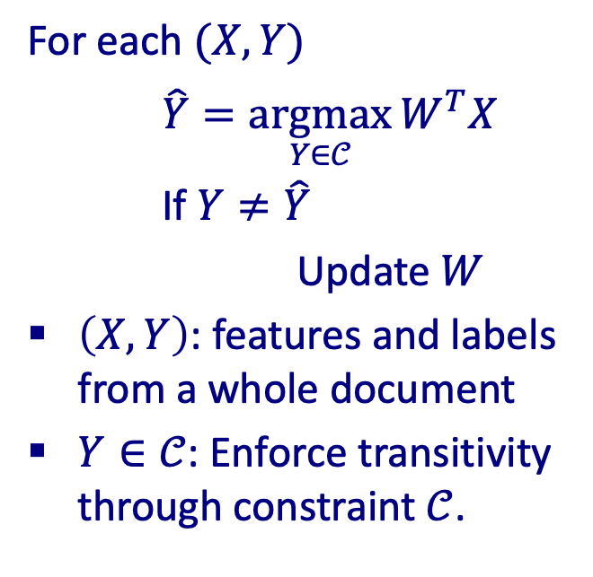
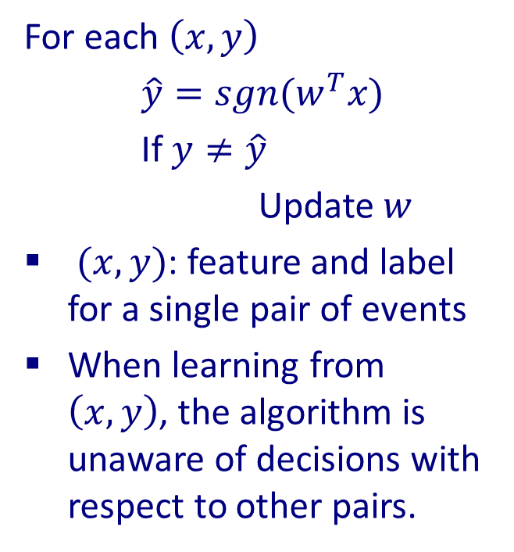
Global/Structured Learning (e.g., Perceptron)
Local Learning
Global Learning
For each $\left(x,y\right)$
$\hat{y}=sgn(w^{T}x)$
If $y≠\hat{y}$
Update $w$
$(x,y)$: feature and label for a single pair of events
When learning from $\left(x,y\right)$, the algorithm is unaware of decisions with respect to other pairs.
For each $(X,Y)$
$\hat{Y}=\underset{Y∈𝒞}{argmax}{W^{T}X}$
If $Y≠\hat{Y}$
Update $W$
$\left(X,Y\right)$: features and labels from a whole document
$Y∈𝒞$: Enforce transitivity through constraint $𝒞$.
$$\hat{Y}=\underset{Y∈𝒞}{argmax}{W^{T}X}$$
Notes:
This comes to the comparison of local learning and global learning.

Slide 17
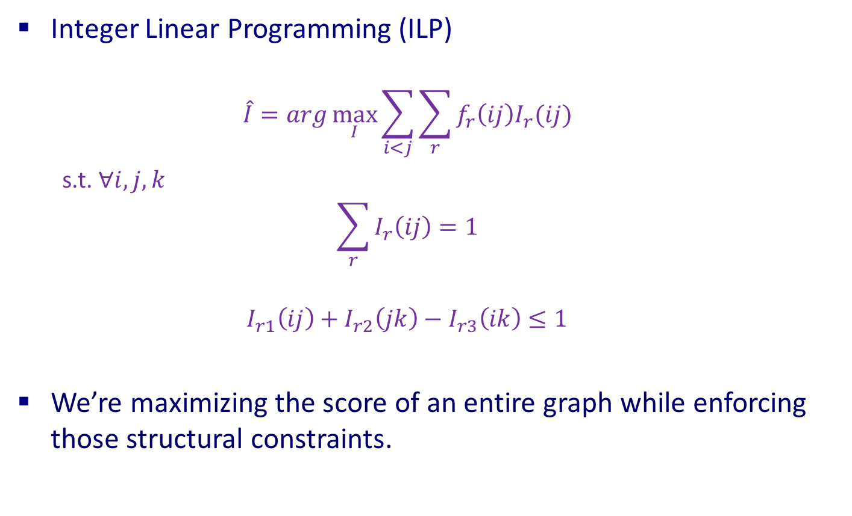
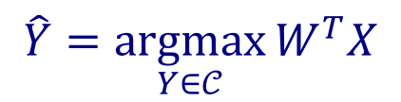
Solving The Inference Step In Global Learning
$$\hat{Y}=\underset{Y∈𝒞}{argmax}{W^{T}X}$$
Integer Linear Programming (ILP)
$$\hat{I}=arg\max_{I}{\sum_{i<j}{\sum_{r}{f_{r}\left(ij\right)I_{r}(ij)}}}$$
s.t. $∀i,j,k$
$$\sum_{r}{I_{r}\left(ij\right)}=1$$
$$I_{r1}\left(ij\right)+I_{r2}\left(jk\right)−I_{r3}\left(ik\right)≤1$$
We’re maximizing the score of an entire graph while enforcing those structural constraints.
softmax: P{(i,j)=r}
boolean var: (i,j)=r
Uniqueness
Transitivity

Slide 18
Results
+Global/structured learning
+Global inference
[UTTime] Laokulrat et al. *SEM’13. UTTime: Temporal relation classiﬁcation using deep syntactic features.
Notes:
Comment on issues that I don’t have time to expand (the missing annotation issue).

Slide 19
Understanding time in natural language
Structured learning
A Structured Learning Approach to Temporal Relation Extraction (EMNLP’17)
Exploiting Partially Annotated Data in Temporal Relation Extraction (*SEM’18)
Partial or Complete, That’s The Question (submitted to NAACL’19)
An End-to-end Temporal Relation Extractor (submitted to NAACL’19)
Common sense
Improving Temporal Relation Extraction with a Globally Acquired Statistical Resource (NAACL’18)
Joint Reasoning for Temporal and Causal Relations (ACL’18)
A Question Answering Benchmark for Temporal Common-sense (submitted to NAACL’19)
KnowSemLM: A Knowledge Infused Semantic Language Model (submitted to TACL)
Data collection
A Multi-Axis Annotation Scheme for Event Temporal Relations (ACL’18)
Online demo
CogCompTime: A Tool for Understanding Time in Natural Language Text (EMNLP’18)

Slide 20
Ph.D. Thesis Research
Part II
Common sense
Improving Temporal Relation Extraction with a Globally Acquired Statistical Resource (NAACL’18)

Slide 21
When Event Content Is Missing
More than 10 people have (event1: died), police said. A car (event2: exploded) on Friday in a group of men.
Question: (e1,e2)=BEFORE or AFTER?
This turns out to be difficult because we cannot use our understanding of those verbs.
Notes:
This was motivated by the fact that when the event content is missing, the problem is very difficult even for humans.

Slide 22
When Event Content Is Present
More than 10 people have (event1: died), police said. A car (event2: exploded) on Friday in a group of men.
Question: (e1,e2)=BEFORE or AFTER?
This turns out to be easy because humans have an “intuition” of which event “usually” happens before another.
We would like to include this prior information.

Slide 23
TemProb: Temporal Relation Probabilistic Knowledge Base
How do we get this prior knowledge?
New York Times 1987-2007, #Articles~1M
Run a TempRel extractor on top of it (via AWS)
What about simply counting (i.e., bigram language modeling)?
Example pairs |  | Time Before (%) | Time After (%)
Text Before | Text After
Ask | Help | 86 | 9
Attend | Schedule | 1 | 82
Accept | Propose | 10 | 77
Die | Explode | 14 | 83

Slide 24
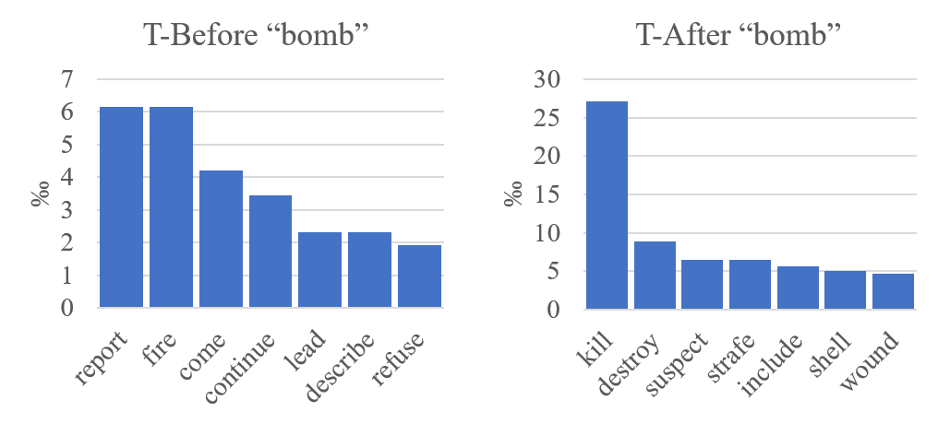
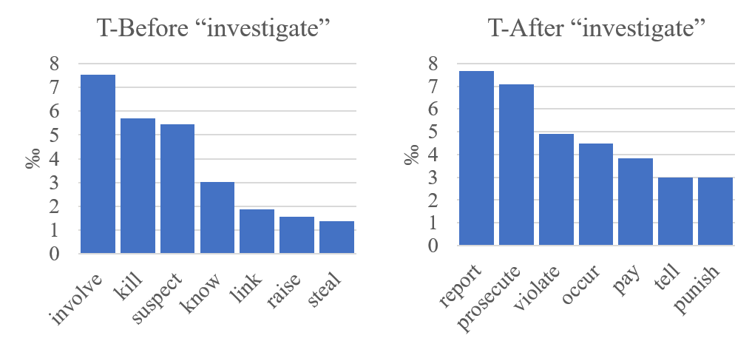
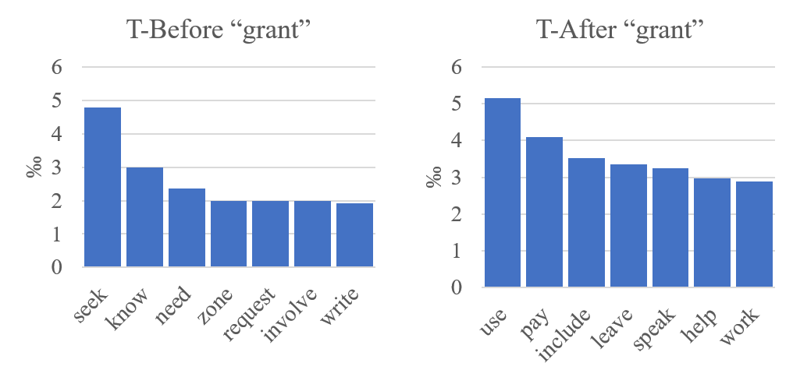
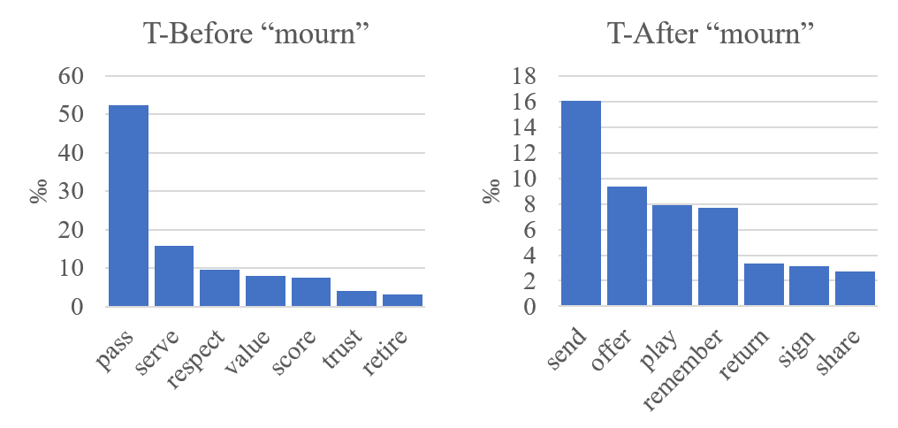
TemProb: Event distributions

Slide 25

Injection Of This Prior Knowledge: Learning
Let $C(v_{i},v_{j},r)$ be the number of appearances of $\left(v_{i},v_{j}\right)$ in TemProb that are classified to be relation $r$.
For each pair of verb events,
$$h_{r}\left(v_{i},v_{j}\right)=\frac{C\left(v_{i},v_{j},r\right)}{\sum_{r^{′}}{C(v_{i},v_{j},r^{′})}}$$
is the prior probability of them being relation $r$.
We can add this as an additional feature and retrain our system.
Example pairs |  | Before (%) | After (%)
Ask | Help | 86 | 9
Attend | Schedule | 1 | 82
Accept | Propose | 10 | 77
Die | Explode | 14 | 83

Slide 26

Injection Of This Prior Knowledge: Inference
We can further add this prior as regularization terms.
$$\hat{I}=arg\max_{I}{\sum_{i<j}{\sum_{r}{(f_{r}\left(ij\right)+h_{r}(ij))I_{r}(ij)}}}$$
$$\text{s}\text{.}\text{t}\text{. }∀i,j,k$$
$$\sum_{r}{I_{r}\left(ij\right)}=1$$
$$I_{r1}\left(ij\right)+I_{r2}\left(jk\right)−I_{r3}\left(ik\right)≤1$$
Uniqueness
Transitivity
Notes:
The grey part was my ILP formulation. We can add this prior as regularization terms to the

Slide 27
Results
TemProb
Structure learning
[CAEVO] Chambers et al. TACL2014. Dense event ordering with a multi-pass architecture.

Slide 28
Understanding time in natural language
Structured learning
A Structured Learning Approach to Temporal Relation Extraction (EMNLP’17)
Exploiting Partially Annotated Data in Temporal Relation Extraction (*SEM’18)
Partial or Complete, That’s The Question (submitted to NAACL’19)
An End-to-end Temporal Relation Extractor (submitted to NAACL’19)
Common sense
Improving Temporal Relation Extraction with a Globally Acquired Statistical Resource (NAACL’18)
Joint Reasoning for Temporal and Causal Relations (ACL’18)
A Question Answering Benchmark for Temporal Common-sense (submitted to NAACL’19)
KnowSemLM: A Knowledge Infused Semantic Language Model (submitted to TACL)
Data collection
A Multi-Axis Annotation Scheme for Event Temporal Relations (ACL’18)
Online demo
CogCompTime: A Tool for Understanding Time in Natural Language Text (EMNLP’18)

Slide 29
Ph.D. Thesis Research
Part III
Data collection
A Multi-Axis Annotation Scheme for Event Temporal Relations (ACL’18)

Slide 30
We Are Approaching The “Upper Bound”
The performance of temporal relation systems has come to a bottleneck. Even if we address this problem from structured learning and common sense, it’s still very low.
Performance is “upper bounded” by the quality of datasets (i.e., inter-annotator agreements)
TB-Dense: Cohen’s Kappa 56%~64%
RED: F1<60%
EventTimeCorpus: Krippendorff’s Alpha~60%
…
This means that the annotation task was difficult even for human annotators.

Slide 31
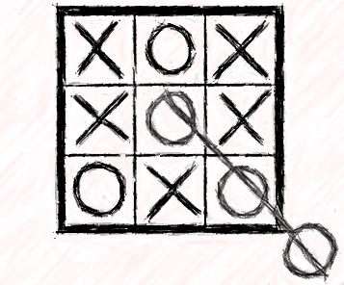
Re-thinking The Task Definition
What we achieved:
300 docs: Annotated the 300 documents from TempEval3
1 week: Finished in about one week (using crowdsourcing)
80%: IAA improved from literature’s 60% to 80%
Time is one dimensional?

Slide 32
Temporal Structure Modeling: Multi-Axis
“Police tried to eliminate the pro-independence army and restore order. At least 51 people were killed in clashes between police and citizens in the troubled region.”
We suggest that multiple time axes may exist in natural language.
Intention axis
restore order
✓
to eliminate army
✓
police tried
51 people killed
Main axis
✓

Slide 33
Results
The overall performance on the proposed dataset is much better than those in the literature for TempRel extraction
We do NOT mean that the proposed baseline is better than other existing algorithms
Rather, our new annotation scheme better defines the machine learning task.
Annotation | Training Set | Test Set | Training |  |  | Test
 |  |  | P | R | F | P | R | F
TB-Dense | Same-axis & Cross-axis | Same-axis | 44 | 67 | 53 | 40 | 60 | 48
Proposed | Same-axis | Same-axis | 73 | 81 | 77 | 66 | 72 | 69
[TB-Dense] Taylor Cassidy, Bill McDowell, Nathanel Chambers,and Steven Bethard. “An annotation framework
for dense event ordering.”. ACL’14.
Notes:
Size of training data: 7k (TBDENSE) vs. 2k

Slide 34
Further Investigation: Neural Method
LSTM takes word embeddings as input
Hidden vectors represents events
FFNN predicts the labels of temporal relations
Siamese network is a generalized TemProb
Siamese network trained on TemProb
v₁
v₂
500
500
150
dropout 0.3
45
dropout 0.3
h_{e1}
h_{e1}
h_{e2}
128
LSTM
output
before
after
equal
vague
word embeddings
h_{e2}
64
128
t₀ t₁ t₂ t_{n}
LSTM w/ concatenations of two hidden states
Final output network

Slide 35
Further Investigation: Neural Method

Slide 36

Vision Of My Future Research In AI
The development of language is a milestone for humankind.
With language, we are able to think and talk abstractly.
Natural language will be the core communication channel between a human and AI.
Teaching machines to learn the semantics of natural language is still very challenging.
We can never have enough data.
How are humans learning from very limited data?
Self-learning/bootstrapping.
Notes:
I came across the book, “Sapiens: A brief history of humankind”. It has an opinion that the development of language is a milestone for human. With language, we are able to think and talk abstractly. Right now, the way we communicate with AI is still programming. And I think in the future, language will be the core communication channel between human and AI.

Slide 37
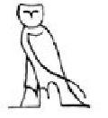
Self Learning – A Psychological Experiment
Egyptian Hieroglyph of OWL
Notes:
Here’s an interesting psychological experiment carried out roughly 100 years ago, where researchers asked people to draw sequentially. Each person only saw the picture drawn by the previous person. This is the original image. This is what is drawn by the first person.

Slide 38
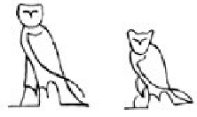
Self Learning – A Psychological Experiment
Notes:
The second drawer was actually doing a pretty good job.

Slide 39
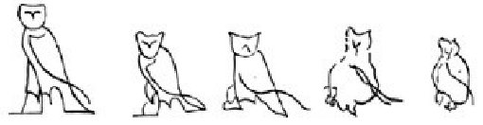
Self Learning – A Psychological Experiment
Notes:
However, crazy things happened…

Slide 40
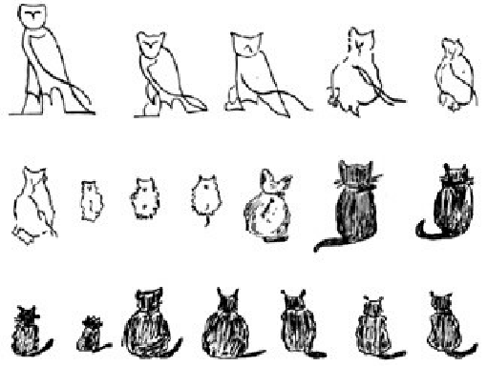
Self Learning—What’s Wrong Here?
owl
cat
Notes:
And things became out of control…What’s wrong here? We started from an owl, and ended up with a cat. This is obviously not the case of the human history, because we have learnt lots of things from ancestors. I think the missing component here is guidance or restrictions. For example, if we had told people that it was an owl, we would have seen much better results.

Slide 41
My existing work on temporal relation extraction
Structure
Common Sense
Annotation
Transitivity
attack → wound
Temporal graphs
These are restricting what we can do.
Notes:
What kind of guidance or restrictions do we humans have? Here let me come back to my existing work, where I used structure, common sense, and annotated data to improve the performance. We can see all of them are restricting what we can do. Structure restricts us from predicting time loops. Common sense tells us that in the probabilistic sense, we should label attack to be before wound more often. Annotation is more straightforward: it tells us directly about the labels.

Slide 42
The three components can also be very general
Structure
Common Sense
Annotation
Physics
“Language models”
Indirect signals
Supervision not only comes from annotation. It can also come from structure and common sense.
Notes:
More generally, we have structural constraints from the physical world. We can view LM as a type of common sense. E.g., after a sequence of words, here’s a list of words that are more likely to happen after that. For data annotations, they can also be more general. Such as indirect signals, that are for a different task (this coincides with multi-task learning), that are noisy (fidelity-weighted learning), and that are from different domains (transferred learning). We can call these restrictions “supervision”. Previously, in supervised learning, people think that annotation is the only supervision, but actually we can have supervision from structure and from common sense as well.

Slide 43
Structure
Incidental supervision
Common Sense
Annotation
Incidental supervision is about how to effectively learn from limited, low-quality, and/or task independent data. [Roth 2017]
In the next 3 to 5 years, I would like to study both the theoretical and practical aspects of incidental supervision, from the angle of structured learning, common sense, and efficient data annotation.
Dan Roth, Incidental Supervision: Moving beyond Supervised Learning AAAI (2017)
Notes:
In short, I’m trying to study the center of three parts.

Slide 44
Effect of Structure On Annotation
[in submission to NAACL’19]
Before
Be_Included
I met with him before leaving for Paris on Thursday.
Before
?
Be_Included
met (1)
met (2)
leaving
Thursday
Time
Question 1: Does the red link provide less information?
Question 2: Do we need the red link (so that the graph is complete)?
Notes:
Here’s an ongoing research on the overlap area between structure and annotation.

Slide 45





Preliminary Investigation: Complete Or Partial
[in submission to NAACL’19]
Training Phase
$$𝒯_{0}$$
(a) Complete
(b) Partial
same budget
same budget
$$𝒰_{0}$$
$$𝒰_{0}$$
$$𝒯_{1}$$
$$𝒰$$
$$𝒫$$
$$𝒫$$
$$𝒯_{test}$$
Testing Phase
Notes:
A natural question to ask is that when we collect data, structured data, should we focus on completeness or coverage. This is not a trivial question. But I think one downside of completeness, as shown in the previous slides, is that the underlying structure makes the remaining part, less and less informational. It might be better if we turn to annotate a brand-new structure, instead of enforcing completeness.

Slide 46

Constraint-Driven Learning (CoDL): Fully Annotated Data (F) & Unannotated Data (U)
Initialize the model on $F$.
Let the model be $S$.
ITERATION
$\tilde{U}=∅$
For each $t∈U$
$\hat{y}=$PREDICT(t) based on $S$
$\tilde{U}=$ $\tilde{U}∪\{(t,\hat{y})\}$
$S=$LEARN($F∪\tilde{U}$)
Since t is a structure, when we bootstrap on t, we can enforce the structural constraints of the task at hand; thus the learning is driven by constraints (CoDL).
Notes:
CoDL is short for … It works on F and U.

Slide 47

Constraint-Driven Learning (CoDL): Fully Annotated Data (F) & Unannotated Data (U)
Structured Self-learning With Partial Annotations (SSPAN) Fully Annotated Data (F) & Partially Annotated Data
Initialize the model on $F$. Let the model be $S$.
ITERATION
$\tilde{U}=∅$
For each $t∈U$
$\hat{y}=$PREDICT(t) based on $S$
$\tilde{U}=$ $\tilde{U}∪\{(t,\hat{y})\}$
$S=$LEARN($F+\tilde{U}$)
Q: What if t is not completely empty?
A: We can simply add the partial annotations as additional (equality) constraints.
Notes:
Then a natural question is: what if t is not completely empty? We can simply…This leads to what I name as SSPAN. Structured self-learning is the CoDL part, so SSPAN is an extension of CoDL with partial annotations.

Slide 48
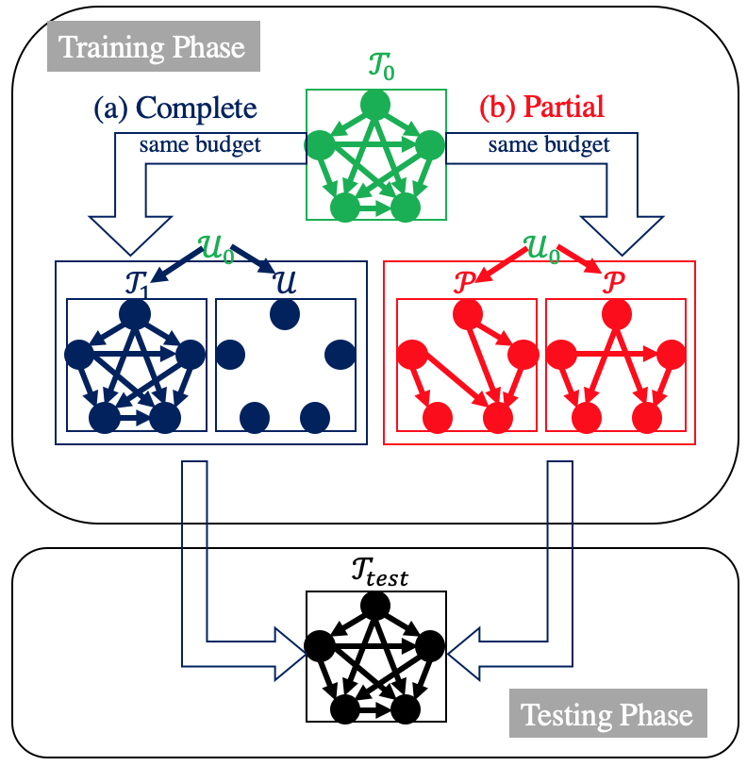
Effect of Structure On Annotation
[in submission to NAACL’19]
++
++
++
++
++
++
++
++
+
Partial annotations may lead to better performance due to “structure”.
Structure itself is “supervision”

Slide 49
Structure
Incidental supervision
Common Sense
Annotation
Incidental supervision is about how to effectively learn from limited, low-quality, and/or task independent data. [Roth 2017]
In the next 3 to 5 years, I would like to study both the theoretical and practical aspects of incidental supervision, from the angle of structured learning, common sense, and efficient data annotation.
Common Sense
Dan Roth, Incidental Supervision: Moving beyond Supervised Learning AAAI (2017)

Slide 50
Temporal Common Sense
[in submission to NAACL’19]
TemProb is a knowledge base of temporal ordering information.
We also summarized other types of temporal common sense:
Duration
They laughed at her in the party. How long did they laugh? (a few minutes)
Stationary vs transient
She adopted the stage name Fontaine. Is she known as Fontaine today? (yes)
Absolute time point
When did he brush his teeth? (in the morning/at night)
Frequency
How often do they go on trips? (twice a year)
Notes:
people know that laughing does not take days and not even hours, but traveling to China does.

Slide 51
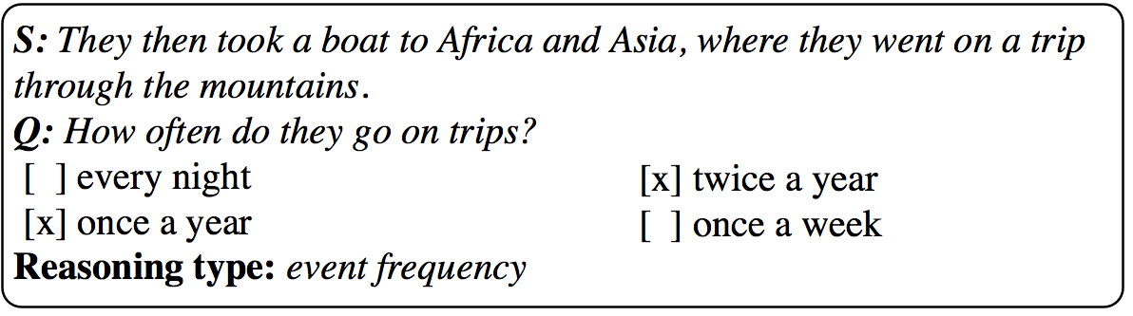
Temporal Common Sense
[in submission to NAACL’19]
We collected 10K Q&A pairs on temporal common sense.
Performance in F1: Random (40%), BERT (70%), Human (93%)
When BERT doesn’t look at the sentence at all, its F1 only drops by 1%.
Answering questions without looking at the context is exactly what we call common sense.

Slide 52
